Slide 1
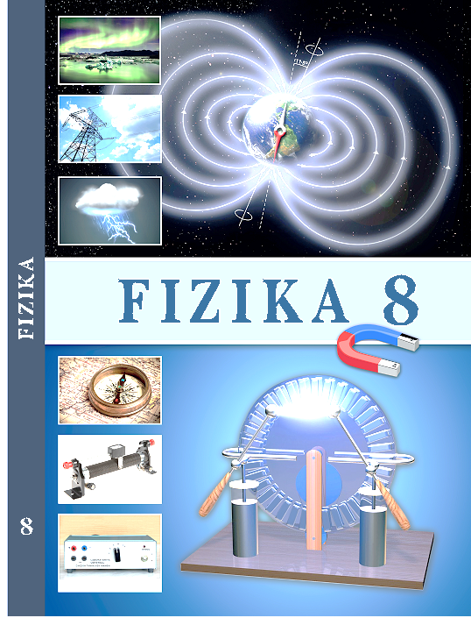
Fizika
8-sinf
7
MAVZU: ZARYADLARNING O‘ZARO TA’SIRI. KULON QONUNI
O‘qituvchi
Hamidova Zaynura Ramazanovna

Slide 2
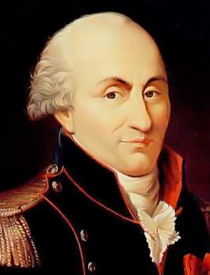
KULON TAJRIBALARI
Fransuz fizigi Sharl Kulon 1770-1789- -yillar mobaynida elektromagnit va mexanik hodisalar borasida tadqiqotlar olib borgan. Elektr va magnit qutblarining o‘zaro ta’siri, elektr zaryadlarining o‘tkazgich sirti bo‘ylab joylashish qonuniyatlari - uning fanga qo‘shgan ulkan hissasidir.
(1736-1806)

Slide 3
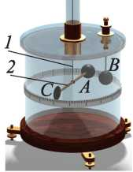
KULON TAJRIBALARI
Buralma tarozida ingichka elastik simga shisha sterjen osilgan. Sterjenning bir uchiga A metall sharcha, ikkinchi uchiga C muvozanatlovchi jism mahkamlangan. B metall sharcha esa tarozining qopqog‘iga qo‘zg‘almas qilib mahkamlangan.

Slide 4
KULON TAJRIBALARI
F$\sim \frac{1}{r^{2}}$
(1)
F$\sim q_{1}{∙q}_{2}$
(2)

Slide 5
KULON QONUNI
F$=k \frac{\left|q_{1}\right|{∙\left|q_{2}\right|}_{ }}{r^{2}}$
k - proporsionallik koeffitsiyenti, k = 9 $∙{10}^{9}\frac{N∙m^{2}}{C^{2}}$
$\left|q_{1}\right|$ va $\left|q_{2}\right|$ - $q_{1}$ va $q_{2}$ zaryadlarning modullari,
r – zaryadlar orasidagi masofa.

Slide 6
KULON QONUNI
O‘zaro ta’sirlashayotgan jismlarni nuqtaviy zaryad deb olaylik. Nuqtaviy zaryad deb, o‘lchami va shakli hisobga olinmaydigan zaryadlangan jismga aytiladi.
(1) va
(2) munosabatlarni umumlashtirib
F$=k \frac{\left|q_{1}\right|{∙\left|q_{2}\right|}_{ }}{r^{2}}$

Slide 7
KULON QONUNI
$$F_{1}$$
r
$$F_{2}$$
+
+
$$q_{1}$$
$$q_{2}$$
$$F_{1}$$
$$F_{2}$$
-
+
$$q_{1}$$
$$q_{2}$$

Slide 8
KULON QONUNI
$$F_{1}$$
r
$$F_{2}$$
+
+
$$q_{1}$$
$$q_{2}$$
$$F_{1}$$
$$F_{2}$$
-
+
$$q_{1}$$
$$q_{2}$$

Slide 9
KULON QONUNI
F$=k \frac{\left|q_{1}\right|{∙\left|q_{2}\right|}_{ }}{r^{2}}$
k = 9 $∙{10}^{9}\frac{N∙m^{2}}{C^{2}}$
Zaryadlari bir kulondan bo‘lgan ikkita nuqtaviy zaryad vakuumda bir biridan bir metr masofada turganda ular F= 9 $∙{10}^{9}N$ kuch bilan ta’sirlashadi.

Slide 10
Masala yechish namunasi
Bir-biridan 10 cm masofada turgan
sharchalardan birining zaryadi -2$∙{10}^{−8}$C,
Ikkinchisining zaryadi esa 3$∙{10}^{−8}$C.
Ular qanday kuch bilan tortishadi?

Slide 11
Masala yechish namunasi
Berilgan:
Formulasi:
Hisoblash:
r = 10 cm= 0,1 m
F$=k \frac{\left|q_{1}\right|{∙\left|q_{2}\right|}_{ }}{r^{2}}$
$q_{1}$= -2$∙{10}^{−8}$C
$\left[F\right]=\frac{N∙m^{2}}{C^{2}}∙\frac{C∙C}{m^{2}}$= N
$q_{2}$= 3$∙{10}^{−8}$C
k = 9 $∙{10}^{9}\frac{N∙m^{2}}{C^{2}}$
F - ?
F$=\text{9 }∙{10}^{9}\frac{\left|\text{−}2∙{10}^{−8}\right|{∙\left|3 ∙{10}^{−8}\right|}_{ }}{{(0,1)}^{2}}$N = 5,4 $∙{10}^{−8}$N
Javob: F = 5,4 $∙{10}^{−8}$N

Slide 12
2-mashq
2. Biri ikkinchisidan 5 cm uzoqlikda joylashgan bir xil zaryadlangan sharchalar 3,6$∙{10}^{−4}$ N kuch bilan ta’sirlashmoqda. Ular qanday miqdorda zaryadlangan?

Slide 13
2-mashq
Berilgan:
Formulasi:
r = 5 cm= 0,05 m
$$\left|q_{1}\right|{∙\left|q_{2}\right|}_{ } =\frac{F∙{ r}^{2}}{k}$$
F$=k \frac{\left|q_{1}\right|{∙\left|q_{2}\right|}_{ }}{r^{2}}$
F = 3,6 $∙{10}^{−4}$N
k = 9 $∙{10}^{9}\frac{N∙m^{2}}{C^{2}}$
$\left[\left|q_{1}\right|{∙\left|q_{2}\right|}_{ }\right] =\frac{N∙m^{2}}{\frac{N∙m^{2}}{C^{2}}}=$ $C^{2}$
q - ?
Hisoblash:
$\left|q_{1}\right|{∙\left|q_{2}\right|}_{ } =\frac{3,6∙{10}^{−4}∙({0,05)}^{2}}{\text{9 }∙{10}^{9}\frac{N∙m^{2}}{C^{2}}}$ $C^{2}$=1 $∙{10}^{−16}$ $C^{2}$
Javob: F = 5,4 $∙{10}^{−8}$N

Slide 14
2-mashq
Hisoblash( davomi):
$\left|q_{1}\right|{∙\left|q_{2}\right|}_{ } =\frac{3,6∙{10}^{−4}∙({0,05)}^{2}}{\text{9 }∙{10}^{9}\frac{N∙m^{2}}{C^{2}}}$ $C^{2}$= 1 $∙{10}^{−16}$ $C^{2}$
$q_{1}$= $q_{2}$ = q
$${ q}^{2}=\text{1} ∙{10}^{−16} C^{2}$$
q = $\sqrt{\text{1} ∙{10}^{−16} C^{2}}$= $\sqrt{\text{(}\text{1} ∙{10}^{−8}\text{C} )^{2}}$= $\text{1} ∙{10}^{−8}\text{C}\text{=}$10 nC
Javob: q = 10 nC

Slide 15
Mustaqil bajarish uchun topshiriqlar:
Mavzu oxiridagi savollarga javob yozing.
2. 2-mashqning 1,3,4- masalalarini yeching.

Slide 16
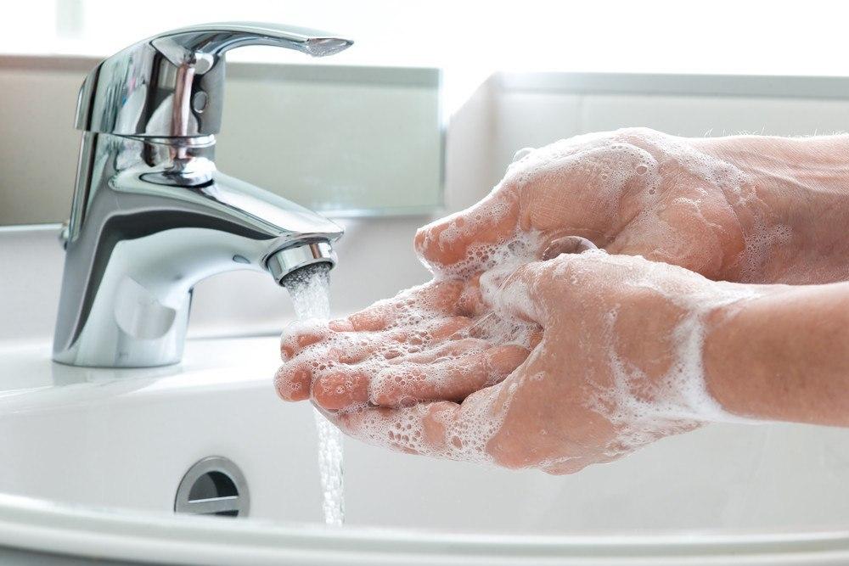
Aziz o‘quvchilar,
Shaxsiy gigiyena qoidalariga amal qiling
va qo‘lingizni tez-tez sovunlab yuvishni unutmang!

