Slide 1

Revision.
English
Grade:
9

Slide 2

Guess the organization
UN - United Nations

Slide 3

Guess the organization
UNESCO - United Nations Educational, Scientific and Cultural Organization

Slide 4


Guess the organizations

Slide 5

Guess the organization
WWF - World Wide Fund For Nature

Slide 6

Guess the organization
UNICEF - United Nations International Children’s Emergency Fund

Slide 7

Guess the NGOs
RED CROSS
RED CRECENT

Slide 8


Guess the NGOs

Slide 9
Guess the words
obey - to act according to what you have been asked or ordered to do by someone in authority, or to behave according to a rule, law, or instruction
statute - a law that has been formally approved and written down
natural disaster - a natural event such as a flood, earthquake, or tsunami that kills or injures a lot of people
war - armed fighting between two or more countries or groups, or a particular example of this
battle - a fight between armed forces
wounded - injured, especially with a cut or hole in the skin
voluntary - done, made, or given willingly, without being forced or paid to do it
volunteer - a person who does something, especially helping other people, willingly and without being forced or paid to do it

Slide 10
What do we call companies that work
in several countries?
an arrangement between two or more companies to work together on a particular project.
large and powerful company that produces and sells goods in many different countries.
a business that is owned by the group of people who have shares in the company; a company that is owned and controlled by shareholders, with shares that are traded on a stock market.
joint ventures
multi-nationals
joint stock companies

Slide 11
LISTENING
Listen to the radio report and write down the missing words.
Coca-Cola has opened its fifth bottling 1________ in Uzbekistan. The new plant, which will specialize in the 2____________ of carbonated soft drinks, is Coca-Cola’s largest plant in Central Asia. Equipped with the latest 3__________ , it has created more than 160 new 4 ________ for highly skilled 5 __________. William Casey, President of Coca- Cola’s Greater Europe Group said: “We are convinced that Uzbekistan will continue to make 6 ________ in creating 7________ for international 8___________ and we are proud to play a role in the 9 ___________ of the Uzbekistan economy”.
plant
production
technology
jobs
specialists
progress
support
investment
development

Slide 12
READING
Read the article and do “TRUE or FALSE” task.
The most important industrial development in Britain in the past 20 years or so has been the growth of the offshore oil and gas industries, as well as the wide application of new microelectronic technologies in industry and commerce. Although expanding service industries, like finance and tourism, now represent about 65 percent of Britain’s national output, manufacturing still plays a vital role in the economy. Britain takes a leading part in high technology industries like chemicals, aerospace and electronics where British companies are among the world’s biggest and most successful.

Slide 13

Reading Comprehension
The most important industrial development in Britain in the past 20 years, has been the growth of the offshore cotton and textile industries.
Service industries represent about 65 percent of Britain’s national output.
Britain takes a leading part in high technology industries.
Finance and tourism industries aren’t expanding in Britain.
Energy industry plays a vital role in Britain’s economy.
F
T
T
F
F

Slide 14
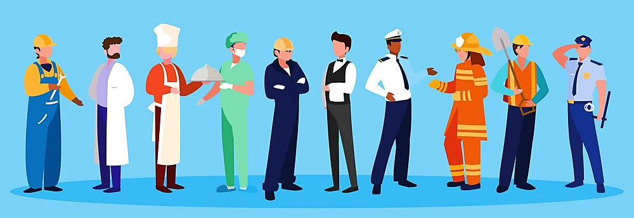
GRAMMAR
Write 5 sentences about what you have had done at each of these places.
1. tailor’s
e.g. I have had my black suit made at the tailor’s.
2. dentist’s
3. dry-cleaner’s
4. hairdresser’s
5. photographer’s
6. shoemaker’s

Slide 15
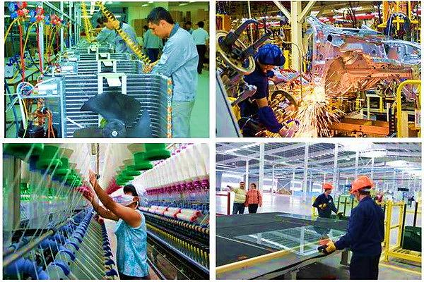
VOCABULARY AND WRITING
Make new words with suffixes -er, -or, -tion from produce, import, invest, manufacture, fertilize and reflect.
Translate them.
e.g. export - exporter
product - production

Slide 16
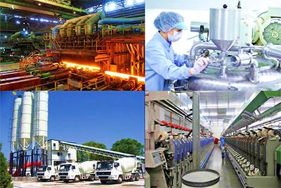
Answer key
producer
importer
investor
manufacturer
fertilizer
reflection

Slide 17


Grammar Exercise 2 page 102

Slide 18
A little knowledge is a dangerous thing.

