Slide 1

Multi-nationals.
English
Grade:
9

Slide 2

Let’s check up

Slide 3
Possible answer
Sayyora Islomova
Yunusabad district
Tashkent city, 100009
Tel: 998042327
sayyoratadjieva4@gmail.com
April 13, 2021
IFCR
Red Crescent Society of Uzbekistan
secretariat@redcrescent.uz
Dear Sir,
We are writing to assist us on our problem: the lack of cold medicine for kids and less drinking water in our district.
Our local government has already provided us with pure water, but we still need the cold medicine.
We would like you to support us with the needed medicine. As we can prepare a list of the most needy families. Thank you for your time and consideration. Looking forward to meeting you.
Sincerely,
Sayyora

Slide 4



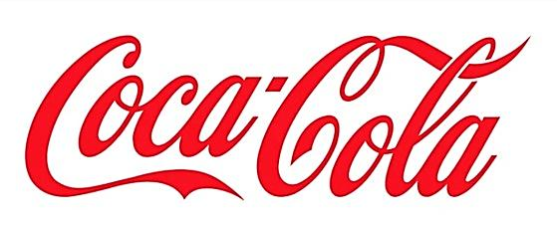




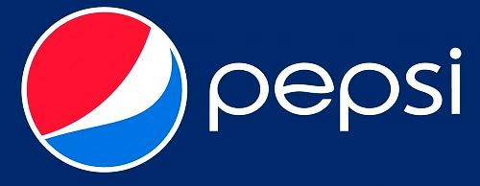

Activity 1a page 99
Look at the logos and say if the companies work in Uzbekistan.

Slide 5
Activity 1b page 99
Match the companies with the country they come from.
USA/UK Germany South Korea
Sri Lanka USA
GM - South Korea Xerox - USA
Siemens – Germany Beta Tea - Sri Lanka
British American Tobacco - USA/UK

Slide 6
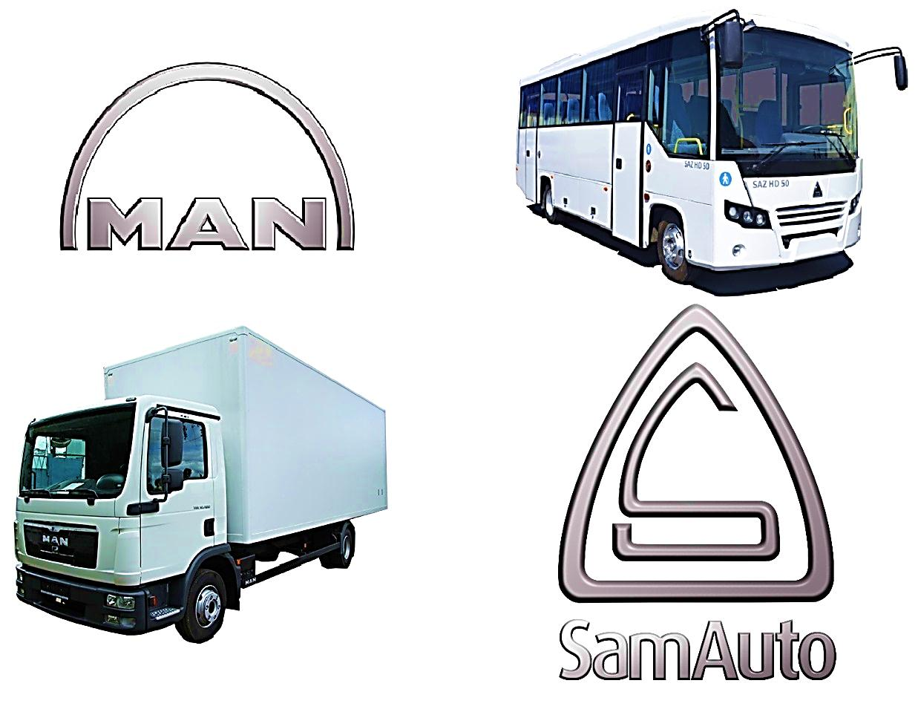
Activity 1c page 99
Add more companies which work in Uzbekistan but have their parent company in another country.
e.g. General Motors (US)
MAN Auto-Uzbekistan (Germany)
SamKochAvto (Turkey)

Slide 7
What do we call companies that work
in several countries?
an arrangement between two or more companies to work together on a particular project.
large and powerful company that produces and sells goods in many different countries.
a business that is owned by the group of people who have shares in the company; a company that is owned and controlled by shareholders, with shares that are traded on a stock market.
joint ventures
multi-nationals
joint stock companies
The companies in 1a are multi-nationals who have set up joint ventures in Uzbekistan.

Slide 8
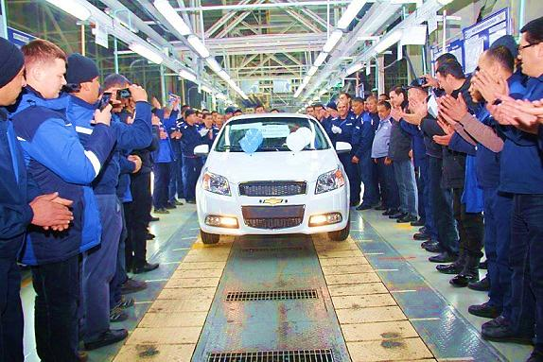
Activity 3a page 99
Listen to the interview with someone
who works for a multi-national.
Good points about the company:
Differences from local companies:
Negative points about the company:

Slide 9



Activity 4 page 99
Say what kind of job you would like and what kind of place you would like to work in.

Slide 10
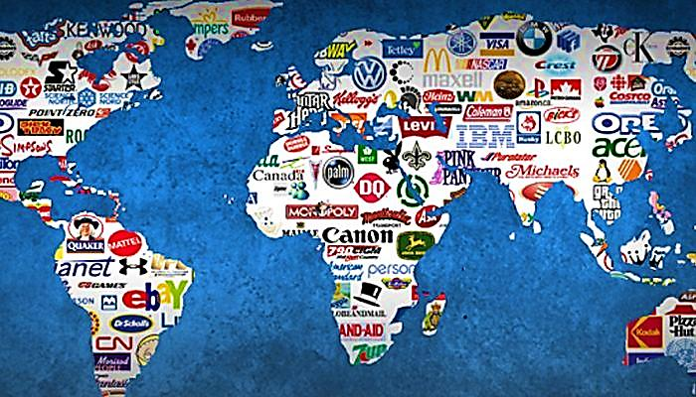
Be careful!
Not all multi-nationals are good guys. Some multi-nationals have caused problems in the past.

Slide 11
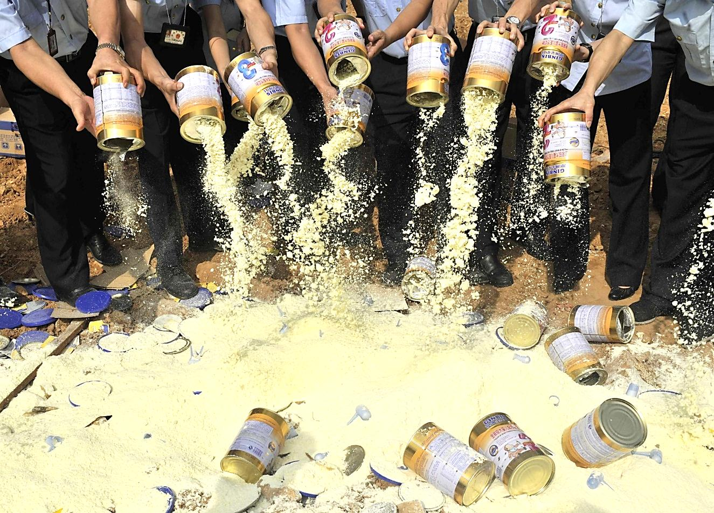
Be careful!
For example, there was the great baby milk scandal. In Europe, companies cannot promote dried milk for babies. In fact, every packet must carry a warning against giving the milk to babies. This is because a mother’s own milk protects babies from diseases and has more food value than dried milk.

Slide 12

Be careful!
But some companies wanted to sell their dried milk. They could not sell very much in Europe because of the regulations. So they sold it in Africa instead. Because people there did not know that it was not the best thing for babies, they bought it. It was not cheap, but they thought it was modern, good and convenient. But it was not good for babies and some babies died.

Slide 13


Lesson 4 p. 103
Grammar exercise 3 p.102

Slide 14
Better to light
one candle
than to curse
the darkness.

