Slide 1

NGOs are organizations which…
Part 1
English
Grade:
9

Slide 2

Let’s check up

Slide 3


UNICEF in Uzbekistan
UNICEF is a specialized agency of the UN. Its full name is the United Nations Children’s Fund. UNICEF works in more than 100 countries to improve conditions for children.

Slide 4
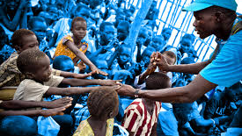
The Fund is currently conducting programmes in about 150 countries in all continents to help protect children from disease and prepare them for healthy, productive adult lives. It was created in 1946 and has received the Nobel Prize for its work.

Slide 5
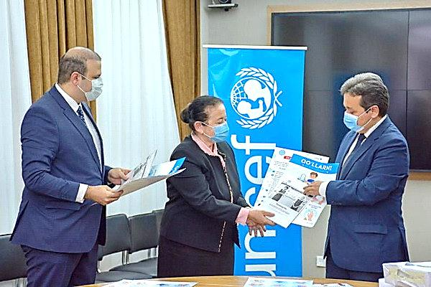
In Uzbekistan UNICEF is working with the government to improve four areas of health care: health and nutrition, water and environmental sanitation, education, and providing for the psychological and social needs of vulnerable children.

Slide 6
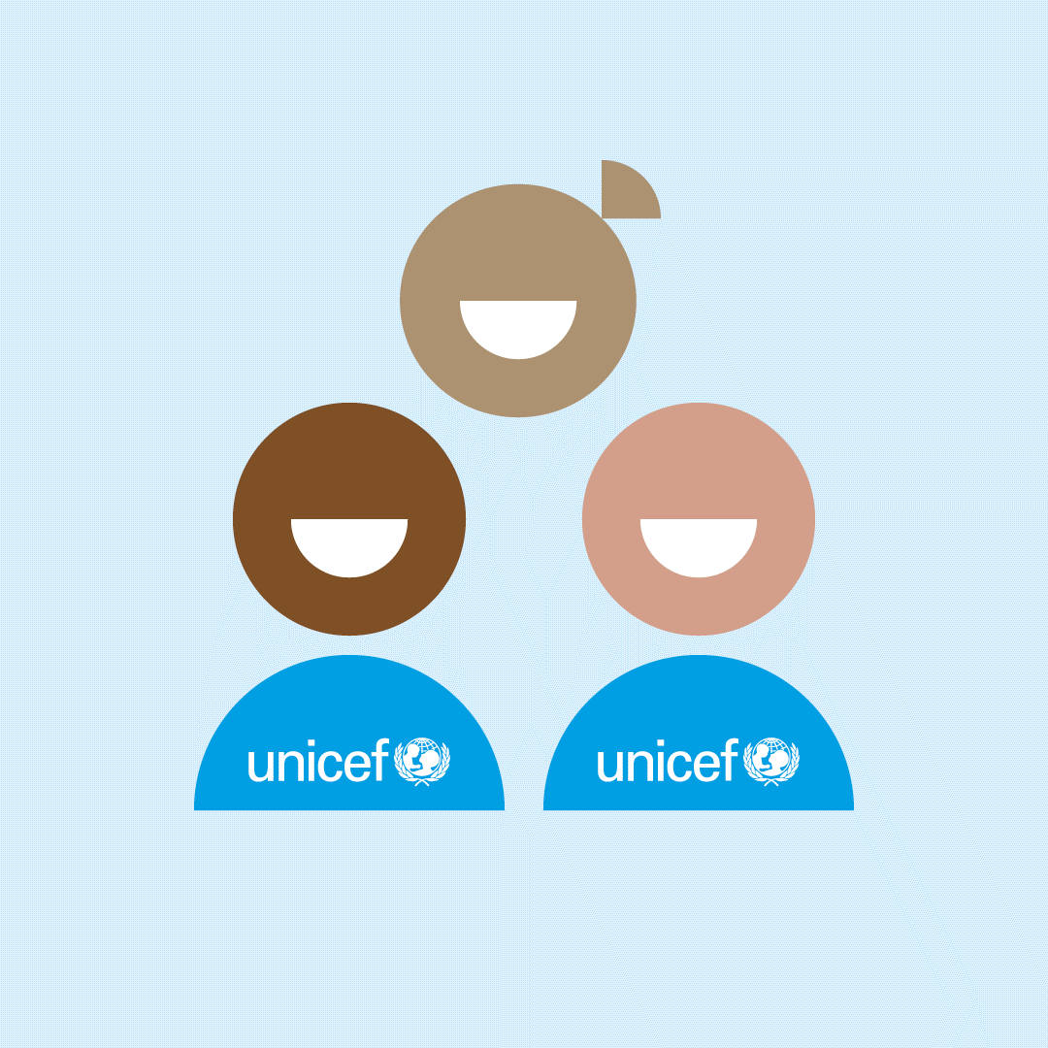
There are programmes to upgrade health care facilities (for example, by providing them with disposable syringes for vaccinations as they are more hygienic) and to provide better nutrition (for example, by distributing iodised salt for cooking).

Slide 7
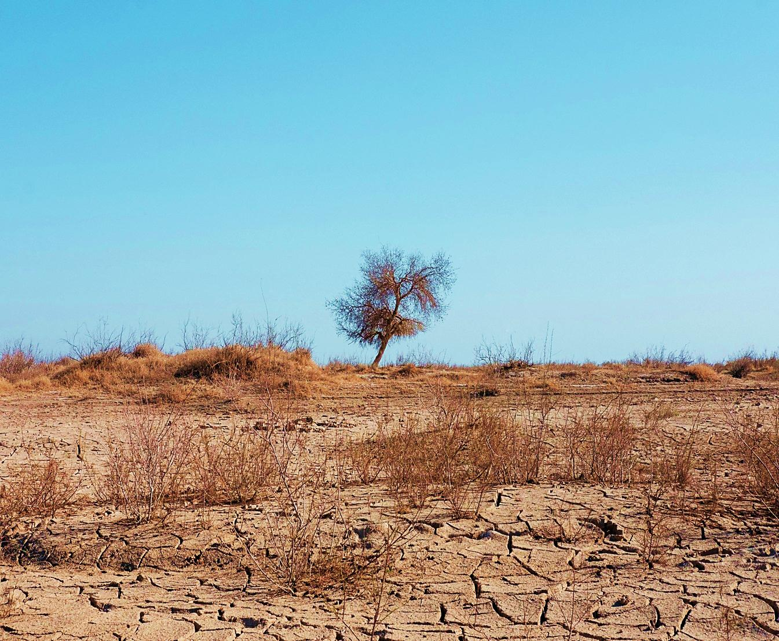
In Khorezm and Karakalpakstan, two regions particularly badly affected by drought, there are programmes to repair desalination units, to provide chemicals to make water safe to drink, to provide water testing equipment so that scientists can monitor the quality of water provided and to provide hand pumps for pumping water.

Slide 8
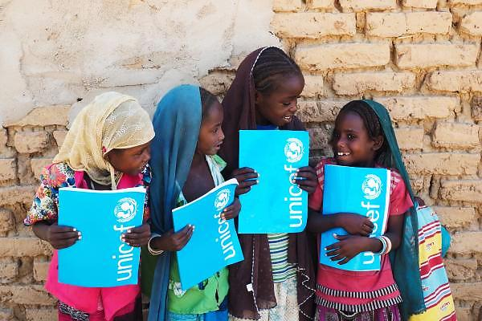
In some areas the schools are not in good condition so UNICEF has programmes to help repair and equip the schools, and build new toilets to improve sanitation and health.

Slide 9
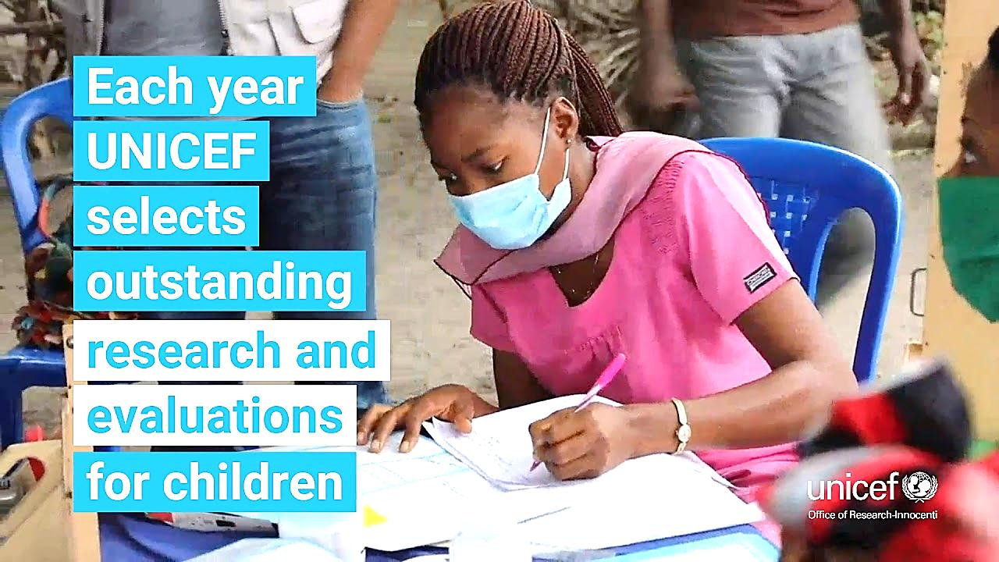
The fourth area that UNICEF is currently working in is to support children who have special problems, those with no family, and those with physical and mental problems.
For more information about Unicef visit the website at www.unicef.org/uzbekistan/

Slide 10
Compare your table
 | UNICEF
Name of agency
When it was founded
Main areas of work
What the agency is doing in Uzbekistan
The United Nations International Children’s Emergency Fund.
UNESCO was created in 1946 and has received the Nobel Prize for its work.
Health and nutrition, water and environmental sanitation, education, and providing for the psychological and social needs of vulnerable children.

Slide 11

Activity 1a page 97
Read and answer the questions.
1. What do the letters NGO stand for?
2. What NGOs do you know?
3. What are the Red Cross and the Red Crescent?
4. What do they do?

Slide 12
New words
obey - to act according to what you have been asked or ordered to do by someone in authority, or to behave according to a rule, law, or instruction
statute - a law that has been formally approved and written down
natural disaster - a natural event such as a flood, earthquake, or tsunami that kills or injures a lot of people
war - armed fighting between two or more countries or groups, or a particular example of this
battle - a fight between armed forces
wounded - injured, especially with a cut or hole in the skin
voluntary - done, made, or given willingly, without being forced or paid to do it
volunteer - a person who does something, especially helping other people, willingly and without being forced or paid to do it

Slide 13

Activity 1c page 97
Listen to the first part of the radio programme and check your answers to 1a.

Slide 14

Check your answers to 1a
What do the letters NGO stand for?
Non-governmental organization
2. What NGOs do you know?
The Red Cross and the Red Crescent
3. What are the Red Cross and the Red Crescent?
Probably the best known NGOs in the world
4. What do they do?
They exist to assist people who have been hit by natural disasters and wars, and those living in difficult or dangerous situations.

Slide 15

Listen to the second part and answer the question.
How did the Red Cross and the Red Crescent begin?

Slide 16
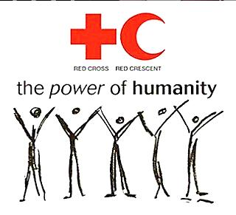
How did the Red Cross and the Red Crescent begin?
It was the result of one man’s experience of seeing the wounded in a war zone. Henri Dunan decided to create an organization to offer relief in emergencies in peace time and help for the wounded in war time.
RED CROSS RED CRECENT

Slide 17


Lesson 3(1) p.103
Grammar exercise 1 p. 102

Slide 18
Do good and
throw it
in the sea!

