Slide 1

UNESCO and UNICEF in Uzbekistan.
English
Grade:
9

Slide 2

Let’s check up

Slide 3

Answer key
UNESCO - United Nations Educational, Scientific and Cultural Organization

Slide 4

Answer key
UNICEF - United Nations International Children’s Emergency Fund / United Nations Children’s Fund In 1953 the General Assembly decided to extend the Fund’s mandate indefinitely and to drop the words ‘International’ and ‘Emergency’ from the official title so the second title is the current one.
UNICEF works in more than 100 countries to improve conditions for children. It supports projects to improve health care, nutrition, water supply and sanitation, education and services for women and women with young children. It was created in 1946 and has received the Nobel Prize for its work for children.

Slide 5



Answer key
WHO - World Health Organization
FAO - Food and Agricultural Organization of the United Nations
WWF - World Wide Fund For Nature

Slide 6
1a Copy and complete the table.
 | UNESCO
Name of agency
When it was founded
Main areas of work
What the agency is doing in Uzbekistan

Slide 7

UNESCO in Uzbekistan
UNESCO is a specialized agency of the UN. Its full name is the United Nations Educational Scientific and Cultural Organization. Countries which belong to UNESCO agree to contribute to peace and security by cooperating in the areas of education, science and culture.

Slide 8

About 160 nations are members of UNESCO and provide most of the agency’s funds. UNESCO was founded in 1946 and has its headquarters in Paris.
UNESCO promotes and supports developments in science, culture and justice. It tries to increase respect for justice and law, human rights and fundamental freedoms for all people.

Slide 9
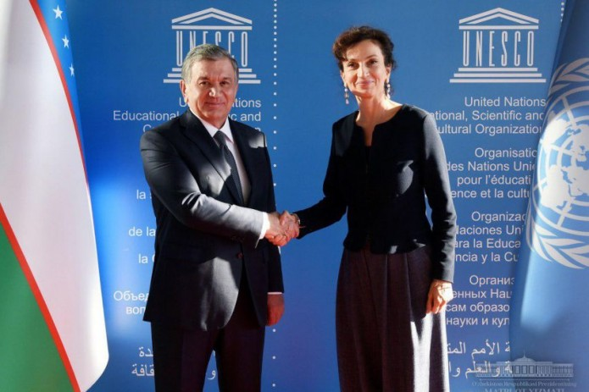
The agency carries out programmes to promote these aims at the request of its members.
On October 29, 1993 Uzbekistan became a member of UNESCO. Soon UNESCO began to have programmes in Uzbekistan.

Slide 10
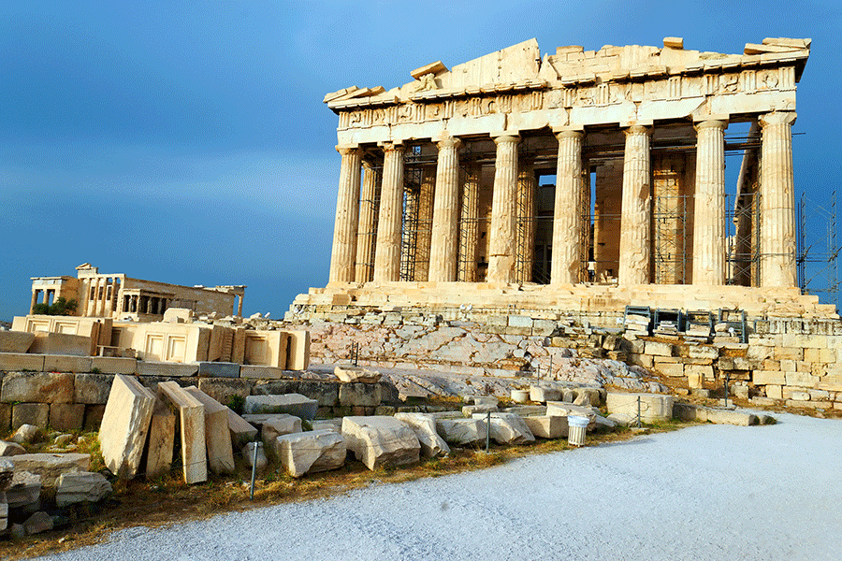
In 1996 in Paris an international conference
was held in honour of Amir Temur. It was called ‘Science and culture in the age of Temur’.
In 1995 at UNESCO’s headquarters in Uzbekistan the 28th session passed a resolution to celebrate the 660th jubilee of Amir Temur’s birth.

Slide 11
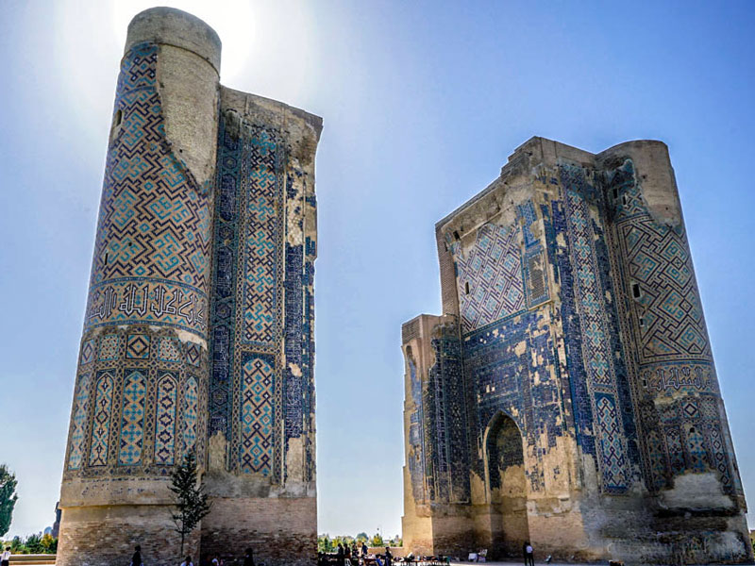
In 2002 UNESCO organised a celebration of the 900th anniversary of the birth of A G‘ijduvoniy, the famous Uzbek poet and scientist, and in 2003 the 2700th anniversary of the founding of the town of Shakhrisabz,
Amir Temur’s birthplace, etc. You may know that UNESCO contributed funds for the restoration of Khiva and has officially listed Khiva as a World Heritage Site. For more information about UNESCO visit the website at www.unesco.org

Slide 12
Compare your table
 | UNESCO
Name of agency
When it was founded
Main areas of work
What the agency is doing in Uzbekistan
The United Nations Educational Scientific and Cultural Organization
UNESCO was founded in 1946 and has its headquarters in Paris
education, natural sciences, social and human sciences, culture, and communication and information
It pursues its work as a member of the UN County Team and building partnerships, contributed funds.

Slide 13
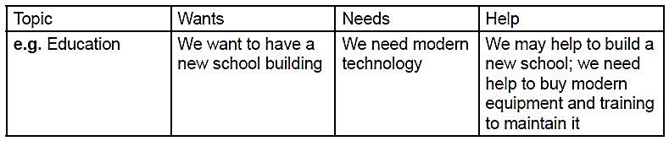
Activity 2a page 96
environment education family
local government health communications
food culture buildings
ancient buildings and sites
Think about your place and your region.
Copy and complete the table.
1. What problems and difficulties are there?
2. What things would you like to share with
the world?
3. What could be done to improve the
situation?
4. How could you/organisations in your place
help?
5. What help could an organisation like UNICEF/UNESCO give?

Slide 14

Remember
the first
the second
the third
the fourth
the 28th
the 600th
the 2,000th
Ordinal Numbers
ordinal = order
We use ordinal numbers for dates and order of something
On October 29, 1993
the 28th session
the 660th jubilee of Amir Temur’s birth

Slide 15


Lesson 2 p.103 ex. 1a p.101(UNICEF)

Slide 16
TO LEARN A LANGUAGE
IS TO HAVE
ONE MORE WINDOW
FROM WHICH TO LOOK AT THE WORLD

