Slide 1
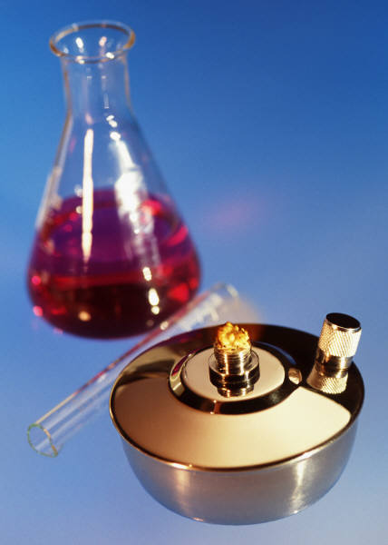
KIMYO
11-sinf

Slide 2
1-masalaning yechimi
l
C_{M}= $\frac{C\%∗p∗10}{M}$
C%= $\frac{\text{C}\text{M}∗M}{p∗10}$=$\frac{\text{0}\text{,}\text{5∗119}}{1,19∗10}$=5 %

Slide 3
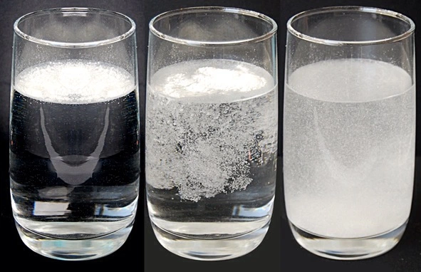
Mustaqil ishlash uchun topshiriqlar
94-b.4-masala
1) 0,5 M li (p=1,19 g/ml) KBr eritmasining foiz konsentratsiyasini aniqlang?

Slide 4
1-masalaning yechimi.
Berilgan:
p=1,19 g/ml
C_{M}=0,5M
C %=?

Slide 5
KIMYO
11-sinf
Mavzu:
Foiz va Normal konsentratsiya o‘rtasida bog‘lanish.

Slide 6
Masalaning yechimi
C_{N}= $\frac{C\%∗p∗10}{E}$
C%= $\frac{\text{C}\text{N}∗M}{p∗10}$

Slide 7
Masalaning yechimi
p= $\frac{\text{C}\text{N}∗E}{C\%∗10}$
E= $\frac{C\%∗p∗10}{\text{C}\text{N}}$

Slide 8
1-masala
3,5 N li (p=1,143 g/ml) H₂SO₄
eritmasining foiz konsentratsiyasini
aniqlang?

Slide 9
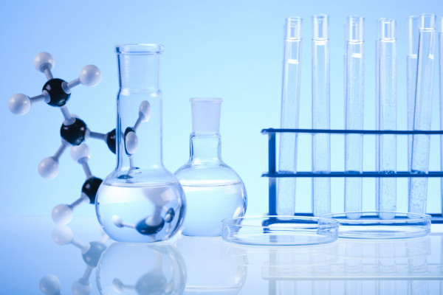
Masalaning yechimi
Berilgan:
C_{N}=3,5 N
p=1,143 g/ml
C%=?

Slide 10
Masalaning yechimi
C_{N}= $\frac{C\%∗p∗10}{E}$
C%= $\frac{\text{C}\text{N}∗E}{p∗10}$=$\frac{\text{3,5∗49}}{1,143∗10}$=15%

Slide 11
2-masala
4 N li (p=1,25 g/ml) NaOH
eritmasining foiz konsentratsiyasini
aniqlang?

Slide 12
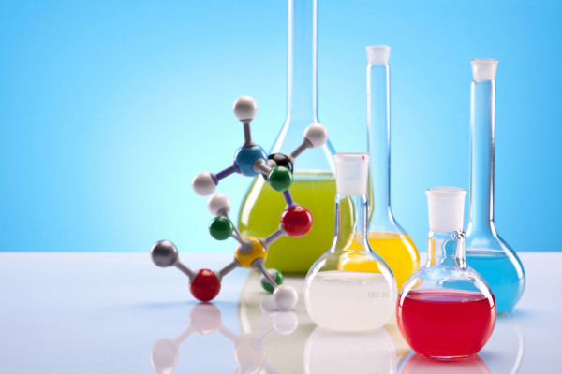
Masalaning yechimi
Berilgan:
C_{N}=4 N
p=1,25 g/ml
C%=?

Slide 13
Masalaning yechimi
C_{N}= $\frac{C\%∗p∗10}{E}$
C%= $\frac{\text{C}\text{N}∗E}{p∗10}$=$\frac{\text{4∗40}}{1,25∗10}$=12,8

Slide 14
3-masala
28 % li (p=1,2 g/ml) KOH
eritmasining normal konsentratsiyasini
aniqlang?

Slide 15
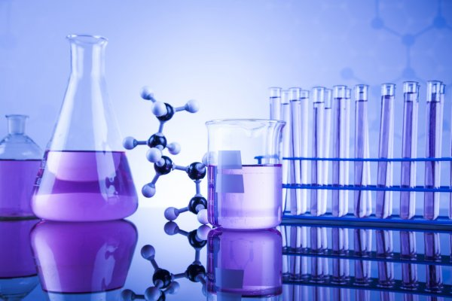
Masalaning yechimi
Berilgan:
C%=28
p=1,2 g/ml
C_{N}=?

Slide 16
Masalaning yechimi
C_{N}= $\frac{C\%∗p∗10}{E}$
C_{N}= $\frac{C\%∗p∗10}{E}$=$\frac{28∗1,2∗10}{56}$=6N

Slide 17
4-masala
26% li (p=1,2 g/ml) Bariy xlorid
eritmasining normal konsentratsiyasini
aniqlang?

Slide 18
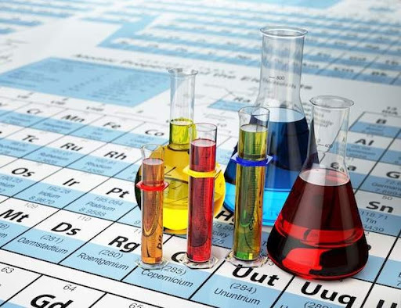
Masalaning yechimi
Berilgan:
C%=26
p=1,2 g/ml
C_{N}=?

Slide 19
Masalaning yechimi
C_{N}= $\frac{C\%∗p∗10}{E}$
C_{N}= $\frac{C\%∗p∗10}{M}$=$\frac{26∗1,2∗10}{208}$=1,5N

Slide 20
5-masala
2 N li (p=1,306 g/ml ) H₃PO₄
eritmasining foiz konsentratsiyasini aniqlang?

Slide 21
Masalaning yechimi
Berilgan:
C_{N}=2 N
p=1,306 g/ml
C%=?

Slide 22
Masalaning yechimi
C_{N}= $\frac{C\%∗p∗10}{E}$
C%= $\frac{\text{C}\text{N}∗E}{p∗10}$=$\frac{\text{2∗32,66}}{1,306∗10}$=5%

Slide 23
6-masala
10 % li p=1,23g/ml noma‘lum modda eritmasing normal konsentratsiyasi 3 N ga teng bo‘lsa, shu eritmada erigan noma‘lum moddaning ekvivalent massasini aniqlang?

Slide 24
Masalaning yechimi
Berilgan:
C%=10
p=1,23 g/ml
C_{N}=3 N
E=?

Slide 25
Masalaning yechimi
C_{N}= $\frac{C\%∗p∗10}{E}$
E= $\frac{C\%∗p∗10}{\text{C}\text{N}}$=$\frac{10∗1,23∗10}{\text{3}}$=41g

Slide 26
Mustaqil bajarish uchun topshiriqlar
97-bet. 2-3-masalalar.
1) 3 N li (p=1,455 g/ml) K₂CrO₄eritmasining foiz konsentratsiyasini aniqlang?
2) 25 % li (p=1,25 g/ml ) NH₄NO₃eritmasining molyar konsentratsiyasini aniqlang?

