Slide 1
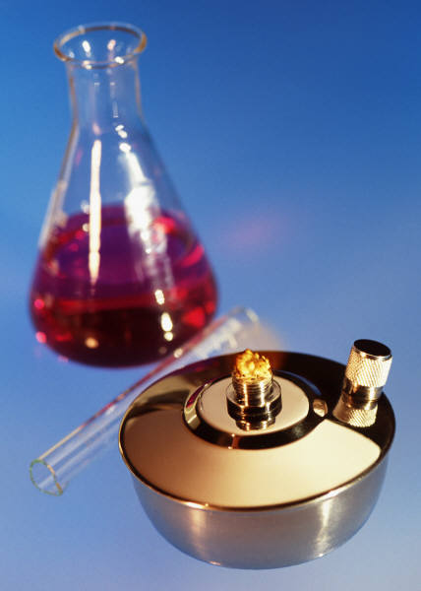
KIMYO
11-sinf

Slide 2
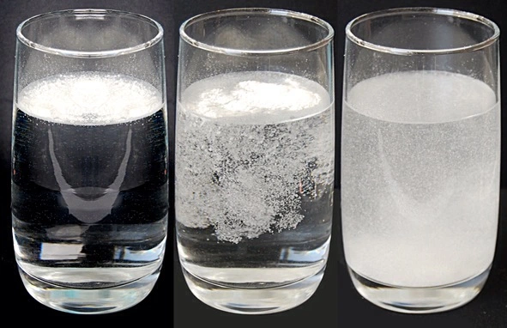
Mustaqil ishlash uchun topshiriqlar
1. 12,6 gr HNO₃ ning 0,5 N li eritmasining ekvivalent miqdorini aniqlang?

Slide 3
Masalaning yechimi
Berilgan:
m=12,6 gr
C_{N}=0,5N
V=?

Slide 4
Masalaning yechimi
l
E_{(kislota)}=$\frac{M(kislota)}{n(H)}$
E_{(kislota)}=$\frac{M(kislota)}{n(H)}$ = $\frac{HNO3}{n(H)}$ = $\frac{63}{1}$=63

Slide 5
Masalaning yechimi
n_{ekv}=$\frac{m}{E}$
n_{ekv}=$\frac{m}{E}$=$\frac{12,6}{63}$=0,2 g/ekv $\text{H}\text{NO}\text{3}$

Slide 6
2-masala
2) 6 N li H₂SO₃ eritmasining molyar konsentratsiyasini aniqlang?

Slide 7
Masalaning yechimi
C_{N}=C_{M}*Val(kat)*n(kat)
C_{M}=$\frac{\text{C}\text{N}}{\text{Val}\text{(}\text{kat}\text{)∗}\text{n}\text{(}\text{kat}\text{) }}$=$\frac{\text{6}}{\text{1∗2} }$=3 M

Slide 8
KIMYO
11-sinf
Mavzu:
Foiz va Molyar konsentratsiya o‘rtasida bog‘lanish.

Slide 9
Foiz va Molyar konsentratsiya
Masala shartida foiz konsentratsiya ma‘lum bo‘lib, molyar konsentratsiyani (C_{M}) ni aniqlash kerak bo‘lsa, foiz konsentratsiyani (C%) eritma zichligiga (p) va 10 ga ko‘paytiramiz va hosil bo‘lgan sonni erigan moddaning molyar massasiga (M) bo‘lamiz.

Slide 10
Foiz va Molyar konsentratsiya
C_{M}= $\frac{C\%∗p∗10}{M}$
C%= $\frac{\text{C}\text{M}∗M}{p∗10}$

Slide 11
Masalaning yechimi
p= $\frac{\text{C}\text{M}∗M}{C\%∗10}$
M= $\frac{C\%∗p∗10}{\text{C}\text{M}}$

Slide 12
1-masala
40 % li (p=1,225 g/ml) H₂SO₄
eritmasining molyar konsentratsiyasini
aniqlang?

Slide 13
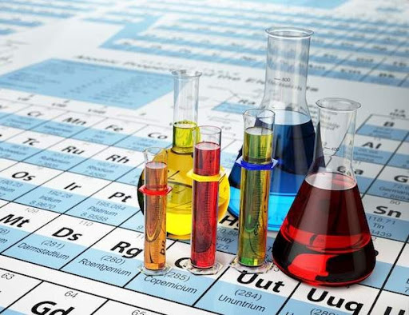
1-masala
Berilgan:
C%=40
p=1,225 g/ml
C_{M}=?

Slide 14
Masalaning yechimi
C_{M}= $\frac{C\%∗p∗10}{M}$
C_{M}= $\frac{C\%∗p∗10}{M}$=$\frac{40∗1,225∗10}{98}$=5M

Slide 15
2-masala
Kalsiy xloridning 55,5% li eritmasining molyar konsentratsiyasi 6 M bo‘lsa, shu eritmaning zichligini (p) aniqlang?

Slide 16
2-masala
Berilgan:
C%=55,5%
C_{M}=6
p=?

Slide 17
Masalaning yechimi
C_{M}= $\frac{C\%∗p∗10}{M}$
p= $\frac{\text{C}\text{M}∗M}{C\%∗10}$=$\frac{6∗111}{55,5∗10}$=1,2g/ml

Slide 18
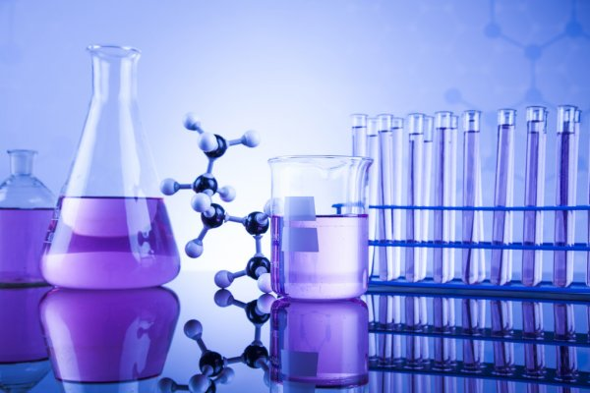
3-masala
3 M li (p=1,26 g/ml) HNO₃
eritmasining foiz konsentratsiyasini aniqlang?

Slide 19
Masalaning yechimi
Berilgan:
C_{M}=3 M
p=1,26 g/ml
C%=?

Slide 20
Masalaning yechimi
C_{M}= $\frac{C\%∗p∗10}{M}$
C%= $\frac{\text{C}\text{M}∗M}{p∗10}$=$\frac{\text{3∗63}}{1,26∗10}$=15 %

Slide 21
4-masala
16% li (p=1,2 g/ml) noma‘lum modda eritmasining molyar konsentratsiyasi 4,8 M ga teng bo‘lsa, shu eritmada erigan noma‘lum moddani aniqlang?

Slide 22
Masalaning yechimi
Berilgan:
C_{M}=4,8 M
p=1,2 g/ml
C%=16
M=?

Slide 23
Masalaning yechimi
C_{M}= $\frac{C\%∗p∗10}{M}$
M= $\frac{C\%∗p∗10}{\text{C}\text{M}}$=$\frac{16∗1,2∗10}{\text{4,8}}$=40 g NaOH

Slide 24
5-masala
10 % li p=1,26 g/ml HNO₃ eritmasining molyar konsentratsiyasini aniqlang?

Slide 25
Masalaning yechimi
Berilgan:
C%=10
p=1,26 g/ml
C_{M}=?

Slide 26
Masalaning yechimi
C_{M}= $\frac{C\%∗p∗10}{M}$
C_{M}= $\frac{C\%∗p∗10}{M}$=$\frac{10∗1,26∗10}{63}$=2M

Slide 27
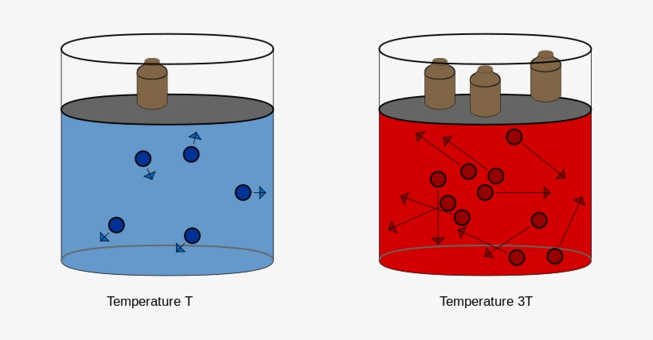
Mustaqil bajarish uchun topshiriqlar
94-b. 4-masala.
1) 0,5 M li (p=1,19 g/ml) KBr eritmasining foiz konsentratsiyasini aniqlang?

