Slide 1
Algebra
10-sinf
Mavzu:
Sodda ratsional tenglamalar
va ularning sistemalari (1-qism)

Slide 2
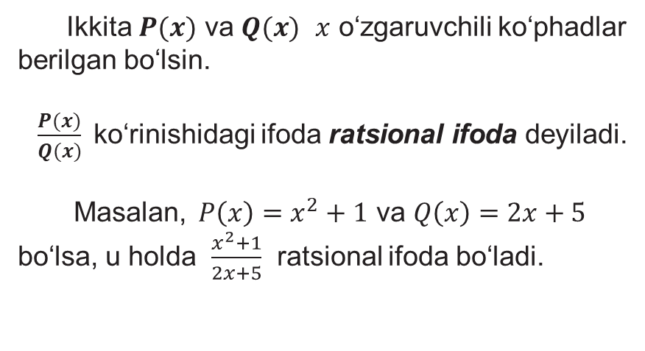
Ratsional ifoda
Ikkita $P(x)$ va $Q(x)$ $x$ o‘zgaruvchili ko‘phadlar berilgan bo‘lsin.
$\frac{P(x)}{Q(x)}$ko‘rinishidagi ifoda ratsional ifoda deyiladi.
Masalan, $P\left(x\right)=x^{2}+1$ va $Q\left(x\right)=2x+5$ bo‘lsa, u holda $\frac{x^{2}+1}{2x+5}$ ratsional ifoda bo‘ladi.

Slide 3
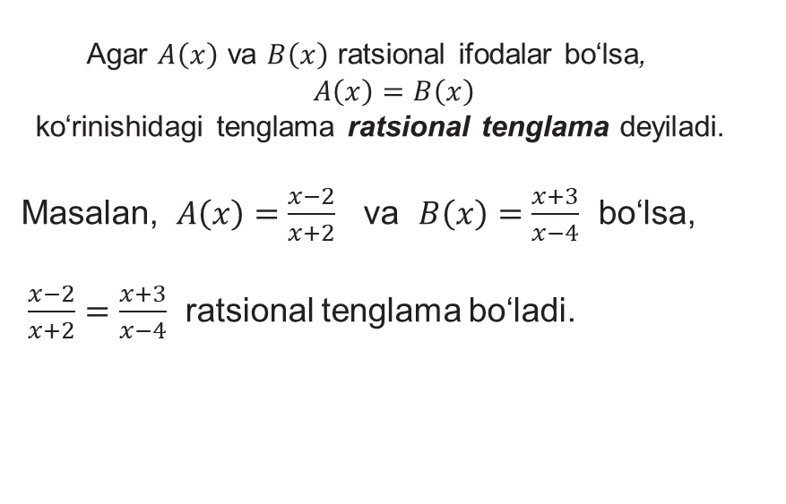
Ratsional tenglama
Agar $A\left(x\right)$ va $B\left(x\right)$ ratsional ifodalar bo‘lsa,
$A\left(x\right)=B\left(x\right)$
ko‘rinishidagi tenglama ratsional tenglama deyiladi.
Masalan, $A\left(x\right)=\frac{x−2}{x+2}$ va $B\left(x\right)=\frac{x+3}{x−4}$ bo‘lsa,
$\frac{x−2}{x+2}=\frac{x+3}{x−4}$ ratsional tenglama bo‘ladi.

Slide 4
Sodda ratsional tenglama
$\frac{P(x)}{Q(x)}=0$ $⇔$ $\left\{\begin{aligned}P\left(x\right)=0, \\ Q(x)≠0.\end{aligned}\right.$
1. Tenglamani yeching: $\frac{x^{2}−2x+1}{x−7}=0.$
$\frac{x^{2}−2x+1}{x−7}=0 ⇒$ $\left\{\begin{aligned}x^{2}−2x+1=0, \\ x−7≠0.\end{aligned}\right.$ ⇒ $\left\{\begin{aligned}{(x−1)}^{2}=0, \\ x≠7.\end{aligned}\right.$ ⇒
$\left\{\begin{aligned}x=1, \\ x≠7.\end{aligned}\right.$ Javob: Tenglama yagona $x=1$ ildizga ega.

Slide 5
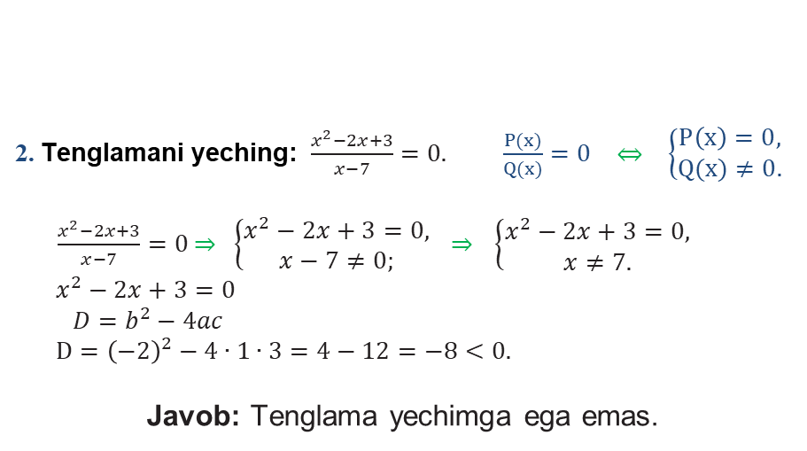
Sodda ratsional tenglama
2. Tenglamani yeching: $\frac{x^{2}−2x+3}{x−7}=0. \frac{P(x)}{Q(x)}=0 ⇔ \left\{\begin{aligned}P\left(x\right)=0, \\ Q(x)≠0.\end{aligned}\right.$
$\frac{x^{2}−2x+3}{x−7}=0$ ⇒ $\left\{\begin{aligned}x^{2}−2x+3=0, \\ x−7≠0;\end{aligned}\right.$ ⇒ $\left\{\begin{aligned}x^{2}−2x+3=0, \\ x≠7.\end{aligned}\right.$
$$x^{2}−2x+3=0$$
$D=b^{2}−4ac$
$$D={\left(−2\right)}^{2}−4∙1∙3=4−12=−8<0.$$
Javob: Tenglama yechimga ega emas.

Slide 6
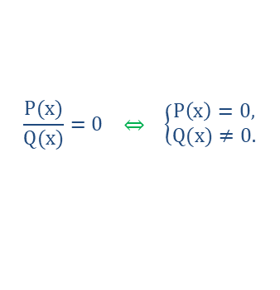
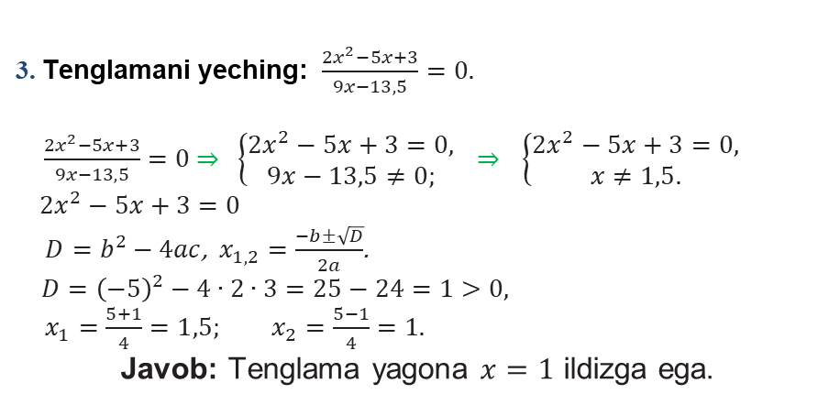
Sodda ratsional tenglama
3. Tenglamani yeching: $\frac{{2x}^{2}−5x+3}{9x−13,5}=0.$
$\frac{{2x}^{2}−5x+3}{9x−13,5}=0$ ⇒ $\left\{\begin{aligned}{2x}^{2}−5x+3=0, \\ 9x−13,5≠0;\end{aligned}\right.$ ⇒ $\left\{\begin{aligned}{2x}^{2}−5x+3=0, \\ x≠1,5.\end{aligned}\right.$
$${2x}^{2}−5x+3=0$$
$D=b^{2}−4ac$, $x_{1,2}=\frac{−b±\sqrt{D}}{2a}$.
$D={\left(−5\right)}^{2}−4∙2∙3=25−24=1>0,$
$x_{1}=\frac{5+1}{4}=1,5; x_{2}=\frac{5−1}{4}=1.$
Javob: Tenglama yagona $x=1$ ildizga ega.
$$\frac{P(x)}{Q(x)}=0 ⇔ \left\{\begin{aligned}P\left(x\right)=0, \\ Q(x)≠0.\end{aligned}\right.$$

Slide 7
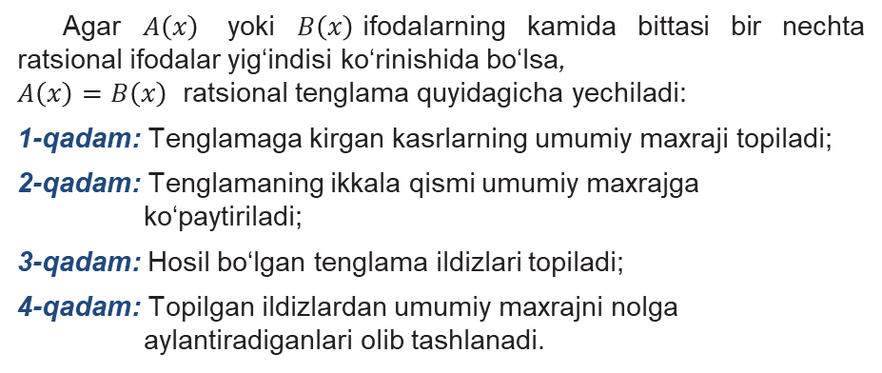
Ratsional tenglama
Agar $A\left(x\right)$ yoki $B\left(x\right)$ifodalarning kamida bittasi bir nechta ratsional ifodalar yig‘indisi ko‘rinishida bo‘lsa,
$A\left(x\right)=B\left(x\right)$ ratsional tenglama quyidagicha yechiladi:
1-qadam: Tenglamaga kirgan kasrlarning umumiy maxraji topiladi;
2-qadam: Tenglamaning ikkala qismi umumiy maxrajga ko‘paytiriladi;
3-qadam: Hosil bo‘lgan tenglama ildizlari topiladi;
4-qadam: Topilgan ildizlardan umumiy maxrajni nolga aylantiradiganlari olib tashlanadi.

Slide 8
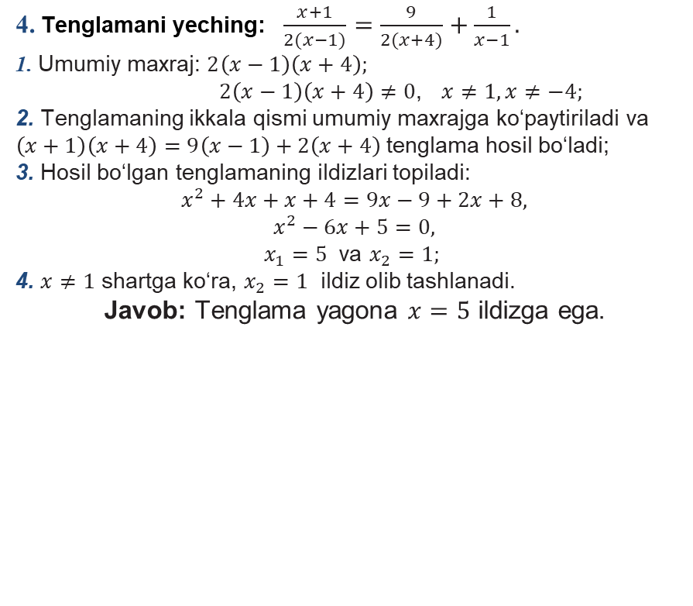
Ratsional tenglama
4. Tenglamani yeching: $\frac{x+1}{2(x−1)}=\frac{9}{2(x+4)}+\frac{1}{x−1}.$
1. Umumiy maxraj: $2\left(x−1\right)\left(x+4\right);$
$2\left(x−1\right)\left(x+4\right)≠0$, $x≠1, x≠−4;$
2. Tenglamaning ikkala qismi umumiy maxrajga ko‘paytiriladi va $\left(x+1\right)\left(x+4\right)=9\left(x−1\right)+2\left(x+4\right)$tenglama hosil bo‘ladi;
3. Hosil bo‘lgan tenglamaning ildizlari topiladi:
$$x^{2}+4x+x+4=9x−9+2x+8,$$
$$x^{2}−6x+5=0,$$
$x_{1}=5$ va $x_{2}=1;$
4. $x≠1$ shartga ko‘ra, $x_{2}=1$ ildiz olib tashlanadi.
Javob: Tenglama yagona $x=5$ ildizga ega.

Slide 9
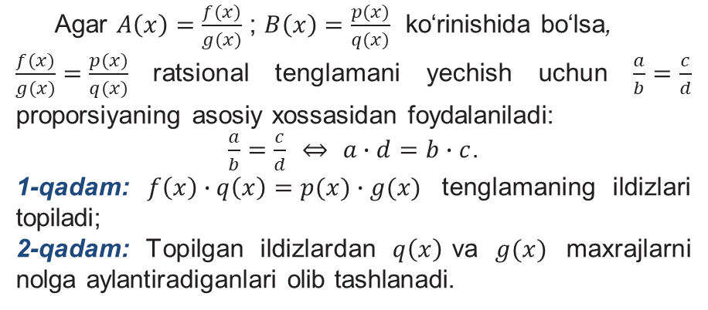
Ratsional tenglama
Agar $A\left(x\right)=\frac{f(x)}{g(x)}$ ; $B\left(x\right)=\frac{p(x)}{q(x)}$ ko‘rinishida bo‘lsa,
$\frac{f(x)}{g(x)}=\frac{p(x)}{q(x)}$ratsional tenglamani yechish uchun $\frac{a}{b}=\frac{c}{d}$ proporsiyaning asosiy xossasidan foydalaniladi:
$\frac{a}{b}=\frac{c}{d}$ ⇔ $a∙d=b∙c$.
1-qadam: $f\left(x\right)∙q\left(x\right)=p(x)∙g(x)$ tenglamaning ildizlari topiladi;
2-qadam: Topilgan ildizlardan $q\left(x\right)$va $g(x)$ maxrajlarni nolga aylantiradiganlari olib tashlanadi.

Slide 10
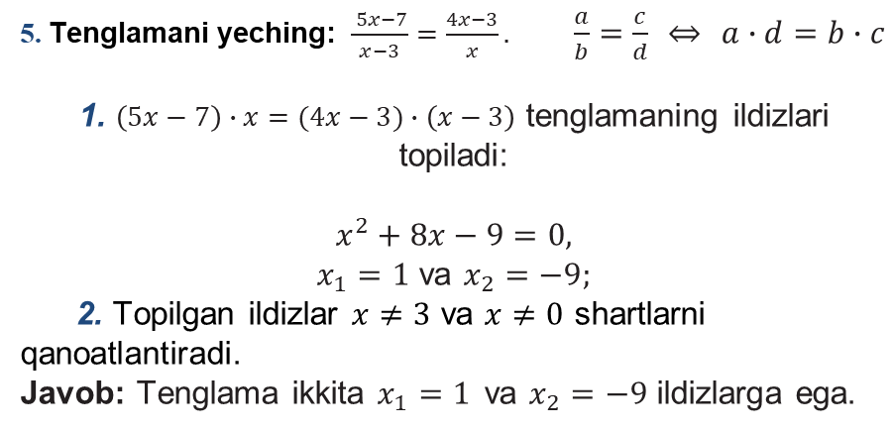
Ratsional tenglama
5. Tenglamani yeching: $\frac{ 5x−7}{x−3}=\frac{4x−3}{x}.$ $\frac{a}{b}=\frac{c}{d}$ ⇔ $a∙d=b∙c$
1. $\left(5x−7\right)∙x=(4x−3)∙\left(x−3\right)$ tenglamaning ildizlari topiladi:
$$x^{2}+8x−9=0,$$
$x_{1}=1$ va $x_{2}=−9;$
2. Topilgan ildizlar $x≠3$ va $x≠0$ shartlarni qanoatlantiradi.
Javob: Tenglama ikkita$x_{1}=1$ va $x_{2}=−9$ ildizlarga ega.
$$5x^{2}−7x=4x^{2}−12x−3x+9,$$

Slide 11
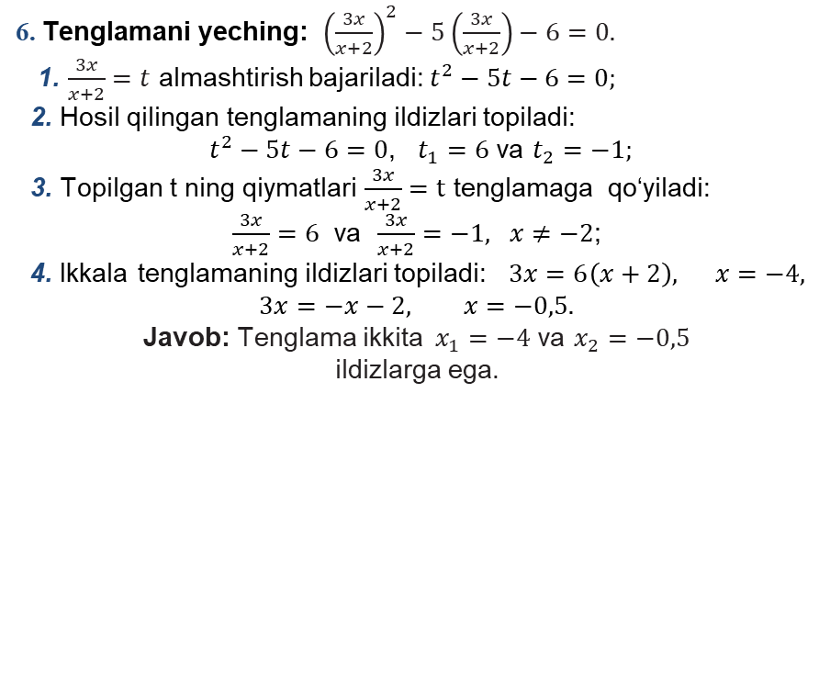
Ratsional tenglama
6. Tenglamani yeching: ${\left(\frac{3x}{x+2}\right)}^{2}−5\left(\frac{3x}{x+2}\right)−6=0.$
1. $\frac{3x}{x+2}=t$ almashtirish bajariladi: $t^{2}−5t−6=0;$
2. Hosil qilingan tenglamaning ildizlari topiladi:
$t^{2}−5t−6=0$, $t_{1}=6$ va $t_{2}=−1;$
3. Topilgan t ning qiymatlari $\frac{3x}{x+2}=t$ tenglamaga qo‘yiladi:
$\frac{3x}{x+2}=6$ va $\frac{3x}{x+2}=−1, x≠−2$;
4. Ikkala tenglamaning ildizlari topiladi: $3x=6\left(x+2\right),$ $x=−4,$
$3x=−x−2,$ $x=−0,5.$
Javob: Tenglama ikkita$x_{1}=−4$ va $x_{2}=−0,5$
ildizlarga ega.

Slide 12
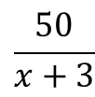
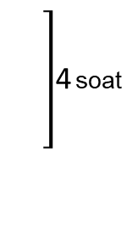
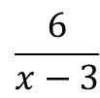
Masalalar yechish
7. Motorli qayiq daryo oqimi bo‘ylab 50 km va oqimga qarshi 6 km yo‘l yurib, butun yo‘lga 4 soat vaqt sarflagan.
Agar daryo oqimining tezligi 3 km/soat bo‘lsa, motorli qayiqning turg‘un suvdagi tezligi qancha?
V, km/soat
t, soat
S, km
Oqim bo‘yicha
$(x+3)$ km/soat
$$\frac{50}{x+3}$$
4 soat
$$50$$
$$\frac{6}{x−3}$$
Oqimga qarshi
$(x−3)$ km/soat
$$6$$

Slide 13

Sodda ratsional tenglama
$\frac{50}{x+3}+\frac{6}{x−3}=4,$
1. Umumiy maxraj: $\left(x+3\right)\left(x−3\right);$
2.
3.
Javob: Motorli qayiqning turg‘un suvdagi tezligi $12$ km/soatga teng.
$x+3≠0$,
$$x≠−3,$$
$$x>3$$
$$x−3≠0,$$
$$x≠3;$$
$$50\left(x−3\right)+6\left(x+3\right)=4\left(x+3\right)\left(x−3\right);$$
$50x−150+6x+18=4x^{2}−36$,
$$4x^{2}−56x+96=0,$$
$x_{1}=2$ va $x_{2}=12$
$$x^{2}−14x+24 =0$$

Slide 14
Mustaqil bajarish uchun topshiriq
63-betdagi 1- misolda berilgan b), d), e) va f) ratsional tenglamalarni yechish.

