Slide 1
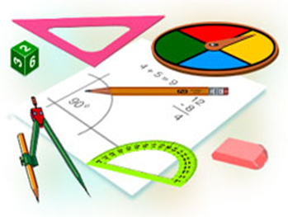
Geometriya
10-sinf
Mavzu: Amaliy mashq va tatbiqlar (piramida)

Slide 2
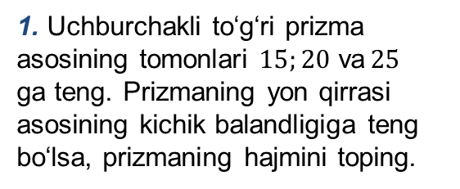
Mustaqil bajarilgan topshiriqni tekshirish
1. Uchburchakli to‘g‘ri prizma asosining tomonlari $15;20$ va$25$ ga teng. Prizmaning yon qirrasi asosining kichik balandligiga teng bo‘lsa, prizmaning hajmini toping.
$$l$$
$$20$$
$$h$$
$$15$$
$$25$$

Slide 3
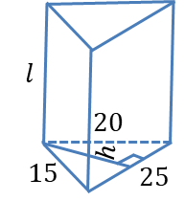

Mustaqil bajarilgan topshiriqni tekshirish
Yechish: $l=h;$ $h=\frac{2S}{25};$
$$S=\sqrt{p(p−a)(p−b)(p−c)};$$
$$V=S_{asos}∙l$$

Slide 4

Mustaqil bajarilgan topshiriqni tekshirish
1) $p=\frac{a+b+c}{2}$
$$p=\frac{15+20+25}{2}=30$$
2) $S=\sqrt{30∙(30−15)∙(30−20)∙(30−25)}$
$$S=\sqrt{30∙15∙10∙5}=\sqrt{3∙10∙3∙5∙10∙5}=$$
$$=3∙10∙5=150$$

Slide 5

Mustaqil bajarilgan topshiriqni tekshirish
3)$h=\frac{2S}{25}$
$$h=\frac{2∙150}{25}=12 ⇒l=12$$
4) $V=S_{asos}∙l$
$$V=150∙12=1800$$
Javob: $V=1800$

Slide 6
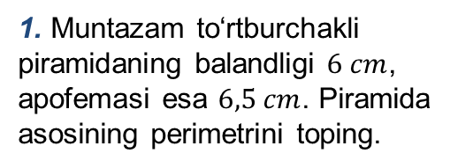
1-masala
1. Muntazam to‘rtburchakli piramidaning balandligi $6 cm$, apofemasi esa $6,5 cm$. Piramida asosining perimetrini toping.
$$⋅$$
$$6,5$$
$$6$$

Slide 7
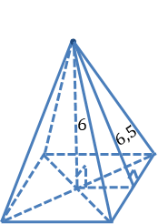

1-masalaning yechimi
Yechish: $x^{2}={6,5}^{2}−6^{2};$
$$x^{2}=\left(6,5−6\right)∙\left(6,5+6\right)=0,5∙12,5=6,25;$$
$x=2,5$
$a=2∙x=2∙2,5=5$
$P=4∙a=4∙5=20$
$$x$$
Javob: Piramida asosining perimetri $20 cm$ ga teng.
$$a$$

Slide 8
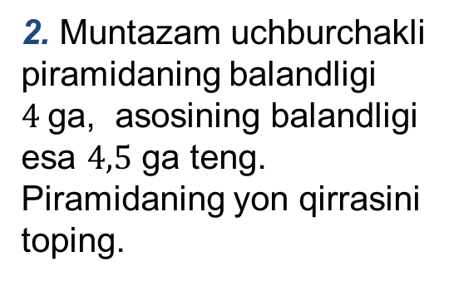
2-masala
2. Muntazam uchburchakli piramidaning balandligi $4$ga, asosining balandligi esa $4,5$ ga teng. Piramidaning yon qirrasini toping.
$$⋅$$
$$l$$
$$4$$
$$⋅$$
$$4,5$$

Slide 9
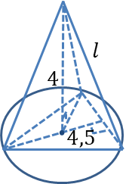
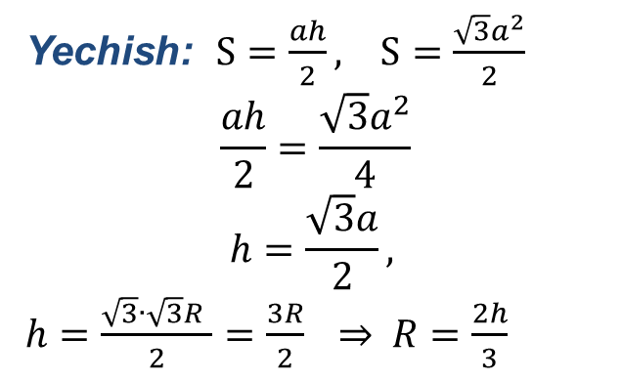
2-masalaning yechimi
Yechish: $S=\frac{ah}{2}, S=\frac{\sqrt{3}a^{2}}{2}$
$$\frac{ah}{2}=\frac{\sqrt{3}a^{2}}{4}$$
$$h=\frac{\sqrt{3}a}{2},$$
$h=\frac{\sqrt{3}∙\sqrt{3}R }{2}=\frac{3R}{2}$ ⇒$R=\frac{2h}{3}$
$$2$$
$$R$$
$$a=\sqrt{3}R$$
$$a$$

Slide 10
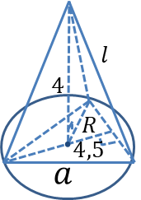
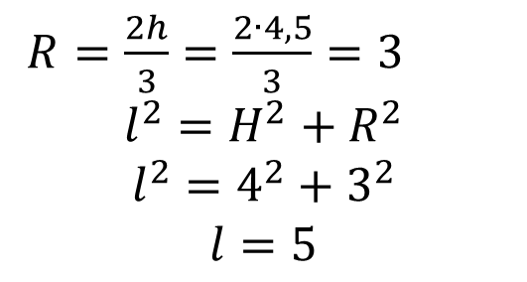
2-masalaning yechimi
$R=\frac{2h}{3}=\frac{2∙4,5}{3}=3$
$$l^{2}=H^{2}+R^{2}$$
$$l^{2}=4^{2}+3^{2}$$
$$l=5$$
Javob: Piramidaning yon qirrasi $5$ ga teng.

Slide 11
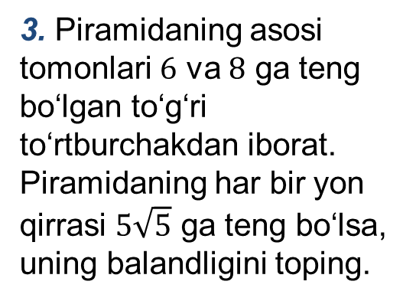
3-masala
3. Piramidaning asosi tomonlari $6$ va $8$ ga teng bo‘lgan to‘g‘ri to‘rtburchakdan iborat. Piramidaning har bir yon qirrasi $5\sqrt{5}$ ga teng bo‘lsa, uning balandligini toping.
$$⋅$$
$$5\sqrt{5}$$
$$6$$
$$8$$

Slide 12
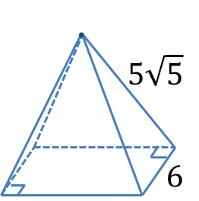
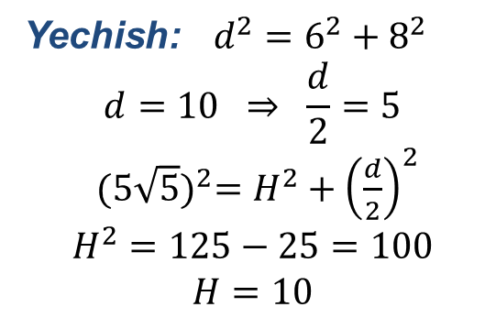
3-masalaning yechimi
Yechish: $d^{2}=6^{2}+8^{2}$
$$d=10 ⇒ \frac{d}{2}=5$$
${(5\sqrt{5})}^{2}=H^{2}+{\left(\frac{d}{2}\right)}^{2}$
$$H^{2}=125−25=100$$
$$H=10$$
$$H$$
$$\frac{d}{2}$$
$$8$$
Javob: Piramidaning balandligi $10$ ga teng.

Slide 13
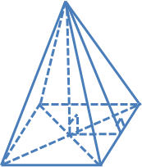
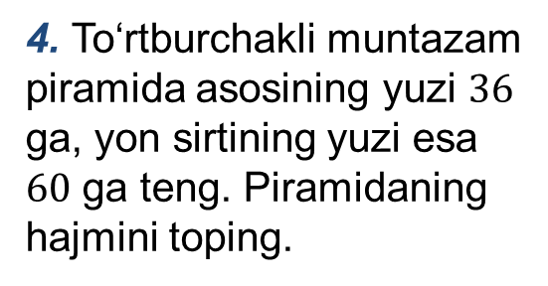
4-masala
4. To‘rtburchakli muntazam piramida asosining yuzi $36$ ga, yon sirtining yuzi esa $60$ ga teng. Piramidaning hajmini toping.

Slide 14
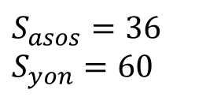
4-masalaning yechimi
$S_{asos}=36$
$$S_{yon}=60$$
$$S_{asos}=a^{2}$$
$$S_{yon}=\frac{Ph}{2}=2ah$$
$$V=?$$
$$h$$
$$a^{2}=36 ⇒ a=6$$
$$h=\frac{S_{yon}}{2a}=\frac{60}{2∙6}=5$$
$$a$$

Slide 15
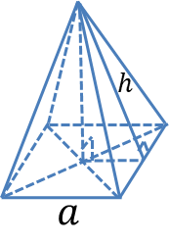
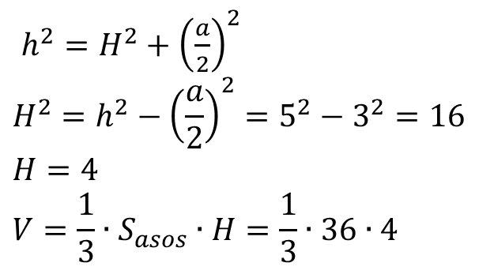
4-masalaning yechimi
$h^{2}=H^{2}+{\left(\frac{a}{2}\right)}^{2}$
$$H^{2}=h^{2}−{\left(\frac{a}{2}\right)}^{2}=5^{2}−3^{2}=16$$
$$H=4$$
$$V=\frac{1}{3}∙S_{asos}∙H=\frac{1}{3}∙36∙4$$
$$H$$
$$12$$
$$\frac{a}{2}$$
$$=48$$
Javob: Piramidaning hajmi $48$ ga teng.

Slide 16
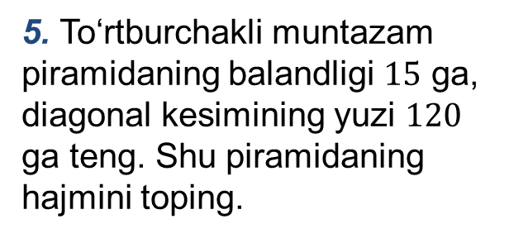
5-masala
5. To‘rtburchakli muntazam piramidaning balandligi $15$ ga, diagonal kesimining yuzi $120$ ga teng. Shu piramidaning hajmini toping.
$$⋅$$
$$S_{kesim}=120$$
$$15$$

Slide 17
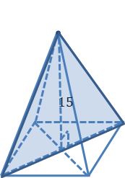
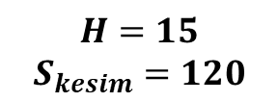
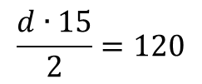
5-masalaning yechimi
$$H=15$$
$$S_{kesim}=120$$
$$S_{kesim}=\frac{dH}{2}=120$$
$$\frac{d∙15}{2}=120$$
$$V=?$$
$$d=16$$
$$d=a\sqrt{2}=16 ⇒ a=\frac{16}{\sqrt{2}}=\frac{16∙\sqrt{2}}{\sqrt{2}∙\sqrt{2}}$$
$$a$$
$$d$$
$$a=8\sqrt{2}$$

Slide 18
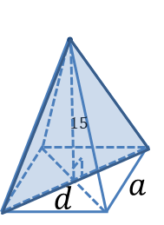
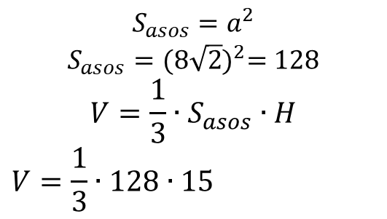
5-masalaning yechimi
$$S_{asos}=a^{2}$$
$$S_{asos}={(8\sqrt{2})}^{2}=128$$
$$V=\frac{1}{3}∙S_{asos}∙H$$
$$V=\frac{1}{3}∙128∙15$$
$$5$$
$$=128∙5=640$$
Javob: Piramidaning hajmi $640$ ga teng.

Slide 19
Mustaqil bajarish uchun topshiriq
1. Muntazam to‘rtburchakli piramidaning hajmi$20$ ga, balandligi esa $1$ ga teng. Piramida apofemasi uzunligini toping.

