Slide 1
Geometriya
10-sinf
Mavzu: Amaliy mashq va tatbiqlar

Slide 2
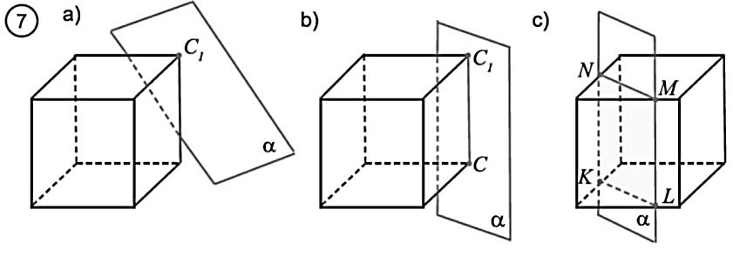
Mustaqil bajarilgan topshiriqni tekshirish
3.21. 7-rasmda keltirilgan holatlarda fazoviy shakllarning qanday kesimi tasvirlanganligini izohlang.

Slide 3
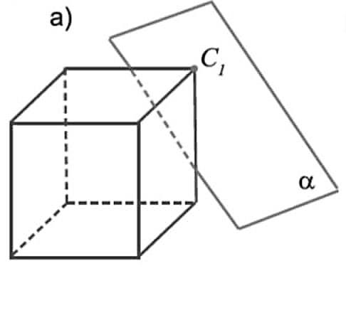
Mustaqil bajarilgan topshiriqni tekshirish
a) rasmda keltirilgan holatda kubning $C_{1}$ uchidan va ${B_{1}C}_{1}$qirrasining $K$ nuqtasidan hamda ${CC}_{1}$qirrasining $L$ nuqtasidan tekislik o‘tkazilgandagi kesimi tasvirlangan.Kesimda $KLC_{1}$ uchburchak hosil bo‘ladi.
$$B_{1}$$
$$K$$
⋅
$$A_{1}$$
$$D_{1}$$
⋅
$$L$$
$$B$$
$$C$$
$$A$$
$$D$$

Slide 4
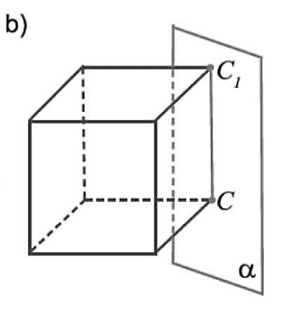
Mustaqil bajarilgan topshiriqni tekshirish
b) rasmda keltirilgan holatda kubning ${CC}_{1}$ qirrasi va $BC$ qirrasining $K$ nuqtasidan hamda ${B_{1}C}_{1}$qirrasining $L$ nuqtasidan tekislik o‘tkazilgandagi kesimi tasvirlangan.Kesimda $KLC_{1}C$ to‘rtburchak hosil bo‘ladi.
$$B_{1}$$
$$L$$
⋅
$$A_{1}$$
$$D_{1}$$
$$K$$
$$B$$
⋅
$$A$$
$$D$$

Slide 5
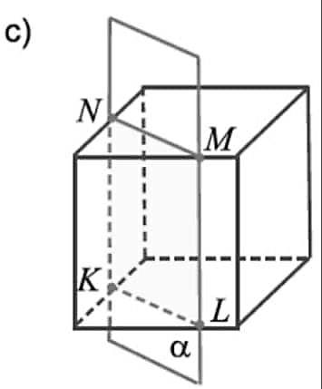
Mustaqil bajarilgan topshiriqni tekshirish
c) Kubni $AB, AD,{A_{1}B}_{1}$ va $A_{1}D$ qirralarini mos ravishda $K, L, N$ va $M$nuqtalarda kesib o‘tuvchi tekislik bilan kesganda, kesimda $KLMN$ to‘g‘ri to‘rtburchak hosil bo‘ladi.
$$B_{1}$$
$$C_{1}$$
$$A_{1}$$
$$D_{1}$$
$$B$$
$$C$$
$$A$$
$$D$$

Slide 6
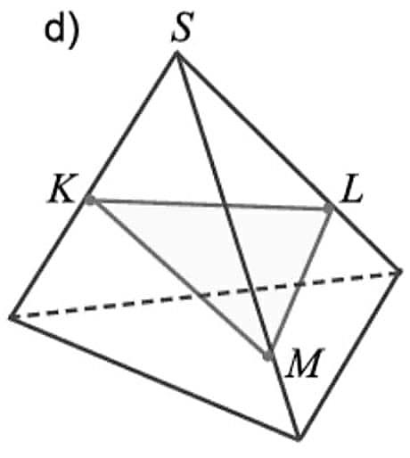
Mustaqil bajarilgan topshiriqni tekshirish
d) Piramidaning yon qirralarini
$K, L$ va $M$nuqtalarda kesib o‘tuvchi tekislik bilan kesganda, kesimda $KLM$ uchburchak hosil bo‘ladi.

Slide 7
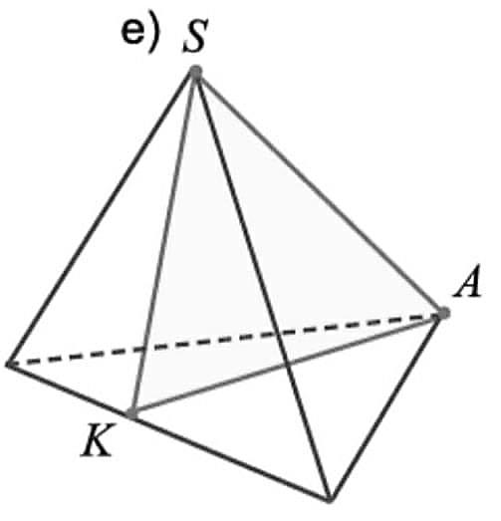
Mustaqil bajarilgan topshiriqni tekshirish
e) Piramidaning $AS$ qirrasidan hamda $BS$qirrasida yotgan
$K$nuqtadan o‘tuvchi tekislik bilan kesganda, kesimda $AKS$ uchburchak hosil bo‘ladi.
$$B$$
$$C$$

Slide 8
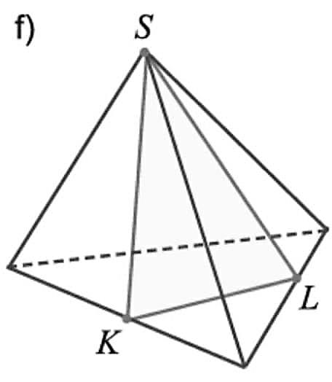
Mustaqil bajarilgan topshiriqni tekshirish
f) Piramidaning $S$ uchi hamda asosining tomonlarida yotuvchi
$K$va $L$ nuqtalardan o‘tadigan tekislik bilan kesganda, kesimda $KLS$ uchburchak hosil bo‘ladi.

Slide 9
Masala yechish
3.22.$ABCDA_{1}B_{1}C_{1}D_{1}$ kubning $AD$ va $CD$ qirralarida $M$ va $N$ nuqtalar berilgan. Kubni $MNB_{1}$ tekislik bilan kesganda hosil bo‘ladigan kesimni yasang.
$$B_{1}$$
$$⋅$$
$$⋅$$
$$C_{1}$$
$$A_{1}$$
$$D_{1}$$
$$⋅$$
$$⋅$$
$$⋅$$
$$B$$
$$C$$
$$∘$$
$$⋅$$
$$⋅$$
$$⋅$$
$$⋅$$
$$N$$
$$A$$
$$D$$
$$M$$

Slide 10
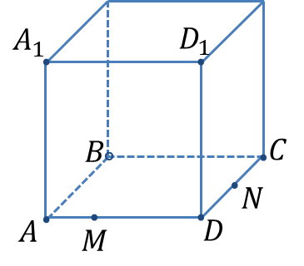
Masala yechish
1) $M∈ABCD$va $N∈ABCD$
bo‘lgani uchun $M$ va $N$nuqtalarni tutashtirsak bo‘ladi.
$$B_{1}$$
$$⋅$$
$$⋅$$
$$C_{1}$$
$$⋅$$
$$N_{1}$$
$$M_{1}$$
$$⋅$$
2) $M_{1}∈A_{1}D_{1}$va $N_{1}∈C_{1}D_{1}$
nuqtalarni olamiz. So‘ng $M$va $M_{1}$,
$N$va $N_{1}$ nuqtalarni tutashtiramiz.
3) $M,N,B∈ABCD$bo‘lgani uchun, $BM$va $BN$kesmalarni o‘tkazamiz.

Slide 11
Masala yechish
4) $B_{1},M_{1},N_{1}∈A_{1}B_{1}C_{1}D_{1}$bo‘lgani uchun, $B_{1}M_{1}$ ,${ B}_{1}N_{1}$ va ${ M}_{1}N_{1}$
kesmalarni o‘tkazamiz.
$$B_{1}$$
$$⋅$$
$$⋅$$
$$C_{1}$$
$$⋅$$
$$N_{1}$$
$$M_{1}$$
$$⋅$$
5) ${M,B}_{1}∈{BMB}_{1}M_{1}$va
${N, B}_{1}∈{BNB}_{1}N_{1}$bo‘lgani uchun, ${MB}_{1}$ hamda ${NB}_{1}$kesmalarni o‘tkazamiz.
Hosil bo‘lgan $MNB_{1}$uchburchak izlanayotgan kesimdan iborat.

Slide 12
Masala yechish
3.23.$ABCDA_{1}B_{1}C_{1}D_{1}$ kubni chizing. $AB, BC$ va $BB_{1}$ qirralari o‘rtalari bo‘lgan $M,$ $N, L$ nuqtalarni belgilang.
a) kubni $LMN$ tekislik bilan kesganda hosil bo‘ladigan kesimni yasang.
$$B_{1}$$
$$⋅$$
$$⋅$$
$$C_{1}$$
$$A_{1}$$
$$D_{1}$$
$$⋅$$
$$⋅$$
$$⋅$$
$$L$$
$$⋅$$
$$N$$
$$⋅$$
$$B$$
$$C$$
$$∘$$
$$⋅$$
$$M$$
$$⋅$$
$$⋅$$
$$A$$
$$D$$

Slide 13
Masala yechish
1) $M,N∈ABCD ,$
$$L,M∈ABA_{1}B_{1}$$
va $L, N∈BCB_{1}C_{1}$ bo‘lgani uchun, bu nuqtalarni mos ravishda tutashtirsak bo‘ladi.
$$B_{1}$$
$$⋅$$
$$⋅$$
$$C_{1}$$
$$A_{1}$$
$$D_{1}$$
$$⋅$$
$$⋅$$
$$⋅$$
$$L$$
$$⋅$$
$$N$$
$$⋅$$
2) Hosil bo‘lgan $LMN$uchburchak izlanayotgan kesimdan iborat.
$$B$$
$$C$$
$$∘$$
$$⋅$$
$$M$$
$$⋅$$
$$⋅$$
$$A$$
$$D$$

Slide 14
Masala yechish
$$B_{1}$$
$$⋅$$
$$⋅$$
$$C_{1}$$
3.23.$ABCDA_{1}B_{1}C_{1}D_{1}$ kubni chizing. $AB, BC$ va $BB_{1}$ qirralari o‘rtalari bo‘lgan $M,$ $N, L$ nuqtalarni belgilang.
b) $LMN$ uchburchakning muntazam uchburchak ekanligini isbotlang.
$$A_{1}$$
$$D_{1}$$
$$⋅$$
$$⋅$$
$$⋅$$
$$L$$
$$⋅$$
$$N$$
$$⋅$$
$$B$$
$$C$$
$$∘$$
$$⋅$$
$$M$$
$$⋅$$
$$⋅$$
$$A$$
$$D$$

Slide 15
Masala yechish
$$B_{1}$$
$$⋅$$
$$⋅$$
$$C_{1}$$
1)$M$ nuqta $AB$qirraning o‘rtasi, demak $BM=\frac{AB}{2}$ ;
$N$ nuqta $BC$qirraning o‘rtasi, u holda $BN=\frac{BC}{2}$ ;
$L$ nuqta $BB_{1}$qirraning o‘rtasi, shunga ko‘ra $BL=\frac{BB_{1}}{2}$ ;
$$A_{1}$$
$$D_{1}$$
$$⋅$$
$$⋅$$
$$⋅$$
$$L$$
$$⋅$$
$$N$$
$$⋅$$
$$B$$
$$C$$
$$∘$$
$$⋅$$
$$M$$
$$⋅$$
$$⋅$$
$$A$$
$$D$$

Slide 16
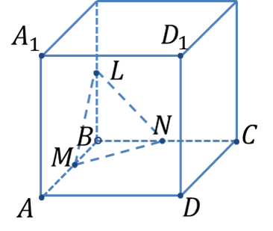
Masala yechish
2) $BLM:$ ${LM}^{2}={BM}^{2}+{BL}^{2}$
$BM=\frac{AB}{2}$, $BL=\frac{BB_{1}}{2}$, $AB=BB_{1}=a$
${LM}^{2}={\left(\frac{AB}{2}\right)}^{2}+{\left(\frac{BB_{1}}{2}\right)}^{2}$
${LM}^{2}={\left(\frac{a}{2}\right)}^{2}+{\left(\frac{a}{2}\right)}^{2}=\frac{a^{2}}{2}$ ⇒ $LM=\frac{\sqrt{2}a}{2};$
$$B_{1}$$
$$C_{1}$$
$$⋅$$
$$⋅$$
3) $BMN:$ ${MN}^{2}={BM}^{2}+{BN}^{2}$
$BM=\frac{AB}{2}$, $BN=\frac{BC}{2}$, $AB=BC=a$
${MN}^{2}={\left(\frac{AB}{2}\right)}^{2}+{\left(\frac{BC}{2}\right)}^{2}$
${MN}^{2}={\left(\frac{a}{2}\right)}^{2}+{\left(\frac{a}{2}\right)}^{2}=\frac{a^{2}}{2}$ ⇒ $MN=\frac{\sqrt{2}a}{2};$

Slide 17
Masala yechish
4) $BLN:$ ${LN}^{2}={BN}^{2}+{BL}^{2}$
$BN=\frac{BC}{2}$, $BL=\frac{BB_{1}}{2}$, $BC=BB_{1}=a$
${LN}^{2}={\left(\frac{BC}{2}\right)}^{2}+{\left(\frac{BB_{1}}{2}\right)}^{2}$
${LN}^{2}={\left(\frac{a}{2}\right)}^{2}+{\left(\frac{a}{2}\right)}^{2}=\frac{a^{2}}{2}$ ⇒ $LN=\frac{\sqrt{2}a}{2};$
$$B_{1}$$
$$C_{1}$$
$$⋅$$
$$⋅$$
5) $LM=\frac{\sqrt{2}a}{2}$, $MN=\frac{\sqrt{2}a}{2}$, $LN=\frac{\sqrt{2}a}{2}$ ⇒
$LM=MN=LN.$
Demak, $LMN$ uchburchak muntazam uchburchakdir.

Slide 18
Masala yechish
c) Kubning qirrasi $1$sm bo‘lsa,
$LMN$ uchburchakning yuzini toping.
$$B_{1}$$
$$C_{1}$$
$$⋅$$
$$⋅$$
1) $LMN−$ muntazam uchburchak. Tomoni $b$ ga teng bo‘lgan muntazam uchburchakning yuzasi $S=\frac{\sqrt{3}b^{2}}{4}$ formula yordamida topiladi.
2) $LM=\frac{\sqrt{2}a}{2}$, $MN=\frac{\sqrt{2}a}{2}$, $LN=\frac{\sqrt{2}a}{2}$
$b=\frac{\sqrt{2}a}{2}$ ⇒ $S_{∆LMN}=\frac{\sqrt{3}∙{\left(\frac{\sqrt{2}a}{2}\right)}^{2}}{4}=\frac{\sqrt{3}a^{2}}{8}=\frac{\sqrt{3}}{8}$.

Slide 19
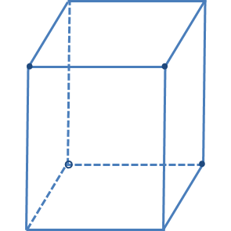
Masala yechish
$$⋅$$
$$⋅$$
$$L$$
$$⋅$$
$$B_{1}$$
$$⋅$$
3.24.$ABCDA_{1}B_{1}C_{1}D_{1}$ to‘g‘ri burchakli parallelepipedning qirralari $AB=6 cm, AD=6 cm$ va $AA_{1}=8 cm$. Parallelepipedning
$BC_{1}D$ tekislik bilan kesimi teng yonli uchburchak ekanligini isbotlang va bu uchburchak balandligini toping.
$$C_{1}$$
$$A_{1}$$
$$D_{1}$$
$$8$$
$$B$$
$$C$$
$$6$$
$$⋅$$
$$⋅$$
$$A$$
$$D$$
$$6$$

Slide 20
Masala yechish
$$⋅$$
$$⋅$$
$$L$$
$$B_{1}$$
$$⋅$$
$$⋅$$
$$C_{1}$$
1) $ABD:$ ${BD}^{2}={AB}^{2}+{AD}^{2}$
$$AB=AD=6 cm$$
$${BD}^{2}=6^{2}+6^{2}$$
$$BD=6\sqrt{2}$$
$$D_{1}$$
$$A_{1}$$
$$⋅$$
$$⋅$$
$$8$$
$$10$$
$$8$$
2) $CDC_{1}:$ ${CD}^{2}={CC_{1}}^{2}+{DC_{1}}^{2}$
$DC=6 cm$, $CC_{1}=8 cm$
$${CD}^{2}=6^{2}+8^{2}$$
$$DC_{1}=10$$
$$⋅$$
$$6$$
$$∘$$
$$⋅$$
$$B$$
$$6\sqrt{2}$$
$$⋅$$
$$C$$
$$6$$
$$A$$
$$6$$
$$D$$

Slide 21
Masala yechish
$$L$$
$$B_{1}$$
$$⋅$$
$$⋅$$
$$C_{1}$$
3) $BCC_{1}:$ ${BC_{1}}^{2}={BC}^{2}+{CC_{1}}^{2}$
$BC=6 cm,$ $CC_{1}=8 cm$
$${BC_{1}}^{2}=6^{2}+8^{2}$$
$$BC_{1}=10$$
$$D_{1}$$
$$A_{1}$$
$$⋅$$
$$⋅$$
$$8$$
$$10$$
$$10$$
$$8$$
4) $BC_{1}=DC_{1}=10$
$BDC_{1}−$ teng yonli uchburchak.
$$⋅$$
$$∘$$
$$6$$
$$6$$
$$6\sqrt{2}$$
$$⋅$$
$$B$$
$$⋅$$
$$C$$
$$6$$
$$A$$
$$6$$
$$D$$

Slide 22
Masala yechish
$$⋅$$
$$⋅$$
$$L$$
$$B_{1}$$
$$⋅$$
$$⋅$$
$$C_{1}$$
5) $DHC_{1}:$ ${DC_{1}}^{2}={DH}^{2}+{{HC}_{1}}^{2}$
$DH=3\sqrt{2} cm,$ $DC_{1}=10 cm$
$${DH}^{2}={10}^{2}−{(3\sqrt{2})}^{2}$$
$${DH}^{2}=82$$
$$DH=\sqrt{82}.$$
$$D_{1}$$
$$A_{1}$$
$$⋅$$
$$⋅$$
$$8$$
$$10$$
$$10$$
$$8$$
Javob: Parallelepipedning
$BC_{1}D$ tekislik bilan kesimi teng yonli uchburchakdir va bu uchburchak balandligini $\sqrt{82}$ cmga teng.
$$\sqrt{82}$$
$$⋅$$
$$∘$$
$$6$$
$$6$$
$$6\sqrt{2}$$
$$⋅$$
$$B$$
$$⋅$$
$$C$$
$$H$$
$$6$$
$$A$$
$$3\sqrt{2}$$
$$6$$
$$D$$

Slide 23
Mustaqil bajarish uchun topshiriq
140-betdagi
3.25-masalani yechish.

