Slide 1
Geometriya
10-sinf
Mavzu: Ko‘pyoqlar va ularning sodda kesimlarini yasash

Slide 2
Mustaqil bajarilgan topshiriqni tekshirish
3.16. $ABC$uchburchak berilgan. $AB$ to‘g‘ri chiziqqa parallel tekislik bu uchburchakning $AC$ tomonini $A_{1}$ nuqtada, $BC$ tomonni $B_{1}$ nuqtada kesib o‘tadi. $A_{1}B_{1}$ kesmaning uzunligini toping. Bunda
c)$B_{1}C=10$ cm, $AB:BC=4:5.$
$$C$$
⋅
$10$cm
$$A_{1}$$
⋅
⋅
$$B_{1}$$
⋅
⋅
$$A$$
$$B$$

Slide 3
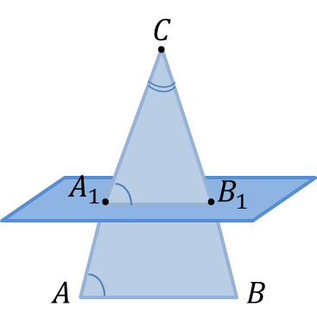
Mustaqil bajarilgan topshiriqni tekshirish
$AB$ to‘g‘ri chiziq berilgan tekislikka parallel va $A_{1}B_{1}$ shu tekislikda yotganligi uchun, $AB∥A_{1}B_{1}.$
Demak, $ABC \sim { A}_{1}B_{1}C_{1}$ (2-alomat).
U holda, $\frac{A_{1}B_{1}}{AB}=\frac{B_{1}C}{BC}$, $A_{1}B_{1}=AB∙\frac{B_{1}C}{BC}$
$$A_{1}B_{1}=B_{1}C∙\frac{AB}{BC}$$
$$A_{1}B_{1}=10∙\frac{4}{5}=2∙4=8$$
Javob: $A_{1}B_{1}=8.$
$10$cm

Slide 4
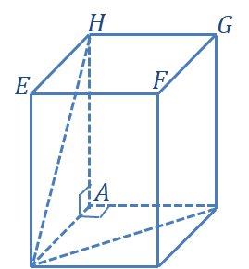
Mustaqil bajarilgan topshiriqni tekshirish
3.20. Asosi kvadrat bo‘lgan to‘g‘ri burchakli parallelepipedning yon sirti $12 {cm}^{2}$ ga teng. Asosining diagonali $\sqrt{2} cm$ bo‘lsa, yon yog‘ining diagonalini toping.
$$?$$
$$B$$
$$S_{yon}=12 {cm}^{2}$$
$$BD=\sqrt{2} cm$$
$$DH= ? cm$$
$$\sqrt{2}$$
$$D$$
$$C$$

Slide 5
Mustaqil bajarilgan topshiriqni tekshirish
1)$ABD:$ ${BD}^{2}={AB}^{2}+{AD}^{2}$
$BD=\sqrt{2} cm$, $AB=AD$
$${(\sqrt{2})}^{2}={AD}^{2}+{AD}^{2}$$
$${(\sqrt{2})}^{2}=2∙{AD}^{2}$$
$${AD}^{2}=1, AD=1 cm;$$
2) $S_{yon}=12 {cm}^{2}$
$$S_{yon}=4∙AD∙AH$$
$AH=\frac{S_{yon}}{4∙AD}=\frac{12}{4∙1}=3 cm$;
$$\sqrt{10}$$
$$3$$
$$B$$
$$1$$
$$\sqrt{2}$$
$$D$$
$$C$$
3) $ADH:$ ${DH}^{2}={AH}^{2}+{AD}^{2}$
$$AD=1 cm, AH=3 cm$$
$${DH}^{2}=1^{2}+3^{2}, {DH}^{2}=10$$
Javob:$DH=\sqrt{10 } cm.$

Slide 6
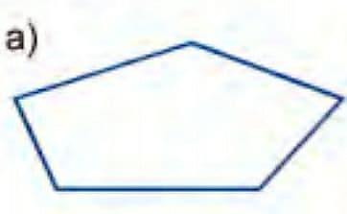
Ko‘pyoqlarni tasvirlash
Prizmani tasvirlash
1. Oldin ko‘pburchak shaklidagi asoslardan biri chiziladi.

Slide 7
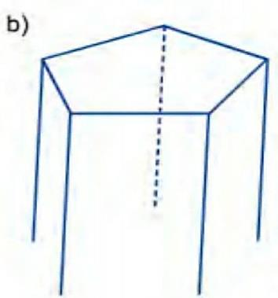
Ko‘pyoqlarni tasvirlash
Prizmani tasvirlash
2. Ko‘pburchakning har bir uchidan o‘zaro parallel va teng kesmalar, ya’ni prizmaning yasovchilari chiziladi.

Slide 8
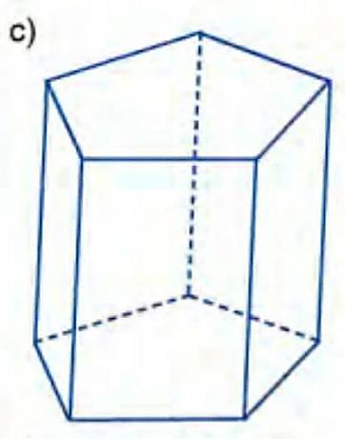
Ko‘pyoqlarni tasvirlash
Prizmani tasvirlash
3. Kesmalarning oxirlari mos ravishda tutashtirib chiqiladi.

Slide 9
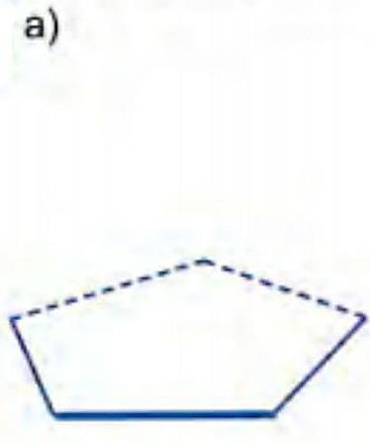
Ko‘pyoqlarni tasvirlash
Piramidani tasvirlash
1. Ko‘pburchak shaklidagi asos chiziladi.

Slide 10
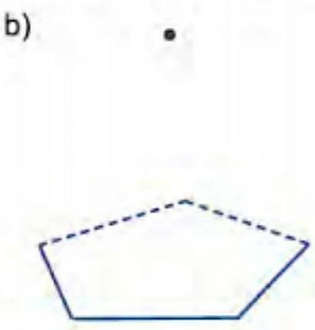
Ko‘pyoqlarni tasvirlash
Piramidani tasvirlash
2. Piramidaning uchi belgilanadi.

Slide 11
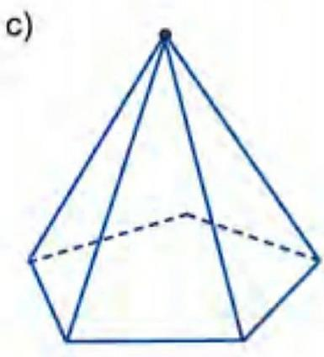
Ko‘pyoqlarni tasvirlash
Piramidani tasvirlash
3. Piramidaning uchi bilan piramida asosining har bir uchi tutashtirib chiqiladi.

Slide 12
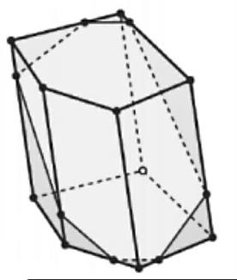
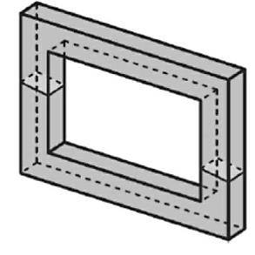
Ko‘pyoqlar va ularning sodda kesimlarini yasash
Ko‘pyoqning kesimi
Aytaylik, ko‘pyoqni biror tekislik kesib o‘tgan bo‘lsin.
Ko‘pyoqning kesimi deb, ko‘pyoqning kesuvchi tekislikka tegishli nuqtalaridan iborat geometrik shaklga aytiladi.

Slide 13
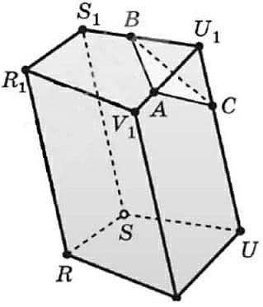
Masala yechish
1. $RSUVR_{1}S_{1}U_{1}V_{1}$to‘rtburchakli prizmaning $U_{1}V_{1},{ S}_{1}U_{1},$ va $UU_{1}$ qirralarini, mos ravishda, $A, B$ va $C$ nuqtalarda kesib o‘tuvchi $α$ tekislik bilan kesganda hosil bo‘lgan kesimni yasaymiz.
$$V$$

Slide 14
Masala yechish
2. $QABC$uchburchakli piramidaning $AB,$ $AQ,$ va $CQ$ qirralarini, mos ravishda, $K, L$ va $M$ nuqtalarda kesib o‘tuvchi $α$ tekislik bilan kesganda hosil bo‘ladigan kesimni yasaymiz.
$$Q$$
$$Q$$
$$⋅$$
$$L$$
$$⋅$$
$$M$$
$$C$$
$$C$$
$$A$$
$$A$$
$$⋅$$
$$B$$
$$K$$
$$B$$

Slide 15
Masala yechish
1) $K∈ABQ$va $L∈ABQ$ bo‘lgani uchun $K$ va $L$nuqtalarni tutashtirsak bo‘ladi.
2) $L∈ACQ$ va $M∈ACQ$ bo‘lgani uchun $L$ va $M$nuqtalarni tutashtiramiz.
$$Q$$
3) $K, X∈ABC ⇒N∈ABC.$
$$⋅$$
$$L$$
4) $M, N∈BCQ$, shuning uchun $M$ va $N$nuqtalarni tutashtiramiz.
$$⋅$$
$$M$$
$$X$$
$$⋅$$
$$C$$
$KLMN$to‘rtburchak kesuvchi tekislikning piramida bilan kesimidan iborat bo‘ladi.
$$⋅$$
$$A$$
$$⋅$$
$$N$$
$$K$$
$$B$$

Slide 16
Masala yechish
3. $OKLMN$to‘rtburchakli piramidaning $OL$ qirrasining $A$ nuqtasi va piramidaning $KLMN$ asosi tekisligida yotuvchi $k$ to‘g‘ri chiziqdan o‘tuvchi $β$ tekislik bilan kesganda hosil bo‘ladigan kesimni yasaymiz.
$$O$$
$$A$$
$$∘$$
$$L$$
$$K$$
$$M$$
$$N$$
$$k$$

Slide 17
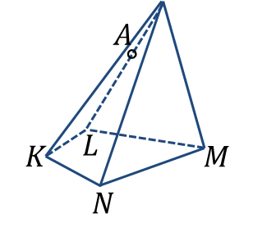
Masala yechish
1) $LM$ va $k$ to‘g‘ri chiziqlar kesishadigan nuqtani topamiz.
$$O$$
$$⋅$$
∘
$$⋅$$
$$⋅$$
$$⋅$$
$$k$$
$$⋅$$
$$X$$

Slide 18
Masala yechish
2)$\left\{\begin{aligned}X∈β, X∈LOM \\ A∈β, A∈LOM \end{aligned}⇒\right.$
$$AX∈β$$
$$O$$
$$⋅$$
$$⋅$$
$$B$$
∘
$$⋅$$
$$⋅$$
$$⋅$$
$$k$$
$$⋅$$
$$X$$

Slide 19
Masala yechish
3)$\left\{\begin{aligned}Y∈β, Y∈OLK \\ A∈β, A∈\text{OLK} \end{aligned}⇒\right.$
$$AY∈β$$
$$O$$
$$⋅$$
$$⋅$$
$$⋅$$
$$B$$
$$D$$
∘
$$⋅$$
$$⋅$$
$$⋅$$
$$k$$
$$⋅$$
$$⋅$$
$$Y$$
$$X$$

Slide 20
Masala yechish
4)$\left\{\begin{aligned}Z∈β, Z∈OKN \\ D∈β, D∈\text{OKN} \end{aligned}⇒\right.$
$$DZ∈β$$
$$O$$
$$⋅$$
$$⋅$$
$$⋅$$
$$D$$
$$B$$
$$⋅$$
$$C$$
∘
$$⋅$$
$$⋅$$
$$⋅$$
$$k$$
$$⋅$$
$$⋅$$
$$⋅$$
$$Y$$
$$Z$$
$$X$$

Slide 21
Masala yechish
5)$B∈OMN, C∈OMN$ bo‘lgani uchun $B$ va $C$ nuqtalarni tutashtiramiz.
$$O$$
$$⋅$$
Demak, $ABCD$ to‘rtburchak izlanayotgan kesimdan iborat.
$$⋅$$
$$⋅$$
$$B$$
$$D$$
$$⋅$$
∘
$$C$$
$$⋅$$
$$⋅$$
$$⋅$$
$$k$$
$$⋅$$
$$⋅$$
$$⋅$$
$$Y$$
$$Z$$
$$X$$

Slide 22
Mustaqil bajarish uchun topshiriq
Darslikning 139-betidagi
3.21-masalani yechish.

