Slide 1
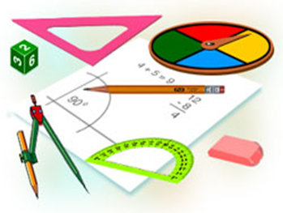
Geometriya
10-sinf
Mavzu:
Masalalar yechish
(1-qism)

Slide 2
Masalalar yechish
1. Teng yonli uchburchakning asosi va balandligi 4 m ga teng. Berilgan nuqtadan uchburchak tekisligigacha bo‘lgan masofa 6 m bo‘lib, bu nuqtadan uchburchak uchlarigacha bo‘lgan masofalar tengdir. Berilgan nuqtadan uchburchak uchlarigacha bo‘lgan masofani toping.

Slide 3
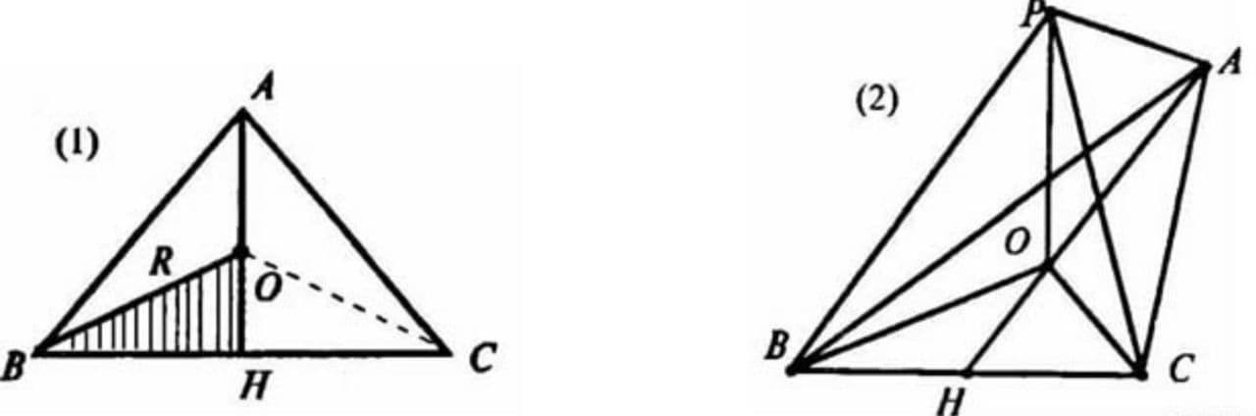
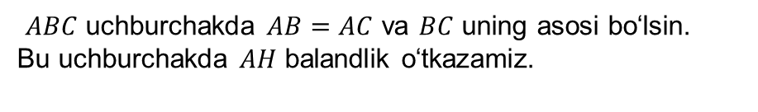

1-masalaning yechimi
$ABC$ uchburchakda $AB=AC$ va $BC$ uning asosi bo‘lsin.
Bu uchburchakda $AH$ balandlik o‘tkazamiz.
$P−$ berilgan nuqta bo‘lsin.

Slide 4
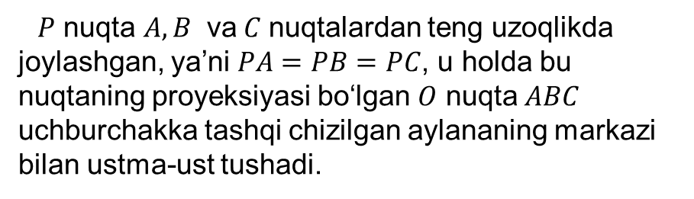
1-masalaning yechimi
$P$ nuqta $A, B$ va$C$ nuqtalardan teng uzoqlikda
joylashgan, ya’ni $PA=PB=PC$, u holda bu nuqtaning proyeksiyasi bo‘lgan $O$ nuqta $ABC$ uchburchakka tashqi chizilgan aylananing markazi bilan ustma-ust tushadi.

Slide 5

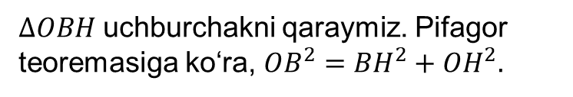
1-masalaning yechimi
Demak, $O$ nuqta $BC$ tomonga tushirilgan $AH$ perpendikulyarda yotadi.
$∆OBH$ uchburchakni qaraymiz. Pifagor teoremasiga ko‘ra, ${OB}^{2}={BH}^{2}+{OH}^{2}.$

Slide 6






1-masalaning yechimi
$BH=\frac{BC}{2}=2 m,$
$OB=R,$
$OH=AH−AO=4−R;$
$${OB}^{2}={BH}^{2}+{OH}^{2}$$
$$R^{2}=2^{2}+{(4−R)}^{2}$$
$$R^{2}=4+16−8R+R^{2}$$

Slide 7



1-masalaning yechimi
$$R^{2}=4+16−8R+R^{2}$$
$$8R=20,$$
$$R=2,5$$

Slide 8

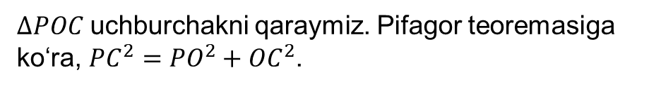
1-masalaning yechimi
$∆POC$ uchburchakni qaraymiz. Pifagor teoremasiga ko‘ra, ${PC}^{2}={PO}^{2}+{OC}^{2}$.
$${PC}^{2}=6^{2}+{2,5}^{2}=36+6,25=42,25$$
$$PC=\sqrt{42,25}=6,5 m.$$

Slide 9

1-masalaning yechimi
Javob: Berilgan nuqtadan uchburchak uchlarigacha bo‘lgan masofalar $6,5$ ga teng.

Slide 10
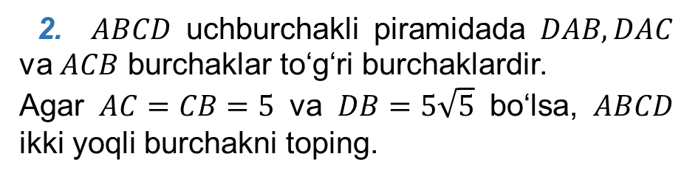
Masalalar yechish
2. $ABCD$ uchburchakli piramidada $DAB, DAC$ va $ACB$ burchaklar to‘g‘ri burchaklardir.
Agar $AC=CB=5$ va $DB=5\sqrt{5}$ bo‘lsa, $ABCD$ ikki yoqli burchakni toping.

Slide 11
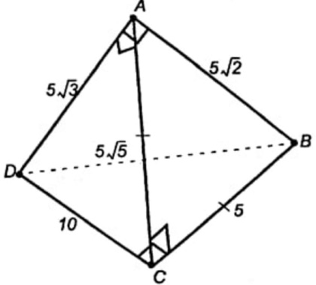
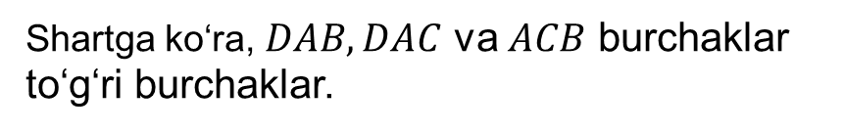



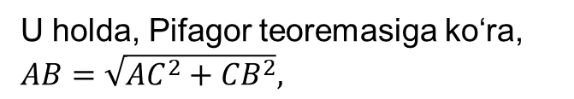
2-masalaning yechimi
Shartga ko‘ra, $DAB, DAC$ va $ACB$ burchaklar to‘g‘ri burchaklar.
U holda, Pifagor teoremasiga ko‘ra,
$AB=\sqrt{{AC}^{2}+{CB}^{2}},$
$AD=\sqrt{{DB}^{2}−{AB}^{2}},$
$DB=\sqrt{{AD}^{2}+{AB}^{2}},$
$DC=\sqrt{{AC}^{2}+{DA}^{2}},$

Slide 12
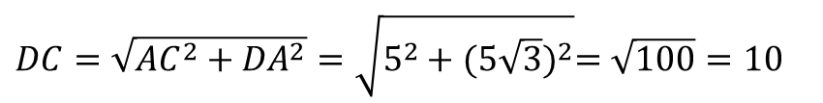
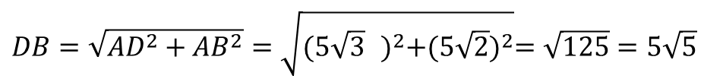
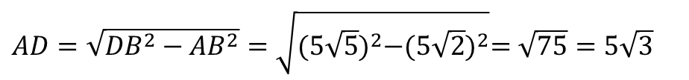
2-masalaning yechimi
$AB=\sqrt{{AC}^{2}+{CB}^{2}}=\sqrt{25+25}=\sqrt{50}=5\sqrt{2}$
$AD=\sqrt{{DB}^{2}−{AB}^{2}}=\sqrt{{(5\sqrt{5})}^{2}−{(5\sqrt{2})}^{2}}=\sqrt{75}=5\sqrt{3}$
$DB=\sqrt{{AD}^{2}+{AB}^{2}}=\sqrt{{(5\sqrt{3} )}^{2}+{(5\sqrt{2})}^{2}}=\sqrt{125}=5\sqrt{5}$
$DC=\sqrt{{AC}^{2}+{DA}^{2}}=\sqrt{5^{2}+{(5\sqrt{3})}^{2}}=\sqrt{100}=10$

Slide 13
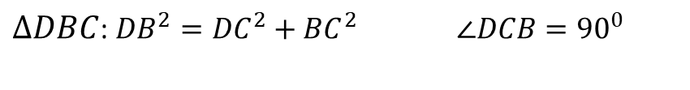
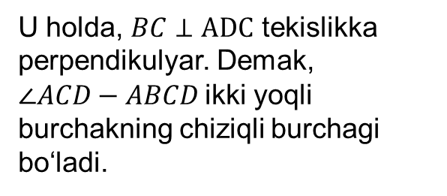

2-masalaning yechimi
$∆DBC$: ${DB}^{2}={DC}^{2}+{BC}^{2}$ $∠DCB={90}^{0}$
$$BC⊥AC, BC⊥DC$$
U holda, $BC⊥ADC$ tekislikka perpendikulyar. Demak, $∠ACD−ABCD$ikki yoqli burchakning chiziqli burchagi bo‘ladi.

Slide 14
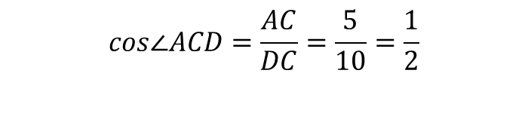
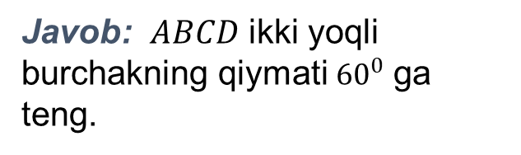

2-masalaning yechimi
$$cos∠ACD=\frac{AC}{DC}=\frac{5}{10}=\frac{1}{2}$$
$$∠ACD={60}^{0}$$
Javob: $ABCD$ ikki yoqli burchakning qiymati ${60}^{0}$ ga teng.

Slide 15
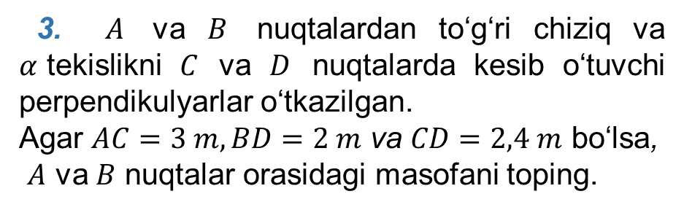
Masalalar yechish
3. $A$ va $B$ nuqtalardan to‘g‘ri chiziq va $α$tekislikni $C$ va $D$ nuqtalarda kesib o‘tuvchi perpendikulyarlar o‘tkazilgan.
Agar $AC=3 m, BD=2 m$ va $CD=2,4 m$ bo‘lsa,
$A$ va $B$ nuqtalar orasidagi masofani toping.

Slide 16
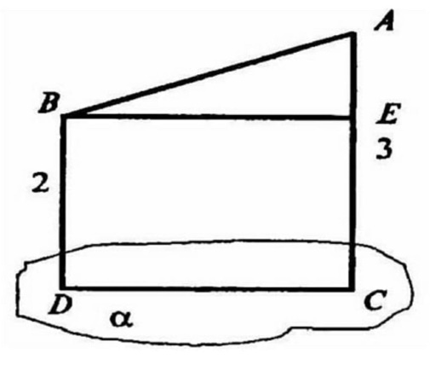
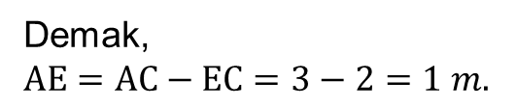
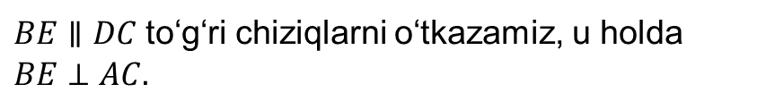

3-masalaning yechimi
$BE∥DC$ to‘g‘ri chiziqlarni o‘tkazamiz, u holda $BE⊥AC.$
$EC=BD=2 m.$
Demak,
$AE=AC−EC=3−2=1 m.$

Slide 17
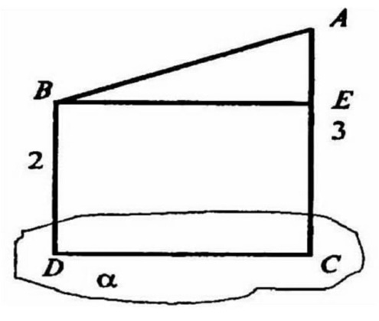



3-masalaning yechimi
Pifagor teoremasiga ko‘ra, $AB=\sqrt{{AE}^{2}+{BE}^{2}},$
$$AB=\sqrt{1^{2}+{2,4}^{2}}=\sqrt{6,76}=2,6 m.$$
Javob: $A$ va $B$ nuqtalar orasidagi masofa $2,6 m$ ga
teng.

Slide 18

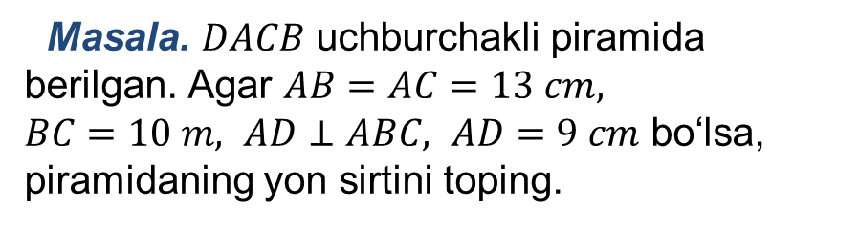
Mustaqil bajarish uchun topshiriq
Masala. $DACB$ uchburchakli piramida berilgan. Agar $AB=AC=13 cm,$
$BC=10 m, AD⊥ABC, AD=9 cm$ bo‘lsa, piramidaning yon sirtini toping.

