Slide 1
Geometriya
10-sinf
Mavzu:
Amaliy mashq va tatbiqlar.

Slide 2
Mustaqil bajarilgan topshiriqni tekshirish
130-betdagi
10-savol: Fazoda to‘g‘ri chiziq va tekisliklarning xossalarini ifodalovchi aksiomalarni ayting.

Slide 3
Mustaqil bajarilgan topshiriqni tekshirish
Agar to‘g‘ri chiziqning ikki nuqtasi bitta tekislikda yotsa, u holda uning barcha nuqtalari shu tekislikda yotadi.
Agar ikki tekislik umumiy nuqtaga ega bo‘lsa, u holda bu tekisliklar shu nuqtadan o‘tuvchi umumiy to‘g‘ri chiziqqa ham ega bo‘ladi.
$$S_{2}$$
$$S_{3}$$

Slide 4
Mustaqil bajarilgan topshiriqni tekshirish
130-betdagi
11-savol: Uch nuqtadan o‘tuvchi tekislik xossasini ayting.
Agar uchta nuqta bir to‘g‘ri chiziqda yotmasa, u holda ular orqali yagona tekislik o‘tkazish mumkin.
$$S_{1}$$

Slide 5
Mustaqil bajarilgan topshiriqni tekshirish
$$B$$
$1. AM∥BK$,
$$M, N, K∈α,$$
$$AM=7,$$
$$BK=42,$$
$$NK=18,$$
$$MN=?$$
$$42$$
$$M$$
$$x$$
⋅
⋅
⋅
$$K$$
$$N$$
$$18$$
$$7$$
$$α$$
$$A$$

Slide 6
Mustaqil bajarilgan topshiriqni tekshirish
$AMN\sim$ $BKN$(1-alomat)
⇒ $\frac{MN}{NK}=\frac{AM}{BK}$
$$B$$
$$42$$
1
$$\frac{x}{18}=\frac{7}{42}$$
$$M$$
$$x$$
⋅
⋅
⋅
$$K$$
$$N$$
$$18$$
6
$$7$$
$$α$$
⇒ $\frac{x}{18}=\frac{1}{6}$ ⇒ $x=3.$
$$A$$
Javob: $MN=3.$

Slide 7
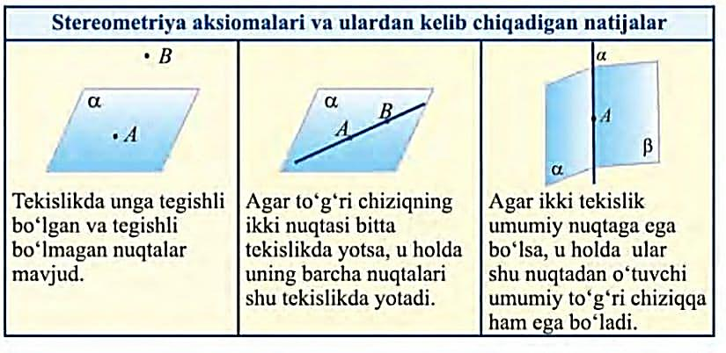
Tayanch nazariy ma’lumotlar

Slide 8
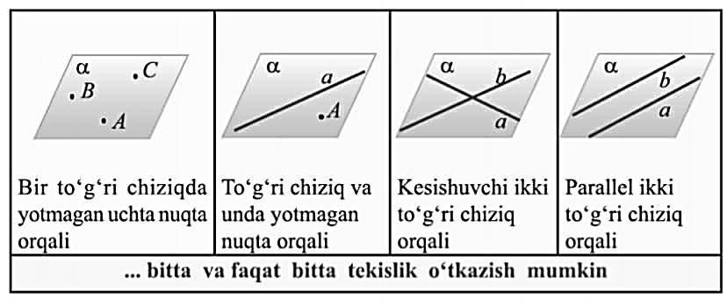
Tayanch nazariy ma’lumotlar

Slide 9
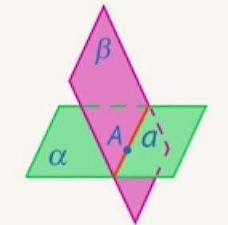
Tayanch nazariy ma’lumotlar
Tekislikda | Fazoda
Agar to‘g‘ri chiziqlar umumiy nuqtaga ega bo‘lsa, ular shu nuqtada kesishadi. | Agar tekisliklar umumiy to‘g‘ri chiziqqa ega bo‘lsa, ular shu to‘g‘ri chiziq bo‘yicha kesishadi.
$$A$$
⋅
$$a$$
$$b$$

Slide 10
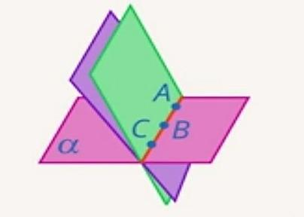
Tayanch nazariy ma’lumotlar
Tekislikda | Fazoda
Tekislikning biror nuqtasidan cheksiz ko‘p to‘g‘ri chiziq o‘tkazish mumkin. | Fazoning biror to‘g‘ri chizig‘idan cheksiz ko‘p tekislik o‘tkazish mumkin.
$$A$$
⋅

Slide 11
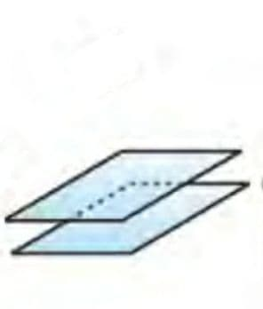
Tayanch nazariy ma’lumotlar
Tekislikda | Fazoda
To‘g‘ri chiziqda yotmaydigan nuqta orqali berilgan to‘g‘ri chiziqqa parallel bitta va faqat bitta to‘g‘ri chiziq o‘tkazish mumkin. | Tekislikda yotmagan to‘g‘ri chiziq orqali berilgan tekislikka parallel bitta va faqat bitta tekislik o‘tkazish mumkin.
$$A$$
$$α$$
⋅
$$a$$
$$a$$
$$β$$
$$b$$

Slide 12
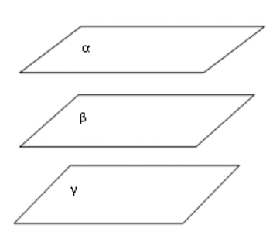
Tayanch nazariy ma’lumotlar
Tekislikda | Fazoda
Bitta to‘g‘ri chiziqqa parallel to‘g‘ri chiziqlar o‘zaro paralleldir. | Bitta tekislikka parallel tekisliklar o‘zaro paralleldir.
$$a$$
$$b$$
$$c$$

Slide 13
Masala yechish
3.16. $ABC$uchburchak berilgan. $AB$ to‘g‘ri chiziqqa parallel tekislik bu uchburchakning $AC$ tomonini $A_{1}$ nuqtada, $BC$ tomonni $B_{1}$ nuqtada kesib o‘tadi. $A_{1}B_{1}$kesmaning uzunligini toping. Bunda a) $AB=15$sm, $AA_{1}:AC=2:3.$
$$C$$
⋅
$$A_{1}$$
⋅
⋅
$$B_{1}$$
⋅
⋅
$$A$$
$$B$$
$15$sm

Slide 14
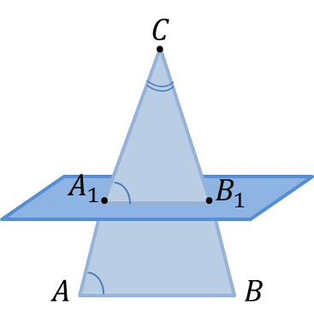
Masala yechish
$AB$ to‘g‘ri chiziq berilgan tekislikka parallel va $A_{1}B_{1}$shu tekislikda yotganligi uchun, $AB∥A_{1}B_{1}.$
Demak, $ABC \sim { A}_{1}B_{1}C_{1}$(2-alomat).
U holda, $\frac{A_{1}C}{AC}=\frac{A_{1}B_{1}}{AB}$, $A_{1}B_{1}=AB∙\left(\frac{A_{1}C}{AC}\right)$
$$A_{1}B_{1}=AB∙\left(\frac{AC−AA_{1}}{AC}\right)$$
$$A_{1}B_{1}=AB∙\left(1−\frac{AA_{1}}{AC}\right)=15\left(1−\frac{2}{3}\right)=5$$
Javob: $A_{1}B_{1}=5.$
$15$sm

Slide 15
Masala yechish
3.18.$ABCDHGFE$ to‘g‘ri burchakli parallelepipedning yon qirrasi $8$sm ga, asosi tomoni $6$ smga teng bo‘lgan kvadratdan iborat. Fazoviy $HFDBH$ siniq chiziqning uzunligini toping.
$$8$$
$$6$$

Slide 16
Masala yechish
$EFH:$ ${FH}^{2}={EH}^{2}+{EF}^{2}$
$$EH=EF=6 sm$$
$${FH}^{2}=6^{2}+6^{2}$$
$${FH}^{2}=2∙6^{2}$$
$$FH=6\sqrt{2};$$
$CDF:$ ${DF}^{2}={CD}^{2}+{CF}^{2}$
$$CD=6 sm, CF=8 sm$$
$${DF}^{2}=6^{2}+8^{2}$$
$${DF}^{2}=100$$
$$DF=10;$$
$$6\sqrt{2}$$
$$6$$
$$6$$
$$10$$
$$8$$
$$6$$

Slide 17
Masala yechish
$BCD:{ BD}^{2}={BC}^{2}+{CD}^{2}$
$$BC=CD=6 sm$$
$${BD}^{2}=6^{2}+6^{2}$$
$${BD}^{2}=2∙6^{2}$$
$$BD=6\sqrt{2};$$
$ABH:$ ${BH}^{2}={AB}^{2}+{AH}^{2}$
$$AB=6 sm, AH=8 sm$$
$${BH}^{2}=6^{2}+8^{2}$$
$${BH}^{2}=100$$
$$BH=10;$$
$$6\sqrt{2}$$
$$6$$
$$6$$
$$8$$
$$10$$
$$10$$
$$8$$
$$6$$
$$6\sqrt{2}$$
$$6$$
$$6$$

Slide 18
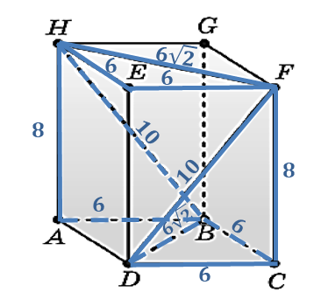
Masala yechish
$$HFDBH=HF+FD+DB+BH$$
$$HFDBH=6\sqrt{2}+10+6\sqrt{2}+10$$
$$HFDBH=20+12\sqrt{2}$$
Javob: $HFDBH=4(5+3\sqrt{2})$

Slide 19
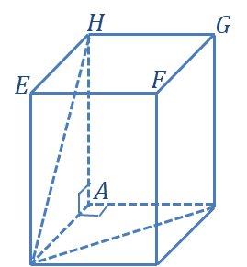
Masala yechish
1.$ABCDHGFE$ muntazam prizma yon yog‘ining diagonali $15$smga teng. Prizma asosining diagonali $9\sqrt{2}$ sm bo‘lsa, prizmaning to‘la sirtini toping.
$$15$$
$$B$$
$$S_{to^{′}la sirt}=2∙S_{asos}+S_{yon}$$
$$S_{to^{′}la sirt}=2∙{AD}^{2}+4∙AD∙AH$$
$$9\sqrt{2}$$
$$D$$
$$C$$

Slide 20
Masala yechish
$ABD:$ ${BD}^{2}={AB}^{2}+{AD}^{2}$
$BD=9\sqrt{2} sm$, $AB=AD$
$${(9\sqrt{2})}^{2}={AD}^{2}+{AD}^{2}$$
$${(9\sqrt{2})}^{2}=2∙{AD}^{2}$$
$${AD}^{2}=81, AD=9 sm;$$
$ADH:$ ${DH}^{2}={AH}^{2}+{AD}^{2}$
$$DH=15 sm, AD=9 sm$$
$${AH}^{2}={DH}^{2}−{AD}^{2}$$
${AH}^{2}={15}^{2}−9^{2}$, ${AH}^{2}=144$
$$AH=12;$$
$$15$$
$$12$$
$$B$$
$$9$$
$$9\sqrt{2}$$
$$D$$
$$C$$
$$S_{to^{′}la sirt}=2∙S_{asos}+S_{yon}$$
$$S_{to^{′}la sirt}=2∙{AD}^{2}+4∙AD∙AH$$
$$S_{to^{′}la sirt}=2∙9^{2}+4∙9∙12=594$$
Javob: $S_{to^{′}la sirt}=594.$

Slide 21
Mustaqil bajarish uchun topshiriq
139-betdagi
3.16: b), c) va 3.20-masalalarni yechish.

