Slide 1

Kimyo
10
sinf
MAVZU: Masala va mashqlar yechish
Toshkent shahar
Yunusobod tumani
288-maktabning kimyo
fani o‘qituvchisi
Turdiyeva Dilfuza Qodirovna

Slide 2
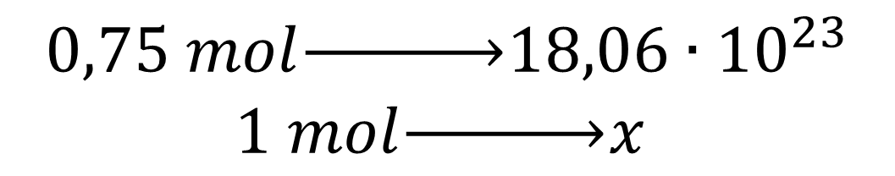

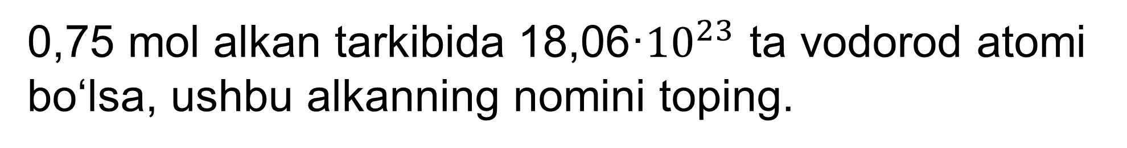
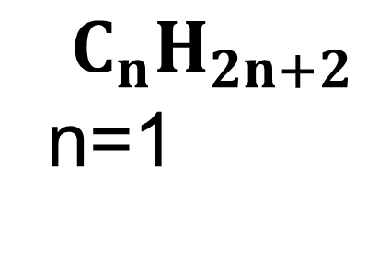
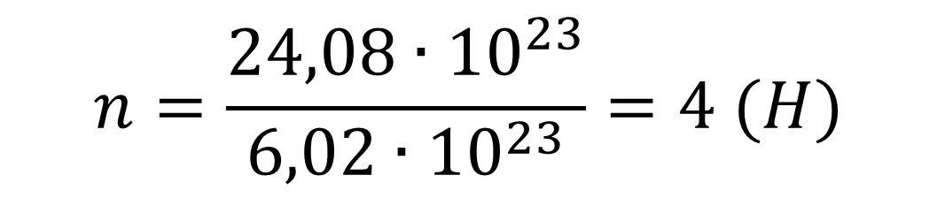
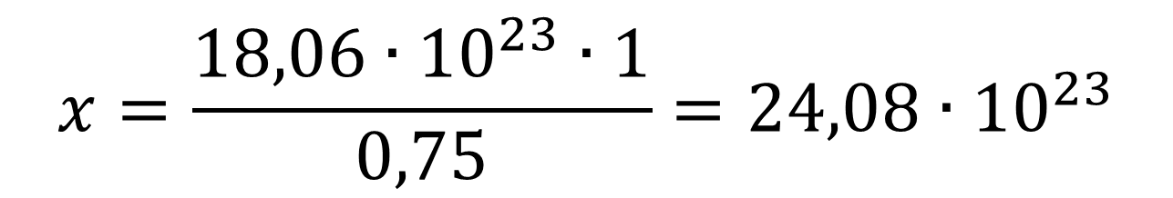
MUSTAHKAMLASH
0,75 mol alkan tarkibida 18,06·${10}^{23}$ ta vodorod atomi bo‘lsa, ushbu alkanning nomini toping.
$$0,75 mol\underset{→}{ }18,06∙{10}^{23}$$
$$1 mol\underset{→}{ }x$$
$$C_{n}H_{2n+2}$$
n=1
$$x=\frac{18,06∙{10}^{23}∙1}{0,75}=24,08∙{10}^{23}$$
$$CH_{4}$$
$$n=\frac{24,08∙{10}^{23}}{6,02∙{10}^{23}}=4 (H)$$
Javob: Metan

Slide 3
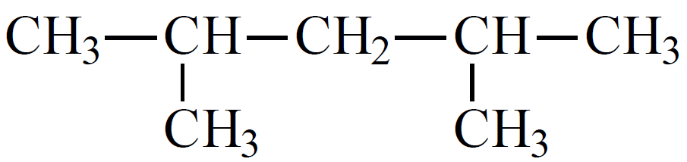
MUSTAHKAMLASH
Ushbu moddalarni sistematik nomenklatura bo‘yicha nomlang.
1
2
3
4
5
Javob: 2,4 dimetilpentan

Slide 4
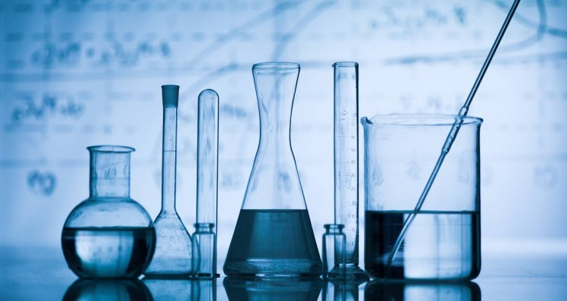
Bugungi darsda
Alkanlarning umumiy formulasiga oid masalalar yechish.
Alkanlarning nomenklaturasiga oid masalalar yechish.
Alkanlarning galogenli hosilalariga oid masalalar yechish.

Slide 5

Masala
Normal sharoitda hajmi 6,72 litr bo‘lgan gazsimon, to‘yingan uglevodorodni og‘irligi 13,2 gramm bo‘lsa alkanning formulasini toping.

Slide 6
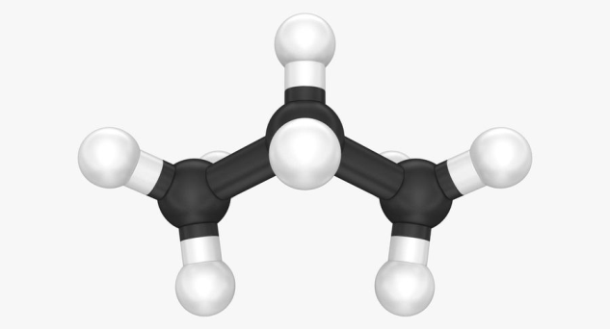
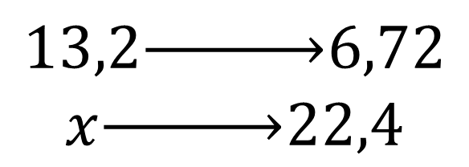
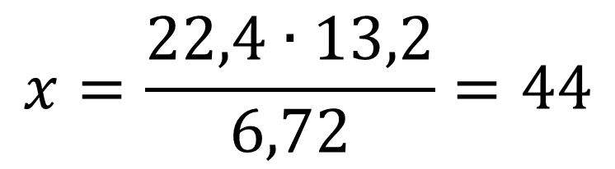
Masalaning yechimi:
Yechish:
Alkan
$$13,2\underset{→}{ }6,72$$
$$x\underset{→}{ }22,4$$
$$x=\frac{22,4∙13,2}{6,72}=44$$
Alkanning molekulyar massasi 44 g/molga teng. Alkanlarning umumiy formulasidan foydalanib:
14n+2=44
14n=42
n=3
CnH2n+2
CnH2n+2
Javob: C3H8, propan

Slide 7
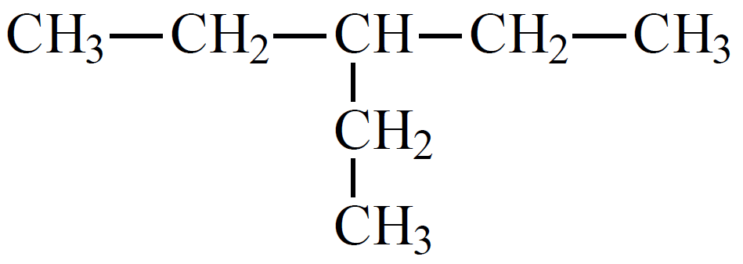
Masala
Ushbu moddalarni sistematik nomenklatura bo‘yicha nomlang.
1
2
3
4
5
Javob: 3 etilpentan

Slide 8
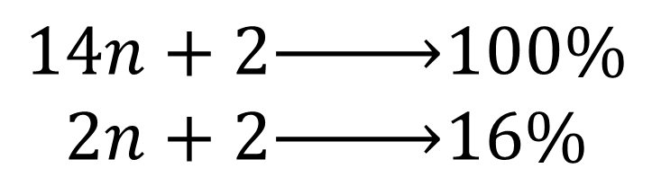
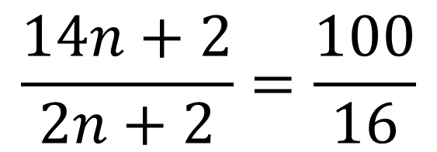
Masala
Vodorodning massa ulushi 16 % ga teng bo‘lgan alkanning formulasini aniqlang.
Yechish:
Alkanlarning umumiy formulasidan foydalanamiz:
CnH2n+2
$$14n+2\underset{→}{ }100\%$$
$$2n+2\underset{→}{ }16\%$$
$$\frac{14n+2}{2n+2}=\frac{100}{16}$$
yoki

Slide 9
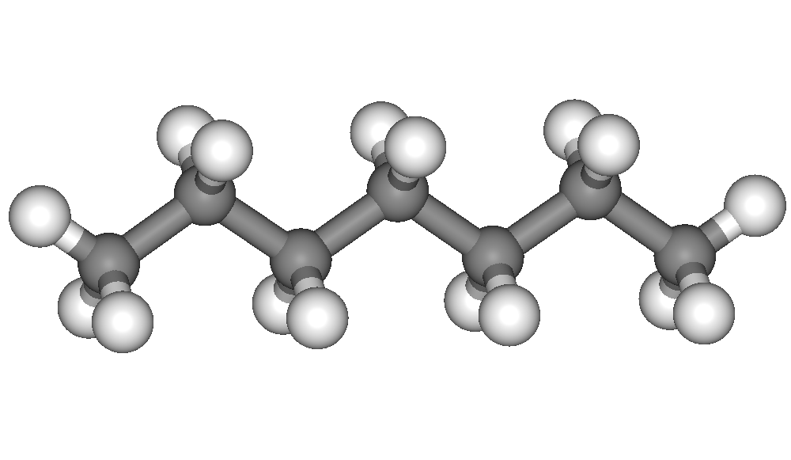
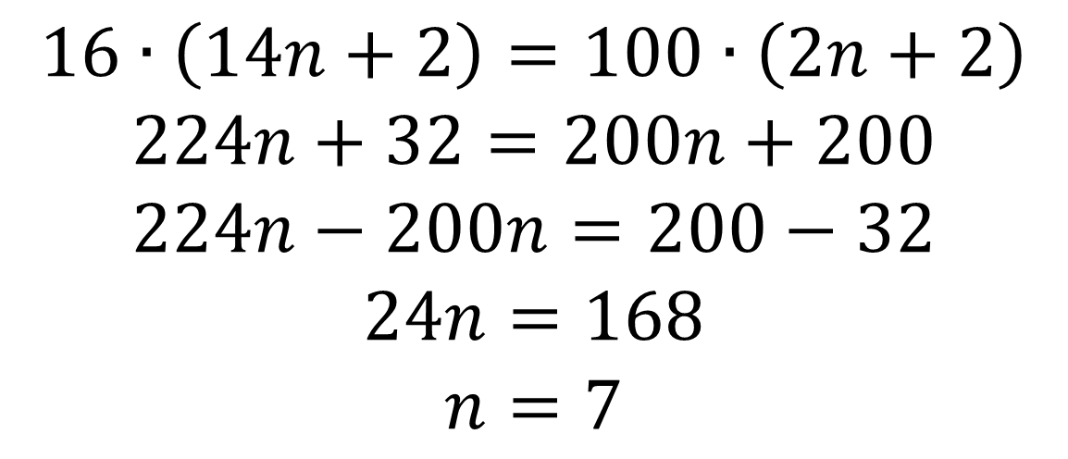
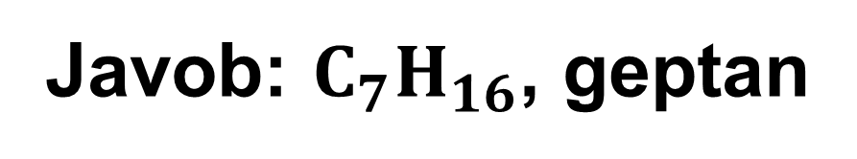
Masalaning yechimi:
$$16∙\left(14n+2\right)=100∙\left(2n+2\right)$$
$$224n+32=200n+200$$
$$224n−200n=200−32$$
$$24n=168$$
$$n=7$$
Javob: $C_{7}H_{16}$, geptan

Slide 10
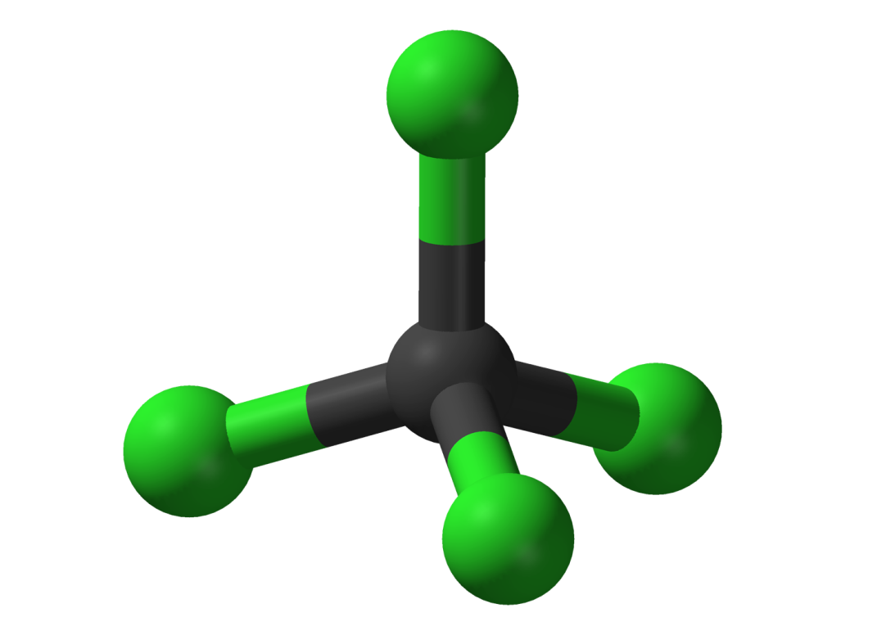
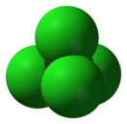
Masala:
Alkan xlorli hosilasi bo‘g‘ini argonga nisbatan zichligi 4,55 ga teng tarkibida massa jihatdan 78% xlor bor. Shu moddani aniqlang.

Slide 11
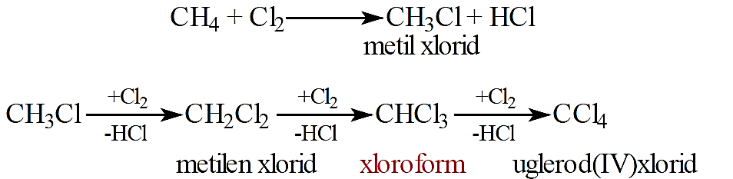
Masalaning yechimi:
Xlor alkanlar bilan yorug‘lik ta’sirida reaksiyaga kirishib, vodorod bilan o‘rin almashadi.

Slide 12
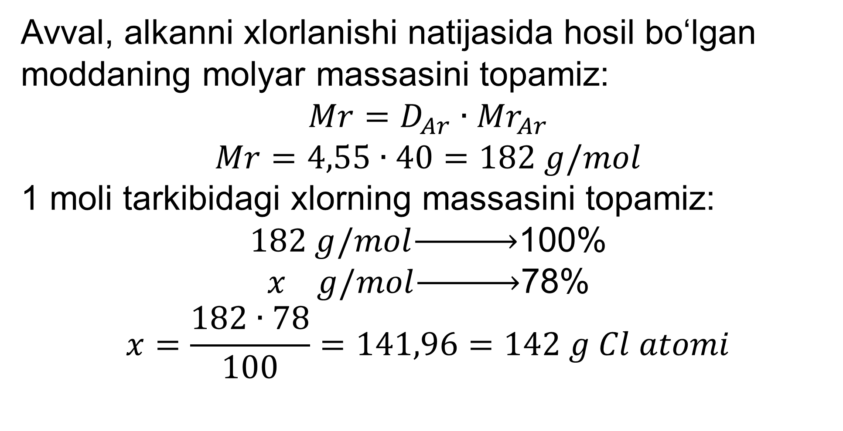
Masalaning yechimi:
Avval, alkanni xlorlanishi natijasida hosil bo‘lgan moddaning molyar massasini topamiz:
$$Mr=D_{Ar}∙{Mr}_{Ar}$$
$$Mr=4,55∙40=182 g/mol$$
1 moli tarkibidagi xlorning massasini topamiz:
$182 g/mol\underset{→}{ }$100%
$x g/mol\underset{→}{ }$78%
$$x=\frac{182∙78}{100}=141,96=142 g Cl atomi$$

Slide 13
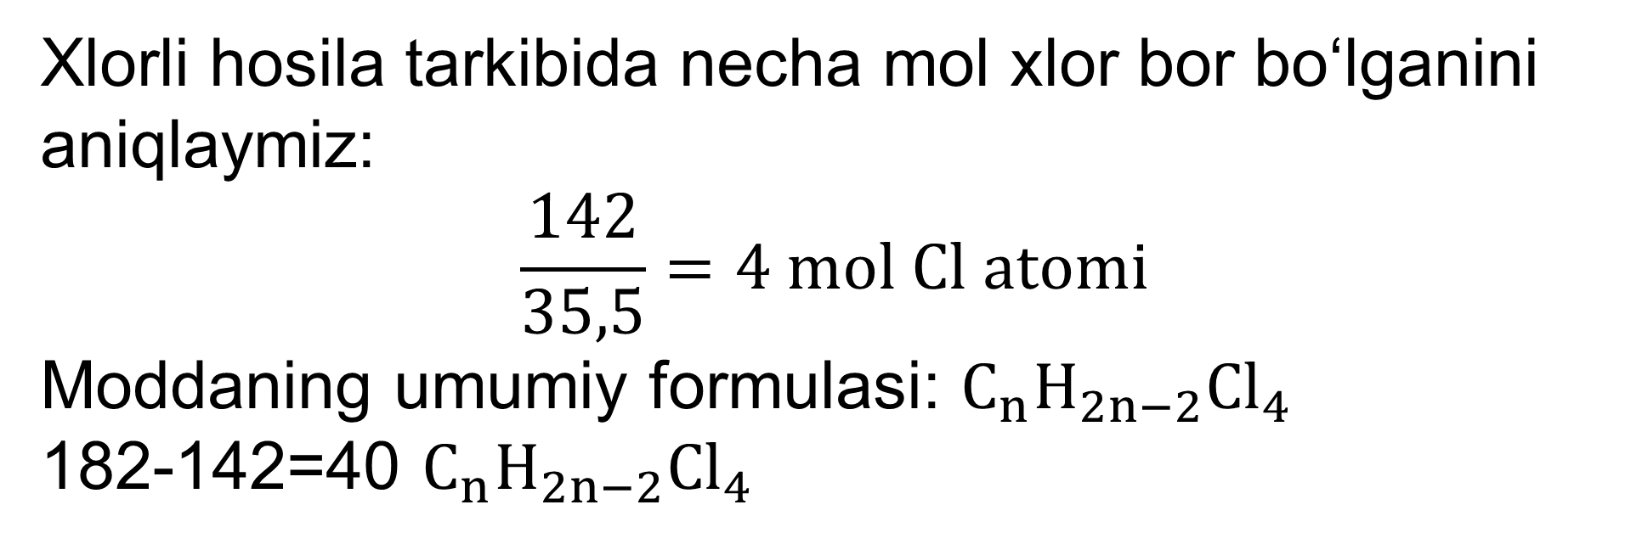
Masalaning yechimi:
Xlorli hosila tarkibida necha mol xlor bor bo‘lganini aniqlaymiz:
$$\frac{142}{35,5}=4 mol Cl atomi$$
Moddaning umumiy formulasi: $C_{n}H_{2n−2}{Cl}_{4}$
182-142=40 $C_{n}H_{2n−2}{Cl}_{4}$

Slide 14
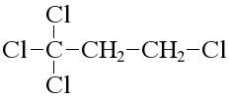
Masalaning yechimi:
Ushbu massadan foydalanib n-ning qiymatini topamiz (n-uglerod soni)
12n+2n-2=40
14n=42
n=3
Dastlabki alkan propan-C3H8 bo‘lgan. Propanni xlorlash natijasida esa tetraxlorpropan –C3H4Cl4 hosil bo‘lgan.
Javob: tetraxlorpropan –C3H4Cl4

Slide 15
Mustaqil bajarish uchun topshiriq
1. Normal sharoitda hajmi 8.96 litr bo‘lgan gazsimon, to‘yingan uglevodorodni og‘irligi 6,4 gramm bo‘lsa alkanning formulasini toping.
2. Vodorodning massa ulushi 20 % ga teng bo‘lgan alkanning formulasini aniqlang.
3. Alkan xlorli hosilasi bo‘g‘ini azotga nisbatan zichligi 5,5 ga teng tarkibida massa jihatdan 92,2 % xlor bor. Shu moddani aniqlang.

