Slide 1
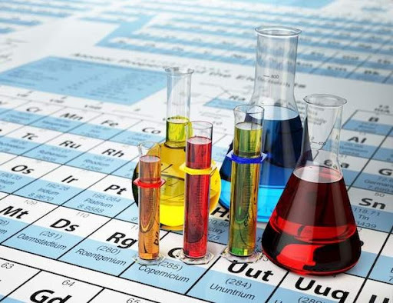
Kimyo
10-sinf
Mavzuga doir masala va mashqlar yechish.
Toshkent shahar
Yunusobod tumani
288-maktabning kimyo
fani o‘qituvchisi
Turdiyeva Dilfuza Qodirovna

Slide 2
MUSTAHKAMLASH:
36 g alyuminiy karbid gidrolizlanganda hosil bo‘ladigan gaz hajmini (n.sh.) toping.
36
x
Al₄C₃ + 12H₂O→4Al(OH)₃ + 3CH₄
144
67,2
$$36\underset{→}{ }x$$
$$144\underset{→}{ }67,2$$
$$x=\frac{36∙67,2}{144}=16,8 l$$
$$Javob:16,8 litr$$

Slide 3
Bugungi darsda
Alkanlarning xossalariga oid masalalar yechish.
Alkanlar va anorganik birikmalar aralashmasiga oid masalalar yechish.
Alkanlarning o‘zaro aralashmasiga oid masalalar yechish.

Slide 4
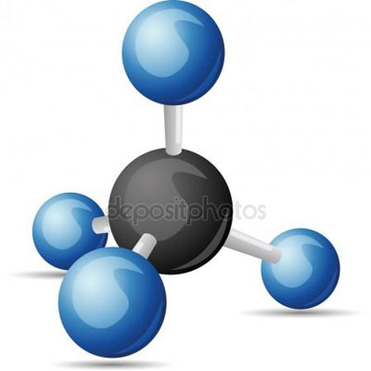
Masala
Massa tarkibi 25 % metan va 75 % noma’lum gazdan iborat aralashmaning geliyga nisbatan zichligi 64 ga teng. Noma’lum gazning molekulyar massasini aniqlang.

Slide 5
Masalaning yechimi:
Gazlar aralashmasinig o‘rtacha molekulyar massasini topamiz:
$$M_{aralashma}=D∙M_{(He)}$$
$$=6,4∙4=25,6 g/mol$$
$$m=\frac{M_{aralashma}∙\%_{(massa ulush)}}{100\%}$$
$$m_{(metan)}=\frac{25,6∙25}{100\%}=6,4 gr$$
$$m_{(noma^{′}lum gaz)}=\frac{25,6∙75}{100\%}=19,2 gr$$

Slide 6
Masalaning yechimi:
Metanning miqdorini topamiz:
$$n=\frac{m_{(massa)}}{M_{(molekulyar massa)}}$$
$$n=\frac{6,4 gr}{16 gr}=0,4 mol$$
$$n_{(noma^{′}lum gaz)}=n_{(umumiy mol)}−n_{(metan)}$$
$$n=1−0,4=0,6 noma^{′}lum gaz$$

Slide 7
Masalaning yechimi:
Noma’lum gaz massasi va molidan foydalanib, molyar massasini topamiz:
$$M_{(molekulyar massa)}=\frac{m_{(massa)}}{n_{(mol)}}$$
$$M=\frac{19,2}{0,6}=32 g/mol$$
Javob: 32 g/mol massali gaz yoki O2

Slide 8
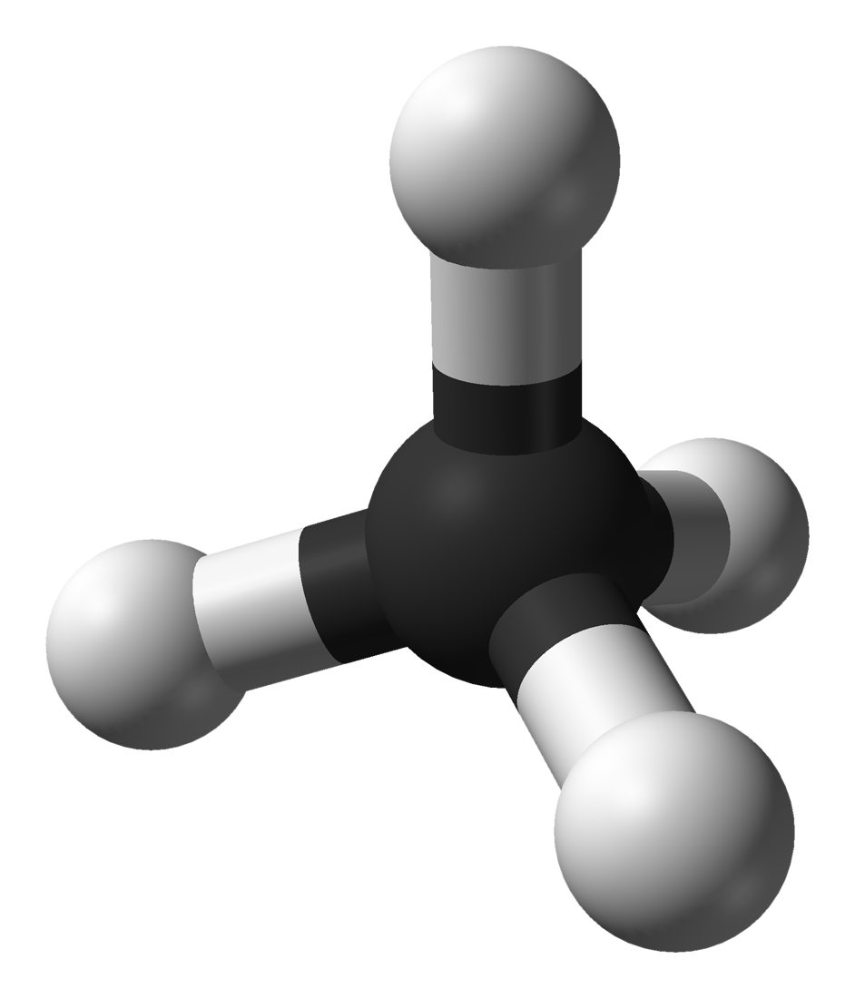
Masala
44,8 litr metan va 134,4 litr (n.sh) karbonat angidriddan iborat aralashmaning o‘rtacha molyar massasini aniqlang.

Slide 9
Masalaning yechimi:
Dastlab, aralashmadagi gazlarning hajmlaridan foydalanib, ularning modda miqdorini topamiz:
$$n=\frac{V}{V_{m}}$$
$$n=\frac{44,8 l}{22,4 l}=2 mol {CH}_{4}$$
$$n=\frac{134,4 l}{22,4 l}=6 mol {CO}_{2}$$

Slide 10
Masalaning yechimi:
Formula asosida ushbu aralashmaning o‘rtacha molyar massasini aniqlaymiz:
$$\overline{M}=\frac{n_{1}∙M_{1}+n_{2}∙M_{2}}{n_{1}+n_{2}}=\frac{2∙16+6∙44}{2+6}=\frac{296}{8}=37 g/mol$$
Javob: 37 g/mol

Slide 11
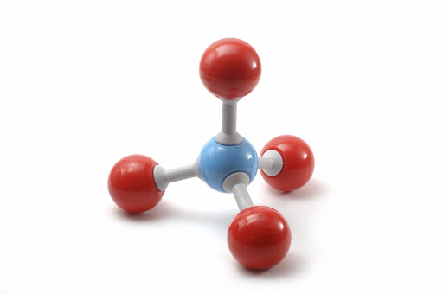
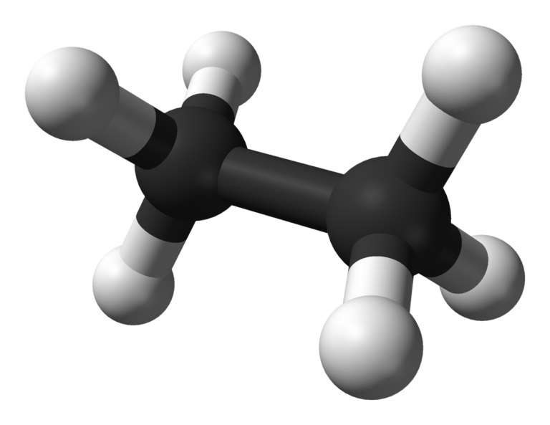
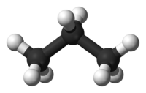
Masala
Massa nisbatlari 1:3:11 bo‘lgan metan, etan va propandan iborat 240 gramm gazlar aralashmasining hajmini (n.sh.da) va etanning hajmiy ulushini (%) hisoblang.

Slide 12
Masalaning yechimi:
Bizda 3 xil gazdan iborat arlashma bor. Ularning massa nisbatlarini gramm deb qabul qilishimiz mumkin:
$$1 g {CH}_{4}\underset{→}{ }3 gC_{2}H_{6}\underset{→}{ }11 g C_{3}H_{8}\underset{→}{ }$$
15 gramm
aralashma

Slide 13
Masalaning yechimi:
240 gramm aralashmadagi moddalarning massalarini aniqlaymiz:
$$1 g {CH}_{4}\underset{→}{ }3 gC_{2}H_{6}\underset{→}{ }11 g C_{3}H_{8}\underset{→}{ }$$
15 gramm
aralashma
$${CH}_{4}{ x}_{3}=16$$
$${C_{2}H}_{4}{ x}_{2}=48$$
$${C_{3}H}_{8}{ x}_{1}=176$$
240 gramm
aralashma
$$1g({CH}_{4})\underset{→}{ }15$$
$$240\underset{→}{ } x$$

Slide 14
Masalaning yechimi:
Har bir moddaning miqdorini aniqlaymiz:
$$n\left({CH}_{4}\right)=\frac{16 g}{16 g/mol}=1 mol {CH}_{4}$$
$$n\left({C_{2}H}_{6}\right)=\frac{48 g}{30 g/mol}=1,6 mol{{ C}_{2}H}_{6}$$
$$n\left({C_{3}H}_{8}\right)=\frac{176 g}{44 g/mol}=4 mol{{ C}_{3}H}_{8}$$
6,6 mol
$$V=6,6mol∙22,4 l=147,84 l aralashma$$

Slide 15
Masalaning yechimi:
Aralashmadagi etanning hajmiy ulushini aniqlaymiz:
$$μ=\frac{n_{1}}{n_{2}}∙100\%$$
$$μ \left(C_{2}H_{6}\right)=\frac{1,6}{6,6}∙100\%=24,24 \%$$
Javob: 147,84, 24,24 %

Slide 16
Mustaqil bajarish uchun topshiriqlar:
1. 67,2 litr etan va 44,8 litr (n.sh) uglerod (II) oksiddan iborat aralashmaning o‘rtacha molyar massasini aniqlang.
2. Massa nisbatlari 1:1,875:2,75 bo‘lgan metan, etan va propandan iborat 65 gramm gazlar aralashmasidagi metanning hajmini (l n.sh.da )hisoblang.
3. Massa nisbatlari 3,2:9:4,4 bo‘lgan metan, etan va propandan iborat 83 gramm gazlar aralashmasining hajmini va etanning hajmiy ulushini (%) hisoblang.

