Slide 1
KIMYO
10-sinf
Mavzu:
Yuqori molekulyar birikmalar mavzusiga doir masala va mashqlar yechish.

Slide 2
1-masala
Polimerlanish darajasi 240 ga teng bo‘lgan polietilen molekulasining massasini (gr/mol) toping.
A) 6720
B) 28
C) 240
D) 1,12* 10 ⁻²⁰

Slide 3
1-masalaning ishlanish usuli
Berilgan;
n = 240
m(monomer)= Mr(C₂H₄) = 28 gr/moli
M (polimer) = ?
Yechish:
M(polimer) = m (monomer)*n =240 x 28 = 6720
Javob: polimerlanish darajasi 240 bo‘lgan polietilennning massasi 6720 gr/mol ga teng.
A) 6720

Slide 4
2-masala
O‘rtacha molekulyar massasi 43400 gr/mol, polimerlanish darajasi 1550 bo‘lgan polimerning monomerini ko‘rsating.
A) akrilonitril
B) tetraftoretilen
C) etilen
D) vinilxlorid

Slide 5
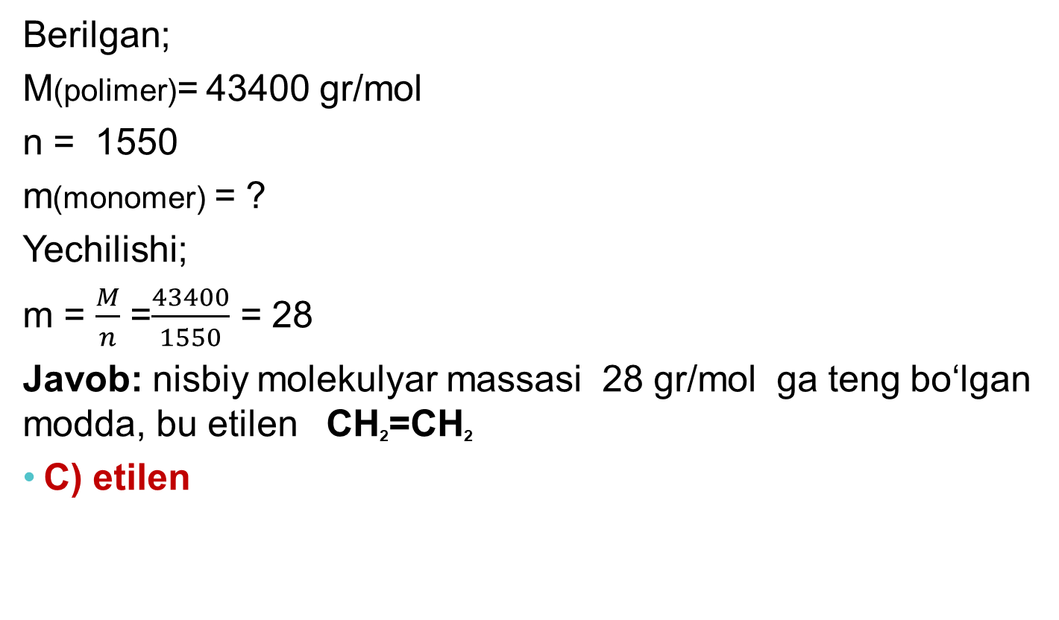
2-masalaning ishlanish usuli
Berilgan;
M(polimer)= 43400 gr/mol
n = 1550
m(monomer) = ?
Yechilishi;
m = $\frac{M}{n}$ =$\frac{43400}{1550}$ = 28
Javob: nisbiy molekulyar massasi 28 gr/mol ga teng bo‘lgan modda, bu etilen CH₂=CH₂
C) etilen

Slide 6
3-masala
Formulasi (-CH₂CH=CHCH₂CH₂CH₂-)n bo‘lgan yuqori molekulyar birikma zvenosi qaysi, monomerlarning qo‘sh polimerlanishi natijasida hosil bo‘ladi?
1) izopren 2) xloropren 3) butadiyen -1,3 4) etilen 5)propen
A) 3,4
B) 1,4
C) 2,5
D) 1,5

Slide 7
3-masalaning ishlanish usuli
Polimerlanish reaksiyasi.
CH₂ = CH – CH = CH₂ + CH₂ = CH₂ = (- CH₂CH=CHCH₂CH₂CH₂-)n
butadiyen – 1,3 etilen
1) izopren 2) xloropren 3) butadiyen -1,3 4) etilen 5)propen
A) 3,4

Slide 8
4-masala
Polivinilxloridning struktur zvenosini ko‘rsating.
A) vinilatsetilen
B) -ClCH₂CH₂Cl-
C) CH₂ = CHCl-
D) -CH₂ - CHCl-

Slide 9
4-masalaning ishlanish usuli
Polivinilxloridning struktur zvenosini ko‘rsating.
A) vinilatsetilen
B) - ClCH₂CH₂Cl-
C) CH₂ = CHCl-
D) - CH₂ - CHCl-
CH₂ = CHCl + CH₂ = CHCl + … = (-CH₂ - CHCl-) _{n}
vinilxlorid polivinilxlorid

Slide 10
5-masala
Polivinilxloridning o‘rtacha molekulyar massasi
10000 gr/mol ga teng bo‘lsa, uning polimerlanish darajasi qanchaga teng bo‘ladi?
A) 1,6
B) 16,6
C) 16
D) 160

Slide 11
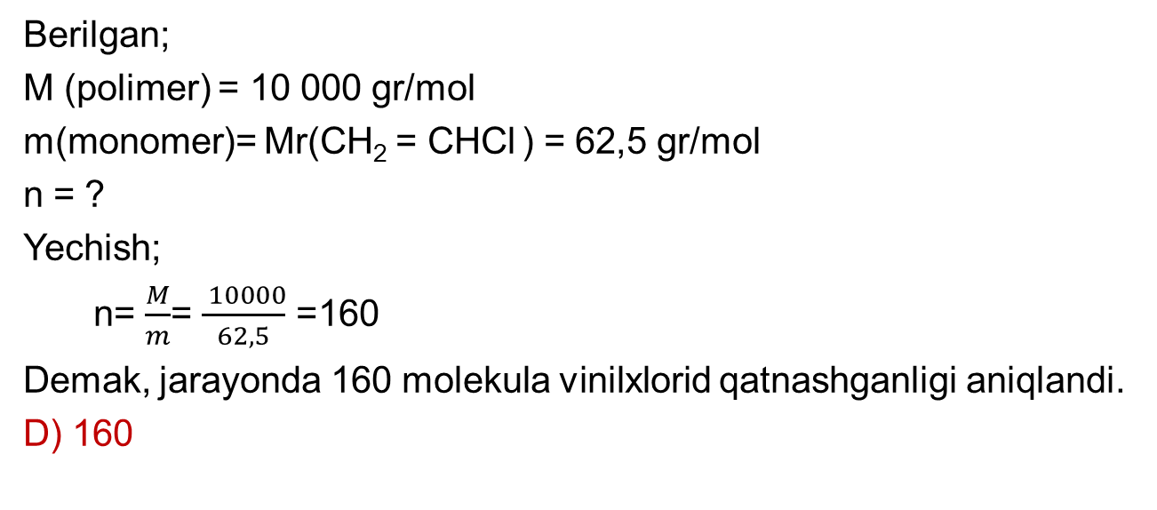
5-masalaning ishlanish usuli
Berilgan;
M (polimer) = 10 000 gr/mol
m(monomer)= Mr(CH₂ = CHCl ) = 62,5 gr/mol
n = ?
Yechish;
n= $\frac{M}{m}$= $\frac{ 10000}{62,5}$ =160
Demak, jarayonda 160 molekula vinilxlorid qatnashganligi aniqlandi.
D) 160

Slide 12
Savol
Polistirolning struktur zvenosini ko‘rsating.
A) vinilxlorid
B) vinilatsetilen
C) vinilbenzol
D) vinilatsetat

Slide 13
Mustaqil bajarish uchun topshiriq
Darslikning 152- sahifasidagi
5,6,7,8,9,10 - masalalarni ishlash.

