Slide 1

Kimyo
10-sinf
Mavzuga doir masala va mashqlar yechish

Slide 2

Mustahkamlash
Keltirilgan tartibdagi o‘zgarishlarni amalga oshirish mumkin bo‘lgan reaksiyalarni yozing:
CH₄ CH₃-Cl CH₃-CH₃ CH₃-CH₂-Cl CH₃-CH₂-OH CH₂=CH₂

Slide 3

Mustahkamlash
CH₄+HCl CH₃Cl+H₂
CH₃Cl+CH₃Cl+2Na CH₃-CH₃+2NaCl
CH₃-CH₃+HCl CH₃-CH₂Cl+H₂
CH₃-CH₂Cl+KOH CH₃-CH₂-OH+KCl
CH₃-CH₂-OH CH₂=CH₂+H₂O
t>140⁰C

Slide 4
Bugun darsda
Spirtlarning formulasini topishga doir maslalar yechish.
Spirtlarning molekulyar massasini topishga doir masalalar yechish.

Slide 5
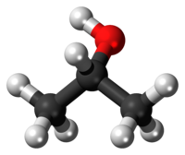
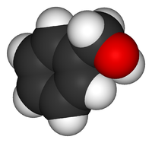
Masalalar yechish
18,5 g bir atomli spirtning ichki molekulyar degidratlanishidan 4,5 g suv hosil bo‘ldi. Spirtning molekulyar formulasini aniqlang.

Slide 6
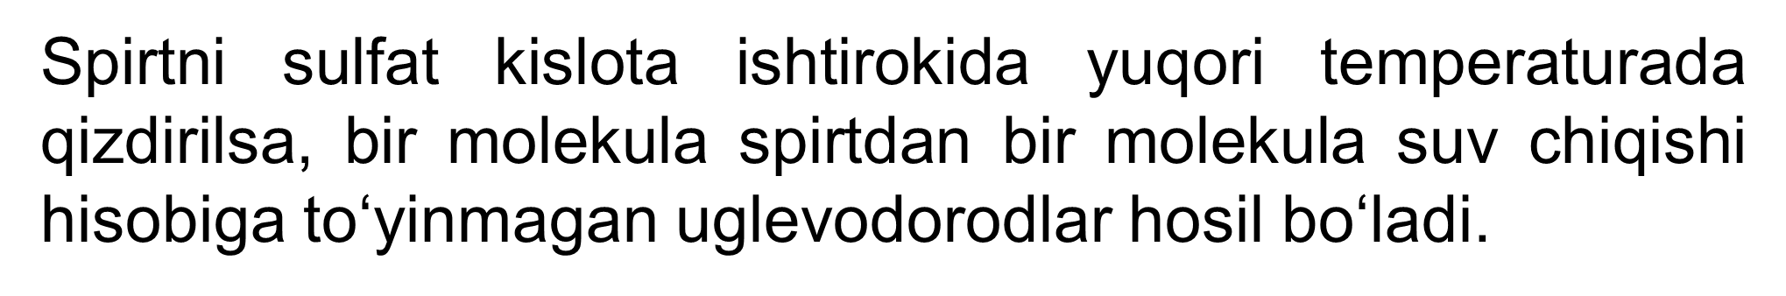
Masalalar yechish
t > 140 ⁰C, H₂SO₄ (kons)
C_{n}H_{2n+1}OH
C_{n}H_{2n}+H₂O
alken
spirt

Slide 7
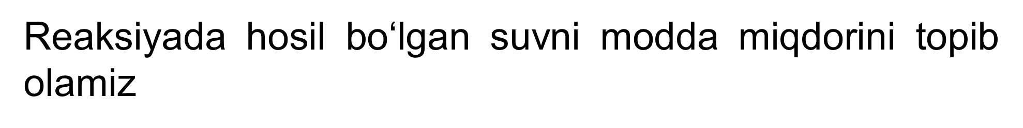
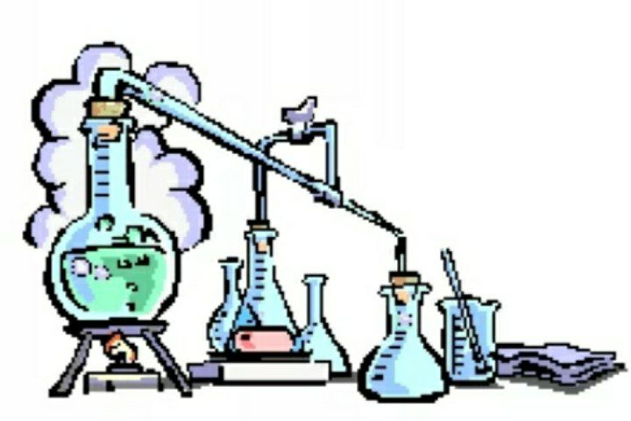
Masalalar yechish
4,5
n=
=0,25 mol
18
Reaksiyadan ko‘rinib turibdiki 1 mol spirtdan 1 mol suv hosil bo‘lar ekan, demak reaksiyada 0,25 mol suv hosil bo‘lishi uchun 0,25 mol spirt degidratlangan bo‘lishi kerak.

Slide 8
Masalalar yechish
x 0,25
1 mol 1 mol x=0,25 mol
C_{n}H_{2n+1}OH C_{n}H_{2n}+H₂O
Spirtning modda miqdori va massasi ma’lum, shu asosida uning molyar massasini topamiz:
m
18,5
M=
=
=74 g/mol
n
0,25

Slide 9
Masalalar yechish
Spirtlarning umumiy formulasiga asosan spirt tarkibida uglerodlar sonini aniqlaymiz:
C_{n}H_{2n+1} OH
14n
18
74-18
n=4
14n
Javob: Bu butil spirti C₄H₉OH

Slide 10
Masalalar yechish
12 g bir atomli spirtning ichki molekulyar degidratlanishidan 3,6 g suv hosil bo‘ldi. Spirtning molekulyar formulasini aniqlang
t<140⁰C
C_{n}H_{2n+2}O C_{n}H_{2n}+H₂O
3,6 g
n=
=0,2 mol H₂O
18

Slide 11
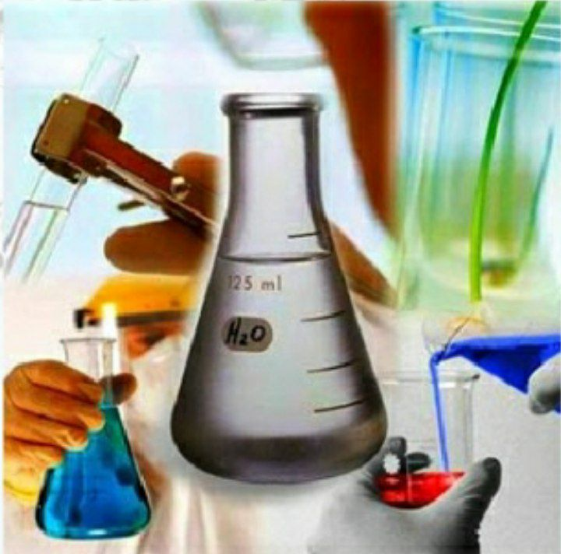
Masalalar yechish
Masala shartidan ma’lumki 0,2 mol suv 12 g spirtidan hosil bo‘lgan. Spirtni formulasini topish uchun reaksiya tenglamasiga ko‘ra 1 mol suv necha gr spirtdan hosil bo‘ldi, deb ishlaymiz.
0,2 mol H₂O 12g C_{n}H_{2n+2}O
1 mol H₂O x
x= 60 g/mol

Slide 12
Masalalar yechish
Spirtlarning umumiy formulasidan uglerod atomi sonini topamiz:
Mr(C_{n}H_{2n+2}O)= 14n+18
14n+18=60
14n=42
n=3
Javob: C₃H₇OH propil spirti

Slide 13
Masalalar yechish
34,5 g bir atomli spirtning ichki molekulyar degidratlanishidan 13,5 g suv hosil bo‘ldi. Spirtning molyar massasini (g/mol) aniqlang.
C_{n}H_{2n+2}O C_{n}H_{2n}+H₂O
13,5 gr
n=
=0,75 mol H₂O
18

Slide 14
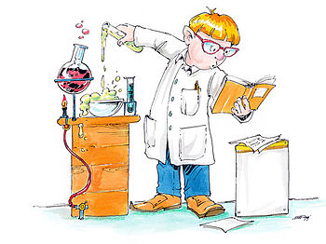
Masalalar yechish
Masalada suvni 1 moli hosil bo‘lishi uchun qancha spirt sarflandi desak, uning molekulyar massasini topa olamiz.
0,75 mol H₂O 34,5 g C_{n}H_{2n+2}O
1 mol H₂O x
x= 46 g/mol

Slide 15
Masalalar yechish
Spirtlarning umumiy formulasidan molekulyar massasini topib olamiz:
Mr(C_{n}H_{2n+2}O)= 14n+18
46=14n+8
28=14n
n=2
Javob: C₂H₅OH etil spirti

Slide 16
Masalalar yechish
4. 2-brom butanga KOH ning suvli eritmasi ta’siridan hosil bo‘lgan spirt massasi 44,4 g bo‘lsa, sarflangan 2-brom butan massasini toping.
Br OH
CH₃-CH-CH₂-CH₃+KOH_{suv} CH₃-CH-CH₂-CH₃+KBr
Mr(C₄H₉OH)=74 g/mol
44,4 g
n=
=0,6 mol
74 g/mol

Slide 17
Masalalar yechish
Reaksiyaga ko‘ra 1 mol butanol-2 hosil bo‘lishi uchun 1 mol 2-brom butan sarflangan. Shunga ko‘ra
2-brom butanning massasini topib olamiz:
1 mol C₄H₉OH 1 mol C₄H₉Br
0,6 mol x x= 0,6 mol
m= Mr*n=137g/mol*0,6 mol=82,2 gr
Javob: 82,2 gr 2-brom butan

Slide 18
Masalalar yechish
5. 30g spirtdan natriy normal sharoitda 5,6 l vodorodni siqib chiqarishi mumkin. Agar shu spirt bir atomli bo‘lsa, uning molyar massasini toping.
2C_{n}H_{2n+1}OH+2Na 2C_{n}H_{2n+1}ONa+H₂
5,6 l
n=
=0,25 mol
22,4 l

Slide 19
Masalalar yechish
Masala shartiga ko‘ra 30 g spirtdan 0,25 mol H₂ ajralib chiqar ekan. Spirtning Mr ni topish uchun 1 mol H₂ necha gramm spirtdan ajralib chiqqan deb hisoblaymiz.
30 g 0,25 mol
x 1 mol x= 120 g bu 2 moldagi spirt massasi
2 mol 120g
1 mol x x=60 gr/mol

Slide 20

Mustaqil bajarish uchun topshiriqlar
Dimetil efir va etanolning struktur tuzilishini yozing, bu moddalarning bir-biriga bo‘lgan munosabatini ko‘rsating:
gomolog 3) struktur izomer
polimer 4) sinflararo izomer

