Slide 1
Geometriya
10
sinf
Mavzu:
Amaliy mashq va tatbiqlar
Komilov Mirodil Xosiljonovich X.T.V. tasarrufidagi AFIDUM matematika fani o‘qituvchisi.

Slide 2
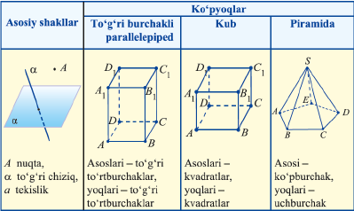
Tayanch nazariy ma’lumotlar
$$a$$
$$a$$
$$α$$

Slide 3
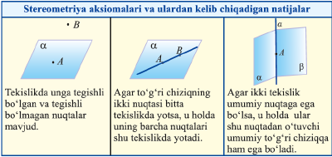
Tayanch nazariy ma’lumotlar

Slide 4
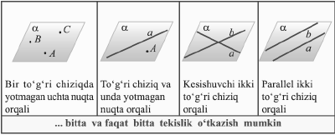
Tayanch nazariy ma’lumotlar

Slide 5
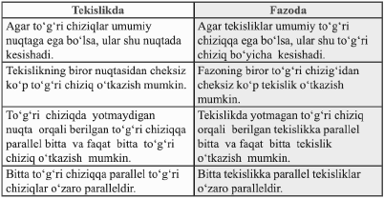
Tayanch nazariy ma’lumotlar

Slide 6
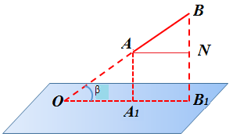
Masalalar yechish
$α$ tekislik va uni kesib o‘tmaydigan $AB=13 cm$ kesma berilgan. Agar kesmaning uchlaridan α tekislikkacha bo‘lgan masofalar $AA_{1}=5 cm, BB_{1}=8 cm$ bo‘lsa, $AB$ kesma yotuvchi to‘g‘ri chiziqning $α$ tekislik bilan tashkil qilgan burchak sinusini aniqlang?
$$AB=13 cm,$$
$AA_{1}=5 cm, BB_{1}=8 cm$
$\sin{β}=?$

Slide 7
Masalalar yechish
$AB=13 cm, AA_{1}=5 cm, BB_{1}=8 cm$, $\sin{β}=?$
$$sinβ=\frac{BN}{AB}=\frac{BB_{1}−AA_{1}}{AB}$$
$$sinβ=\frac{8−5}{13}=\frac{3}{13}$$

Slide 8
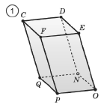
Masalalar yechish
3.3. Rasmda $NOPQDEFC$ parallelepiped tasvirlangan.
$a)$ $CD$ to‘g‘ri chiziq bilan kesishuvchi
to‘g‘ri chiziqlarni belgilang;
$c)$ $CD$ to‘g‘ri chiziqqa parellel to‘g‘ri chiziqlarni belgilang;
$e)$ $CD$ to‘g‘ri chiziq bilan ayqash to‘g‘ri chiziqlarni belgilang;

Slide 9
Masalalar yechish
$a)$ $CD$ to‘g‘ri chiziq bilan kesishuvchi
$$CQ; CF; DE; DN.$$
$c)$ $CD$ to‘g‘ri chiziqqa parellel
$$QN; FE; PO.$$
$e)$ $CD$ to‘g‘ri chiziq bilan ayqash
$$QP; NO; FP; EO.$$

Slide 10
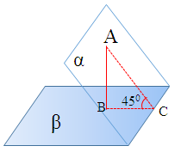
Masalalar yechish
$α$ va β tekisliklar 45⁰ burchak ostida kesishadi.
$α$ tekislikdagi A nuqtadan β tekislikkacha bo‘lgan masofa 2 ga teng. A nuqtadan tekisliklarning kesishish chizig‘igacha bo‘lgan masofani toping.
$$AB=2, γ=45°, AC=?$$
$$sinγ=\frac{AB}{AC}$$
$$AC=\frac{AB}{sin{45}^{0}}=\frac{2}{\frac{\sqrt{2}}{2}}=2\sqrt{2}$$

Slide 11
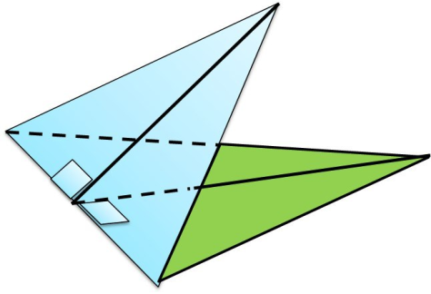
Masalalar yechish
Ikkita teng yonli uchburchak umumiy asosga ega bo‘lib, ularning tekisliklari $60°$ li burchak tashkil qiladi. Umumiy asosning uzunligi $12 cm$, bitta uchburchak- ning yon tomoni $10 cm$, ikkinchi uchburchakning yon tomonlari o‘zaro perpendikulyar. Uchburchaklar uchlari orasidagi masofani toping.
$$C$$
$$AB=12 cm,$$
$AC=BC=10 cm, ∠D=90°, CD=?$
$$A$$
$$α$$
$$∟$$
$$D$$
$$K$$
$$B$$

Slide 12
Masalalar yechish
$AB=12 cm, AC=BC=10 cm, ∠D=90°, CD=?$
$$C$$
$CK=\sqrt{{AC}^{2}−{AK}^{2}}=\sqrt{100−36}=8$
$DK=KB=\frac{AB}{2}=6$
$$A$$
$$α$$
$$∟$$
$$D$$
$$K$$
$$B$$
$$CD=\sqrt{{CK}^{2}+{DK}^{2}−2∙CK∙DK∙\cos{α}}$$
$CD=\sqrt{64+36−2∙8∙6∙\frac{1}{2}}=\sqrt{52}=2\sqrt{13}$

Slide 13
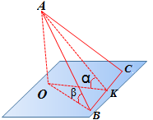
Masalalar yechish
Muntazam ABC uchburchakning BC tomoni orqali tekislik o‘tkazilgan. Uchburchakning AK medianasi tekislik bilan 60° li burchak tashkil etadi. AB to‘g‘ri chiziq bilan tekislik orasidagi burchakning sinusini toping.
$$α=60\text{°} \text{sin}β=?$$
$$AO=H AB=a AK=\frac{a\sqrt{3}}{2}$$
$sinα=\frac{H}{AK}=>H=sin60°AK=$
$=\frac{\sqrt{3}}{2}∙\frac{a\sqrt{3}}{2}=\frac{3a}{4}$
$$sinβ=\frac{H}{a}=\frac{\frac{3a}{4}}{a}=\frac{3}{4}$$

Slide 14
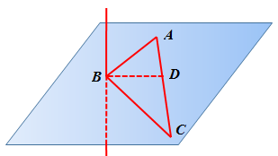
Masalalar yechish
$ABC$ uchburchakning to‘g‘ri burchakli $B$ uchidan uchburchak tekisligiga perpendikulyar to‘g‘ri chiziq $b$ o‘tkazilgan. $AB=3, BC=4$. $b$ va $AC$ to‘g‘ri chiziqlar orasidagi masofani toping.
$$AB=3, BC=4, BD=?$$
$$S_{ABC}=\frac{AB∙BC}{2}=\frac{AC∙BD}{2}$$
$$AC=\sqrt{{AB}^{2}+{BC}^{2}}=5$$
$$\frac{3∙4}{2}=\frac{5∙BD}{2}=>BD=2,4$$

Slide 15
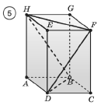
Masalalar yechish
3.18. $ABCDHGFE$ to‘g‘ri burchakli parallelepipedning yon qirrasi 8 cm ga, asosi tomoni 6 cm ga teng kvadratdan iborat. Fazoviy $HFDBH$ siniq chiziq uzunligini toping.
$$l_{HFDBH}=HF+FD+DB+BH$$
$$HF=DB=a\sqrt{2}=6\sqrt{2}$$
$$HB=FD=d=\sqrt{8^{2}+6^{2}}=10$$
$$l_{HFDBH}=6\sqrt{2}+10+6\sqrt{2}+10=20+12\sqrt{2}$$

Slide 16
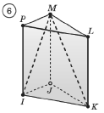
Masalalar yechish
3.19. $IJKPML$ uchburchakli to‘g‘ri prizmaning asosi va yon qirrasi uzunliklari 2:3 nisbatda. Agar fazoviy $IPLKMI$ siniq chiziq uzunligi $16+4\sqrt{13}$ ga teng bo‘lsa prizma yon sirtining yuzini toping.
$$2x$$
$$l_{IPLKMI}=IP+PL+LK+KM+MI$$
$$IP=LK=3x; PL=2x$$
$$3x$$
$$KM=MI=d=\sqrt{{4x}^{2}+{9x}^{2}}=x\sqrt{13}$$
$$3x+2x+3x+x\sqrt{13}+x\sqrt{13}=16+4\sqrt{13}$$

Slide 17
Masalalar yechish
$$3x+2x+3x+x\sqrt{13}+x\sqrt{13}=16+4\sqrt{13}$$
$$x(8+2\sqrt{13}) =16+4\sqrt{13}$$
$$x=\frac{16+4\sqrt{13}}{8+2\sqrt{13}}=2$$
$$2x$$
$$S_{yon}=P∙h=6x∙3x=18x^{2}$$
$$3x$$
$$S_{yon}=18∙2^{2}=72$$

Slide 18
Mustaqil yechish uchun topshiriq
Darslikning
139-betidagi 3.16, 3.20, 3.21-mashqlar.

Slide 19
E’TIBORINGIZ UCHUN RAHMAT!
ARALASHMAGA OID MASALALAR

