Slide 1
Geometriya
10
sinf
Mavzu:
Amaliy mashq va tatbiqlar. (3-dars)
Komilov Mirodil Xosiljonovich X.T.V. tasarrufidagi AFIDUM matematika fani o‘qituvchisi.

Slide 2
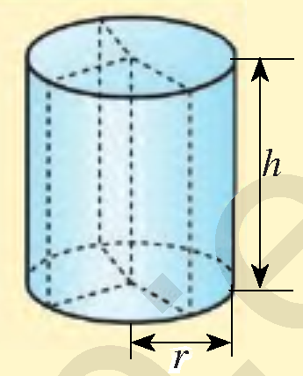
Mustaqil bajarilgan topshiriqni tekshirish
2.18. Silindr asosining yuzi $300π$ ${cm}^{2}$, yasovchisi 6 cm bo‘lsa, silindr yon sirti yuzini toping.
$$S_{asos}=300π {cm}^{2}, h=6 cm$$
$$S_{yon}=?$$
$$S_{yon}=2πrH$$
$$S_{asos}=πr^{2}=>r^{2}π=300π$$
$$H$$
$$r=\sqrt{300}=10\sqrt{3}$$
$$S_{yon}=2πrH=2∙π∙10\sqrt{3}∙6$$
$$S_{yon}=120\sqrt{3}π$$

Slide 3
Mustaqil bajarilgan topshiriqni tekshirish
2.20. Silindr asosining diametri 1 m, yasovchisi esa
asos aylana uzunligiga teng. Silindr yon sirtining
yuzini toping.
$$d=1 m, l=C_{asos}, S_{yon}=?$$
$$r=\frac{d}{2}=\frac{1}{2}=0,5$$
$$H$$
$$l$$
$$l=2πr=2∙0,5∙π=π=H$$
$$S_{yon}=2πrH=2π∙0,5∙π=π^{2}$$
Javob: $π^{2}$

Slide 4
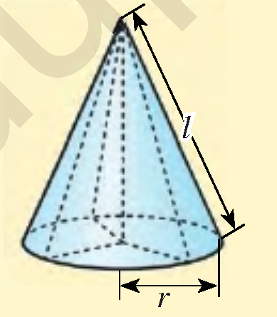
Mustaqil bajarilgan topshiriqni tekshirish
2.25. Konus asosining diametri 32 cm, konus uchini
asos markazi bilan tutashtiruvchi kesma uzunligi
63 cm ga teng. Konus yon sirtini toping.
$$d=32 cm; h=63 cm$$
$$S_{yon}=πrl$$
$$r=\frac{d}{2}=\frac{32}{2}=16 cm$$
$$l=\sqrt{r^{2}+h^{2}}$$
$$l=\sqrt{{16}^{2}+{63}^{2}}=\sqrt{4225}=65$$
$$S_{yon}=πrl=π∙16∙65=1040π {cm}^{2}$$
Javob: $1040π {cm}^{2}$

Slide 5
Mustaqil bajarilgan topshiriqni tekshirish
2.27. Konusning yasovchisi $l$ ga teng bo‘lib, u asos
Radiusi bilan $α$ burchak tashkil qiladi. Agar $l=20 dm$
$α=45°$ bo‘lsa, konusning to‘la sirtini toping.
$$l=20 dm, α=45°, S_{to^{′}la}=?$$
$$α=45°=>h=r$$
$$l^{2}=h^{2}+r^{2} => l^{2}=2r^{2}$$
$$l$$
$$h$$
$$r=\frac{\sqrt{2}l}{2}=\frac{\sqrt{2}∙20}{2}=10\sqrt{2}$$
$$α$$
$$r$$
$$S_{to^{′}la}=πr\left(r+l\right)=π∙10\sqrt{2}∙\left(10\sqrt{2}+20\right)$$
$$S_{to^{′}la}=200\left(\sqrt{2}+1\right)π {dm}^{2}$$

Slide 6
Masalalar yechish
2.30. 7-rasmdagi ma’lumotlardan foydalanib,
ko‘pyoqlarning to‘la sirtini toping.
$$a=8,3 cm$$
$$S=6a^{2}$$
$$S=6∙{\left(8,3\right)}^{2}=413,34 {cm}^{2}$$
$$a=5x mm; b=c=3x mm$$
$$S=2\left(ab+ac+bc\right)$$
$$S=2 ∙\left(5x∙3x+5x∙3x+3x∙3x\right)$$
$$S=78x^{2} {mm}^{2}$$

Slide 7
Masalalar yechish
2.30. 7-rasmdagi ma’lumotlardan foydalanib,
ko‘pyoqlarning to‘la sirtini toping.
$$a=0,67 m;b=0,92 m;c=1,43m$$
$$S=2\left(ab+ac+bc\right)$$
$S=2$ $∙\left(0,67∙0,92+0,67∙1,43+0,92∙1,43\right)$
$$S=5,7802 m^{2}$$

Slide 8
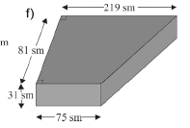
Masalalar yechish
2.30. 7-rasmdagi ma’lumotlardan foydalanib,
ko‘pyoqlarning to‘la sirtini toping.
$$75$$
$$x=219−75=$$
$$=144$$
$$a$$
$$a$$
$$81$$
$$81$$
$$a^{2}={81}^{2}+{144}^{2}$$
$$x$$
$$a=\sqrt{27927}$$
$$219$$
$$S_{T}=\frac{75+219}{2}∙81=11907 {cm}^{2}$$
$$a≈167 cm$$

Slide 9
Masalalar yechish
2.30. 7-rasmdagi ma’lumotlardan foydalanib,
ko‘pyoqlarning to‘la sirtini toping.
$$S_{T}=11907 {cm}^{2}$$
$$a≈167 cm$$
$$a$$
$$S_{1}=31∙75=2325$$
$$S_{2}=31∙81=2511$$
$$S_{3}=31∙219=6789$$
$$S_{4}=31∙167=5177$$
$$S_{To^{′}la}=2∙11907+2325+2511+6789+5177=$$
$$=40616 {cm}^{2}$$

Slide 10
Masalalar yechish
Konusning o‘q kesimi muntazam uchburchakdan iborat . Uchburchakning yuzi $16\sqrt{3}$ ga teng. Konus to‘la sirtini toping.
$$S=16\sqrt{3}, l=2R$$
Teng yonli
uchburchak
$$\frac{l^{2}\sqrt{3}}{4}=16\sqrt{3}$$
$$l$$
$$l$$
$$S_{to^{′}la}=?$$
$$H$$
$$S_{kesim}=RH$$
$$l=8; R=4$$
$$R$$
$$R$$
$$S_{to^{′}la}=πR\left(R+l\right)=π∙4∙\left(4+8\right)=48π$$

Slide 11
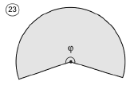
Masalalar yechish
Konus asosining radiusi 12 ga, yasovchisi esa
40 ga teng. Shu konus yoyilmasining uchidagi
burchagini toping.
$$R=12; l=40; φ=?$$
$$C=2πR$$
Radiusi $l$ bo‘lgan aylananing
uzunligi $2πl$ bo‘lib, u $360°$
markaziy burchakka tiralgan.
$$l$$
$$l$$
$$φ − 2πR$$
$$360°−2πl$$
$$φ=\frac{2πR∙360°}{2πl}=\frac{12∙360°}{40}=108°$$

Slide 12
Masalalar yechish
Konusning yasovchisi 15 ga, yon sirti
yoyilmasining uchidagi burchagi $120°$ ga teng.
Konus asosining diametrini toping.
$$l=15; φ=120°; d=?$$
$$C=2πR$$
$$φ=\frac{R∙360°}{l}$$
$$l$$
$$l$$
$$R=\frac{l∙φ}{360°}=\frac{15∙120°}{360°}=\frac{15}{3}=5$$
$$d=2R=2∙5=10$$

Slide 13
Masalalar yechish
O‘tkir burchakli uchburchakni uning biror tomoni
atrofida aylantirishdan hosil bo‘lgan jismning sirti
va hajmini topish formulalari:
$a$ tomon: $S_{a}=πh_{a}\left(b+c\right)$;
$$V=\frac{1}{3}πah_{a}^{2}$$
$$b$$
$$c$$
$$a$$
$b$ tomon: $S_{b}=πh_{b}\left(a+c\right)$;
$$V=\frac{1}{3}πbh_{b}^{2}$$
$c$ tomon: $S_{c}=πh_{c}\left(a+b\right)$;
$$V=\frac{1}{3}πch_{c}^{2}$$

Slide 14
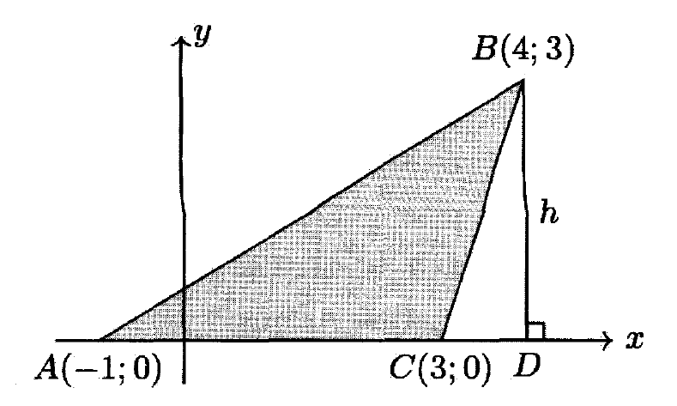
Masalalar yechish
Rasmda uchlari $A, B$ va $C$ nuqtalarda bo‘lgan
Uchburchakni $Ox$ o‘qi atrofida to‘liq aylantirishdan
hosil bo‘lgan jismning hajmini toping.
$$a=4; h_{a}=3; V=?$$
$a$ tomon: $S_{a}=πh_{a}\left(b+c\right)$;
$$V=\frac{1}{3}πah_{a}^{2}$$
$$V=\frac{1}{3}πah_{a}^{2}=\frac{1}{3}π∙4∙9=12π$$

Slide 15
Masalalar yechish
Teng tomonli silindrning va konusning balandligi
o‘zaro teng. Ularning to‘la sirtlari nisbatini toping.
$$S_{S}=2πR\left(R+H\right)$$
$$S_{S}=2π∙\frac{H}{2}∙\left(\frac{H}{2}+H\right)=\frac{3πH^{2}}{2}$$
$$l$$
$$l$$
$$H$$
$$H$$
$$R$$
$$R$$
$$S_{K}=πR\left(R+l\right)$$
$$H=2R$$
$$l=2R$$
$$H=\frac{l\sqrt{3}}{2} =>l=\frac{2H}{\sqrt{3}};R=\frac{H}{\sqrt{3}}$$

Slide 16
Masalalar yechish
$$S_{S}=\frac{3πH^{2}}{2}$$
$$S_{K}=πR\left(R+l\right)$$
$$l$$
$$l$$
$$H=\frac{l\sqrt{3}}{2} =>l=\frac{2H}{\sqrt{3}};R=\frac{H}{\sqrt{3}}$$
$$H$$
$$H$$
$$R$$
$$R$$
$$S_{K}=π∙\frac{H}{\sqrt{3}}∙\left(\frac{H}{\sqrt{3}}+\frac{2H}{\sqrt{3}}\right)=πH^{2}$$
$$H=2R$$
$$l=2R$$
$$\frac{S_{S}}{S_{K}}=\frac{\frac{3πH^{2}}{2}}{πH^{2}}=\frac{3}{2}$$

Slide 17
Masalalar yechish
Misdan ishlangan balandligi 30 cm bo‘lgan
konus eritilib, undan silindr yasaldi. Agar konus va
silindr asoslari teng aylanalardan iborat bo‘lsa,
hosil bo‘lgan silindr balandligini toping.
$$h_{k}=30 cm, h_{s}=?$$
$$r_{k}=r_{s}=r, V_{k}=V_{s}$$
$$V_{k}=\frac{1}{3}πr^{2}h_{k}$$
$$V_{s}=πr^{2}h_{s}$$
$$\frac{1}{3}πr^{2}h_{k}=πr^{2}h_{s} =>h_{s}=\frac{1}{3}h_{k}$$
$$h_{s}$$
$$h_{k}$$
$$r$$
$$h_{s}=\frac{1}{3}h_{k}=\frac{1}{3}∙30=10 cm$$
$$r$$

Slide 18
Masalalar yechish
Kovak shar devorining hajmi $156π$ ga, devorning
qalinligi 3 ga teng. Tashqi sharning radiusini toping.
$$\frac{4}{3}πR^{3}−\frac{4}{3}πr^{3}=156π$$
$$V_{kovak}=V_{R}−V_{r}$$
$$3$$
$$r$$
$$R^{3}−r^{3}=117$$
$$R=r+3$$
$$R$$
$${\left(r+3\right)}^{3}−r^{3}=117$$
$$r^{3}+9r^{2}+27r+27−r^{3}=117$$
$$9r^{2}+27r−90=0$$
$$r_{1}=−5; r_{2}=2$$
$$r=2$$
$$R=r+3=2+3=5$$

Slide 19
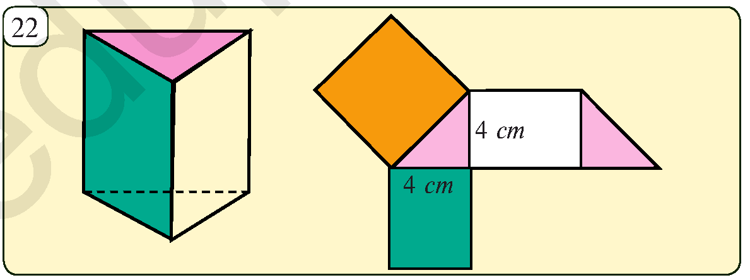
Masalalar yechish
Rasmda prizma va uning yoyilmasi tasvirlangan. Agar
prizma katta yog‘i kvadratdan iborat bo‘lsa, uning to‘la sirtining yuzini toping.
$$a=\sqrt{4^{2}+4^{2}}=4\sqrt{2}$$
$$S_{K}=a^{2}={\left(4\sqrt{2}\right)}^{2}=32$$
$$S_{T.T.}=4a=4∙4\sqrt{2}=$$
$$=16\sqrt{2}$$
$$a$$
$$a$$
$$a$$
$$S_{U}=\frac{4∙4}{2}=8$$
$$a$$
$$S_{To^{′}la}=S_{K}+2S_{T.T.}+2S_{U}$$
$$S_{To^{′}la}=32+32\sqrt{2}+16=48+32\sqrt{2} {cm}^{2}$$

Slide 20
Mustaqil yechish uchun topshiriq
Darslikning
122-betidagi 2.31, 2.32, 2.33-mashqlar.

Slide 21
E’TIBORINGIZ UCHUN RAHMAT!
ARALASHMAGA OID MASALALAR

