Slide 1
Geometriya
10
sinf
Mavzu:
Amaliy mashq va tatbiqlar. (2-dars)
Komilov Mirodil Xosiljonovich X.T.V. tasarrufidagi AFIDUM matematika fani o‘qituvchisi.

Slide 2
Mustaqil bajarilgan topshiriqni tekshirish
2.9. Muntazam $n−$burchakli prizmaning asosining
tomoni $a$, yon qirrasi $h$ ga teng.
Agar $a) n=3, a=5, h=10;$ $b) n=4, a=10, h=30;$
$c) n=6, a=18, h=32;$ $d) n=5, a=16, h=25$ bo‘lsa, prizmaning yon sirti va to‘la sirtini toping.
$$a) n=3, a=5, h=10$$
$$S_{yon}=P_{asos}∙h=3∙5∙10=150$$
$$a$$
$$S_{to^{′}la}=2∙S_{asos}+S_{yon}=2∙\frac{a^{2}\sqrt{3}}{4}+S_{yon}=$$
$=2∙\frac{25\sqrt{3}}{4}+150=150+12,5∙\sqrt{3}$
$$a$$
$$h$$

Slide 3
Mustaqil bajarilgan topshiriqni tekshirish
$$a$$
$$b) n=4, a=10, h=30$$
$$S_{yon}=P_{asos}∙h=4∙10∙30=1200$$
$$S_{to^{′}la}=2∙S_{asos}+S_{yon}=2∙a^{2}+S_{yon}=$$
$=2∙100+150=350$
$$h$$
$$a$$
$$a$$
$$c)n=6, a=18, h=32$$
$$S_{yon}=P_{asos}∙h=6∙18∙32=3456$$
$S_{to^{′}la}=2∙S_{asos}+S_{yon}=2∙\frac{3a^{2}\sqrt{3}}{2}+S_{yon}=$
$=3∙324\sqrt{3}+3456=3456+972\sqrt{3}$
$$h$$
$$a$$

Slide 4
Mustaqil bajarilgan topshiriqni tekshirish
2.11. Muntazam to‘rtburchakli piramida asosi 12 cm ga, piramida uchini asos markazi bilan tutashtiruvchi kesma uzunligi 16 cm ga teng.
$a)$piramida yon qirrasi va apofemasini;
$b)$piramida yon sirtini;
$c)$piramida to‘la sirtini toping.
$$a=12 cm, h=16 cm, l=?f=? S_{yon}=, S_{to^{′}la}=?$$

Slide 5
Mustaqil bajarilgan topshiriqni tekshirish
$$a=12 cm, h=16 cm, l=2\sqrt{82}, f=2\sqrt{73}$$
$$S_{yon}=, S_{to^{′}la}=?$$
$$S_{yon}=\frac{P}{2}∙f=\frac{4a}{2}∙f=2∙12∙2\sqrt{73}=$$
$$=48\sqrt{73} {cm}^{2}$$
$$h$$
$$f$$
$$l$$
$$S_{asos}=a^{2}={12}^{2}=144{ cm}^{2}$$
$$r$$
$$a$$
$$R$$
$$S_{to^{′}la}=S_{asos}+S_{yon}=$$
$$=144+48\sqrt{73}{ cm}^{2}$$
$$a$$

Slide 6
Mustaqil bajarilgan topshiriqni tekshirish
$$a=12 cm, h=16 cm,$$
$$l=?f=? S_{yon}=, S_{to^{′}la}=?$$
$$r=\frac{a}{2}=\frac{12}{2}=6; R=\frac{a\sqrt{2}}{2}=6\sqrt{2}$$
$$h$$
$$f$$
$$l=\sqrt{h^{2}+R^{2}}=\sqrt{{16}^{2}+{\left(6\sqrt{2}\right)}^{2}}=$$
$$=\sqrt{256+72}=\sqrt{328}=2\sqrt{82}$$
$$l$$
$$r$$
$$a$$
$$R$$
$$f=\sqrt{h^{2}+r^{2}}=\sqrt{{16}^{2}+6^{2}}=$$
$$=\sqrt{256+36}=\sqrt{292}=2\sqrt{73}$$
$$a$$

Slide 7
Mustaqil bajarilgan topshiriqni tekshirish
$$a=12 cm, h=16 cm, l=2\sqrt{82}, f=2\sqrt{73}$$
$$S_{yon}=, S_{to^{′}la}=?$$
$$S_{yon}=\frac{P}{2}∙f=\frac{4a}{2}∙f=2∙12∙2\sqrt{73}=$$
$$=48\sqrt{73} {cm}^{2}$$
$$h$$
$$f$$
$$l$$
$$S_{asos}=a^{2}={12}^{2}=144{ cm}^{2}$$
$$r$$
$$a$$
$$R$$
$$S_{to^{′}la}=S_{asos}+S_{yon}=$$
$$=144+48\sqrt{73}{ cm}^{2}$$
$$a$$

Slide 8
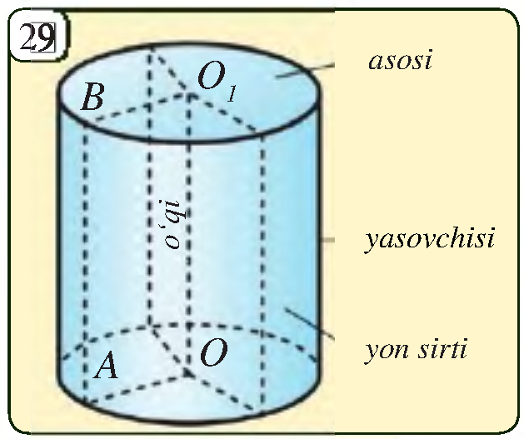
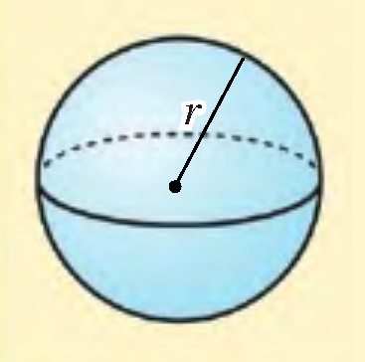
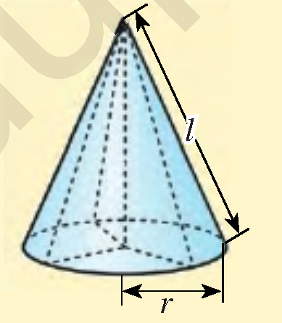
Aylanish jismlari

Slide 9
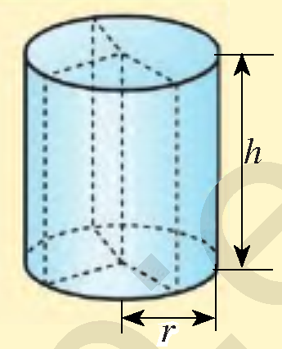
Masalalar yechish
2.17.Silindr asosining radiusi va yasovchisiga ko‘ra
uning yon sirtini toping.
$$S_{yon}=2πrH$$
$a) r=7cm, l=12 cm$
$$S_{yon}=2π∙7∙12=168π {cm}^{2}$$
$b) r=1 m, l=1,2 m$
$$H$$
$$l$$
$$S_{yon}=2π∙1∙1,2=2,4π m^{2}$$
$c) r=0,7 m, l=1,2 m$
$$S_{yon}=2π∙0,7∙1,2=1,68π m^{2}$$

Slide 10
Masalalar yechish
2.19.Silindr yon sirtining yuzi $90π {cm}^{2}$, yasovchisi
5 cm bo‘lsa, silindrning to‘la sirti yuzini toping.
$$S_{yon}=90π {cm}^{2}, l=H=5 cm$$
$$S_{to^{′}la}=?$$
$$S_{yon}=2πrH=>90π=2πr∙5$$
$$H$$
$$l$$
$$r=9 cm$$
$$S_{to^{′}la}=2πr∙\left(r+H\right)$$
$$S_{to^{′}la}=2π∙9∙\left(9+5\right)=252π {cm}^{2}$$

Slide 11
Masalalar yechish
2.21. Silindr yasovchisi uning asosi radiusidan 12 cm
ga uzun. Silindr to‘la sirtining yuzi esa $128π {cm}^{2}$.
Silindr asosining radiusi va yasovchisini toping.
$$S_{to^{′}la}=128π, l=r+12, r=?, l=?$$
$$S_{to^{′}la}=2πr∙\left(r+H\right)$$
$$128π=2πr∙\left(r+r+12\right)$$
$$H$$
$$l$$
$$r^{2}+12r−64=0$$
$$r_{1}=−16, r_{2}=4$$
$$r=4 cm;$$
$$l=r+12=4+12=16 cm$$
Javob: $4 cm va 16 cm$

Slide 12
Masalalar yechish
Agar to‘g‘ri silindr o‘q kesimining yuzi 8 ga teng
bo‘lsa, silindrning yon sirti yuzini toping.
To‘g‘ri
to‘rtburchak
$$H$$
$$S_{kesim}=2RH$$
$$R$$
$$R$$
$$8=2RH$$
$$S_{yon}=2πRH=8π$$
$$S_{yon}=π∙S_{kesim}$$

Slide 13
Masalalar yechish
Konus yasovchisi asos radiusidan 3 marta katta.
Konus to‘la sirtining asos yuziga nisbatini toping.
$$l=3r, \frac{S_{to^{′}la}}{S_{asos}}=?$$
$$S_{to^{′}la}=πr∙\left(r+l\right)=4πr^{2}$$
$$S_{asos}=πr^{2}$$
$$h$$
$$\frac{S_{to^{′}la}}{S_{asos}}=\frac{4πr^{2}}{πr^{2}}=4$$

Slide 14
Masalalar yechish
2.24. Konus asosining radiusi 12 mm, konus uchini
asos markazi bilan tutashtiruvchi kesma uzunligi
35 mm ga teng. Konus yon sirtini toping.
$$r=12 mm, h=35 mm, S_{yon}=?$$
$$l^{2}=r^{2}+h^{2} =>l=\sqrt{r^{2}+h^{2}}$$
$$l=\sqrt{{12}^{2}+{35}^{2}}=\sqrt{1369}=37$$
$$h$$
$$S_{yon}=πrl=π∙12∙37=444π {mm}^{2}$$
Javob: $444π {mm}^{2}$

Slide 15
Masalalar yechish
2.26. Konusning yasovchisi $l$ ga teng bo‘lib, u asos
tekisligi bilan $α$ burchak tashkil qiladi. Agar $l=10 cm$
$α=30°$ bo‘lsa, konus asosining yuzini toping.
$$l=10 cm, α=30°, S_{asos}=?$$
$$\cos{α}=\frac{r}{l} => r=l∙\cos{α}$$
$$l$$
$$r=10∙\cos{30°}=10∙\frac{\sqrt{3}}{2}=5\sqrt{3}$$
$$α$$
$$r$$
$$S_{asos}=πr^{2}=π∙{\left(5\sqrt{3}\right)}^{2}=75π {cm}^{2}$$
Javob: $75π {cm}^{2}$

Slide 16
Masalalar yechish
Konusning to‘la sirti 24 ga teng. Agar konus o‘q kesimi muntazam uchburchakdan iborat bo‘lsa, konus asosining yuzini toping.
Teng yonli
uchburchak
$$l$$
$$l$$
$$H$$
$$S_{kesim}=RH$$
$$R$$
$$R$$
$$3πR^{2}=24$$
$$S_{to^{′}la}=24, l=2R, S_{asos}=?$$
$$πR^{2}=8$$
$$S_{to^{′}la}=πR\left(R+l\right)=3πR^{2}$$
$$S_{asos}=πR^{2}=8$$

Slide 17
Masalalar yechish
Katetlari uzunliklari 6 cm va 7 cm ga teng bo‘lgan
to‘g‘ri burchakli uchburchakning gipotenuzasi
atrofida to‘liq aylantirishdan hosil bo‘lgan jismning
yuzini toping.
$$6$$
$$7$$
$$c=\sqrt{6^{2}+7^{2}}=\sqrt{85}$$
$$∟$$
$$6$$
$$7$$
$$h$$
$$x=\frac{6^{2}}{c}=\frac{36}{\sqrt{85}}$$
$$x$$
$$y$$
$$6$$
$$7$$
$$y=\frac{7^{2}}{c}=\frac{49}{\sqrt{85}}$$
$$h=\frac{6∙7}{\sqrt{85}}=\frac{42}{\sqrt{85}}$$

Slide 18
Masalalar yechish
$$h_{1}=\frac{36}{\sqrt{85}}$$
$$h_{2}=\frac{49}{\sqrt{85}}$$
$$R=\frac{42}{\sqrt{85}}$$
$$6$$
$$7$$
$$R$$
$$h_{1}$$
$$h_{2}$$
$$V_{1}=\frac{1}{3}∙π∙{\left(\frac{42}{\sqrt{85}}\right)}^{2}∙\frac{36}{\sqrt{85}}=\frac{21168π}{85\sqrt{85}}$$
$$6$$
$$7$$
$$V_{2}=\frac{1}{3}∙π∙{\left(\frac{42}{\sqrt{85}}\right)}^{2}∙\frac{49}{\sqrt{85}}=\frac{28812π}{85\sqrt{85}}$$
$$V=V_{1}+V_{2}=\frac{21168π}{85\sqrt{85}}+\frac{28812π}{85\sqrt{85}}=\frac{588π}{\sqrt{85}}$$

Slide 19
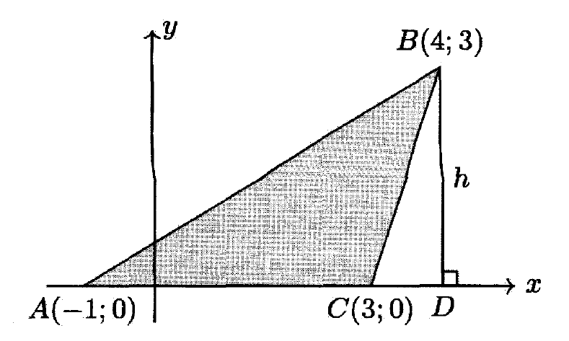
Masalalar yechish
Rasmda uchlari $A, B$ va $C$ nuqtalarda bo‘lgan
Uchburchakni $Ox$ o‘qi atrofida to‘liq aylantirishdan
hosil bo‘lgan jismning hajmini toping.
$$V=V_{1}−V_{2}$$
$$R=h=3; H=5$$
$$V_{1}=\frac{1}{3}πR^{2}H=\frac{1}{3}π∙9∙5=15π$$
$$R=h=3; H=1$$
$$A(−1;0)$$
$$C(3;0)$$
$$V_{1}=\frac{1}{3}πR^{2}H=\frac{1}{3}π∙9∙1=3π$$
$$V=15π−3π=12π$$

Slide 20
Mustaqil yechish uchun topshiriq
Darslikning
121-betidagi 2.18, 2.20, 2.22,
2.25, 2,27-mashqlar.

Slide 21
E’TIBORINGIZ UCHUN RAHMAT!
ARALASHMAGA OID MASALALAR

