Slide 1
Geometriya
10
sinf
Mavzu:
Amaliy mashq va tatbiqlar. (1-dars)
Komilov Mirodil Xosiljonovich X.T.V. tasarrufidagi AFIDUM matematika fani o‘qituvchisi.

Slide 2
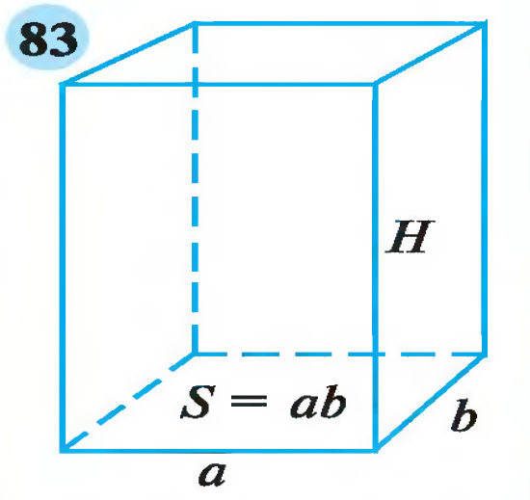
Ko‘pyoqlar

Slide 3
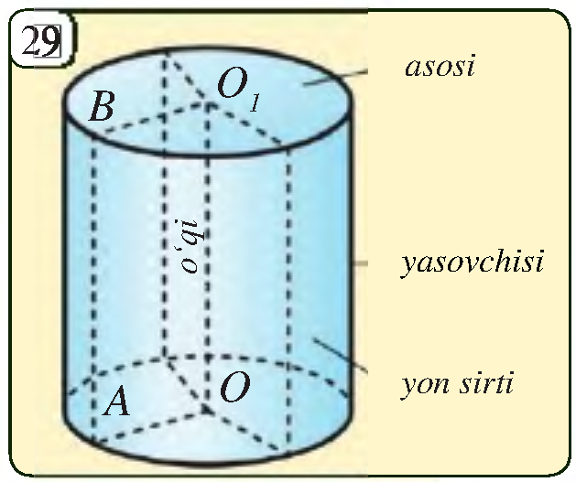
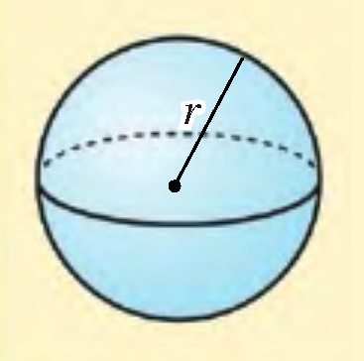
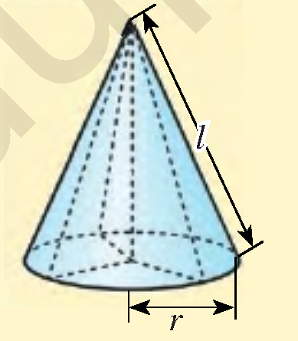
Aylanish jismlari

Slide 4
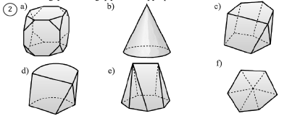
Masalalar yechish
2.4. Rasmdagi jismlarning qaysi biri ko‘pyoq bo‘ladi?
Ko‘pyoq deb yassi ko‘pburchaklar bilan
chegaralangan jismga aytiladi

Slide 5
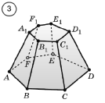
Masalalar yechish
2.5. 3-rasmda $ABCDEFA_{1}B_{1}C_{1}D_{1}E_{1}F_{1}$ ko‘pyoq tasvir-
langan. Bu ko‘pyoqda quyidagilarni ayting:
$a) CD$ qirra umumiy bo‘lgan yoqlarni;
$b) DD_{1}$ qirra umumiy bo‘lgan yoqlarni;
$c) E$ uch umumiy bo‘lgan yoqlarni;
$d) C_{1}$uch umumiy bo‘lgan yoqlarni;
$e) A$ uch umumiy bo‘lgan qirralarni;
$f) F_{1}$uch umumiy bo‘lgan qirralarni.

Slide 6
Masalalar yechish
$a) CD$ qirra umumiy bo‘lgan yoqlarni;
$$ABCDEF, CDD_{1}C_{1}$$
$c) E$ uch umumiy bo‘lgan yoqlarni;
$$ABCDEF, DEE_{1}D_{1}, EFF_{1}E_{1}$$
$e) A \text{uch} \text{umumiy} \text{bo}\text{‘}\text{lgan} \text{qirralarni}$;
$$AA_{1}, AB, AF$$

Slide 7
Masalalar yechish
$d) C_{1}$uch umumiy bo‘lgan yoqlarni;
$$A_{1}B_{1}C_{1}D_{1}E_{1}F_{1}, BCC_{1}B_{1}, CDD_{1}C_{1}$$
$e) A \text{uch} \text{umumiy} \text{bo}\text{‘}\text{lgan} \text{qirralarni}$;
$$AA_{1}, AB, AF$$
$f) F_{1}\text{uch} \text{umumiy} \text{bo}\text{‘}\text{lgan} \text{qirralarni}$;
$$FF_{1}, E_{1}F_{1}, A_{1}F_{1}$$

Slide 8
Mustaqil bajarilgan topshiriqni tekshirish
To‘g‘ri parallelepipedning balandligi 8 m va asosi rombdan iborat. Rombning diagonallari 10 m va 24 m ga teng. Parallelepipedning to‘la sirtini toping.
$$S_{T}=S_{asos}+S_{yon}$$
$$S_{asos}=2S_{romb}=2∙\frac{1}{2}d_{1}∙d_{2}=10∙24=240$$
$$a=\frac{\sqrt{d_{1}^{2}+d_{2}^{2}}}{2}=\frac{\sqrt{100+576}}{2}=\frac{26}{2}=13$$
$$H$$
$$d_{2}$$
$$a$$
$$S_{yon}=4∙aH=4∙13∙8=416$$
$$d_{1}$$
$$a$$
$$S_{T}=240+416=656 m^{2}$$

Slide 9
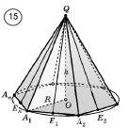
Masalalar yechish
$n−$ piramida asosining tomonlari soni bo‘lsin.
Piramida asosining diagonallari soni: $\frac{n\left(n−3\right)}{2}$ ta
Barcha uchlarining soni: $n+1$ ta
Barcha yoqlarining soni: $n+1$ ta
Barcha yon yoqlarining soni: $n$ ta
Barcha qirralarining soni: $2n$ ta

Slide 10
Masalalar yechish
Agar piramidaning uchlari soni bilan yoqlari soni
yig‘indisi 42 bo‘lsa, piramida asosining diagonallari
sonini toping.
Piramida asosining diagonallari soni: $\frac{n\left(n−3\right)}{2}$ ta
Barcha uchlarining soni: $n+1$ ta
Barcha yoqlarining soni: $n+1$ ta
$$n+1+n+1=42 =>2n=40$$
$$n=20$$
$$\frac{n\left(n−3\right)}{2}=\frac{20∙\left(20−3\right)}{2}=170$$

Slide 11
Masalalar yechish
To‘g‘ri burchakli parallelepipedning uchta turli
yoqlarining yuzalari 56 ${cm}^{2}$; 63 ${cm}^{2}$va 72 ${cm}^{2}$ bo‘lsa,
parallelepipedning hajmini toping.
$$S_{1}=56 {cm}^{2};S_{2}=63 {cm}^{2}; S_{3}=72 {cm}^{2}$$
$$V=abc=?$$
$$S_{1}$$
$$\left\{\begin{aligned}ab=56 \\ bc=63 \\ ac=72\end{aligned}\right.$$
$$a^{2}b^{2}c^{2}=56∙63∙72$$
$$S_{2}$$
$$abc=\sqrt{56∙63∙72}=$$
$$=\sqrt{7∙8∙7∙9∙8∙9}=7∙8∙9$$
$$S_{3}$$
$$c$$
$$b$$
$$a$$
$$V=abc=7∙8∙9=504 {cm}^{3}$$

Slide 12
Masalalar yechish
2.8. Muntazam uchburchakli prizma asosining tomoni 6 cm, yon qirrasi esa 11 sm ga teng. Prizmaning to‘la sirtini toping.
$$a=6 cm, h=11 cm$$
$$S_{yon}=P_{asos}∙h=3∙6∙11=198$$
$$a$$
$$S_{asos}=2∙S_{∆}=2∙\frac{a^{2}\sqrt{3}}{4}=\frac{36\sqrt{3}}{2}=18\sqrt{3}$$
$$a$$
$$h$$
$$S_{to^{′}la}=S_{asos}+S_{yon}=198+18\sqrt{3} {cm}^{2}$$

Slide 13
Masalalar yechish
To‘g‘ri prizmaning asosi rombdan iborat bo‘lib, uning diagonal kesimlarining yuzlari 12 ${dm}^{2}$ va 16 ${dm}^{2}$ ga teng. Shu prizmaning yon sirtini yuzini toping.
$$d_{1}∙h=12$$
$$d_{2}∙h=16$$
$$S_{yon}=4∙ah$$
$$d_{2}$$
$$d_{2}$$
$$a$$
$$d_{1}$$
$$d_{1}$$
$$a=\frac{\sqrt{d_{1}^{2}+d_{2}^{2}}}{2}=\frac{\sqrt{\frac{{12}^{2}}{h^{2}}+\frac{{16}^{2}}{h^{2}}}}{2}=\frac{\sqrt{{12}^{2}+{16}^{2}}}{2h}=\frac{20}{2h}=\frac{10}{h}$$
$$h$$
$$h$$
$$h$$
$$h$$
$$S_{yon}=4∙ah=4∙\frac{10}{h}∙h=40 {dm}^{2}$$
$$a$$
$$a$$

Slide 14
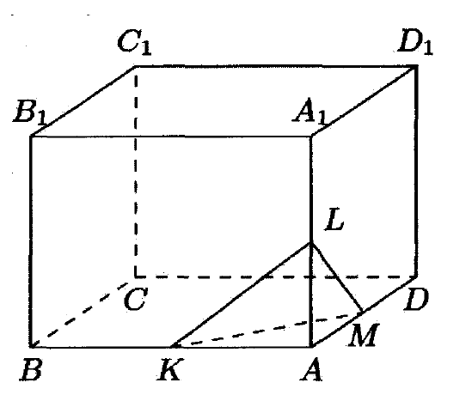
Masalalar yechish
To‘g‘ri burchakli parallelepipedning $A$ uchidan chiquvchi qirralari 8 dm, 9 dm va 12 dm. Shu qirralaridan mos ravishda $A$ nuqtadan boshlab hisoblaganda qirralari 3 dm, 5 dm va 6 dm bo‘lgan piramida qirqib olindi. Qolgan qismining hajmini toping.
$$V=V_{T.B.P.}−V_{P}$$
$$V_{T.B.P.}=8∙9∙12=864 {dm}^{3}$$
$$V_{P}=\frac{1}{3}∙3∙5∙6=30 {dm}^{3}$$
$$V=V_{T.B.P.}−V_{P}=864−30=834 {dm}^{3}$$

Slide 15
Masalalar yechish
Uchburchakli piramidaning yon qirralari o‘zaro perpendikulyar hamda uzunliklari 6 dm, 7 dm va 8 dm ga teng. Piramidaning hajmini toping.
$$V=\frac{abc}{6}$$
$$b$$
$$a$$
$$V=\frac{6∙7∙8}{6}=56 {dm}^{3}$$
$$c$$

Slide 16
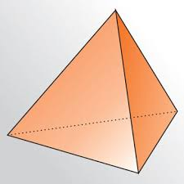
Masalalar yechish
Tetraedrning asosining yuzi $36\sqrt{3} m^{2}$ bo‘lsa, uning
hajmini toping.
$$S_{asos}=\frac{a^{2}\sqrt{3}}{4}$$
$$36\sqrt{3}=\frac{a^{2}\sqrt{3}}{4}$$
$$a$$
$$a$$
$$a^{2}=144 =>a=12$$
$$a$$
$$a$$
$$V=\frac{a^{3}\sqrt{2}}{12}=\frac{{12}^{3}∙\sqrt{2}}{12}=144\sqrt{2} m^{3}$$
$$a$$
$$a$$

Slide 17
Masalalar yechish
2.10. Muntazam uchburchakli piramida apofemasi 15 ga, piramida uchini asos markazi bilan tutashtiruvchi kesma uzunligi 12 ga teng. $a)$ piramida yon qirrasi va asosining tomonini; $b)$piramida yon sirtini; $c)$ piramida to‘la sirtini toping.
$$f=15; h=12;$$
$$l=?, a=?, S_{yon}=?, S_{To^{′}la}=?$$
$$l$$
$$f^{2}=r^{2}+h^{2} =>r=\sqrt{f^{2}−h^{2}}$$
$$h$$
$$f$$
$$r=\sqrt{225−144}=\sqrt{81}=9$$
$$r$$
$$r$$
$$a$$
$$a=2\sqrt{3}r=2\sqrt{3}∙9=18\sqrt{3}$$
$$a$$

Slide 18
Masalalar yechish
$$f=15; h=12;$$
$$l=?, a=?, S_{yon}=?, S_{To^{′}la}=?$$
$$R=2r=2∙9=18$$
$$l$$
$S_{asos}=\frac{ah}{2}=\frac{a(R+r)}{2}=\frac{18\sqrt{3}∙27}{2}=243\sqrt{3}$
$$h$$
$$f$$
$$l^{2}=R^{2}+h^{2}=>l=\sqrt{R^{2}+h^{2}}$$
$$R$$
$$R$$
$$r$$
$$r$$
$$a$$
$$l=\sqrt{324+144}=6\sqrt{13}$$
$$a$$
$$S_{yon}=\frac{P}{2}∙f=\frac{3a}{2}∙f=\frac{3∙18\sqrt{3}}{2}∙15=405\sqrt{3}$$
$$S_{to^{′}la}=243\sqrt{3}+405\sqrt{3}=648\sqrt{3}$$

Slide 19
Masalalar yechish
2.14. Muntazam oltiburchakli piramida asosining tomoni 10 cm ga teng. Piramida uchini asos markazi bilan tutashtiruvchi kesma uzunligi $\sqrt{69}$ cm ga teng. Piramida
$a)$ yon qirrasi va apofemasini;
$b)$yon sirtini; $c)$ to‘la sirtini toping.
$$h$$
$$l$$
$$f$$
$$a=10 cm; h=\sqrt{69} cm$$
$$l=?, f=?, S_{yon}=?, S_{To^{′}la}=?$$
$$a$$

Slide 20
Masalalar yechish
$$a=10 cm; h=\sqrt{69} cm$$
$$l=?, f=?, S_{yon}=?, S_{To^{′}la}=?$$
$R=a=10 cm, r=\frac{a\sqrt{3}}{2}=\frac{10\sqrt{3}}{2}=5\sqrt{3}$
$S_{asos}=\frac{3\sqrt{3}a^{2}}{2}=\frac{3\sqrt{3}∙100}{2}=150\sqrt{3}$
$$h$$
$$l$$
$$f$$
$$l=\sqrt{R^{2}+h^{2}}=\sqrt{100+69}=\sqrt{169}=13$$
$$f=\sqrt{r^{2}+h^{2}}=\sqrt{75+69}=\sqrt{144}=12$$
$$R$$
$$r$$
$$a$$

Slide 21
Masalalar yechish
$$a=10 cm; h=\sqrt{69} cm$$
$$l=13, f=12, S_{yon}=?, S_{To^{′}la}=?$$
$S_{asos}=\frac{3\sqrt{3}a^{2}}{2}=\frac{3\sqrt{3}∙100}{2}=150\sqrt{3}$
$$S_{yon}=\frac{P}{2}∙f=\frac{6a}{2}∙f=3∙10∙12=360$$
$$h$$
$$l$$
$$f$$
$$S_{to^{′}la}=150\sqrt{3}+360$$
$$R$$
Javob: $l=13 cm, f=12 cm,$
$S_{yon}=360 {cm}^{2}, S_{To^{′}la}=150\sqrt{3}+360 {cm}^{2}$
$$r$$
$$a$$

Slide 22
E’TIBORINGIZ UCHUN RAHMAT!
ARALASHMAGA OID MASALALAR

