Slide 1
Geometriya
10
sinf
Mavzu:
Aylanish jismlari:
Silindr, konus va shar
Komilov Mirodil Xosiljonovich X.T.V. tasarrufidagi AFIDUM matematika fani o‘qituvchisi.

Slide 2
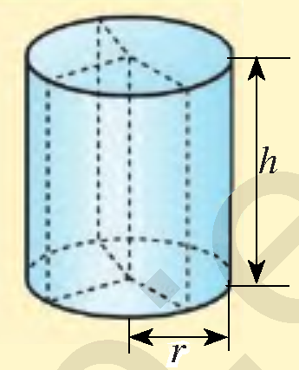
Mustaqil bajarilgan topshiriqni tekshirish
2.25. Konus asosining diametri 32 cm, konus uchini
asos markazi bilan tutashtiruvchi kesma uzunligi
63 cm ga teng. Konus yon sirtini toping.
$$d=32 cm; H=63 cm$$
$$S_{yon}=2πrH=>300π=2πr∙6$$
$$H$$
$$l$$
$$r=25 cm$$
$$S_{asos}=?$$
$$S_{asos}=πr^{2}={25}^{2}π=625π$$
Javob: $625π {cm}^{2}$

Slide 3
Mustaqil bajarilgan topshiriqni tekshirish
2.20. Silindr asosining diametri 1 m, yasovchisi esa
asos aylana uzunligiga teng. Silindr yon sirtining
yuzini toping.
$$d=1 m, l=C_{asos}, S_{yon}=?$$
$$r=\frac{d}{2}=\frac{1}{2}=0,5$$
$$H$$
$$l$$
$$l=2πr=2∙0,5∙π=π=H$$
$$S_{yon}=2πrH=2π∙0,5∙π=π^{2}$$
Javob: $π^{2}$

Slide 4
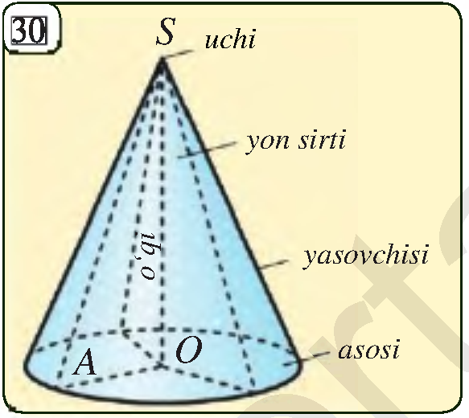
Konus
To‘g‘ri burchakli uchburchakni bir kateti atrofida
aylantirishdan hosil bo‘lgan jism konus deyiladi.
Bunday aylantirishda uchburchak-
ning bir kateti qo‘zg‘alishsiz qoladi
va uni konusning o‘qi deb ataymiz.

Slide 5
Konus
Bu aylantirishda boshqa katet hosil qilgan doira
konusning asosi;
gipotenuza hosil qilgan sirt esa konusning yon sirti;
gipotenuzaning o‘zi esa konusning
yasovchisi deyiladi.
Bu aylanishda qo‘zg‘almasdan
qolgan uchburchak uchi konusning
uchi deyiladi.

Slide 6
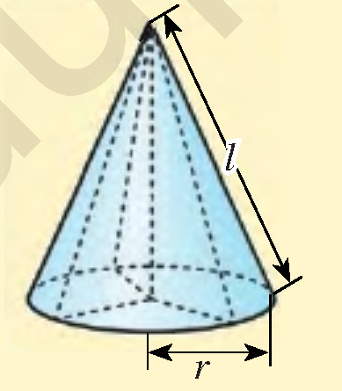
Konus
$$S_{yon}=πrl$$
$$S_{asos}=πr^{2}$$
$$S_{to^{′}la}=S_{asos}+S_{yon}$$
$$h$$
$$S_{to^{′}la}=πr^{2}+πrl=πr\left(r+l\right)$$
$$V=\frac{1}{3}∙S_{asos}∙h=\frac{1}{3}∙πr^{2}h$$

Slide 7
Masalalar yechish
Konus uchun $r=5 cm, l=13 cm$ bo‘lsa, uning yon
sirtini, asosini yuzini, to‘la sirtini va hajmini toping.
$$S_{yon}=πrl=5∙13π=65π {cm}^{2}$$
$$S_{asos}=πr^{2}=5^{2}π=25π {cm}^{2}$$
$$S_{to^{′}la}=S_{asos}+S_{yon}$$
$$S_{to^{′}la}=65π+25π=90π {cm}^{2}$$
$$h$$
$$h=\sqrt{l^{2}−r^{2}}=\sqrt{169−25}=12 cm$$
$$V=\frac{1}{3}∙S_{asos}∙h=\frac{1}{3}∙25π∙12=100π{ cm}^{3}$$

Slide 8
Masalalar yechish
Konusning yon sirti $60π$ ga, to‘la sirti $96π$ ga teng.
Konusning yasovchisini toping.
$$S_{yon}=60π, S_{to^{′}la}=96π, l=?$$
$$S_{yon}=πrl$$
$$60π=πrl =>60=rl$$
$$S_{to^{′}la}=πr^{2}+πrl$$
$$96π=πr^{2}+60π$$
$$h$$
$$r^{2}=36 =>r=6$$
$$60=6∙l$$
$$l=10$$
Javob: $10$

Slide 9
Masalalar yechish
2.24. Konus asosining radiusi 12 mm, konus uchini
asos markazi bilan tutashtiruvchi kesma uzunligi
35 mm ga teng. Konus yon sirtini toping.
$$r=12 mm, h=35 mm, S_{yon}=?$$
$$l^{2}=r^{2}+h^{2} =>l=\sqrt{r^{2}+h^{2}}$$
$$l=\sqrt{{12}^{2}+{35}^{2}}=\sqrt{1369}=37$$
$$h$$
$$S_{yon}=πrl=π∙12∙37=444π {mm}^{2}$$
Javob: $444π {mm}^{2}$

Slide 10
Masalalar yechish
2.26. Konusning yasovchisi $l$ ga teng bo‘lib, u asos
tekisligi bilan $α$ burchak tashkil qiladi. Agar $l=10 cm$
$α=30°$ bo‘lsa, konus asosining yuzini toping.
$$l=10 cm, α=30°, S_{asos}=?$$
$$\cos{α}=\frac{r}{l} => r=l∙\cos{α}$$
$$l$$
$$r=10∙\cos{30°}=10∙\frac{\sqrt{3}}{2}=5\sqrt{3}$$
$$α$$
$$r$$
$$S_{asos}=πr^{2}=π∙{\left(5\sqrt{3}\right)}^{2}=75π {cm}^{2}$$
Javob: $75π {cm}^{2}$

Slide 11
Masalalar yechish
2.27. Konusning yasovchisi $l$ ga teng bo‘lib, u asos
Radiusi bilan $α$ burchak tashkil qiladi. Agar $l=20 dm$
$α=45°$ bo‘lsa, konusning to‘la sirtini toping.
$$l=20 dm, α=45°, S_{to^{′}la}=?$$
$$α=45°=>h=r$$
$$l^{2}=h^{2}+r^{2} => l^{2}=2r^{2}$$
$$l$$
$$h$$
$$r=\frac{\sqrt{2}l}{2}=\frac{\sqrt{2}∙20}{2}=10\sqrt{2}$$
$$α$$
$$r$$
$$S_{to^{′}la}=πr\left(r+l\right)=π∙10\sqrt{2}∙\left(10\sqrt{2}+20\right)$$
$$S_{to^{′}la}=200\left(\sqrt{2}+1\right)π {dm}^{2}$$

Slide 12
O‘q kesim
Konusning to‘la sirti 24 ga teng.
Agar konus o‘q kesimi muntazam
uchburchakdan iborat bo‘lsa,
konus asosining yuzini toping.
Teng yonli
uchburchak
$$H$$
$$R$$
$$S_{to^{′}la}=24, l=2R, S_{asos}=?$$
$$S_{kesim}=RH$$
$$S_{to^{′}la}=πR\left(R+l\right)=3πR^{2}$$
$$l$$
$$l$$
$$3πR^{2}=24$$
$$πR^{2}=8$$
$$R$$
$$S_{asos}=πR^{2}=8$$
Javob: $8$

Slide 13
Masalalar yechish
2.35. Rasmda tasvirlangan jismning to‘la sirtini
toping.
$$l$$
$$S_{to^{′}la}=S_{s.yon sirti}+2∙S_{k.yon sirti}$$
$$h$$
$$d=1,8m =>r=0,9m; H=4m$$
$$S_{s.yon sirti}=2πrH=2∙0,9∙4π=7,2π$$
$$l^{2}=r^{2}+h^{2} =>l=\sqrt{r^{2}+h^{2}}=\sqrt{{(0,9)}^{2}+{\left(1\right)}^{2}}≈1,34$$
$$S_{k.yon sirti}=πrl=0,9∙1,34π=1,206π$$
$$S_{to^{′}la}=7,2π+2∙1,206π=9,612π m^{2}$$

Slide 14
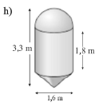
Masalalar yechish
2.35. Rasmda tasvirlangan jismning to‘la sirtini
toping.
$$S_{to^{′}la}=S_{yarim shar}+S_{s.yon sirti}+S_{k.yon sirti}$$
$$d=1,6 =>r=0,8=r_{konus}=r_{shar}$$
$$S_{yarim shar}=\frac{4πr^{2}}{2}=2πr^{2}=2π{\left(0,8\right)}^{2}=1,28π$$
$$S_{s.yon sirti}=2πrh=2∙0,8∙1,8π=2,88π$$

Slide 15
Masalalar yechish
2.35. Rasmda tasvirlangan jismning to‘la sirtini
toping.
$$d=1,6 =>r=0,8=r_{konus}=r_{shar}$$
$$h_{konus}=3,3−1,8−0,8=0,7$$
$$l=\sqrt{h^{2}+r^{2}}=\sqrt{{\left(0,7\right)}^{2}+{\left(0,8\right)}^{2}}≈1,08$$
$$S_{k.yon sirti}=πrl=0,8∙1,08π=0,864π$$
$$S_{to^{′}la}=S_{yarim shar}+S_{s.yon sirti}+S_{k.yon sirti}$$
$$S_{to^{′}la}=1,28π+2,88π+0,864π=5,024π m^{2}$$

Slide 16
Kesik konus
Konus asosiga parallel tekislik bilan kesilganda hosil bo‘lgan jism kesik konus deb nomlanadi.
$$l^{2}=H^{2}+{\left(R−r\right)}^{2}$$
$$S_{1asos}=πr^{2}$$
$$S_{2asos}=πR^{2}$$
$$r$$
$$S_{yon}=π\left(R+r\right)l$$
$$l$$
$$l$$
$$S_{to^{′}la}=πr^{2}+πR^{2}+π\left(R+r\right)l$$
$$H$$
$$V=\frac{1}{3}π∙H\left(R^{2}+R∙r+r^{2}\right)$$
$$R$$

Slide 17
Mustaqil bajarish uchun topshiriqlar
Darslikning
121-betidagi 2.25, 2.28-mashqlar;
122-betidagi 2.30-mashq.

Slide 18
E’TIBORINGIZ UCHUN RAHMAT!
ARALASHMAGA OID MASALALAR

