Slide 1
Geometriya
10
sinf
Mavzu:
Aylanish jismlari:
Silindr, konus va shar

Slide 2
Mustaqil bajarilgan topshiriqni tekshirish
2.11. Muntazam to‘rtburchakli piramida asosi 12 cm ga, piramida uchini asos markazi bilan tutashtiruvchi kesma uzunligi 16 cm ga teng.
$a)$piramida yon qirrasi va apofemasini;
$b)$piramida yon sirtini;
$c)$piramida to‘la sirtini toping.
$$a=12 cm, h=16 cm, l=?f=? S_{yon}=, S_{to^{′}la}=?$$

Slide 3
Mustaqil bajarilgan topshiriqni tekshirish
$$a=12 cm, h=16 cm,$$
$$l=?f=? S_{yon}=, S_{to^{′}la}=?$$
$$r=\frac{a}{2}=\frac{12}{2}=6; R=\frac{a\sqrt{2}}{2}=6\sqrt{2}$$
$$h$$
$$f$$
$$l=\sqrt{h^{2}+R^{2}}=\sqrt{{16}^{2}+{\left(6\sqrt{2}\right)}^{2}}=$$
$$=\sqrt{256+72}=\sqrt{328}=2\sqrt{82}$$
$$l$$
$$r$$
$$a$$
$$R$$
$$f=\sqrt{h^{2}+r^{2}}=\sqrt{{16}^{2}+6^{2}}=$$
$$=\sqrt{256+36}=\sqrt{292}=2\sqrt{73}$$
$$a$$

Slide 4
Mustaqil bajarilgan topshiriqni tekshirish
$$a=12 cm, h=16 cm, l=2\sqrt{82}, f=2\sqrt{73}$$
$$S_{yon}=, S_{to^{′}la}=?$$
$$S_{yon}=\frac{P}{2}∙f=\frac{4a}{2}∙f=2∙12∙2\sqrt{73}=$$
$$=48\sqrt{73} {cm}^{2}$$
$$h$$
$$f$$
$$l$$
$$S_{asos}=a^{2}={12}^{2}=144{ cm}^{2}$$
$$r$$
$$a$$
$$R$$
$$S_{to^{′}la}=S_{asos}+S_{yon}=$$
$$=144+48\sqrt{73}{ cm}^{2}$$
$$a$$

Slide 5
Aylanish jismlari
Fazoviy shakllarning yana muhim sinflaridan biri – bu
aylanish jismlaridir.
Aylanish jismlari – bular silindr, konus va shar.

Slide 6
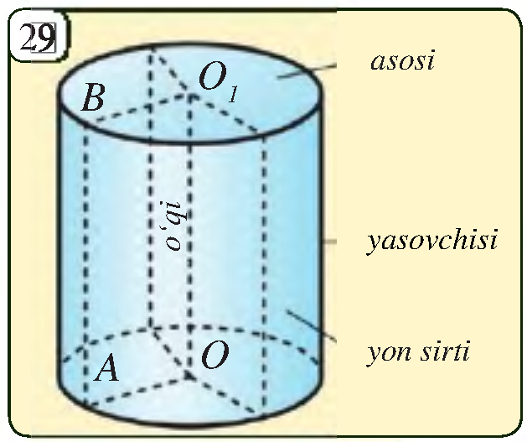
Silindr
To‘g‘ri to‘rtburchakni bir tomoni atrofida aylantirish-
dan hosil bo‘lgan jism silindr deb ataladi.
Bunday aylantirishda to‘g‘ri
to‘rtburchakning bir tomoni
qo‘zg‘alishsiz qoladi va uni
silindrning o‘qi deb ataymiz.
$OO_{1}−$ silindrni o‘qi

Slide 7
Silindr
O‘qqa qarama-qarshi tomon
aylanishidan hosil bo‘lgan
sirt silindrning yon sirti deb,
tomonning o‘zi esa silindrning
yasovchisi deyiladi.
To‘g‘ri to‘rtburchakning
qolgan tomonlarining har biri
bu aylanishda doira ko‘rinishidagi sirtni hosil qiladi.
Bu doiralar silindrning asoslari deb ataladi.

Slide 8
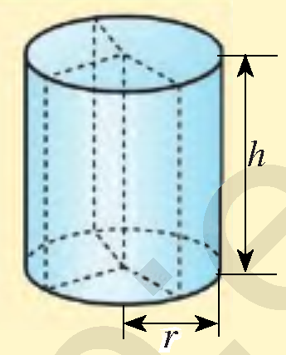
Silindr
$$S_{yon}=2πrh$$
$$S_{asos}=πr^{2}$$
$$S_{to^{′}la}=2S_{asos}+S_{yon}$$
$$S_{to^{′}la}=2πr^{2}+2πrh=2πr\left(r+h\right)$$
$$V=S_{asos}∙h=πr^{2}h$$

Slide 9
Masalalar yechish
Silindr uchun $h=5 cm, r=6 cm$ bo‘lsa, uning yon
sirtini, asosini yuzini, to‘la sirtini va hajmini toping.
$$S_{yon}=2πrh=2π∙5∙6=60π {cm}^{2}$$
$$S_{asos}=πr^{2}=6^{2}∙π=36π{ cm}^{2}$$
$$S_{to^{′}la}=2∙36π+60π=132π {cm}^{2}$$
$$V=S_{asos}∙h=36π∙5=180π {cm}^{3}$$

Slide 10
Masalalar yechish
2.17.Silindr asosining radiusi va yasovchisiga ko‘ra
uning yon sirtini toping.
$$S_{yon}=2πrH$$
$a) r=7cm, l=12 cm$
$$S_{yon}=2π∙7∙12=168π {cm}^{2}$$
$b) r=1 m, l=1,2 m$
$$H$$
$$l$$
$$S_{yon}=2π∙1∙1,2=2,4π m^{2}$$
$c) r=0,7 m, l=1,2 m$
$$S_{yon}=2π∙0,7∙1,2=1,68π m^{2}$$

Slide 11
Masalalar yechish
2.19.Silindr yon sirtining yuzi $90π {cm}^{2}$, yasovchisi
5 cm bo‘lsa, silindrning to‘la sirti yuzini toping.
$$S_{yon}=90π {cm}^{2}, l=H=5 cm$$
$$S_{to^{′}la}=?$$
$$S_{yon}=2πrH=>90π=2πr∙5$$
$$H$$
$$l$$
$$r=9 cm$$
$$S_{to^{′}la}=2πr∙\left(r+H\right)$$
$$S_{to^{′}la}=2π∙9∙\left(9+5\right)=252π {cm}^{2}$$

Slide 12
Masalalar yechish
2.21. Silindr yasovchisi uning asosi radiusidan 12 cm
ga uzun. Silindr to‘la sirtining yuzi esa $128π {cm}^{2}$.
Silindr asosining radiusi va yasovchisini toping.
$$S_{to^{′}la}=128π, l=r+12, r=?, l=?$$
$$S_{to^{′}la}=2πr∙\left(r+H\right)$$
$$128π=2πr∙\left(r+r+12\right)$$
$$H$$
$$l$$
$$r^{2}+12r−64=0$$
$$r_{1}=−16, r_{2}=4$$
$$r=4 cm;$$
$$l=r+12=4+12=16 cm$$
Javob: $4 cm va 16 cm$

Slide 13
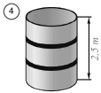
Masalalar yechish
2.22. 4-rasmda tasvirlangan silindr shaklidagi bakning
har ikki tomonini bo‘yash lozim. Agar bakning
balandligi 2,5 m, asosining diametri 1,2 m va bo‘yoq
qatlami qalinligi 0,1 mm bo‘lsa, bakni bo‘yash uchun
qancha bo‘yoq kerak bo‘ladi?
$$d=1,2m; H=2,5 m;c=0,1 mm;V=?$$
$$r=\frac{d}{2}=\frac{12}{2}=6 dm;$$
$$S_{yon}=2πrH=2∙3,14∙6∙25=942$$
$$V=S_{yon}∙c=942∙0,001=0,942≈1 litr$$

Slide 14
O‘q kesim
Agar to‘g‘ri silindr o‘q
kesimining yuzi 8 ga teng
bo‘lsa, silindrning yon
sirti yuzini toping.
To‘g‘ri
to‘rtburchak
$$H$$
$$R$$
$$8=2RH$$
$$S_{yon}=2πRH=8π$$
$$S_{kesim}=2RH$$
$$S_{yon}=π∙S_{kesim}$$
$$R$$

Slide 15
Masalalar yechish
Silindrning balandligi 5 ga, o‘q kesimining diagonali
13 ga teng. Silindr asosining radiusini toping.
$$d^{2}=H^{2}+{\left(2R\right)}^{2}$$
$$d$$
$$H$$
$$H$$
$$2R=\sqrt{d^{2}−H^{2}}$$
$$R$$
$$R$$
$$R=\frac{\sqrt{{13}^{2}−5^{2}}}{2}=\frac{\sqrt{169−24}}{2}=\frac{\sqrt{144}}{2}=\frac{12}{2}=6$$

Slide 16
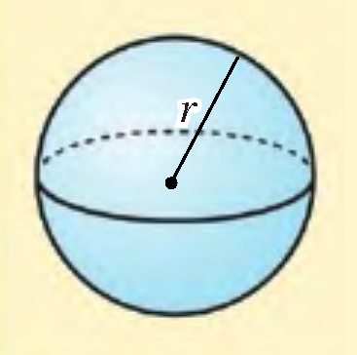
Shar
Doiraning o‘z diametri atrofida aylantirishdan hosil
bo‘lgan jism shar deyiladi.
Bunday aylantirishda aylana hosil
qilgan sirt sfera deyiladi.
Sfera markazidan uning ixtiyoriy
nuqtasigacha bo‘lgan masofa
uning radiusini aniqlaydi.
$$V=\frac{4}{3}πr^{3}$$
$$S=4πr^{2}$$

Slide 17
Masalalar yechish
Shar uchun $r=8 cm$ bo‘lsa, uning sirti yuzini va
hajmini toping.
$$S=4πr^{2}=4π∙64=256π {cm}^{2}$$
$$V=\frac{4}{3}πr^{3}=\frac{4}{3}π∙512=\frac{2048}{3}π {cm}^{3}$$

Slide 18
Masalalar yechish
Shar sirti yuzi $36π$ bo‘lsa, uning hajmini toping.
$$S=4πr^{2}$$
$$36π=4πr^{2}$$
$$r^{2}=9 =>r=3$$
$$V=\frac{4}{3}πr^{3}$$
$$V=\frac{4}{3}π∙3^{3}=\frac{4}{3}∙27∙π=36π$$

Slide 19
Masalalar yechish
Radiuslari 6 cm, 8 cm, 10 cm bo‘lgan uchta metall
sharchalar eritilib, bitta katta metall shar hosil qilindi.
Hosil bo‘lgan shar radiusini toping.
$$V=V_{1}+V_{2}+V_{3}$$
$$\frac{4}{3}πR^{3}=\frac{4}{3}πr_{1}^{3}+\frac{4}{3}πr_{2}^{3}+\frac{4}{3}πr_{3}^{3}$$
$$R^{3}=r_{1}^{3}+r_{2}^{3}+r_{3}^{3} =>R=\sqrt{r_{1}^{3}+r_{2}^{3}+r_{3}^{3}}$$
$$R=\sqrt{6^{3}+8^{3}+{10}^{3}}=\sqrt{216+512+1000}=\sqrt{1728}=12$$

Slide 20
Masalalar yechish
Kovak shar devorining hajmi $156π$ ga, devorning
qalinligi 3 ga teng. Tashqi sharning radiusini toping.
$$\frac{4}{3}πR^{3}−\frac{4}{3}πr^{3}=156π$$
$$V_{kovak}=V_{R}−V_{r}$$
$$3$$
$$r$$
$$R^{3}−r^{3}=117$$
$$R=r+3$$
$$R$$
$${\left(r+3\right)}^{3}−r^{3}=117$$
$$r^{3}+9r^{2}+27r+27−r^{3}=117$$
$$9r^{2}+27r−90=0$$
$$r_{1}=−5; r_{2}=2$$
$$r=2$$
$$R=r+3=2+3=5$$

Slide 21
Mustaqil bajarish uchun topshiriqlar
Darslikning
120-betidagi 2.18, 2.12, 2.13-mashqlar.

Slide 22
E’TIBORINGIZ UCHUN RAHMAT!
ARALASHMAGA OID MASALALAR

