Slide 1
Geometriya
10
sinf
Mavzu:
Amaliy mashq va
tadbiq.
Komilov Mirodil Xosiljonovich X.T.V. tasarrufidagi AFIDUM matematika fani o‘qituvchisi.

Slide 2
Masalalar yechish
1.1. Ikki to‘g‘ri chiziqning kesishishidan to‘rtta burchak hosil bo‘ldi. Quyida keltirilgan jadvalda har bir shart (A-E) ga undan kelib chiquvchi xulosa (1-5) ni mos qo‘ying.
$$A) ∠1=∠3$$
$$1) ∠3=∠4=90°$$
$$B) ∠2+∠3=180°$$
$$2) ∠1=∠2=∠4=90°$$
$$1$$
$$C) ∠1=∠2=90°$$
$3) ∠1$ va $∠2−$ qo‘shni
$$2$$
$$4$$
$$3$$
$$D) ∠2+∠4=260°$$
$4) ∠1$ va $∠3−$ o‘tkir
$$E) ∠3=90°$$
$5) ∠2$ va $∠4−$ vertikal
$$A$$ | $$B$$ | $$C$$ | $$D$$ | $$E$$

Slide 3
Masalalar yechish
$$A) ∠1=∠3$$
$$1) ∠3=∠4=90°$$
$$1) ∠3=∠4=90°$$
$$B) ∠2+∠3=180°$$
$$2) ∠1=∠2=∠4=90°$$
$$2) ∠1=∠2=∠4=90°$$
$$1$$
$$C) ∠1=∠2=90°$$
$3) ∠1$ va $∠2−$ qo‘shni
$3) ∠1$ va $∠2−$ qo‘shni
$$2$$
$$4$$
$4) ∠1$ va $∠3−$ o‘tkir
$$3$$
$$D) ∠2+∠4=260°$$
$4) ∠1$ va $∠3−$ o‘tkir
$$E) ∠3=90°$$
$5) ∠2$ va $∠4−$ vertikal
$5) ∠2$ va $∠4−$ vertikal
$$A$$ | $$B$$ | $$C$$ | $$D$$ | $$E$$
$$5$$
$$3$$
$$1$$
$$4$$
$$2$$

Slide 4
Masalalar yechish
1.4. Agar rasmda $CD∥AB$, $∠1=∠2$ va $∠2=72°$ bo‘lsa, $∠3=?$
$A) 72°;$ $B) 144°$; $C) 108°;$ $D) 36°;$ $E) 124°$
$$B) 144°$$
$$A$$
$$B$$
$$∠1+∠2+∠4=180°$$
$$4$$
$$2$$
$$1$$
$$72°+72°+∠4=180°$$
$$∠4=180°−144°$$
$$3$$
$$∠4=36°$$
$$C$$
$$D$$
$CD∥AB$ $=>∠3+∠4=180°$
$$∠3+36°=180°$$
$$∠3=144°$$
Javob: $144°$

Slide 5
Masalalar yechish
1.5. Agar teng yonli uchburchak burchaklari 3:4:3 nisbatda bo‘lsa, uning uchining bissektrisasi va yon tomoni orasidagi burchakni toping
$A) 18°;$ $B) 36°$; $C) 72°;$ $D) 60°;$ $E) 30°$
$B) 36°$;
$$3x+4x+3x=180°$$
$$10x=180°$$
$$x=18°$$
$$72°$$
$$4x$$
$$y$$
$3x=54°$, $3x=54°$, $4x=72°$,
$$l$$
$$y=\frac{72°}{2}=36°$$
$$54°$$
$$54°$$
$$3x$$
$$3x$$
Javob: $36°$

Slide 6
MATNLI MASALALAR
Aylanadagi metrik munosabatlar
$$α$$
$$R$$
$$x=α$$
$$o$$
diametr
$$x$$
$$y=\frac{α}{2}=\frac{x}{2}$$
vatar
$$R$$
$$y$$
$$C=2πR$$
$$o$$
$$l$$
$$α$$
$$R$$
$$α$$
$$α$$
$$l=αR$$
$$α$$

Slide 7
Masalalar yechish
1.8. $∆BOC$ burchaklarini toping.
$$C$$
$OC=OB=R=> ∆BOC−$teng yonli
$$∠B=∠C,$$
$$∠B=\frac{∠AOC}{2}=\frac{48°}{2}=24°$$
$$∠B=∠C=24°$$
$$∠O=180°−48°$$
$$∠O=132°$$
$$48°$$
$$A$$
$$B$$
$$O$$
Javob: $24°$, $24°$, $132°$

Slide 8
Masalalar yechish
1.9. Uchburchakning uchlari radiuslari 6 cm, 7cm va 8 cm bo‘lgan va jufti-jufti bilan urinadigan uchta aylana markazlarida yotibdi. Bu uchburchakning perimetrini toping
$R_{1}=6 cm$, $R_{2}=7 cm,$ $R_{3}=8 cm$
$$AB=R_{1}+R_{2}=6+7=13 cm$$
$$R_{1}$$
$$R_{2}$$
$$B$$
$$A$$
$$R_{1}$$
$$R_{2}$$
$$BC=R_{2}+R_{3}=7+8=15 cm$$
$$R_{3}$$
$$AC=R_{1}+R_{3}=6+8=14 cm$$
$$R_{3}$$
$$C$$
$$P=AB+BC+AC=13+15+14=42$$
Javob: 42 cm

Slide 9
Masalalar yechish
1.11.Trapetsiyaning bitta asosi ikkinchisidan $8 cm$ ga uzun, o‘rta chizig‘i esa $10 cm$ ga teng. Trapetsiyaning kichik asosini toping.
$A) 2 cm$, $B) 4 cm$, $C) 6 cm$, $D) 8 cm$, $E) 10 cm$
$C) 6 cm$,
$$B$$
$$x$$
$$m=\frac{AD+BC}{2}=\frac{x+8+x}{2}=\frac{2x+8}{2}$$
$$C$$
$$m$$
$$m=x+4$$
$$10=x+4$$
$$x=6$$
$$A$$
$$x+8$$
$$D$$
Javob: 6 cm

Slide 10
Masalalar yechish
1.13. Chizmadagi $m$ va $n$ to‘g‘ri chiziqlar o‘zaro parallel bo‘lsa, $a$ va $b$ to‘g‘ri chiziqlar orasidagi burchakni toping.
$A) 50°;$ $B) 80°$; $C) 100°;$ $D) 65°;$ $E) 115°$
$D) 65°;$
$$∠1+∠2=x$$
$$m$$
$${25}^{0}$$
$$m∥n =>∠1=25°$$
$$x$$
$$∠2=40°$$
$$n$$
$$1$$
$$2$$
$$x=∠1+∠2=25°+40°=65°$$
$$b$$
$${40}^{0}$$
$$a$$
Javob: $65°$

Slide 11
Masalalar yechish
1. 14. $∆ABC$ yuzini toping.
$$B$$
$BC=5 cm$, $DC=4 cm$, $AD=2 cm$
$$S_{ABC}=\frac{AC∙BD}{2}$$
$$5$$
$$2$$
$$4$$
$$AC=AD+DC=2+4=6 cm$$
$$A$$
$$∟$$
$$C$$
$$D$$
$$∆BDC =>BD=\sqrt{{BC}^{2}−{DC}^{2}}=\sqrt{5^{2}−4^{2}}=\sqrt{9}=3$$
$$S_{ABC}=\frac{AC∙BD}{2}=\frac{6∙3}{2}=9 {cm}^{2}$$
Javob: $9 {cm}^{2}$

Slide 12
Masalalar yechish
1. 15. $R$ radiusli aylanaga ichki chizilgan $∆ABC$ ning $BC$ tomonini toping.
$A) R$, $B) \frac{R\sqrt{2}}{2}$, $C)R\sqrt{2}$, $D)R\sqrt{3}$, $E)\frac{R\sqrt{3}}{2}$
$$D)R\sqrt{3}\text{,}$$
$$B$$
$$a$$
$$a=2R∙\sin{α}$$
$$60°$$
$$α$$
$$BC=2R∙\sin{60°}$$
$$A$$
$$C$$
$$R$$
$$O$$
$$R$$
$$O$$
$$BC=2R∙\frac{\sqrt{3}}{2}=R\sqrt{3}$$
Javob: $R\sqrt{3}$

Slide 13
Aylanaga ichki va tashqi chizilgan kvadrat
1. 17. Tomoni $6 cm$ ga teng bo‘lgan
kvadratga ichki chizilgan doira
yuzini toping.
$$R$$
$$a$$
$$r$$
$$r=\frac{a}{2}=\frac{6}{2}=3 cm$$
$$r=\frac{a}{2},$$
$$S=π∙r^{2}=π∙3^{2}=9π$$
$$R=\frac{a\sqrt{2}}{2}$$
Javob: $9π$

Slide 14
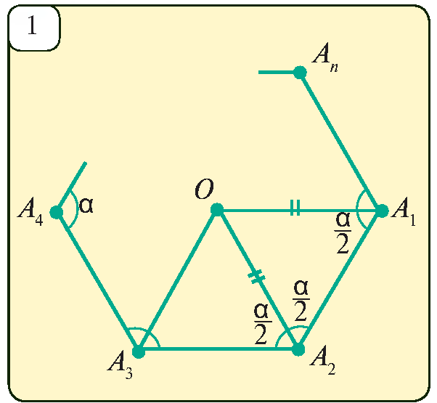
Muntazam ko‘pburchaklar
Hamma tomonlari teng va hamma burchaklari teng bo‘lgan qavariq ko‘pburchakka muntazam ko‘pburchak deyiladi.
$$S=\left(n−2\right)∙180°$$
$$α=\frac{\left(n−2\right)∙180°}{n}$$
$$β=\frac{360°}{n}$$
$$d=\frac{n∙\left(n−3\right)}{2}$$

Slide 15
Muntazam ko‘pburchaklar
1.19. Ichki burchakari yig‘indisi $1800°$ bo‘lgan muntazam ko‘pburchakning tomonlari sonini toping.
$$S=1800° =>n=?$$
$$S=\left(n−2\right)∙180°$$
$$1800°=\left(n−2\right)∙180°$$
$$n−2=\frac{1800°}{180°}$$
$$n−2=10$$
$$n=12$$
Javob: $12$

Slide 16
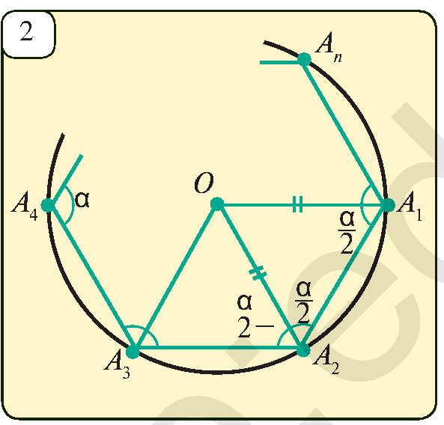
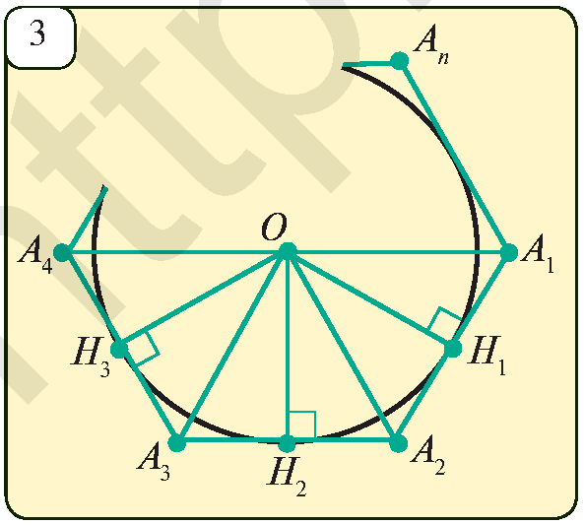
Muntazam ko‘pburchakka ichki va
tashqi chizilgan aylana
Muntazam ko‘pburchakka ham tashqi, ham ichki aylana chizish mumkin va bu aylanalarning markazlari ustma ust tushadi.

Slide 17
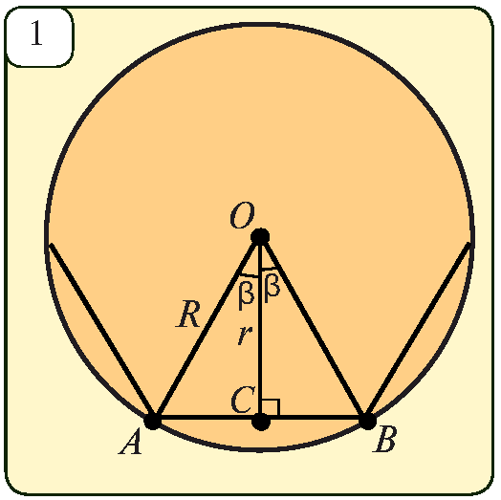
Muntazam ko‘pburchakka ichki va
tashqi chizilgan aylana
$a_{n}−$ muntazam $n$ burchak tomoni
$R−$ tashqi chizilgan aylana radiusi
$r−$ ichki chizilgan aylana radiusi
$O−$ ko‘pburchakning markazi
$$β=∠AOC=\frac{1}{2}∠AOB=\frac{1}{2}∙\frac{360°}{n}=\frac{180°}{n}$$
$$R=OA=\frac{AC}{\sin{β}}=\frac{a_{n}}{2\sin{\frac{180°}{n}}}$$
$$r=OC=\frac{AC}{\operatorname{tg}{β}}=\frac{a_{n}}{2\operatorname{tg}{\frac{180°}{n}}}$$

Slide 18
Masalalar yechish
Tomoni uzunligi $12 cm$ ga teng bo‘lgan muntazam oltiburchak berilgan. Unga ichki va tashqi chizilgan aylanalar radiuslarini, oltiburchak perimetri va yuzini toping.
$R=\frac{a_{6}}{2\sin{\frac{180°}{6}}}=\frac{12}{2∙\sin{30°}}=12$
$r=\frac{a_{6}}{2\operatorname{tg}{\frac{180°}{6}}}=\frac{12}{2∙tg30°}=6\sqrt{3}$
$$r$$
$$R$$
$$P=6∙a=6∙12=72;$$
$$S=6∙S_{1}=$$
$$=6∙\frac{a^{2}\sqrt{3}}{4}=6∙\frac{144\sqrt{3}}{4}=216\sqrt{3}$$
$$S_{1}$$
$$a$$

Slide 19
Mustaqil bajarish uchun topshiriqlar
Darslikning
109 betidagi 2, 3, 6, 7 mashqlar;
110 betidagi 10, 12, 16 mashqlar;

Slide 20
E’TIBORINGIZ UCHUN RAHMAT!
ARALASHMAGA OID MASALALAR

