Slide 1
Fizika
10-sinf
Mavzu:
Masalalar yechish.

Slide 2
Savol
Rasmda tasvirlangan ko‘ndalang to‘lqin uzunligi qaysi raqam bilan ko‘rsatilgan?
Javob: 4-kesma

Slide 3
Masala
Garmonik tebranish $x=Asin\left(\frac{π}{3}t\right)$ qonuniyat bo‘yicha ro‘y bermoqda tebranish chastotasini toping.

Slide 4
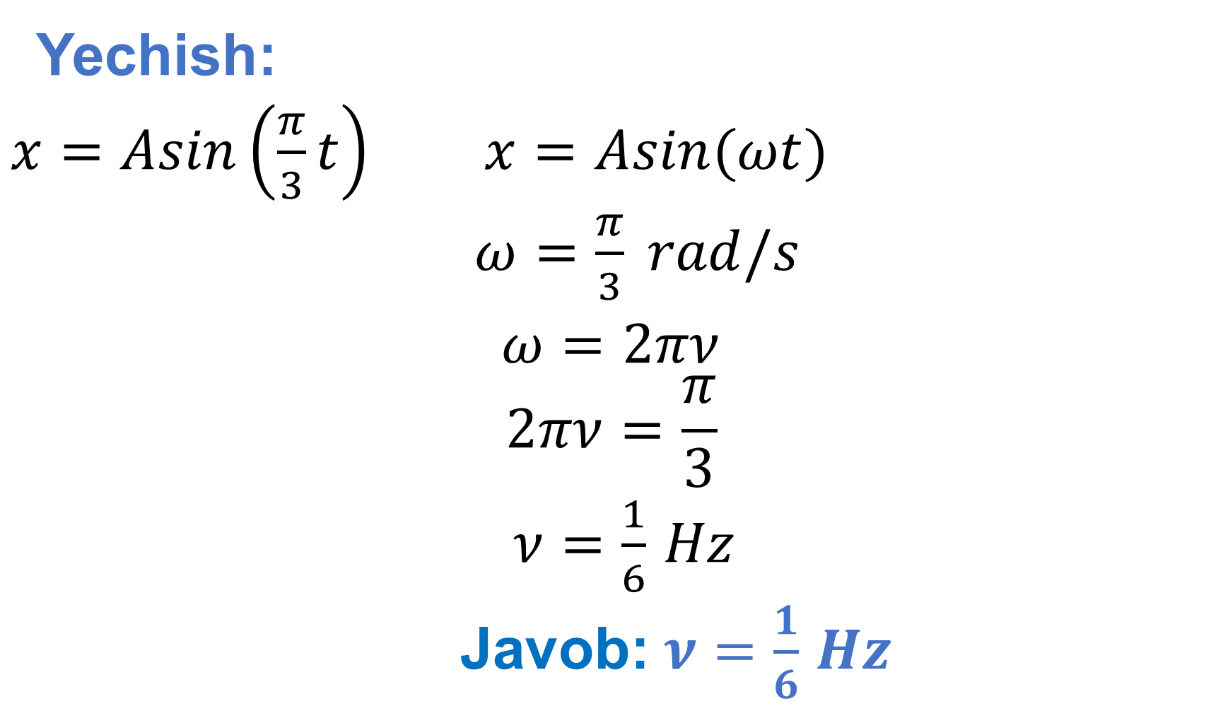
Yechish:
$x=Asin\left(\frac{π}{3}t\right)$ $x=Asin(ωt)$
$ω=\frac{π}{3} rad/s$
$ω=2πν$
$$2πν=\frac{π}{3}$$
$ν=\frac{1}{6}$ $Hz$
Javob: $ν=\frac{1}{6}$ $Hz$

Slide 5

Masala
Garmonik tebranish $x=0,1sin⁡(\frac{π}{6}t)$ qonun bo‘yicha ro‘y bermoqda, jism tezlansihning maksimal qiymatini toping ($π=3$ deb oling).

Slide 6
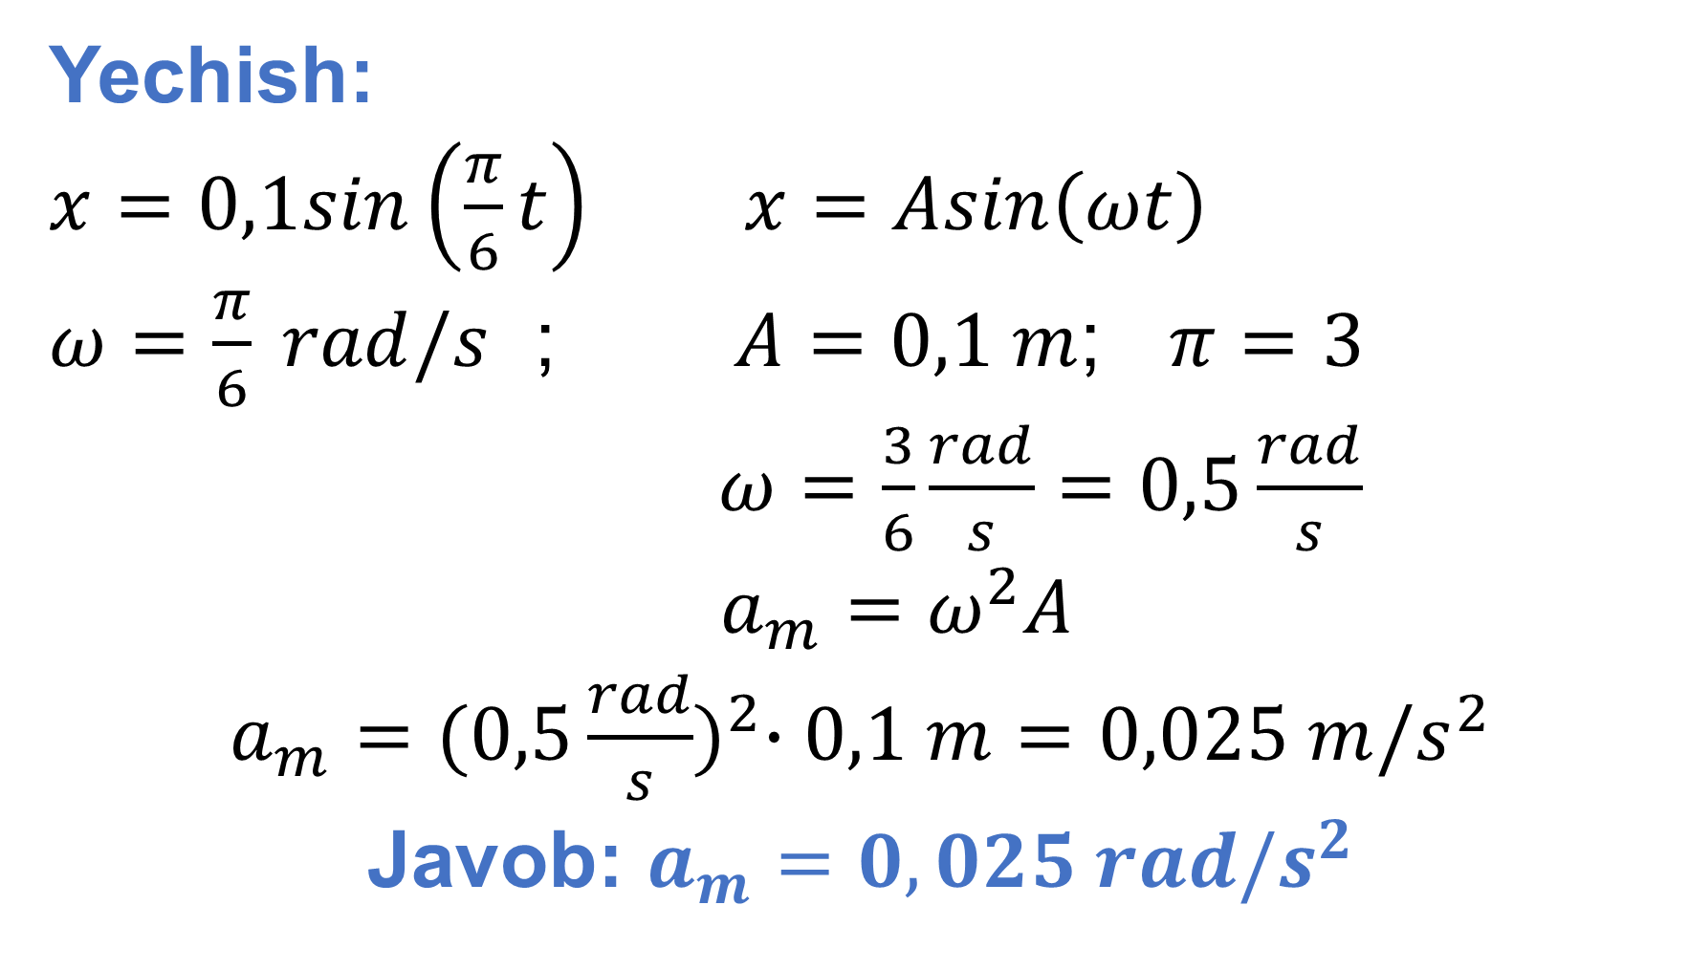
Yechish:
$x=0,1sin\left(\frac{π}{6}t\right)$ $x=Asin\left(ωt\right)$
$ω=\frac{π}{6} rad/s$ ; $A=0,1 m$; $π=3$
$ω=\frac{3}{6}\frac{rad}{s}=0,5\frac{rad}{s}$
$a_{m}=ω^{2}A$
$a_{m}={(0,5\frac{rad}{s})}^{2}∙0,1 m=0,025 m/s^{2}$
Javob: $a_{m}=0,025 rad/s^{2}$

Slide 7

Masala
Garmonik tebranayotgan jismning maksimal tezlanishi $5\frac{m}{s^{2}},$ siklik chastotasi $2 rad/s$ bo‘lsa, tebranishning maksimal tezligini toping.

Slide 8
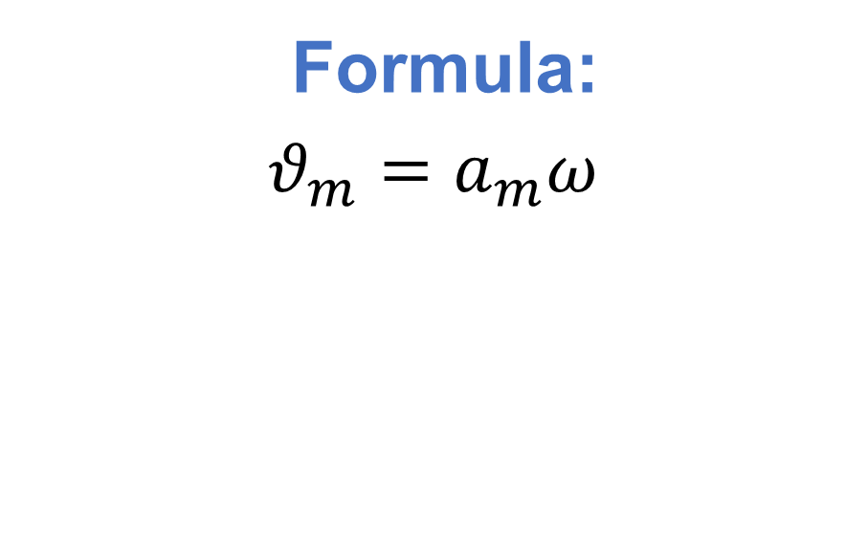
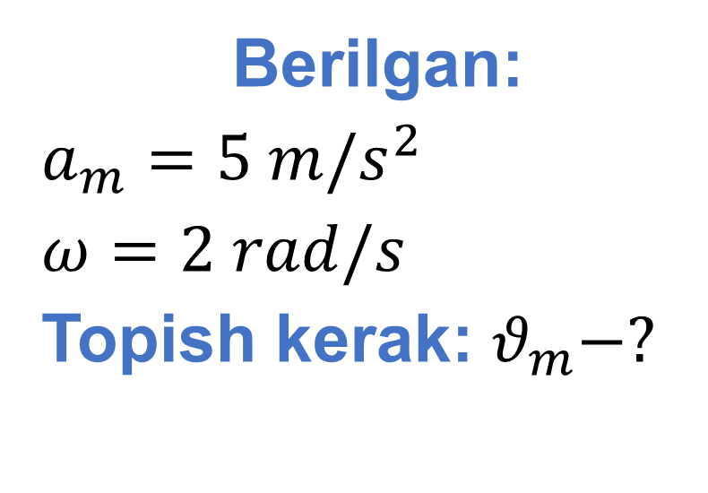
Berilgan:
$a_{m}=5 m/s^{2}$
$ω=2 rad/s$
Topish kerak: $θ_{m}−?$
Formula:
$θ_{m}=a_{m}ω$
Yechish: $θ_{m}=5\frac{m}{s^{2}}∙2\frac{rad}{s}=10 m/s$
Javob: $θ=10 m/s$

Slide 9
Masala
Bikrligi 1200 N/m bo‘lgan prujinaning bir uchiga mahkamlangan 3 kg li jism 2,5 cm amplituda bilan tebranmoqda. Agar kuzatish boshlanganda jism muvozanat nuqtasidan o‘tgan bo‘lsa jism harakat tenglamasini yozing (boshlang‘ich faza nolga teng deb oling).

Slide 10

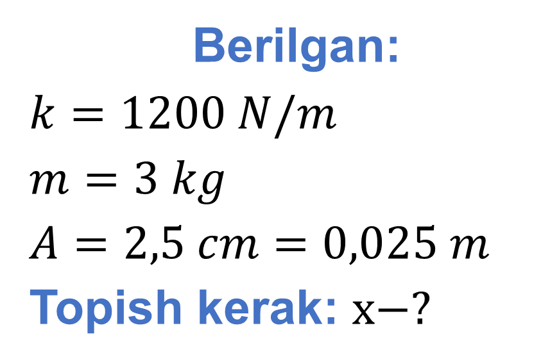
Berilgan:
$k=1200 N/m$
$m=3 kg$
$A=2,5 cm=0,025 m$
Topish kerak: $x−?$
Formula:
$x=Acosωt$
$ω=\sqrt{\frac{k}{m}}$
Yechish: $ω=\sqrt{\frac{1200 N/m}{3 kg}}=20 rad/s$
$x=0,025cos⁡(20t)$
Javob:$x=0,025cos⁡(20t)$

Slide 11
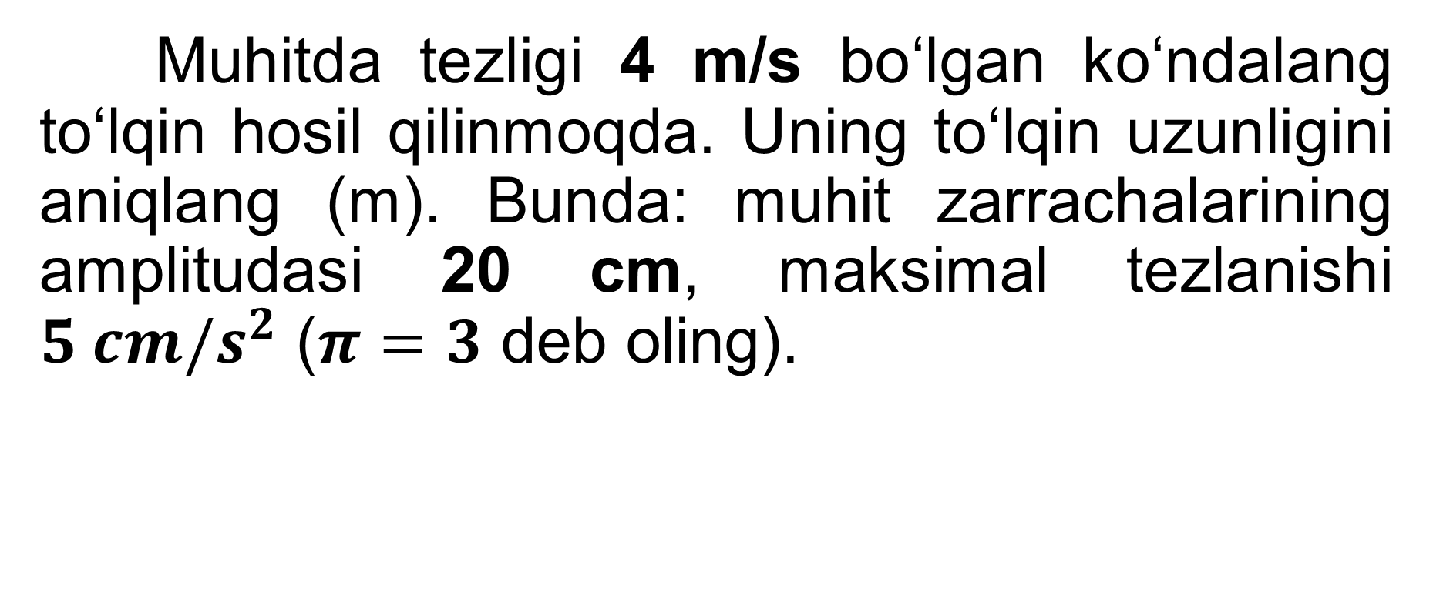
Masala
Muhitda tezligi 4 m/s bo‘lgan ko‘ndalang to‘lqin hosil qilinmoqda. Uning to‘lqin uzunligini aniqlang (m). Bunda: muhit zarrachalarining amplitudasi 20 cm, maksimal tezlanishi $5 cm/s^{2}$ ($π=3$ deb oling).

Slide 12
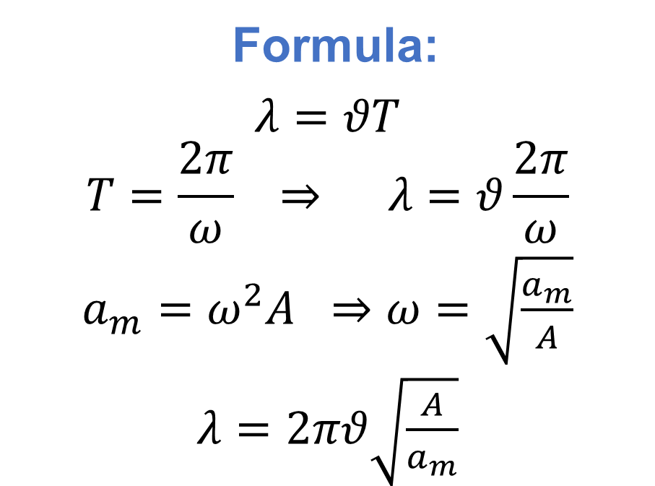
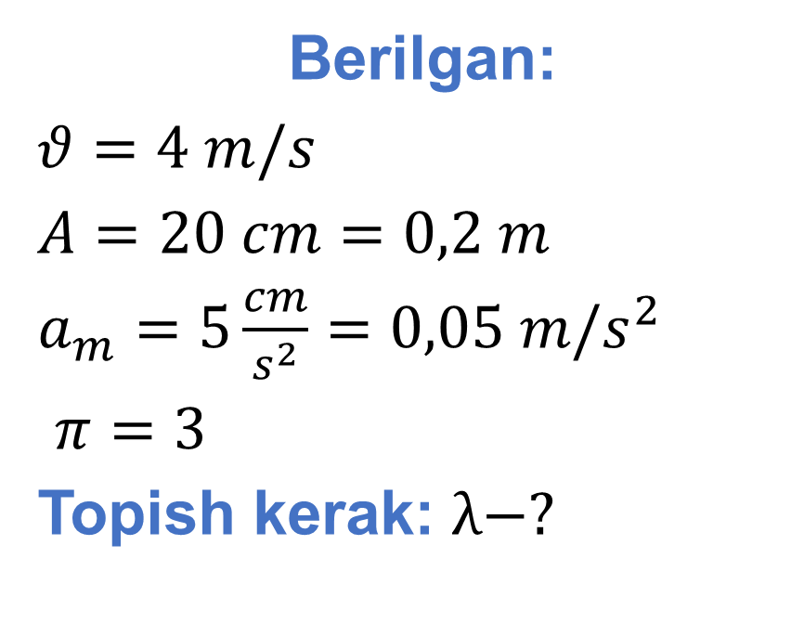
Berilgan:
$θ=4 m/s$
$A=20 cm=0,2 m$
$a_{m}=5\frac{cm}{s^{2}}=0,05 m/s^{2}$
$π=3$
Topish kerak: $λ−?$
Formula:
$λ=θT$
$$T=\frac{2π}{ω} ⇒ λ=θ\frac{2π}{ω}$$
$a_{m}=ω^{2}A ⇒ω=\sqrt{\frac{a_{m}}{A}}$
$λ=2πθ\sqrt{\frac{A}{a_{m}}}$
Yechish: $λ=2∙3∙4\frac{m}{s}∙\sqrt{\frac{0,2 m}{0,05\frac{m}{s^{2}}}}=48 m$
Javob: $λ=48 m$

Slide 13
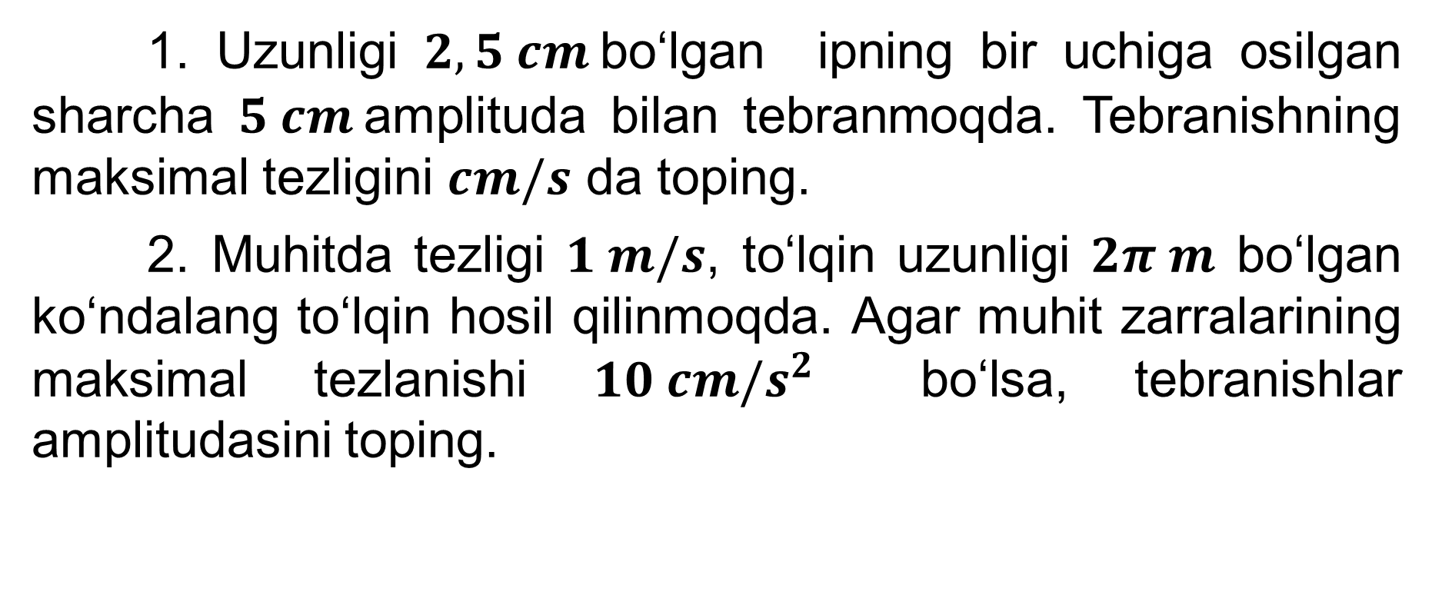
Mustaqil bajarish uchun topshiriqlar
1. Uzunligi $2,5 cm$bo‘lgan ipning bir uchiga osilgan sharcha $5 cm$amplituda bilan tebranmoqda. Tebranishning maksimal tezligini $cm/s$ da toping.
2. Muhitda tezligi $1 m/s$, to‘lqin uzunligi $2π m$ bo‘lgan ko‘ndalang to‘lqin hosil qilinmoqda. Agar muhit zarralarining maksimal tezlanishi $10 cm/s^{2}$ bo‘lsa, tebranishlar amplitudasini toping.

