Slide 1
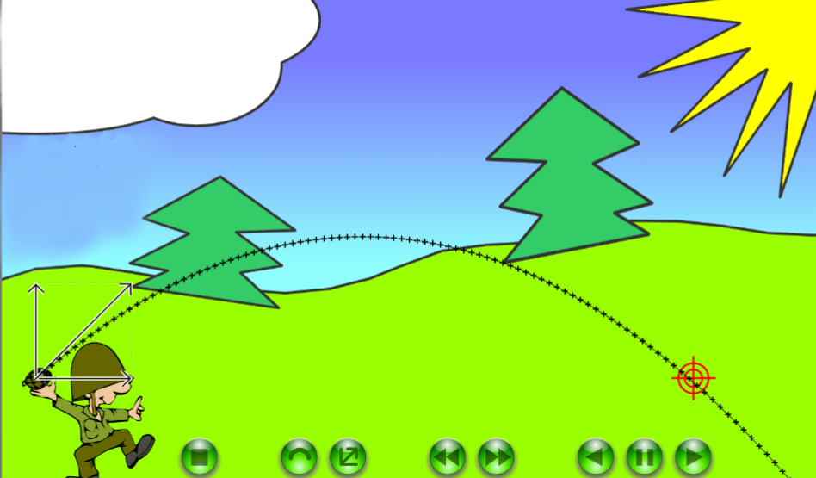
Fizika
10
sinf
MAVZU: Masalalar yechish.

Slide 2
To‘g‘ri chiziqli tekis harakat
Teng vaqtlar oralig‘ida teng masofalarni bosib o‘tadi.
$$S=θ∙t ; θ=\frac{S}{t}$$
$$t=\frac{S}{θ}$$
𝑆=𝜗∙𝑡 ; 𝜗=𝑆/𝑡
𝑡=𝑆/𝜗
To‘g‘ri chiziqli notekis harakat
Harakat tezligining kattaligi o‘zgaradi.
$S=θ_{o‘rt}∙t ;θ_{o‘rt}=\frac{S}{t}$
$$t=\frac{S}{θ_{o‘rt}}$$
𝑆=𝜗_(𝑜‘𝑟𝑡)∙𝑡 ;𝜗_(𝑜‘𝑟𝑡)=𝑆/𝑡
𝑡=𝑆/𝜗_(𝑜‘𝑟𝑡)
To‘g‘ri chiziqli tekis o‘zgaruvchan harakat
Teng vaqtlar oralig‘ida tezligini teng qiymatlarga o‘zgartiradi.
$$S=θ_{0}∙t+\frac{g∙t^{2}}{2}$$
$$a=\frac{θ−θ_{0}}{t}$$
𝑆=𝜗_0∙𝑡+(𝑔∙𝑡^2)/2
𝑎=(𝜗−𝜗_0)/𝑡

Slide 3
$$h=θ_{0}∙t+\frac{g∙t^{2}}{2}$$
ℎ=𝜗_0∙𝑡+□(64&(𝑔∙𝑡^2)/2)
Vertikal yuqoriga otilgan jism harakati.
$$h=θ_{0}∙t−\frac{g∙t^{2}}{2}$$
ℎ=𝜗_0∙𝑡−□(64&(𝑔∙𝑡^2)/2)
$$θ=θ_{0}−g∙t$$
𝜗=𝜗_0−𝑔∙𝑡
Tushish vaqti ko‘tarilish vaqtiga teng.
$$t_{k}=t_{tush}=\frac{θ_{0}}{g}$$
𝑡_𝑘=𝑡_𝑡𝑢𝑠ℎ=𝜗_0/𝑔
$$t_{umumiy}=\frac{2θ_{0}}{g}$$
𝑡_𝑢𝑚𝑢𝑚𝑖𝑦=(2𝜗_0)/𝑔
Vertikal pastga tushayotgan (erkin tushayotgan) jism harakati.
$$θ=θ_{0}+g∙t$$
𝜗=𝜗_0+𝑔∙𝑡

Slide 4
Chiziqli tezlik
$$θ=\frac{\breve{S}}{t}==ω∙R$$
𝜗=𝑆 ̆/𝑡==𝜔∙𝑅
Burchaktezlik
$$ω=\frac{∆φ}{∆t}$$
𝜔=∆𝜑/∆𝑡
Burchak tezlanish
$$ε=\frac{∆ω}{∆t}$$
𝜀=∆𝜔/∆𝑡
Burilish burchagi
$$∆φ=\frac{\breve{S}}{R}$$
∆𝜑=𝑆 ̆/𝑅

Slide 5
Friksion usulda harakatni uzatish.
Har xil diametrli ikki g‘ildirak bir biriga siqib turiladi, ular ishqalanish kuchi ta’sirida qarama-qarshi yo‘nalishda aylanadi.
$$\frac{ω_{1}}{ω_{2}}=\frac{R_{2}}{R_{1}}$$
𝜔_1/𝜔_2 =𝑅_2/𝑅_1
Harakatni tasmali usulda uzatish.
Ikki g‘ildirak bir-biriga tarang tortilgan tasma bilan biriktiriladi. Bunda uzatish ishqalanish hisobiga amalga oshiriladi.
$$\frac{ω_{1}}{ω_{2}}=\frac{R_{2}}{R_{1}}$$
𝜔_1/𝜔_2 =𝑅_2/𝑅_1
Harakatni tishli g‘ildiraklar orqali uzatish.
Har xil diametrli ikkita tishli g‘ildirakning tishlarini bir-biriga kiygazish orqali amalga oshiriladi.
$$\frac{N_{1}}{N_{2}}=\frac{ν_{2}}{ν_{1}}$$
𝑁_1/𝑁_2 =𝜈_2/𝜈_1

Slide 6
Gorizontal otilgan jism harakati
$$θ_{x}=θ_{0} θ_{y}=g∙t$$
$$θ^{2}=θ_{x}^{2}+θ_{y}^{2}$$
𝜗_𝑥=𝜗_0 𝜗_𝑦=𝑔∙𝑡
𝜗^2=𝜗_𝑥^2+𝜗_𝑦^2
$$x=S=θ_{0}∙t$$
$$S=θ_{0}\sqrt{\frac{2h}{g}}$$
𝑥=𝑆=𝜗_0∙𝑡
𝑆=𝜗_0 √(2ℎ/𝑔)
$$t=\frac{S}{θ_{0}}=\sqrt{\frac{2h}{g}}$$
𝑡=𝑆/𝜗_0 =√(2ℎ/𝑔)
$$h=\frac{g∙t^{2}}{2}$$
$$y=h−\frac{g}{2θ_{0}^{2}}x^{2}$$
ℎ=(𝑔∙𝑡^2)/2
𝑦=ℎ−𝑔/(2𝜗_0^2 ) 𝑥^2

Slide 7
Gorizontga qiya otilgan jism harakati
$$θ_{0x}=θ_{0}∙\sin{α}$$
$$θ_{0y}=θ_{0}∙\sin{α}$$
$$θ^{2}=θ_{x}^{2}+θ_{y}^{2}$$
𝜗_0𝑥=𝜗_0∙sin⁡𝛼
𝜗_0𝑦=𝜗_0∙sin⁡𝛼
𝜗^2=𝜗_𝑥^2+𝜗_𝑦^2
$$x=S=θ_{0x}∙t==θ_{0}∙t∙\cos{α}$$
$$S=\frac{θ_{0}^{2}∙\sin{2α}}{g}$$
𝑥=𝑆=𝜗_0𝑥∙𝑡==𝜗_0∙𝑡∙cos⁡𝛼
𝑆=(𝜗_0^2∙sin⁡2𝛼)/𝑔
$$t=\frac{2θ_{0}∙\sin{α}}{g}$$
𝑡=(2𝜗_0∙sin⁡𝛼)/𝑔
$$h_{max}=\frac{2θ_{0}^{2}\sin^{2}α}{2g}$$
$$y=x∙\tan{α}−\frac{g}{2θ_{0}^{2}\cos^{2}α}$$
ℎ_𝑚𝑎𝑥=(2𝜗_0^2 〖𝑠𝑖𝑛〗^2 𝛼)/2𝑔
𝑦=𝑥∙tan⁡𝛼−𝑔/(2𝜗_0^2 〖𝑐𝑜𝑠〗^2 𝛼)

Slide 8
1-namunaviy masala
Samalyot ko‘tarilishi uchun zarur bo‘lgan yo‘lning uzunligi 675 m. Agar samalyot tekis tezlanuvchan harakat qilib 15 s dan so‘ng yerdan ko‘tarilsa, uning yerdan uzilish tezligi qanday?

Slide 9
Berilgan: Formula:
$θ_{0}=0$ $θ=θ_{0}+a∙t$; $θ_{0}=0$ da $θ=a∙t$
$S=675 m$ $S=θ_{0}∙t+\frac{a∙t^{2}}{2}$ $θ_{0}=0$ uchun
$t=15 s$ $S=\frac{a∙t^{2}}{2} ⇒ a=\frac{2∙S}{t^{2}}$
$θ=\frac{2∙S}{t^{2}}∙t=\frac{2∙S}{t}$
T.K: $θ−?$
Yechish: $θ=\frac{2∙675 m}{15 s}=\frac{1350 m}{15 s}=90 m/s$
Javob: $θ=90 m/s$

Slide 10
2-test
Jism 15 m/s tezlik bilan vertikal pastga qarab tashlandi. U 2 s o‘tgach qanday tezlikka erishadi (m/s)?
A) 25
B) 35
C) 30
D) 40

Slide 11
Berilgan: Formula:
$θ_{0}=15 m/s$ $θ=θ_{0}+g∙t$
$t=2 s$
$g=10\frac{m}{s^{2}}$
T.K: $θ−?$
Yechish:$θ=15\frac{m}{s}+10\frac{m}{s^{2}}∙2 s=35 m/s$
Javob: B) 35 $m/s$

Slide 12
5-test
Massalari 100 g va 150 g bo‘lgan ikki metall sharcha bir xil tezlik bilan tik yuqoriga otildi. Ularning qaysi biri balandroq ko‘tariladi? Havoning qarshiligini hisobga olmang.
A) massasi kichik bo‘lgan sharcha;
B) massasi katta bo‘lgan sharcha;
C) ikkalasi bir xil balandlikkacha ko‘tariladi;
D) berilgan ma’lumotlar yetarli emas.
Yechish: $h_{max}=\frac{θ_{0}^{2}}{2g}$ ; $θ_{1−0}=θ_{2−0} ⇒h_{1−max}=h_{2−max}$
Javob: C) ikkalasi bir xil balandlikkacha ko‘tariladi;

Slide 13
9-test
125 m balandlikdagi minoradan jism 30 m/s tezlik bilan gorizontal yo‘nalishda otildi. Jismning uchish uzoqligini aniqlang.
A) 300 m
B) 120 m
C) 240 m
D) 150 m

Slide 14
Berilgan: Formula:
$θ_{0}=30 m/s$ $S=θ_{0}∙t$ $h=\frac{g∙t^{2}}{2}$
$h=125 m$ $t^{2}=\frac{2h}{g}⇒ t=\sqrt{\frac{2h}{g}}$
$g=10\frac{m}{s^{2}}$ $S=θ_{0}∙\sqrt{\frac{2h}{g}}$
T.K: $S−?$
Yechish:$S=30\frac{m}{s}∙\sqrt{\frac{2∙125 m}{10 \frac{m}{s^{2}}}}=30\frac{m}{s}∙5 s=150 m$
Javob: D) 150 m

Slide 15
10-test
Jism yerdan gorizontga 30$°$ burchak ostida 20 m/s boshlang‘ich tezlik bilan otildi. Boshlang‘ich tezlik vektorining gorizontal va vertikal tashkil etuvchilarini aniqlang (m/s).
A) 10 va 14,1; B) 17,3 va 10;
C) 14,1 va 10; D) 20 va 10

Slide 16
Yechish: $\sin{30°}=0,5$ $\cos{30°}≈0,867$
${ θ}_{x}=θ_{0}∙\cos{α}=20\frac{m}{s}∙0,5=10 m/s$
${ θ}_{y}=θ_{0}∙\sin{α}=20\frac{m}{s}∙0,867=17,34 m/s$
Javob: B) 17,3 va 10;

Slide 17
Mustaqil bajarish uchun topshiriqlar:
24-25-betdagi 1,3,4,6,7,8-testlarni yechish.

