Slide 1
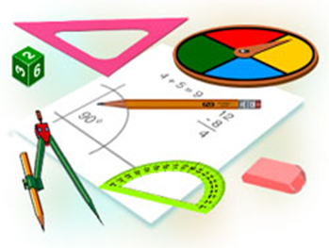
Algebra
10-sinf
Mavzu:
Misollar yechish

Slide 2
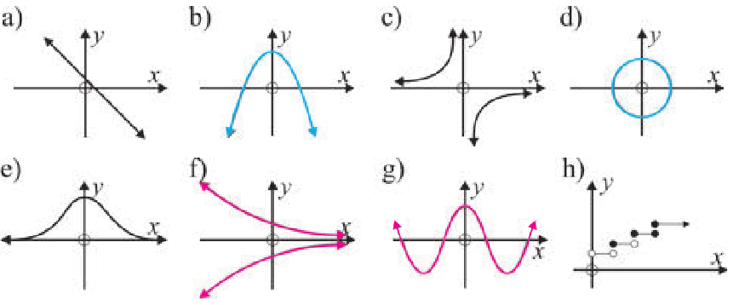
Mustaqil bajarish uchun berilgan mashqlarni tekshirish
74-mashq.
Quyidagi munosabatlardan qaysilari funksiya bo‘ladi?

Slide 3
Misollar yechish
76-mashq.
$x^{2}+y^{2}=9$ tenglama bilan berilgan munosabat funksiya bo‘ladimi?
Yechish.
${(x−a)}^{2}+{(y−b)}^{2}=R^{2}$ markazi O(a,b) bo‘lgan aylana tenglamasi.
$a=b=0$, $R=3$
$$y$$
O(0;0)
$$R$$
$$x$$
$$O$$

Slide 4
Bir o‘zgaruvchili irratsional tengsizliklar
Misollar yechish
77-mashq.
Agar $f\left(x\right)=3x+2$ bo‘lsa, quydagi qiymatlarni toping:
$A)f\left(0\right);$ $B)f\left(2\right);$ $C)f\left(−1\right);$ $D)f\left(−5\right);$
Yechish.
$$A)f\left(0\right)=3∙0+2=0+2=2$$
B$)f\left(2\right)=3∙2+2=6+2=2$
C$)f\left(−1\right)=3∙\left(−1\right)+2=−3+2=−1$
D$)f\left(−5\right)=3∙\left(−5\right)+2=−15+2=−13$

Slide 5
Bir o‘zgaruvchili irratsional tengsizliklar
Misollar yechish
78-mashq.
Agar $f\left(x\right)=3x−x^{2}+2$ bo‘lsa, quydagi qiymatlarni toping:
$A)f\left(0\right);$ $B)f\left(3\right);$ $C)f\left(−3\right);$ $D)f\left(−7\right);$
Yechish.
$$A) f\left(0\right)=3∙0−0^{2}+2=0+2=2$$
B$) f\left(3\right)=3∙3−3^{2}+2=9−9+2=0+2=2$
C$) f\left(−3\right)=3∙(−3)−(−{3)}^{2}+2=−9−9+2=−16$
D$) f\left(−1\right)=3∙(−7)−(−{7)}^{2}+2=−21−49+2=−68$

Slide 6
Bir o‘zgaruvchili irratsional tengsizliklar
Misollar yechish
79-mashq.
Agar $g\left(x\right)=x−\frac{4}{x}$ bo‘lsa, quydagi qiymatlarni toping:
$A) g\left(1\right);$ $B) g\left(4\right);$ $C) g\left(−1\right);$ $D) g\left(−4\right);$
Yechish.
$$A) g\left(1\right)=1−\frac{4}{1}=1−4=−3$$
B$) g\left(4\right)=4−\frac{4}{4}=4−1=3$
C$) g\left(−1\right)=−1−\frac{4}{(−1)}=−1+4=3$
D$) g\left(−1\right)=−4−\frac{4}{\left(−4\right)}=−4+1=−3$

Slide 7
Bir o‘zgaruvchili irratsional tengsizliklar
Misollar yechish
82-mashq. $G\left(x\right)=\frac{2x+3}{x−4}$ funksiya uchun:
$$\text{a}\text{) }G\left(2\right), G\left(0\right) \text{va} G\left(−0,5\right) \text{larni} \text{toping}\text{;}$$
$$\text{b}\text{) }\text{Qanday} x \text{larda} G\left(x\right) \text{mavjud} \text{emas}\text{?}$$
$\text{c}\text{) }G\left(x+2\right)ni$toping va soddalashtiring;
$$\text{d}\text{) }x \text{ning} G\left(x\right)=−3 \text{bo}\text{‘}\text{ladigan} \text{qiymatini} \text{toping}\text{.}$$
Yechish.
a) $G\left(2\right)=\frac{2∙2+3}{2−4}=−\frac{7}{2};$ $G\left(2\right)=\frac{2∙0+3}{0−4}=−\frac{3}{4};$
$$G\left(2\right)=\frac{2∙(−0,5)+3}{−0,5−4}=−\frac{2}{4,5}=−\frac{4}{9}$$
$\text{b}\text{) }x=4$ da $G\left(x\right)$ mavjud emas!

Slide 8
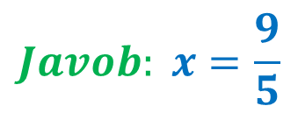
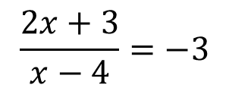
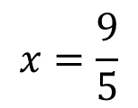
Bir o‘zgaruvchili irratsional tengsizliklar
Misollar yechish
82-mashq. $G\left(x\right)=\frac{2x+3}{x−4}$ funksiya uchun:
$$\text{c}\text{) }G\left(x+2\right)=\frac{2∙\left(x+2\right)+3}{\left(x+2\right)−4}=\frac{2x+4+3}{x+2−4}=\frac{2x+7}{x−2}$$
$\text{d}\text{) }G\left(x\right)=−3$
$$\frac{2x+3}{x−4}=−3$$
$$2x+3x =12−3$$
$$5x=9$$
$$2x+3 =−3(x−4)$$
$$x=\frac{9}{5}$$
$$Javob: x=\frac{9}{5}$$
$$2x+3 =−3x+12$$

Slide 9
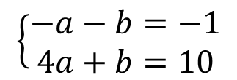
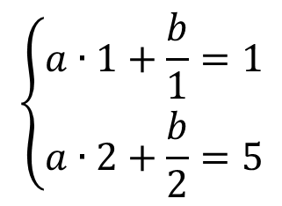
Bir o‘zgaruvchili irratsional tengsizliklar
Misollar yechish
87-mashq.
Agar $f\left(x\right)=ax+\frac{b}{x}, f\left(1\right)=1, f\left(2\right)=5$ bo‘lsa, a,b larni toping:
Yechish.
$$\left\{\begin{aligned}a∙1+\frac{b}{1}=1 \\ a∙2+\frac{b}{2}=5\end{aligned}\right.$$
$$\left\{\begin{aligned}a+b=1 \\ 4a+b=2∙5\end{aligned}\right.$$
$$\left\{\begin{aligned}−a−b=−1 \\ 4a+b=10\end{aligned}\right.$$
$$3+b=1$$
$$b=−2$$
$3a=$9
$$a=3$$
$$Javob:a=3, b=−2$$

Slide 10
Bir o‘zgaruvchili irratsional tengsizliklar
Misollar yechish
89-mashq.
Agar $f\left(x\right)=2^{x}$ bo‘lsa, $f\left(a\right)∙f(b)=f(a+b)$ tenglikni isbotlang.
Yechish.
$$f\left(a\right)=2^{a}$$
$$f\left(a+b\right)=2^{a+b}$$
$$f\left(b\right)=2^{b}$$
$$f\left(a\right)∙f\left(b\right)={2^{a}∙2}^{b}=2^{a+b}$$
$$2^{a+b}=2^{a+b}$$
$$f\left(a\right)∙f\left(b\right)=f\left(a+b\right)$$

Slide 11
Mustaqil yechish uchun topshiriq
Darslik II qismining 8-sahifasidagi 86-88-mashqlarni yechish

