Slide 1
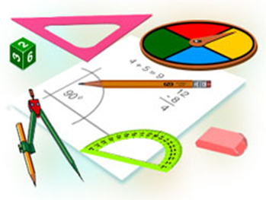
Algebra
10-sinf
Mavzu:
Misollar yechish

Slide 2
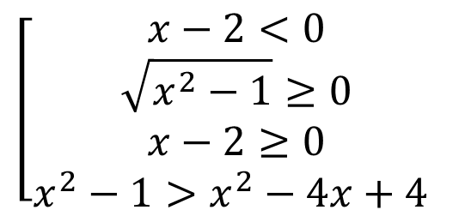
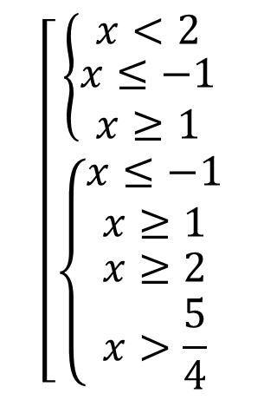
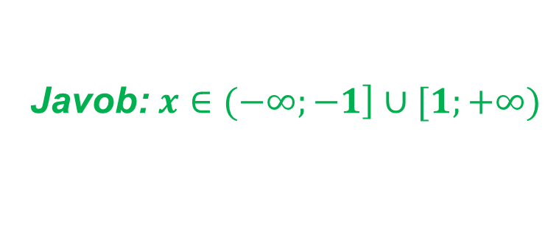
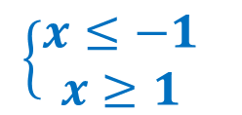
Mustaqil bajarish uchun berilgan mashqlarni tekshirish
60-mashq. Tengsizlikni yeching:
$$2) \sqrt{x^{2}−1}>x−2$$
$$\left[\begin{aligned}\left\{\begin{aligned}x<2 \\ \begin{aligned}x≤−1 \\ x≥1\end{aligned}\end{aligned}\right. \\ \left\{\begin{aligned}\begin{aligned}x≤−1 \\ x≥1\end{aligned} \\ \begin{aligned}x≥2 \\ x>\frac{5}{4}\end{aligned}\end{aligned}\right.\end{aligned}\right.$$
Yechish.
$$\left[\begin{aligned}x−2<0 \\ \sqrt{x^{2}−1}≥0 \\ x−2≥0 \\ x^{2}−1>x^{2}−4x+4 \end{aligned}\right.$$
$$\left\{\begin{aligned}x≤−1 \\ x≥1\end{aligned} \right.$$
Javob:$x∈(−∞;\left.−1\right]∪[1;+∞)$

Slide 3
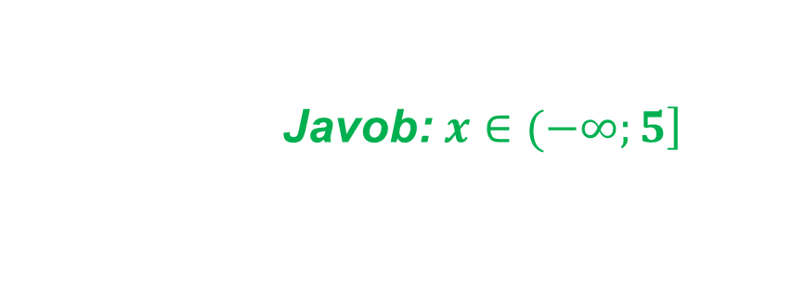
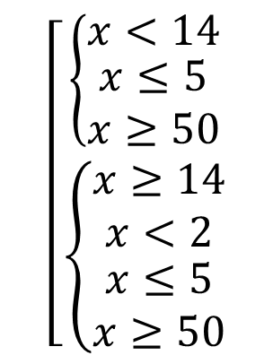
Mustaqil bajarish uchun berilgan mashqlarni tekshirish
62-mashq. Tengsizlikni yeching:
$$2) \sqrt{x^{2}−55x+250}>x−14$$
Yechish.
$$\left[\begin{aligned}\left\{\begin{aligned}x<14 \\ \begin{aligned}x≤5 \\ x≥50\end{aligned}\end{aligned}\right. \\ \left\{{\begin{aligned}x≥14 \\ x<2\end{aligned} \atop \begin{aligned}x≤5 \\ x≥50\end{aligned}}\right.\end{aligned}\right.$$
$$\left[\begin{aligned}x−14<0 \\ x^{2}−55x+250≥0 \\ x−14≥0 \\ x^{2}−55x+250>x^{2}−28x+196 \end{aligned}\right.$$
Javob:$x∈(−∞;\left.5\right]$

Slide 4
Mustaqil bajarish uchun berilgan mashqlarni tekshirish
68-mashq.
Tekislikda $A\left(2;4\right), B\left(−3;5\right), C(x,y)$ nuqtalar berilgan. $AC>BC$ shartni qanoatlantiruvchi sohani toping.
Yechish.
$\sqrt{{(x−2)}^{2}+{(y−4)}^{2}}>\sqrt{{(x+3)}^{2}+{(y−5)}^{2}}$
${(x−2)}^{2}+{(y−4)}^{2}>{(x+3)}^{2}+{(y−5)}^{2}$
$x^{2}−4x+4+y^{2}−8y+16>x^{2}+6x+9+y^{2}−10y+25$
$$10y−8y>6x+4x+34−20$$
$$2y>10x+14$$
$$y>5x+7$$
Javob:$y>5x+7$

Slide 5
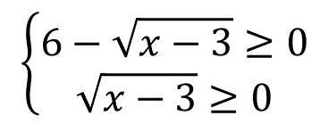
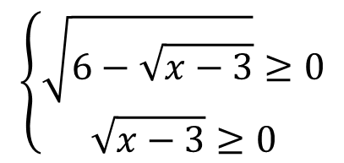
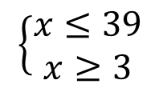
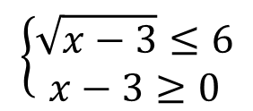
Bir o‘zgaruvchili irratsional tengsizliklar
Misollar yechish
1-mashq. Noma’lumlarning qaysi qiymatlarida tengsizlik ma’noga ega?
$$\sqrt{6−\sqrt{x−3}}<4$$
Yechish.
$$\left\{\begin{aligned}\sqrt{6−\sqrt{x−3}}≥0 \\ \sqrt{x−3}≥0\end{aligned}\right.$$
$$\left\{\begin{aligned}\sqrt{x−3}≤6 \\ x−3≥0\end{aligned}\right.$$
$$6−\sqrt{x−3}<16$$
$$\sqrt{x−3}>−10$$
$$\left\{\begin{aligned}x≤39 \\ x≥3\end{aligned}\right.$$
$$\left\{\begin{aligned}6−\sqrt{x−3}≥0 \\ \sqrt{x−3}≥0\end{aligned}\right.$$
Javob:$x∈\left[3;39\right]$

Slide 6
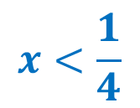
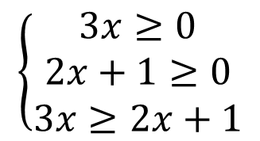
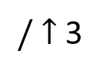
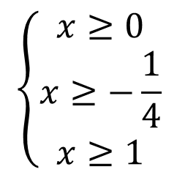
Misollar yechish
2-mashq. Tengsizlikni yeching:
$1) \sqrt[3]{x+1}>\sqrt[3]{5x}$ $2) \sqrt{3x}−\sqrt{2x+1}≥0$
Yechish.
$$1) \sqrt[3]{x+1}>\sqrt[3]{5x}$$
$/$ $↑$ 3
$$2) \sqrt{3x}−\sqrt{2x+1}≥0$$
$$\left\{\begin{aligned}x≥0 \\ x≥−\frac{1}{4} \\ x≥1\end{aligned}\right.$$
$$x+1 >5x$$
$$\left\{\begin{aligned}3x≥0 \\ 2x+1≥0 \\ 3x≥2x+1\end{aligned}\right.$$
$$1 >4x$$
$$x<\frac{1}{4}$$
Javob: $x∈(−∞;\frac{1}{4})$
Javob: $x∈[1;+∞)$

Slide 7
Misollar yechish
3-mashq.
Tekislikda $A\left(4;4\right), B\left(−5;7\right), C(x,y)$ nuqtalar berilgan. $AC>BC$ shartni qanoatlantiruvchi sohani toping.
Yechish.
$\sqrt{{(x−4)}^{2}+{(y−4)}^{2}}>\sqrt{{(x+5)}^{2}+{(y−7)}^{2}}$
${(x−4)}^{2}+{(y−4)}^{2}>{(x+5)}^{2}+{(y−7)}^{2}$
$x^{2}−8x+16+y^{2}−8y+16>x^{2}+10x+25+y^{2}−14y+49$
$$14y−8y>10x+8x+74−32$$
$$6y>18x+42$$
$$y>3x+7$$
Javob:$y>3x+7$

Slide 8
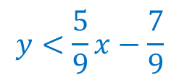
Misollar yechish
4-mashq.
Tekislikda $A\left(2;4\right), B\left(3;−5\right), C(x,y)$ nuqtalar berilgan. $AC>BC$ shartni qanoatlantiruvchi sohani toping.
Yechish.
$\sqrt{{(x−2)}^{2}+{(y−4)}^{2}}>\sqrt{{(x−3)}^{2}+{(y+5)}^{2}}$
${(x−2)}^{2}+{(y−4)}^{2}>{(x−3)}^{2}+{(y+5)}^{2}$
$x^{2}−4x+4+y^{2}−8y+16>x^{2}−6x+9+y^{2}+10y+25$
$$−10y−8y>−6x−4x+34−20$$
$$y<\frac{5}{9}x−\frac{7}{9}$$
Javob:$y<\frac{5}{9}x−\frac{7}{9}$
$$−18y>−10x+14$$

Slide 9
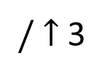
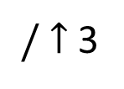
Misollar yechish
5-mashq. Tengsizlikni yeching:
$1) \sqrt[3]{x^{2}+6x}>x$ $2) x\sqrt[3]{2}<\sqrt[3]{x^{2}−x}$
Yechish.
$$1) \sqrt[3]{x^{2}+6x}>x$$
$/$ $↑$ 3
$$2) x\sqrt[3]{2}<\sqrt[3]{x^{2}−x}$$
$/$ $↑$ 3
$$x^{2}+6x>x^{3}$$
$$x^{3}∙2<x^{2}−x$$
$$x^{3}−x^{2}−6x<0$$
$${2x}^{3}−x^{2}+x<0$$
$$x(x+2)(x−3)<0$$
$$x(2x^{2}−x+1)<0$$
$$x<0$$
Javob: $x∈(−∞;−2)∪(0;3)$
Javob: $x∈(−∞;0)$

Slide 10
Mustaqil yechish uchun topshiriq
Darslikning 84-sahifasidagi 71-72-mashqlarni yechish

