Slide 1
Algebra
10-sinf
Mavzu:
Ko‘rsatkichli funksiya va uning grafigi

Slide 2
Mustaqil bajarish uchun berilgan mashqlarni tekshirish
174-mashq. Moddiy nuqta koordinatalari parametrik ko‘rinishda berilgan. x va y koordinatalar orasidagi bog‘lanishni aniqlang:
$$2) \left\{\begin{aligned}x=27t^{2}+21 \\ y=23t\end{aligned}\right.$$
$$t=\frac{y}{23}$$
$$x=27{\left(\frac{y}{23}\right)}^{2}+21$$
$$x−21=27{\left(\frac{y}{23}\right)}^{2}$$
$$y=23∙\sqrt{\frac{x−21}{27}}$$
$$\frac{x−21}{27}={\left(\frac{y}{23}\right)}^{2}$$

Slide 3
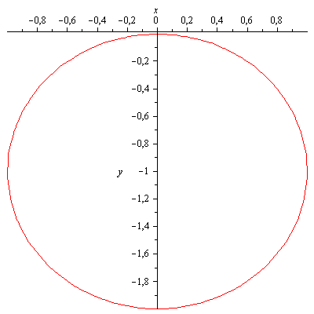
Mustaqil bajarish uchun berilgan mashqlarni tekshirish
176-mashq. Parametrik ko‘rinishda berilgan funksiya grafigi qanday chiziqdan iborat? Mos rasmni chizing:
$$2) \left\{\begin{aligned}x=3sint \\ y=3cost−1 \\ 0≤t≤2π\end{aligned}\right.$$
$$sint=\frac{x}{3}$$
$$\sin^{2}t={\left(\frac{x}{3}\right)}^{2}$$
$$\cos^{2}t={\left(\frac{y+1}{3}\right)}^{2}$$
$$cost=\frac{y+1}{3}$$
$$1={\left(\frac{x}{3}\right)}^{2}+{\left(\frac{y+1}{3}\right)}^{2}$$
$$\sin^{2}t+\cos^{2}t=1$$
$$x^{2}+{\left(y+1\right)}^{2}=9$$

Slide 4
Daraja va uning xossalari
Haqiqiy son ko‘rsatkichli daraja quyidagi xossalarga ega:
($a>0, 0≠1):$
1) $a^{x}∙a^{y}=a^{x+y};$
2) $a^{x}:a^{y}=a^{x−y};$
3) ${(a^{x})}^{y}=a^{x∙y};$
5) ${\left(\frac{a}{b}\right)}^{x}=\frac{a^{x}}{b^{x}}$
4) ${(a∙b)}^{x}=a^{x}∙b^{x}$
6) agar $0<a<b$ va $x>0$bo‘lsa, 7) agar $0<a<b$ va $x<0$bo‘lsa,
$a^{x}<b^{x};$ $a^{x}>b^{y};$
8) agar $x<y va a>1$bo‘lsa, 9) agar $x<y va 0<a<1$bo‘lsa
$a^{x}<a^{y};$ ${ a}^{x}>a^{y}$

Slide 5
Misollar yechish
1-misol. Taqqoslang: $2^{−\sqrt{3}} va 3^{−\sqrt{3}}$.
7-xossaga ko‘ra $0<2<3$ va $−\sqrt{3}<0$ bo‘lgani uchun
${ 2}^{−\sqrt{3}}>3^{−\sqrt{3}}$
2-misol. Taqqoslang: ${\left(\frac{1}{2}\right)}^{0,2}va {\left(\frac{1}{2}\right)}^{0,3}$
9-xossaga ko‘ra $0,2<0,3$ va $0<\frac{1}{2}<1$ bo‘lgani uchun
${\left(\frac{1}{2}\right)}^{0,2}>{\left(\frac{1}{2}\right)}^{0,3}$

Slide 6
Ko‘rsatkichli funksiya
Ko‘rsatkichli funksiya va uning xossalari
$f\left(x\right)=a^{x}, a>0 ,a≠1$ ko‘rinishdagi funksiya ko‘rsatkichli funksiya deyiladi.
Bunday funksiya quyidagi xossalarga ega:
aniqlanish sohasi $(−∞;+∞)$ oraliqdan iborat;
qiymatlar sohasi $\left(0;+∞\right)$ oraliqdan iborat;
barcha $a \left(a>0,a≠1\right)$ uchun $a^{0}=1;$

Slide 7
Daraja va uning xossalari
$a>1$ bo‘lsa, funksiya o‘suvchi;
$0<a<1$ bo‘lsa, funksiya kamayuvchidir.
177-mashq. Hisoblang: ${1) \left({\left(\sqrt{3}\right)}^{\sqrt{2}}\right)}^{\sqrt{2}};$2) $9^{\sqrt{3}}:3^{2\sqrt{3}};$ 3)${{ (2}^{\sqrt[3]{4}})}^{\sqrt[3]{2}}$
1) 3-xossaga ko‘ra ${\left(\sqrt{3}\right)}^{\sqrt{2∙}\sqrt{2}}={\left(\sqrt{3}\right)}^{2}=3$
2) $9^{\sqrt{3}}:3^{2\sqrt{3}}=3^{2^{\sqrt{3}}}:3^{2\sqrt{3}}=3^{2\sqrt{3}}:3^{2\sqrt{3}}=3^{2\sqrt{3}−2\sqrt{3}}=3^{0}=1$
3)${{ (2}^{\sqrt[3]{4}})}^{\sqrt[3]{2}}=2^{\sqrt[3]{4}∙\sqrt[3]{2}}=2^{\sqrt[3]{4∙2}}=2^{\sqrt[3]{8}}=2^{2}=4$

Slide 8
Misollar yechish
Bir o‘zgaruvchili irratsional tengsizliklar
178-mashq. Taqqoslang: 1) ${ 2}^{−\sqrt{3}} va 1$; $2){ 4}^{−\sqrt{6}} va {\left(\frac{1}{2}\right)}^{4 }$
${1) 2}^{−\sqrt{3}}={\left(\frac{1}{2}\right)}^{\sqrt{3}}$va ${ 1=\left(\frac{1}{2}\right)}^{0}$
9-xossaga ko‘ra $0<\frac{1}{2}<1$ va $\sqrt{3}>0$ bo‘lgani uchun ${\left(\frac{1}{2}\right)}^{\sqrt{3}}<$ ${ \left(\frac{1}{2}\right)}^{0}$
ya’ni $2^{−\sqrt{3}}<1.$
$$2) {\left(\frac{1}{4}\right)}^{\sqrt{6}} va {\left(\frac{1}{4}\right)}^{2}$$
9-xossaga ko‘ra $0<\frac{1}{4}<1$ va $\sqrt{6}>0$ bo‘lgani uchun ${\left(\frac{1}{4}\right)}^{\sqrt{6}}<$ ${ \left(\frac{1}{4}\right)}^{2}$

Slide 9
Bir o‘zgaruvchili irratsional tengsizliklar
Misollar yechish
179-mashq. Taqqoslang: $2) {\left(\frac{1}{2}\right)}^{−\sqrt{2}}$va ${\left(\frac{1}{3}\right)}^{−\sqrt{2}}$
7-xossaga ko‘ra $−\sqrt{2}=−\sqrt{2 } va −\sqrt{2}<0$ hamda $0<\frac{1}{3}<\frac{1}{2}$ bo‘lgani uchun
$${\left(\frac{1}{2}\right)}^{−\sqrt{2}}< {\left(\frac{1}{3}\right)}^{−\sqrt{2}}$$
180-mashq. Funksiyaning o‘suvchi yoki kamayuvchi ekanligini aniqlang: $1) y=4^{x}$ $2)y=−3^{x}$
Demak ko‘rsatkichli funksiyaning umumiy ko‘rinishi quyidagicha edi:
$$f\left(x\right)=a^{x}, a>1, a≠1$$

Slide 10
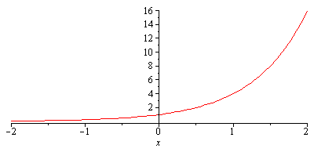
Bir o‘zgaruvchili irratsional tengsizliklar
Misollar yechish
Bizda $a=4$ 4-xossaga ko‘ra $a>1$ bo‘lsa, funksiya o‘suvchi:

Slide 11
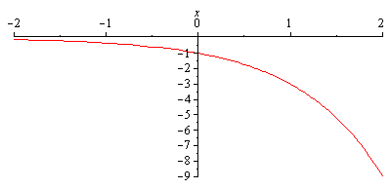
Misollar yechish
Bir o‘zgaruvchili irratsional tengsizliklar
180-mashq. Funksiyaning o‘suvchi yoki kamayuvchi ekanligini aniqlang: $1) y=4^{x}$ $2)y=−3^{x}$
$$y=k∙a^{x}$$
$k>0 va a>1$holatda o‘suvchi
$k<0 va a>1$ holatda kamayuvchi ekanligidan foydalansak,
Demak, $k=−1,a=3$ va $y=−3^{x} −$ kamayuvchi

Slide 12
Mustaqil yechish uchun topshiriqlar
Darslik II qismining 55-sahifasidagi 181-182-mashqlarning 2-tartibli misollarini yechish

Slide 13
Algebra
10-sinf
Mavzu:
Bevosita yechiladigan ko‘rsatkichli tengsizliklar

Slide 14
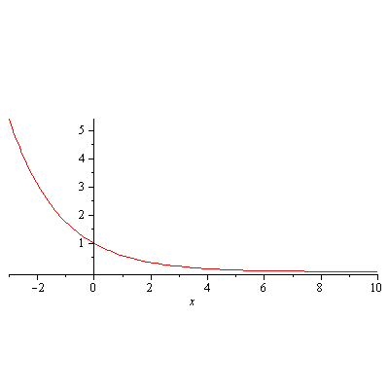
Mustaqil bajarish uchun berilgan mashqlarni tekshirish
181-mashq. Funksiyaning o‘suvchi yoki kamayuvchi ekanligini aniqlang: $2)y={\left(\frac{1}{\sqrt{3}}\right)}^{x}$
$$\frac{1}{\sqrt{3}}≈\frac{1}{1,73}≈0,57$$
Demak, $a=0,57$ va $y={0,57 }^{x} −$ kamayuvchi

Slide 15
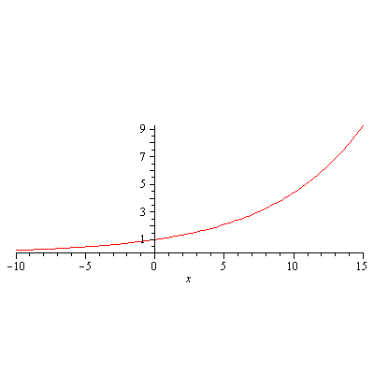
Mustaqil bajarish uchun berilgan mashqlarni tekshirish
182-mashq. Funksiyaning o‘suvchi yoki kamayuvchi ekanligini aniqlang: $2)y={\left(\sqrt{10}−2\right)}^{x}$
$$\sqrt{10}−2≈3,16−2≈1,16$$
Demak, $a=1,16$ va $y={1,16}^{x} −$ o‘suvchi

Slide 16
Bevosita yechiladigan ko‘rsatkichli tengsizliklar
$a^{f(x)}>a^{g(x)},a>0,a≠0$ ko‘rinishidagi tengsizliklar
$a^{f(x)}>a^{g(x)},a>0,a≠0$ tengsizliklar ko‘rsatkichli tengsizlikka misol bo‘ladi. Bu tengsizlik $a>1$ bo‘lganda f(x)>g(x) tengsizlikka, 0<a<1 bo‘lganda esa $f(x)<g(x)$ tengsizlikka, teng kuchlidir.
1-misol. Tengsizlikni yeching: $3^{x+5}>3^{2−5x}.$
$a=3, a>1$ bo‘lgani uchun berilgan tengsizlik $x+5>2−5x$ tengsizlikka teng kuchli.
$$6x>−3$$
$$x>−0,5$$
Javob: $x∈(−0.5;∞)$

Slide 17
Misollar yechish
2-misol. Tengsizlikni yeching:${2∙3}^{x+2}−2∙3^{x+1 }−5∙3^{x}<63$
$3^{x}\left(2∙3^{2}−2∙3−5∙1\right)<63$
$3^{x}∙7<63$
$3^{x}<9$
$x<2$
Javob: $x∈(−∞;2)$
3-misol. Tengsizlikni yeching: $8^{5x^{2}−46}≥8^{2(x^{2}+1)}$
$a=8, a>1$ bo‘lgani uchun berilgan tengsizlik ${5x}^{2}−46≥2(x^{2}+1)$ tengsizlikka teng kuchli.
$$3x^{2}≥48$$
$$x^{2}≥16$$
$$(x−4)(x+4)≥0$$
$x∈\left(−∞;−4\right]∪\left[4;+∞\right)$

Slide 18
Misollar yechish
4-misol. Tengsizlikni yeching: $4^{x}+2^{x}−6≥0$
$$2^{x}=t$$
$$t^{2}+t−6≥0$$
$$t≤−3, t≥2$$
$2^{x}≥2$
$$x≥1$$
$$2^{x}≤−3$$
yechimi yo‘q
Javob: $x∈[1;+∞)$
183-mashq. Tengsizlikni yeching:
$1){ 4}^{3x+5}≤4^{3−5x}; 3){ 6}^{x+5}>6^{3x};$
$7) 2∙2^{x+2}−{3∙2}^{x+1}−{5∙2}^{x}≤−6$; ${11) 13}^{x^{2}+46}≤{13}^{x^{2}+25x}$

Slide 19
Misollar yechish
183-mashq misollarining yechimi:
$$1){ 4}^{3x+5}≤4^{3−5x}$$
$$a^{f(x)}>a^{g(x)},a>0,a≠0$$
$$3x+5≤3−5x$$
$$3x+5x≤3−5$$
$$8x≤−2$$
$$x≤\frac{−2}{8}$$
$$x≤−0,25$$
$$3){ 6}^{x+5}>6^{3x}$$
$a^{f(x)}>a^{g(x)},a>0,a≠0$
$$x+5>3x$$
$$2x<5$$
$$x<2,5$$
$$\text{Javob}\text{:} x∈(−∞;2,5)$$
Javob: $x∈(−∞;−0,25]$

Slide 20
Misollar yechish
183-mashq misollarining yechimi:
$$7) 2∙2^{x+2}−{3∙2}^{x+1}−{5∙2}^{x}≤−6$$
$${2∙2}^{x}∙2^{2}−{3∙2}^{x}∙2^{1}−5∙2^{x}≤−6$$
$$2^{x}∙\left(2^{1+2}−3∙2^{1}−5∙1\right)≤−6$$
$$2^{x}∙\left(8−6−5\right)≤−6$$
$$2^{x}∙\left(−3\right)≤−6$$
$2^{x}≥\frac{−6}{−3}$
$$2^{x}≥2$$
$$2^{x}≥2^{1}$$
$$x≥1.$$
$${11) 13}^{x^{2}+46}≤{13}^{x^{2}+25x}$$
$$x^{2}+46≤x^{2}+25x$$
$$x^{2}−x^{2}−25x+46≤0$$
$$−25x≤−46$$
$$x≥\frac{46}{25}$$
$$\text{Javob}\text{:} x∈\left(\frac{46}{25};+∞\right)$$
Javob: $x∈[1;+∞)$

Slide 21
Misollar yechish
184-mashq. Tengsizlikni yeching: $1) 9^{x}+3^{x}−6≤84;$
$2) {25}^{x}+5^{x}−30>0.$
$$1) 9^{x}+3^{x}−6≤84$$
$$3^{2x}+3^{x}−90≤0$$
$$3^{x}=t$$
$$t^{2}+t−90≤0$$
$t_{1}=9 t_{2}=−10$ $3^{x}≤9 3^{x}≥−10$
$$3^{x}≤3^{2}$$
$$x≤2$$
$$2) {25}^{x}+5^{x}−30>0$$
$$5^{2x}+5^{x}−30>0$$
$$5^{x}=a$$
$$a^{2}+a−30>0$$
$a_{1}=5 a_{2}=−$6
$5^{x}>5 5^{x}<−6$
$$5^{x}>5^{1}$$
$$x>1$$
Javob: $x∈(−∞;2]$
$$\text{Javob}\text{:} x∈\left(1;+∞\right)$$

Slide 22
Mustaqil yechish uchun topshiriqlar
Darslik II qismining 56-sahifasidagi 183-mashqning 2,8,12-tartibli misollarini yechish

