Slide 1
Kimyo
11-sinf
Mavzu : Qaytar va qaytmas reaksiyalar

Slide 2
Test
Quyidagi reaksiya tenglamalari orasidan qaytar reaksiyani ko‘rsating?
A. Cu+4HNO₃→Cu(NO₃)₂+ 2NO₂↑ + 2H₂O
B. K₂CO₃ + 2HCl → 2KCl + CO₂ ↑ + H₂O.
C. Fe + S → FeS
D. N₂ + 3H₂ → 2NH₃

Slide 3
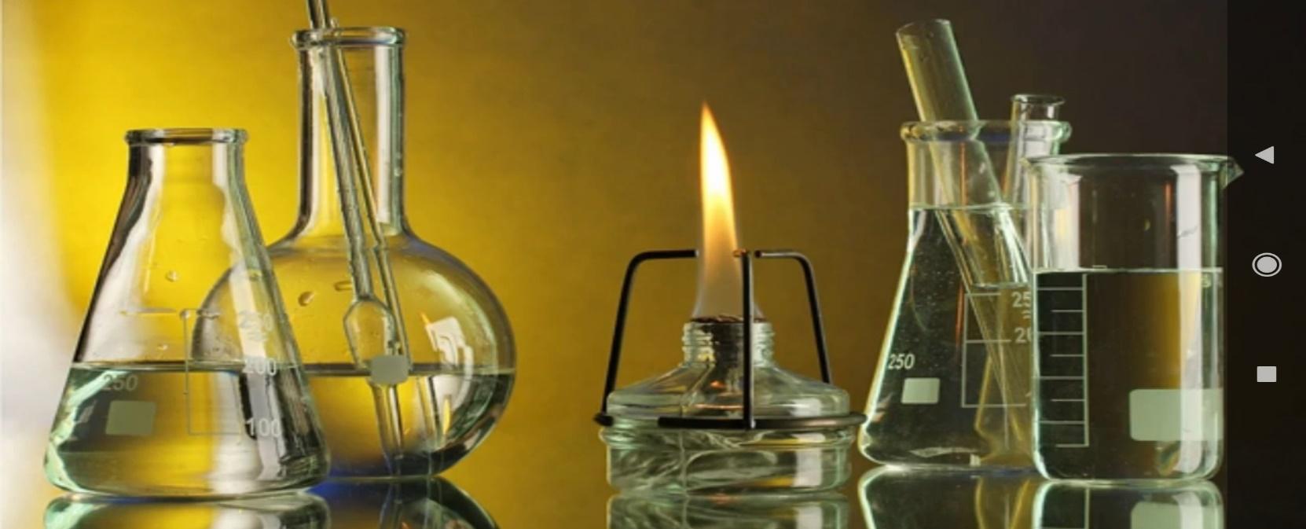
Testning yechimi
A. Cu+4HNO₃→Cu(NO₃)₂+ 2NO₂↑ + 2H₂O

Slide 4
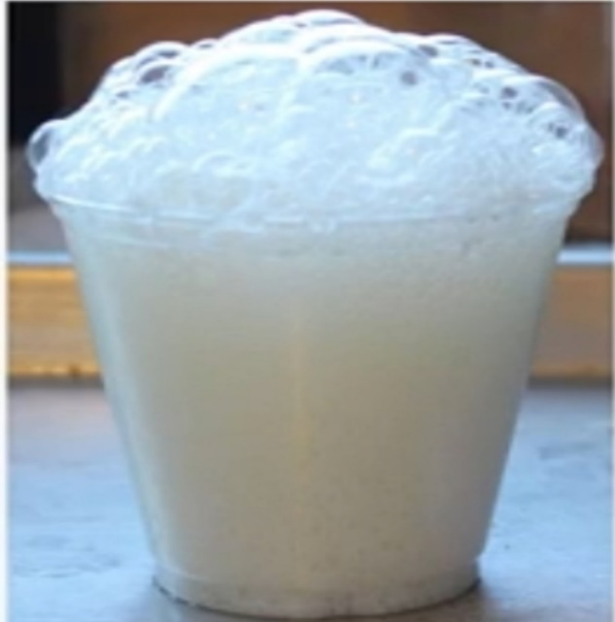
Testning yechimi
B. K₂CO₃ + 2HCl → 2KCl + CO₂ ↑ + H₂O

Slide 5
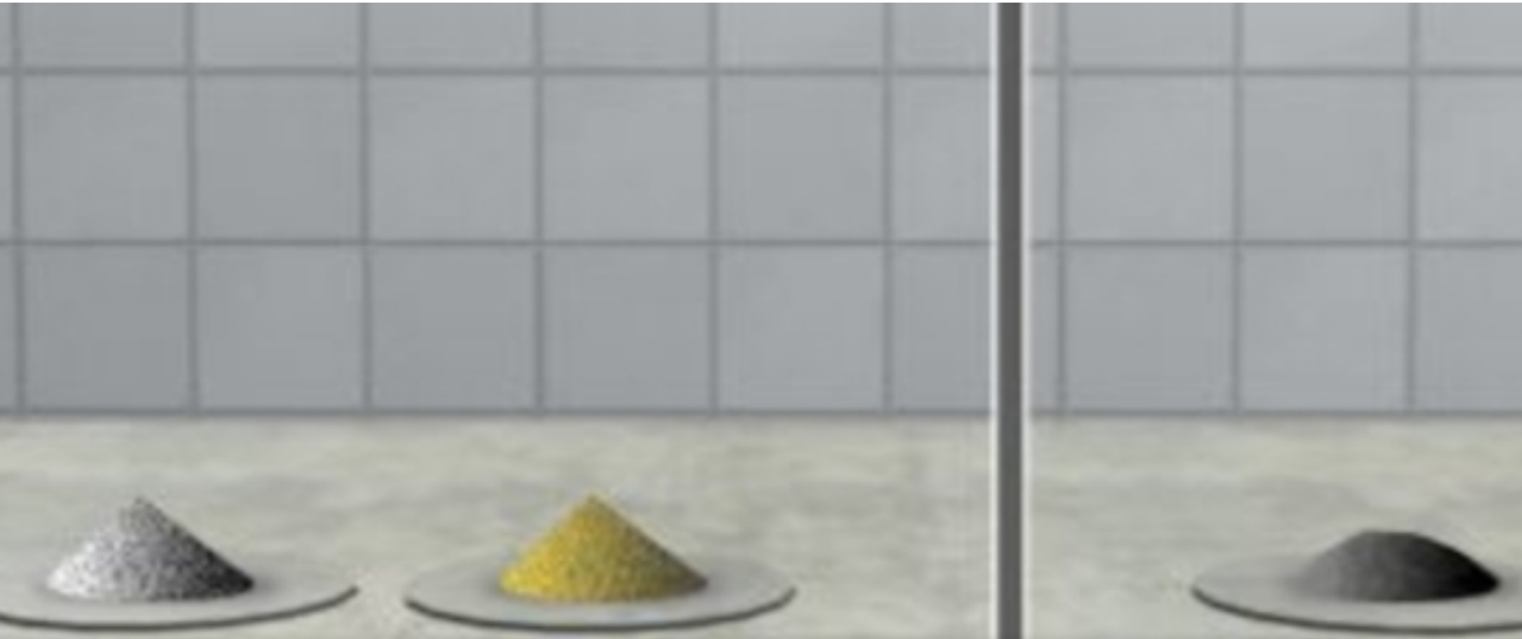
Testning yechimi
C. Fe + S → FeS

Slide 6
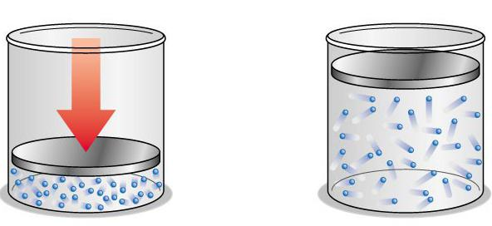
Testning yechimi
D. N₂ + 3H₂ → 2NH₃
To‘g‘ri javob: D

Slide 7
2-test
Quyidagi reaksiya tenglamalari orasidan qaytmas reaksiyani ko‘rsating?
A. SO₂ + H₂O → H₂SO₃
B. H₂+J₂ → 2HJ
C. NaOH + HCl → NaCl + H₂O
D. N₂+O₂ → 2NO

Slide 8
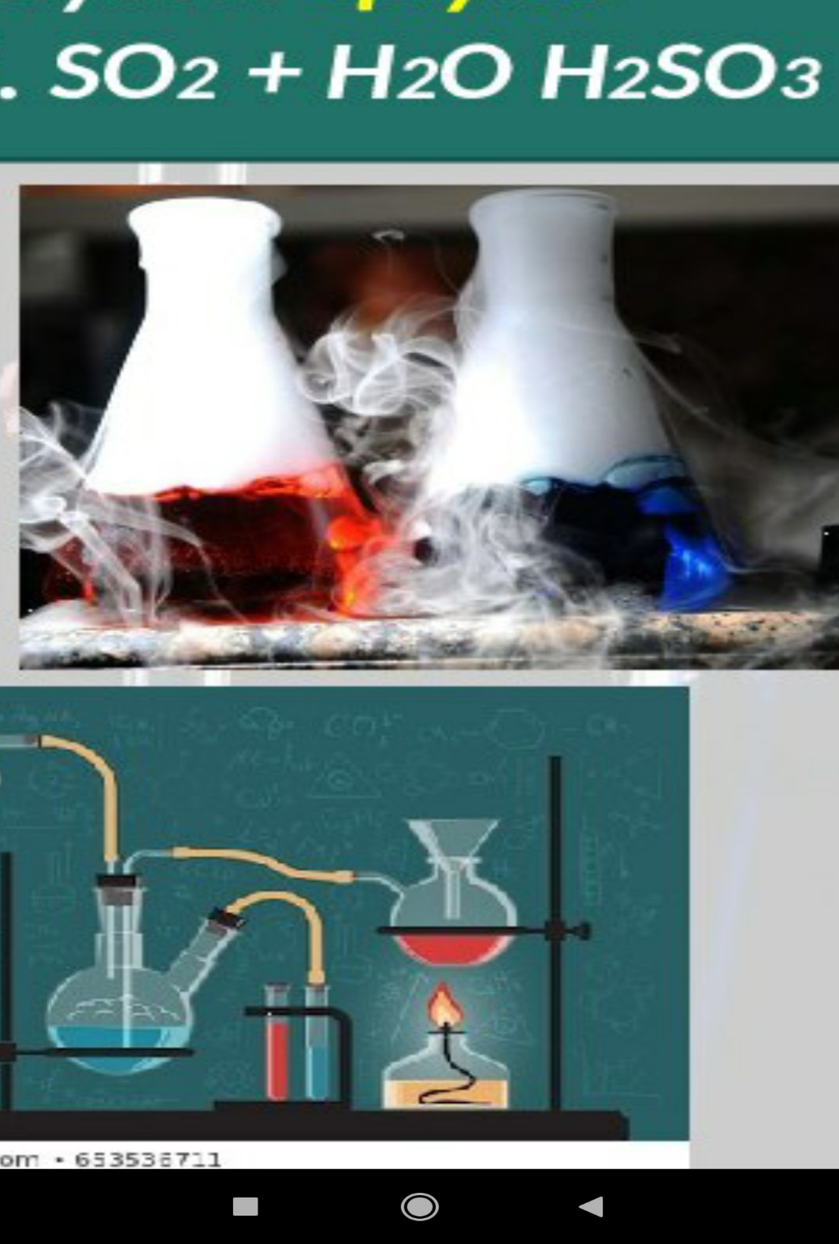
Testning yechimi
A. SO₂ + H₂O → H₂SO₃

Slide 9
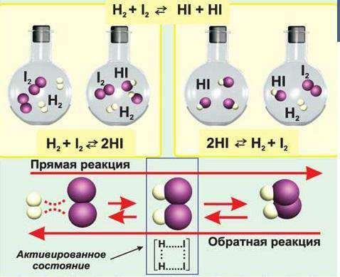
Testning yechimi
B. H₂+J₂ → 2HJ
To‘g‘ri reaksiya
Teskari reaksiya
Faollashgan holat

Slide 10
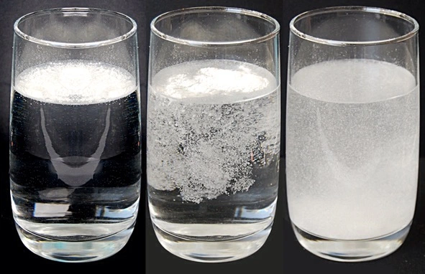
Testning yechimi
C. NaOH + HCl → NaCl + H₂O

Slide 11
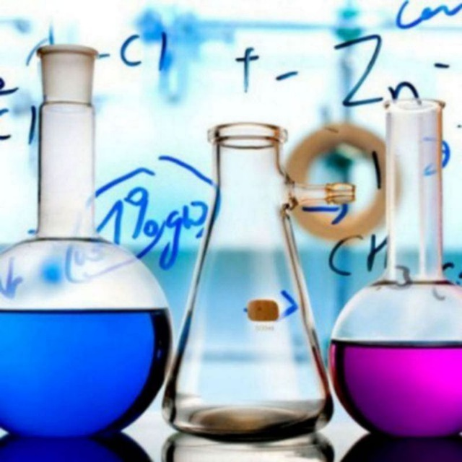
Testning yechimi
D. N₂+O₂ → 2NO

Slide 12
Testning yechimi
C. NaOH + HCl → NaCl + H₂O
To‘g‘ri javob: C

Slide 13
1-masala
A+B=C+D reaksiya bo‘yicha muvozanat qaror topgandan so‘ng moddalarning muvozanat konsentratsiyalari quyidagicha: [A]=0,125 mol/l, [B]=0,4 mol/l, [C]=0,2 mol/l, [D]=0,5 mol/l bo‘lsa, muvozanat konstantasini aniqlang.

Slide 14
Masalaning yechimi
aA + bB = cC + dD
K_{M}$=\frac{{[C]}^{c}∗[{D]}^{d}}{{[A]}^{a}∗[{B]}^{b}}$

Slide 15
Masalaning yechimi
$$\text{A}\text{+}\text{B}\text{=}\text{C}\text{+}\text{D}$$
K_{M}$=\frac{{[0,2]}^{1}∗[{0,5]}^{1}}{{[o,125]}^{1}∗[{0,4]}^{1}}$=2

Slide 16
2-masala
A + B↔ C reaksiya muvozanat holatida boshlang‘ich moddalar konsentratsiyalari [A]=0,1 mol/l; [B]=0,125 mol/l ga teng bo‘lsa, muvozanat holatidagi C moddaning konsentratsiyasini (mol/ l) toping (K_{M} =2).

Slide 17
Masalaning yechimi
$$\text{A}\text{+}\text{B}\text{=}\text{C}$$
2$=\frac{x}{{[0,1]}^{1}∗[{0,125]}^{1}}$
X=0,025

Slide 18
3-masala
A+B=2C+D reaksiya bo‘yicha muvozanat qaror topgandan so‘ng moddalarning muvozanat konsentratsiyalari quyidagicha: [A]=0,08 mol/l, [B]=0,2 mol/l, [C]=0,2 mol/l, [D]=0,5 mol/l bo‘lsa, muvozanat konstantasini aniqlang.

Slide 19
Masalaning yechimi
$$\text{A}\text{+}\text{B}\text{=2}\text{C}\text{+}\text{D}$$
K_{M}$=\frac{{[0,2]}^{2}∗[{0,5]}^{1}}{{[0,08]}^{1}∗[{0,2]}^{1}}$=1,25

Slide 20
4-masala
A + 2B↔ C reaksiya muvozanat holatida boshlang‘ich moddalar konsentratsiyalari [A]=0,5 mol/l; [B]=1 mol/l ga teng bo‘lsa, muvozanat holatidagi C moddaning konsentratsiyasini (mol/ l) toping (KM=1).

Slide 21
Masalaning yechimi
$$\text{A}\text{+2}\text{B}\text{=}\text{C}$$
1$=\frac{x}{{[0,5]}^{1}∗[{1]}^{2}}$
X=0,5

Slide 22
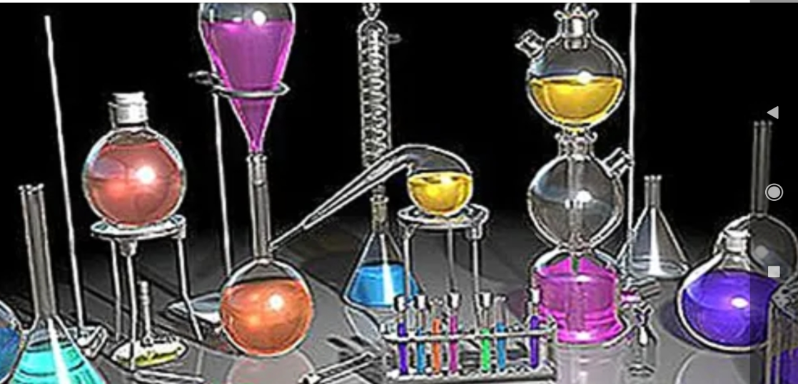
Mustaqil bajarish uchun topshiriqlar
Darslikning 112-113-sahifalarini o‘qib o‘rganing, reaksiya tenglamalarini daftaringizga yozib boring.

