Slide 1
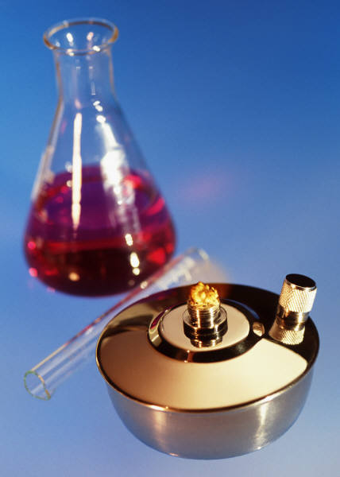
KIMYO
11-sinf

Slide 2
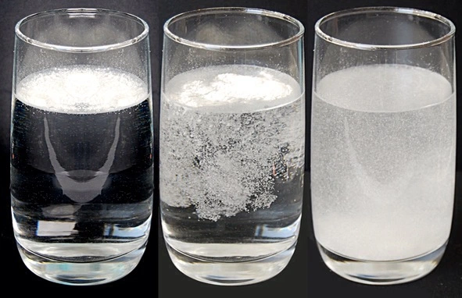
Mustaqil ishlash uchun topshiriqlar
97-bet. 2-masala.
1) 3 N li (p=1,455g/ml) K₂CrO₄ eritmasining foiz konsentratsiyasini aniqlang.

Slide 3
1-masalaning yechimi
Berilgan:
p=1,455 g/ml
C_{N}=0,5M
C %=?

Slide 4
1-masalaning yechimi
C_{N}= $\frac{C\%∗p∗10}{E}$
C%= $\frac{\text{C}\text{N}∗E}{p∗10}$=$\frac{\text{3}\text{∗}97}{1,455∗10}$=20 %

Slide 5
Mustaqil bajarish uchun topshiriqlar
97-bet 3-masala.
2) 25 % li (p=1,25 g/ml ) NH₄NO₃ eritmasining normal konsentratsiyasini aniqlang.

Slide 6
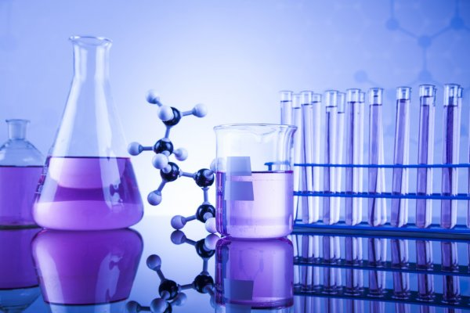
Masalaning yechimi
Berilgan:
C%=25
p=1,25 g/ml
C_{N}=?

Slide 7
Masalaning yechimi
C_{N}= $\frac{C\%∗p∗10}{E}$
C_{N}= $\frac{C\%∗p∗10}{E}$=$\frac{25∗1,25∗10}{80}$=3,9N

Slide 8
KIMYO
11-sinf
Mavzu: Turli molyar konsentratsiyali eritma tayyorlash. Foiz konsentratsiyali eritmalardan molyar yoki normal konsentratsiyali eritma tayyorlash va hayotda qo‘llash

Slide 9
1- masala
400 ml eritma tarkibida 41 g Ca(NO₃)₂ erigan bo‘lsa eritmaning molyar konsentratsiyasini aniqlang.

Slide 10
Masalaning yechimi
Berilgan:
m=41 g
V=400 ml=0,4l
C_{M}-?
C_{M}=$\frac{m}{MV}$=$\frac{41}{164∗0,4}$=0,625M

Slide 11
2- masala
0,125 M li eritma hosil qilish uchun 250 ml eritmada necha gramm CuSO₄*5H₂O eritish kerak?

Slide 12
Masalaning yechimi
Berilgan:
V=250 ml=0,25l
C_{M}=0,125M
m=?

Slide 13
Masalaning yechimi
C_{M}=$\frac{m}{MV(l)}$
_{m= M*V*} C_{M} _{m=250*0,25*0,125=7,81 gr} CuSO₄*5H₂O

Slide 14
3-masala
48,8 gr BaCl₂*2H₂O kristallogidrati suvda eritilib, hajmi 500 ml ga yetkazildi.
Hosil bo‘lgan eritmaning normal konsentratsiyasini aniqlang.

Slide 15
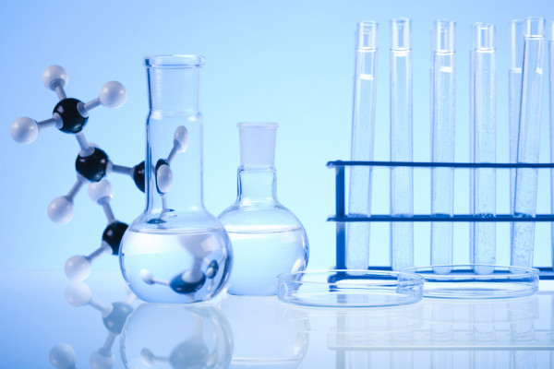
Masalaning yechimi
Berilgan:
m=48,8 gr BaCl₂*2H₂O
V=500 ml=0,5 l
C_{N}=?

Slide 16
3-masalaning yechimi
E_{(tuz)}=$\frac{M(tuz)}{n∗V}$ n_{ekv}=$\frac{m}{E}$
E_{(tuz)}=$\frac{M(\text{BaCl}\text{2}\text{∗2}\text{H}\text{2}\text{O})}{2}$=$\frac{244}{2}$=122
n _{ekv}=$\frac{m}{E}$= $\frac{48,8}{122}$= 0,4 g/ekv

Slide 17
3-masalaning yechimi
$$\text{C}\text{N}\text{=}\frac{n}{V}\text{ekv}$$
$$\text{C}\text{N}\text{=}\frac{n}{V(l)}\text{ekv} \text{=}\frac{0,4}{0,5} \text{=}\text{0,8}\text{ekv}\text{/}\text{l}$$

Slide 18
4-masala
450 ml 1,5 N li K₂SO₄ eritmasini tayyorlash uchun qancha tuz olish kerak?

Slide 19
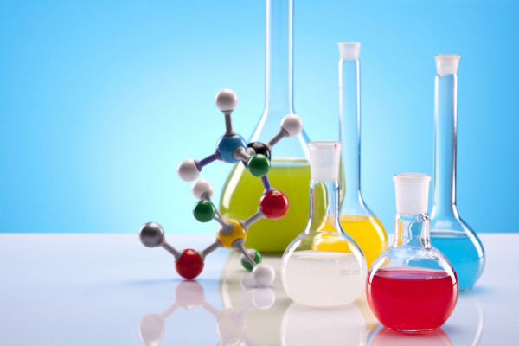
Masalaning yechimi
Berilgan:
C_{N}=1,5 N
V= 450ml=0,45 l
m=?

Slide 20
4-masalaning yechimi
E_{(tuz)}=$\frac{M(tuz)}{n∗V}$ n_{ekv}=$\frac{m}{E}$
E_{(tuz)}=$\frac{M(\text{K}\text{2}\text{SO}\text{4})}{2}$=$\frac{174}{2}$=87
n _{ekv}=$\frac{m}{E}$= $\frac{48,8}{122}$= 0,4 g/ekv

Slide 21
Masalaning yechimi
n_{ekv}=$\frac{m}{E}$
m=E*n_{ekv}=87*0,675=58,72g

Slide 22
5-masala
3 N li Fe(NO₃)₃ eritmasining molyar konsentratsiyasini
aniqlang.

Slide 23
Masalaning yechimi
C_{N}=C_{M}*Val(kat)*n(kat)
C_{M}=$\frac{\text{C}\text{N}}{\text{Val}\text{(}\text{kat}\text{)∗}\text{n}\text{(}\text{kat}\text{) }}$=$\frac{\text{3}}{\text{3∗1} }$=1 M

Slide 24
6-masala
3,2 N li (p=1,28 g/ml) CuSO₄
eritmasining foiz konsentratsiyasini
aniqlang.

Slide 25
Masalaning yechimi
Berilgan:
p=1,28 g/ml
C_{N}=3,2 N
C%=?

Slide 26
Masalaning yechimi
C_{N}= $\frac{C\%∗p∗10}{E}$
C%= $\frac{\text{C}\text{N}∗E}{p∗10}$=$\frac{\text{3,2∗80}}{1,28∗10}$=20 %

Slide 27
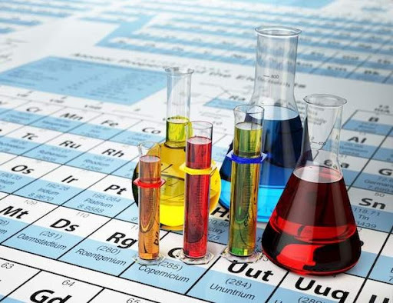
Masalaning yechimi
Berilgan:
C%=26
p=1,2 g/ml
C_{N}=?

Slide 28
Masalaning yechimi
C_{N}= $\frac{C\%∗p∗10}{E}$
C_{N}= $\frac{C\%∗p∗10}{M}$=$\frac{26∗1,2∗10}{208}$=1,5N

Slide 29
Esda tuting!
Eritmalar inson hayotida va amaliy faoliyatida nihoyatda muhim ahamiyatga ega. Ovqat hazm qilish jarayoni oziq moddalarni eritmaga aylantirish bilan bog‘liqdir.
Eng muhim barcha fiziologik suyuqliklar (qon, limfa va boshqalar) eritmalardir.
Kimyoviy protseslarga asoslangan barcha ishlab chiqarishlar har xil eritmalardan foydalanish bilan ma’lum darajada bog‘langandir.

Slide 30
Har xil konsentratsiyali eritmalarni tayyorlash usullarini bilish tibbiy-biologik va sanitar gigeyenik mutaxassislarni amaliy ishlarida zarur omillardan biridir.

Slide 31
Lipidlarning, karbon suvlarning, tuzlarning suvda erigan murakkab aralashmasidir. Ularning miqdoriy aniqlash natijalaridan kasallikni turini aniqlash uchun foydalaniladi.
Organizmga yuboriladigan dori-darmonlarni hammasi aniq konsentratsiyali eritma holida yuboriladi.

Slide 32
Ishlab chiqarishni nazorat qilish, atrof-muhitni muhofaza qilish, oziq-ovqat mahsulotlarini iste‘molga yaroqliligini bilish uchun ham aniq konsentratsiyali eritmalardan foydalaniladi.
Shu sababli eritmalar ularning konsentratsiyalari tog‘risida ma‘lumotga ega bo‘lish muhim ahamiyatga ega.

Slide 33
Mustaqil bajarish uchun topshiriqlar
97-bet. 14-16-masalalar.
1) 0,5 M li Al₂(SO₄)₃ eritmasining normal konsentratsiyasini aniqlang.
2) 2 N li H₃PO₃ eritmasining molyar konsentratsiyasini aniqlang.

