Slide 1
Kimyo
11-sinf
Mavzularga doir mashqlar bajarish

Slide 2
Bugun darsda
Azot atomi oksidlanish darajasi faqat +5 ga oksidlanganlarni tanlang.
NO₂ + O₂ + NaOH = NaNO₃ + H₂O
NO₂ + H₂O = HNO₃ + NO
NO₂ + NaOH = NaNO₃ + NaNO₂ + H₂O
NO₂ + HJ = NO + J₂ + H₂O
NO₂ = NO + O₂
NO₂ + O₂ + H₂O = HNO₃
A) 1, 2, 3, 6; B) 2, 6; C) 1, 6; D) 4, 5, 6

Slide 3
Oksidlanish-qaytarilish reaksiyalari
1. Quyidagi reaksiyada chap tomon koeffitsiyentlari yig‘indisi nechaga teng?
PbO ₂ + MnSO ₄ + HNO₃ = HMnO₄ +PbSO₄ +Pb(NO₃) ₂+H₂O
A) 22; B) 9; C) 21; D) 13.

Slide 4
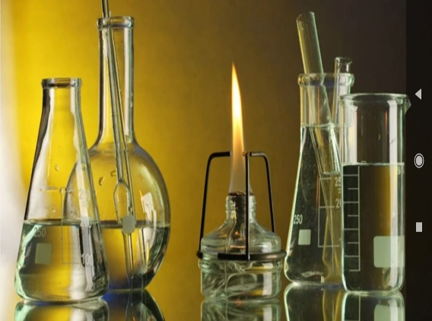
Oksidlanish-qaytarilish reaksiyalari
2. Quyidagi reaksiyada barcha koeffitsiyentlar yig‘indisi nechaga teng?
H₂O₂ + CrCl₃ + KOH = K ₂CrO₄ + KCl + H ₂ O
A) 13; B) 15; C) 18; D) 31; E) 16

Slide 5
Mustaqil bajarish uchun topshiriqlar
Darslikning 131-132-sahifalaridagi 2-6-testlarni bajaring!

