Slide 1
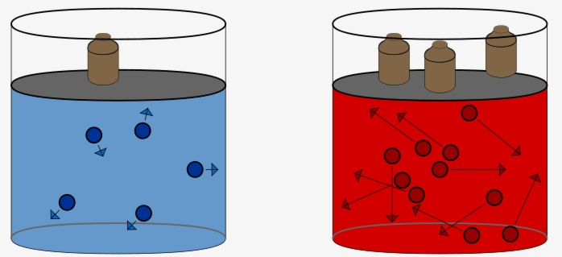
Kimyo
11-sinf
Mavzu:
Masalalar yechish.

Slide 2
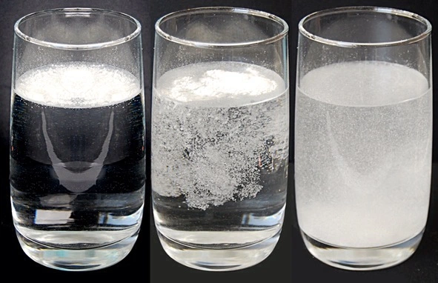
1-masala
300 ml eritmada 0,6 mol KOH erigan bo‘lsa eritma molyarligini aniqlang ?

Slide 3
Masalaning yechimi.
Berilgan:
n=0,6 mol
V=300 ml=0,3l
C_{m}-?
C_{m}=$\frac{n}{V}$=$\frac{0,6}{0,3}$=2M

Slide 4
2-masala
400 g 12%li va 300 ml p=1,2g/ml 20%li NaOH eritmalari aralashtirilganda zichligi 1,05 g/ml bo‘lgan eritma hosil bo‘ldi. Uning molyarligini aniqlang?

Slide 5
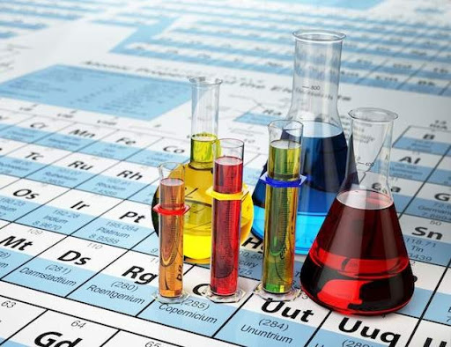
Masalaning yechimi.
Berilgan:
M₁=400 gr
C%=12
V=300ml
P₂=1,2gr/ml
C%=20
P₂=1,05gr/ml
C_{m}-?
M₂=pV=1,2*300=360gr
M=400+360=760 gr

Slide 6
Masalaning yechimi
1) 400-----------100%
x------------12 % x= $\frac{400∗12}{100}$=48 gr
2) 360------------100%
x-------------20% x= $\frac{360∗20}{100}$=72 gr
m=48+72=120 V=$\frac{M}{P}=\frac{760}{1,05}=$724ml=0,724l
C_{m}=$\frac{m}{MV}$=$\frac{120}{40∗0,724}$=4M

Slide 7
3-masala
KCl ning to’yingan eritmasi (p=1,25) molyar
konsentratsiyasini aniqlang. S=37,25
M_{eritma} =100+37,25=137,25gr
V=$\frac{M}{P}=\frac{137,25}{1,25}$=110ml=0,110l
C_{m}=$\frac{n}{V}$=$\frac{0,5}{0,110}$=4,5M

Slide 8
4-masala
200 ml 4,5 M KOH eritmasida 8% (p=1,02 g/ml)
eritma hosil qilish uchun qancha hajmgacha suyultirish kerak?

Slide 9
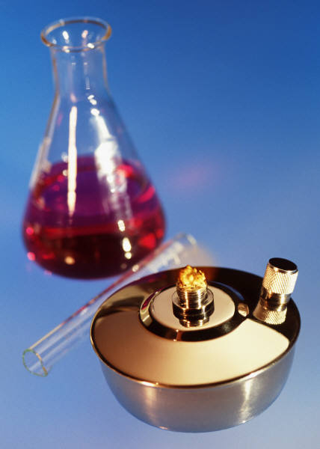
Masalaning yechimi
Berilgan:
V =200 ml=0,2l
C_{M} = 4,5M
C%=8%
p=1,02g/ml
V=?

Slide 10
Masalaning yechimi
C_{M}= $\frac{C\%∗p∗10}{M}=\frac{8∗1,02∗10}{56}≈1,5$
C_{M1}*V₁= C_{M2}*V₂
4,5*0,2=1,5*V₂
V₂=0,6

Slide 11
5-masala
1,25 mol/l 400 ml hajmli eritmada necha gram nitrat kislota bo‘ladi?
C_{M}=$\frac{n}{V}$
n=v $∗$C_{M}
m=n $∗$M

Slide 12
Masalaning yechimi
Berilgan:
C_{m}=1,25mol/l
V=400ml=0,4l
n=?
n=v $∗$C_{m}
n=o,4 $∗$1,25=0,5
m=n $∗$M
m=0,5 $∗$63=31,5

Slide 13
6-masala
25%li (p=1,176g/ml) noma‘lum modda eritmasining molyar konsentratsiyasi 3M ga teng
bo‘lsa ,shu eritmada erigan noma‘lum moddani aniqlang?

Slide 14
Masalaning yechimi
Berilgan: C_{M}= $\frac{C\%∗p∗10}{M}$
C%=25
p=1,176g/ml M= $\frac{C\%∗p∗10}{\text{C}\text{M}}=\frac{25∗1,176∗10}{3}$=98g
C_{M}=3mol/l
M=? H₂SO₄

Slide 15
7-masala
5% li (p=1,26 g/ml ) Nitrat kislota eritmasining molyar
konsentratsiyasini aniqlang ?

Slide 16
Masalaning yechimi
Berilgan: C_{M}= $\frac{C\%∗p∗10}{M}$ = $\frac{5∗1,26∗10}{63}$ =1 M
C%=5%
p=1,26g/ml
C_{M}=?

Slide 17
8-masala
NaNO₃ ning 17% li eritmasining molyar
konsentratsiyasi 2,5 M bo`lsa, shu
eritmaning zichligini aniqlang ?

Slide 18
Masalaning yechimi
Berilgan:
C_{M}=2,5mol/l C_{M}= $\frac{C\%∗p∗10}{M}$
$C\%$=17 % p= $\frac{M∗\text{C}\text{M}}{C\%∗10}$=$\frac{85∗2,5}{17∗10}$=1,25g/ml
p = ?

Slide 19
Mustaqil bajarish uchun topshiriqlar
1)1,4M li 240 gram NaOH eritmasi (p=1,12g/ml)
bilan 260 gram 24%li eritmasi aralashtirildi.Hosil bo‘lgan eritma(p=1,17g/ml) molyar konsentratsiyasini aniqlang?
2)2M li NaOH eritmasi 6,4%li bo‘lsa ,eritmaning zichligini aniqlang?

