Slide 1
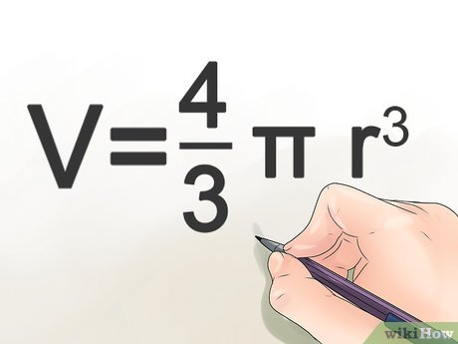
Geometriya
11-sinf
Mavzu: Sharning hajmi

Slide 2
Kavalyeri prinsipi
Fazoda berilgan $F_{1}$ va $F_{2}$ jismlarni bitta tekislikka parallel tekisliklar bilan kesganda kesimda teng yuzaga ega bo‘lgan shakllar hosil bo‘lsa, bu jismlar hajmi teng bo‘ladi.
$$F_{1}$$
$$F_{2}$$
$$S_{1}$$
$$S_{2}$$
$$α$$
$$β$$

Slide 3
Kavalyeri prinsipi
$F_{1}$ va $F_{2}$ jismlarni bitta tekislikka parallel tekisliklar bilan kesganda hosil bo‘ladigan yupqa qatlamlardan tuzilgan. Bu qatlamlarni bir xil qalinlikdagi (balandlikdagi) to‘g‘ri silindrlar deb olsak,
$$r$$
$$r$$
$$h$$

Slide 4
Kavalyeri prinsipi
shartga ko‘ra ularning asoslari yuzalari tengligidan bu silindrlarning hajmlari ham bir-biriga teng bo‘lishi kelib chiqadi. Demak, bu qatlamlardan tuzilgan $F_{1}$ va $F_{2}$ jismlarning hajmlari ham o‘zaro teng bo‘ladi.
$$r$$
$$r$$
$$h$$

Slide 5
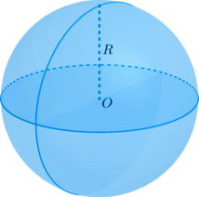
Sharning hajmi
Teorema. Radiusi $R$ ga teng sharning hajmi
$V=\frac{4}{3}πR^{3}$
ga teng bo‘ladi.

Slide 6
1-masala
Rasmdagi B sharning hajmi A shar-ning hajmidan ikki marta katta bo‘lsa, uning radiusini toping.
$$r cm$$
$$5 cm$$
$$A$$
$$B$$

Slide 7
Masalaning yechimi
Berilgan:
$\frac{4}{3}π{r_{B}}^{3}=2∙\frac{4}{3}π{r_{A}}^{3}$
$$r_{A}=5 cm$$
$${r_{B}}^{3}=2{r_{A}}^{3}=2∙5^{3}$$
$$V_{B}=2V_{A}$$
Topish kerak:
$$r_{B}=5\sqrt[3]{2}$$
$$r_{B}= ?$$
Javob: $5\sqrt[3]{2}$

Slide 8
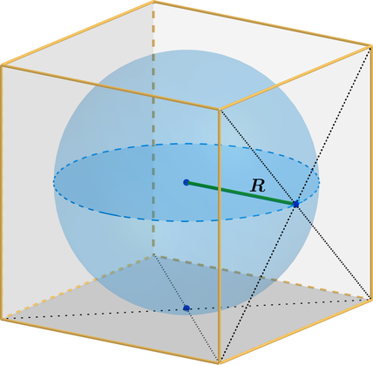
2-masala
Hajmi $8 m^{3}$ ga teng bo‘lgan kubga ichki chizilgan shar hajmini toping.

Slide 9
Masalaning yechimi
Berilgan:
$$V_{kub}=a^{3}$$
$r=\frac{a}{2}$
$$V_{kub}=8 m^{3}$$
$$a^{3}=8=2^{3}$$
$r=\frac{2}{2}=1 m$
Topish kerak:
$$a=2 m$$
$$V_{shar}= ?$$
$V_{shar}=\frac{4}{3}πr^{3}=\frac{4}{3}π∙1^{3}=\frac{4}{3}π m^{3}$
Javob: $\frac{4}{3}π m^{3}$

Slide 10
3-masala
Rasmda tasvirlangan yarim doiraning vertikal diametri atrofida aylanishi-dan hosil bo‘gan fazoviy jismning hajmini toping.
$$12 cm$$

Slide 11
Masalaning yechimi
Berilgan:
$R=\frac{d}{2}$
$$d=2R$$
$$d=12 cm$$
$R=\frac{12}{2}=6 cm$
$$R$$
Topish kerak:
$V_{shar}=\frac{4}{3}πr^{3}$
$$V_{shar}= ?$$
$V_{shar}=\frac{4}{3}π∙6^{3}=288 cm^{3}$
Javob: $288 cm^{3}$

Slide 12
4-masala
Sharning markazidan $6 cm$ masofada joylashgan kesimning yuzi $64 {cm}^{2}$ bo‘lsa, sharning hajmini toping.

Slide 13
Masalaning yechimi
Berilgan:
$$O_{1}$$
$$B$$
$$OO_{1}=6 cm$$
$$O$$
$$S_{kesim}=64 π {cm}^{2}$$
Topish kerak:
$$V_{shar}= ?$$

Slide 14
$$S_{kesim}=π{r_{1}}^{2}$$
$$64π=π{r_{1}}^{2}$$
$$O_{1}$$
$$B$$
$$O$$
$${r_{1}}^{2}=64$$
$$r_{1}=8 cm$$
$$r_{1}=O_{1}B$$
$$O_{1}B=8 cm$$
$${OB}^{2}={O_{1}B}^{2}+{{OO}_{1} }^{2}$$
$${OB}^{2}=8^{2}+{6 }^{2}=64+36=100$$
$$R=OB=10$$

Slide 15
$$R=OB=10$$
$$O_{1}$$
$$B$$
$$O$$
$$V_{shar}=\frac{4}{3}πr^{3}$$
$$V_{shar}=\frac{4}{3}π∙{10}^{3}=\frac{4}{3}π∙1000=\frac{4000}{3}π cm^{3}$$
Javob: $\frac{4000}{3}π cm^{3}$

Slide 16
5-masala
Radiusi $3 cm$ va $5 cm$ bo‘lgan sharlar tarozining bir pallasiga, radiusi $8 cm$ bo‘lgan shar ikkinchi pallasiga qo‘yildi. Qaysi palla og‘irroq bo‘ladi?

Slide 17
Masalaning yechimi
$$V_{1}=\frac{4}{3}π∙3^{3}+\frac{4}{3}π∙5^{3}=36π+\frac{500}{3}π=\frac{608}{3}π$$
$$V_{2}=\frac{4}{3}π∙8^{3} =\frac{4}{3}π∙512=\frac{2048}{3}π$$
$$V_{1}<V_{2}$$
Javob: $2$-palla og‘ir

Slide 18
6-masala
Sharga ichki chizilgan kubning hajmi shar hajmidan necha marta kichik?

Slide 19
Masalaning yechimi
Berilgan:
$$V_{kub};$$
$$V_{shar}$$
Topish kerak:
$$\frac{V_{shar}}{V_{kub}}= ?$$

Slide 20
$R=\frac{a\sqrt{3}}{2}$
$a=\frac{2R}{\sqrt{3}}$
$$V_{kub}=a^{3}$$
$V_{kub}={\left(\frac{2R}{\sqrt{3}}\right)}^{3}=\frac{8R^{3}}{3\sqrt{3}}$
$V_{shar}=\frac{4}{3}πr^{3}$
$$\frac{V_{shar}}{V_{kub}}=\frac{\frac{4}{3}πr^{3}}{\frac{8R^{3}}{3\sqrt{3}}}=\frac{\sqrt{3}}{2}π$$
Javob: $\frac{\sqrt{3}}{2}π$

Slide 21
Mustaqil bajarish uchun topshiriqlar
158-sahifa
539
543
548

