Slide 1
Algebra
11-sinf
Mavzu: Masalalar yechish

Slide 2
1-masala
$y =x^{2}$parabola va $y^{2}−x=0$ chiziqlar bilan chegaralangan shaklning $Ox$ o‘qi atrofida aylanishidan hosil bo‘ladigan jism hajmini toping.

Slide 3
Masalaning yechimi
$$y =x^{2}; y =\sqrt{x}$$
$$x^{2}=\sqrt{x}$$
$$x^{4}=x$$
$$x\left(x^{3}−1\right)=0$$
$$x_{1}=0$$
$$x_{2}=1$$

Slide 4
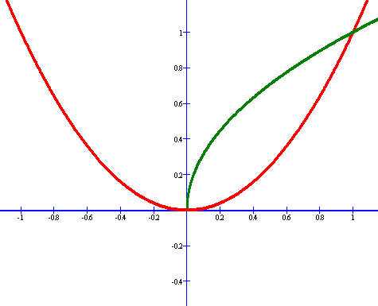
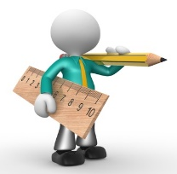
$$y$$
$y^{2}−x=0$
$$y =x^{2}$$
$$0$$
$$x$$
$$1$$
$$x =0$$
$$x =1$$

Slide 5
$$V=π\int_{a}^{b}{y^{2}dx}=π\int_{0}^{1}{\left({y_{2}}^{2}−{y_{1}}^{2}\right)dx}=$$
$$=π\int_{0}^{1}{\left({\left(\sqrt{x}\right)}^{2}−{\left(x^{2}\right)}^{2}\right)dx}={π\left.\left(\frac{x^{2}}{2}−\frac{x^{5}}{5}\right)\right|}_{0}^{1}=$$
$$=π\left(\frac{1^{2}}{2}−\frac{1^{5}}{5}\right)=\frac{3}{10}π$$
kub birlik

Slide 6
2-masala
$y =x^{2}$parabola va $y=x$ chiziqlar bilan chegaralangan shaklning $Oy$ o‘qi atrofida aylanishidan hosil bo‘ladigan jism hajmini toping.

Slide 7
Masalaning yechimi
$$y =x^{2}; y =x$$
$$x=\sqrt{y}; x=y$$
$$\sqrt{y}=y$$
$$y=y^{2}$$
$$y\left(y−1\right)=0$$
$$y_{1}=c=0$$
$$y_{2}=d=1$$

Slide 8
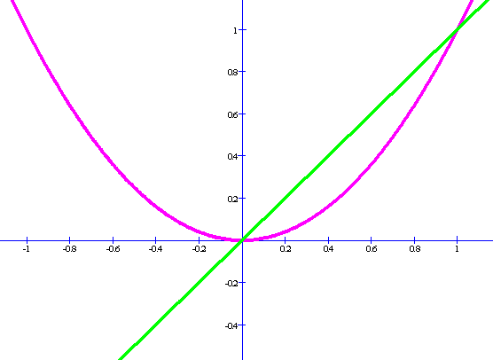
$$y$$
$$y=x$$
$$y =x^{2}$$
$$x$$
$$0$$
$$1$$
$$x =0$$
$$x =1$$

Slide 9
$$V=π\int_{c}^{d}{\left({x_{2}}^{2}(y)−{x_{1}}^{2}(y)\right)dy}=$$
$$=π\int_{0}^{1}{\left(y−y^{2}\right)dy}={π\left.\left(\frac{y^{2}}{2}−\frac{y^{3}}{3}\right)\right|}_{0}^{1}=$$
$$=π\left(\frac{1^{2}}{2}−\frac{1^{3}}{3}\right)=\frac{1}{6}π$$
kub birlik

Slide 10
3-masala
$y =x−2$, $x=3$, $x=4$, $y=0$ chiziqlar bilan chegaralangan shaklning $Ox$ o‘qi atrofida aylanishidan hosil bo‘ladigan jism hajmini toping.

Slide 11
Masalaning yechimi
$$y =x−2; y =0$$
$$x=3; x=4$$
$$V=π\int_{a}^{b}{f^{2}\left(x\right)dx}$$

Slide 12
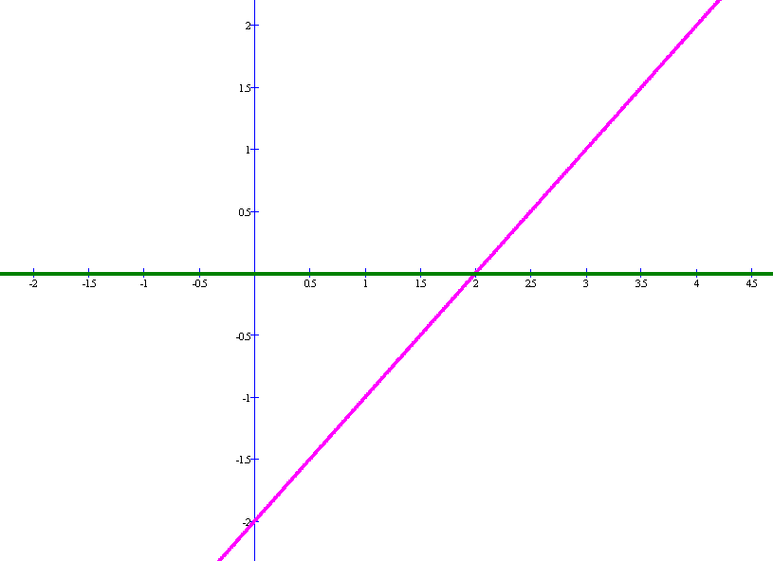
$$y$$
$$y =x−2$$
$$y =0$$
$$x$$
$$3$$
$$4$$
$$x =3$$
$$x =4$$

Slide 13
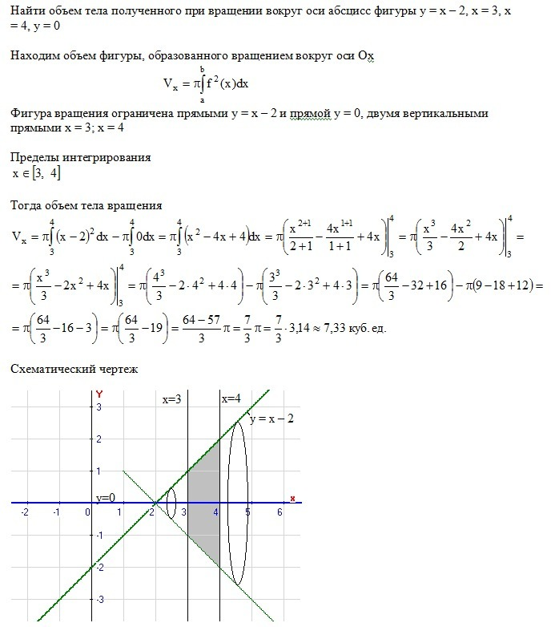
$$V=π\int_{3}^{4}{{\left(x−2\right)}^{2}dx}−π\int_{3}^{4}{0dx}=$$
$$=π\int_{0}^{1}{\left(x^{2}−4x+4\right)dx=}{π\left.\left(\frac{x^{3}}{3}−2x^{2}+4x\right)\right|}_{0}^{1}=$$

Slide 14
$$=π\left(\frac{4^{3}}{3}−2∙4^{2}+4∙4−\left(\frac{3^{3}}{3}−2∙3^{2}+4∙3\right)\right)=$$
$$=π\left(\frac{64}{3}−\frac{27}{3}−32+18+16−12\right)=$$
$$=π\left(\frac{37}{3}−10\right)=\frac{7}{3}π$$
kub birlik

Slide 15
4-masala
$y =\frac{2}{1+x^{2}}$, $y=x^{2}$chiziqlar bilan chegaralangan shaklning $Oy$ o‘qi atrofida aylanishidan hosil bo‘ladigan jism hajmini toping.

Slide 16
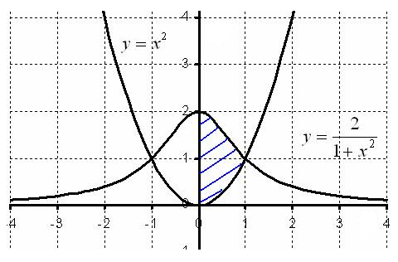
$$y$$
$$x$$

Slide 17
Masalaning yechimi
$y =x^{2}$ $→$ $x=\sqrt{y}$
$y =\frac{2}{1+x^{2}}$ $→1+x^{2}=\frac{2}{y}$ $→$ $x=\sqrt{\frac{2}{y}−1}$

Slide 18
$$V=V_{1}−V_{2}=π\int_{0}^{1}{{\left(\sqrt{y}\right)}^{2}dy}+π\int_{1}^{2}{{\left(\sqrt{\frac{2}{y}−1}\right)}^{2}dy}=$$
$$=π\int_{0}^{1}{ydy}+π\int_{1}^{2}{\left(\frac{2}{y}−1\right)dy}=$$

Slide 19
$$=\frac{π}{2}{\left.y^{2}\right|}_{0}^{1}+{\left.π\left(2lny−y\right)\right|}_{1}^{2}=$$
$$=\frac{π}{2}\left(1−0\right)+π\left(2ln2−2−0+1\right)=$$
$$=\frac{π}{2}+π\left(2ln2−1\right)=π\left(2ln2−\frac{1}{2}\right)$$
kub birlik

Slide 20
5-masala
$y =4x−x^{2}$, $y=x$chiziqlar bilan chegaralangan shaklning $Ox$ o‘qi atrofida aylanishidan hosil bo‘ladigan jism hajmini toping.

Slide 21
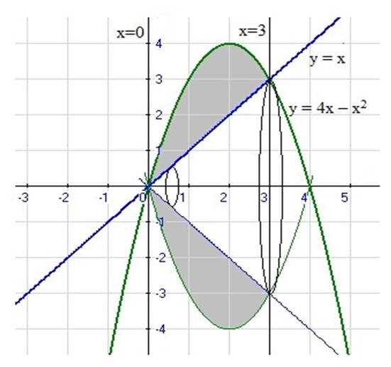
Masalaning yechimi
$y =4x−x^{2}$ $y=x$
$$y$$
$$4x−x^{2}=x$$
$$x^{2}−3x=0$$
$$x\left(x−3\right)=0$$
$$x$$
$$x_{1}=0$$
$$x_{2}=3$$
$$x∈\left[0;3\right]$$

Slide 22
$$V=π\int_{0}^{3}{{\left(4x−x^{2}\right)}^{2}dx}+π\int_{0}^{3}{x^{2}dx}=$$
$$=π\int_{0}^{3}{\left({16x}^{2}−8x^{3}+x^{4}\right)dx}+π\int_{0}^{3}{x^{2}dx}=$$
$$=π\int_{0}^{3}{\left({16x}^{2}−8x^{3}+x^{4}−x^{2}\right)dx}=$$

Slide 23
$$=π\int_{0}^{3}{\left({15x}^{2}−8x^{3}+x^{4}\right)dx}=π{\left.\left(5x^{3}−2x^{4}+\frac{x^{5}}{5}\right)\right|}_{0}^{3}=$$
$$=π\left(5∙3^{3}−2∙3^{4}+\frac{3^{5}}{5}\right)=π\left(135−162+\frac{243}{5}\right)=$$
$$=π\left(−27+\frac{243}{5}\right)=\frac{108}{5}π$$
kub birlik

Slide 24
6-masala
$y^{2}=9−9x, y=3−3x$chiziqlar bilan chegaralangan shaklning $Oy$ o‘qi atrofida aylanishidan hosil bo‘ladigan jism hajmini toping.

Slide 25
Masalaning yechimi
$$y^{2}=9−9x$$
$x=1−\frac{1}{9}y^{2}$
$$y=3−3x$$
$x=1−\frac{1}{3}y$
$1−\frac{1}{9}y^{2}=1−\frac{1}{3}y$
$$y^{2}−3y=0$$
$$y\left(y−3\right)=0$$
$$y_{1}=0$$
$$y_{2}=3$$

Slide 26
$$V=2π\int_{0}^{3}{\left(1−\frac{1}{9}y^{2}\right)ydy}−2π\int_{0}^{3}{\left(1−\frac{1}{3}y \right)ydy}=$$
$$=2π\int_{0}^{3}{\left(\frac{1}{3}y^{2}−\frac{1}{9}y^{3}\right)dy}={\left.\frac{2π}{9}\left(y^{3}−\frac{1}{4}y^{4}\right)\right|}_{0}^{3}=$$

Slide 27
$$=\frac{2π}{9}\left(y^{3}−\frac{1}{4}y^{4}\right)=\frac{2π}{9}\left(3^{3}−\frac{3^{4}}{4}\right)=$$
$$=\frac{2π}{9}\left(27−\frac{81}{4}\right)=\frac{2π}{9}∙\frac{27}{4}=\frac{3}{2}π$$
kub birlik

Slide 28
Mustaqil bajarish uchun topshiriqlar
104-sahifa
47 va 48-misollar
2
4
6

