Slide 1
Algebra
11-sinf
Mavzu: Ikkita tur ma’lumotlar o‘rtasidagi bog‘liqlikni tadqiq qilish

Slide 2
1-masala
14 nafar bola tanlanib, ularning bo‘ylari va vazn-lari o‘lchandi. Natijada quyidagi jadval hosil bo‘ldi:
Bo‘yi $(cm)$ | 167 | 169 | 179 | 178 | 177 | 175 | 171
Vazni $$(kg)$$ | 62 | 67 | 70 | 72 | 70 | 69 | 63

Slide 3
1-masala
14 nafar bola tanlanib, ularning bo‘ylari va vazn-lari o‘lchandi. Natijada quyidagi jadval hosil bo‘ldi:
Bo‘yi $(cm)$ | 181 | 174 | 175 | 180 | 174 | 172 | 178
Vazni $$(kg)$$ | 62 | 67 | 70 | 72 | 70 | 69 | 63
Inson bo‘yi va vazni orasida bog‘lanish bormi?

Slide 4
vazni
Dekart
koordinatalar
sistemasida
abssissalari
bo‘ylar, ordinatalari
vaznlar bo‘lgan
$$\left(167;62\right),…,\left(171;66\right)$$
nuqtalarni tasvirlaymiz.
$$85$$
$$80$$
$$75$$
$$70$$
$$65$$
$$60$$
bo‘yi
$$160$$
$$170$$
$$175$$
$$180$$
$$185$$

Slide 5
vazni
Hosil bo‘lgan diagramma sochilish
diagrammasi deyiladi.
$$85$$
$$80$$
$$75$$
$$70$$
$$65$$
$$60$$
bo‘yi
$$160$$
$$170$$
$$175$$
$$180$$
$$185$$

Slide 6
Taxminan bir xil vaznga
ega bo‘lgan insonlar turli bo‘ylarga ega bo‘lishi mumkin va aksincha, taxminan bir xil bo‘yga
ega bo‘lgan insonlar
turli vaznlarga
ega bo‘lishi mumkin.
Demak, bo‘y va vazn orasida qat’iy bog‘lanish yo‘q.
Umuman aytganda, insonning bo‘yi kattalashsa, uning vazni ham katta bo‘laveradi.
vazni
$$85$$
$$80$$
$$75$$
$$70$$
$$65$$
$$60$$
bo‘yi
$$160$$
$$170$$
$$175$$
$$180$$
$$185$$

Slide 7
Sochilish diagrammasi ikki tur ma’lumotlar qatorlari orasidagi bog‘lanishning taxminiy xarakterini ko‘rsatadi.

Slide 8
Bog‘lanishning yo‘nalishi
1-hol
Bu holda bog‘lanish mavjud bo‘lib, unga musbat bog‘lanish deyiladi. Bunday holatlarda birinchi ma’lumotlar qatoridagi belgi o‘ssa, ikkinchi ma’lumotlar qatoridagi belgi ham o‘sadi.

Slide 9
Bog‘lanishning yo‘nalishi
2-hol
Bu holda bog‘lanish mavjud bo‘lib, unga manfiy bog‘lanish deyiladi. Bunday holatlarda birinchi ma’lumotlar qatoridagi belgi o‘ssa, ikkinchi ma’lumotlar qatoridagi belgi ham kamayadi.

Slide 10
Bog‘lanishning yo‘nalishi
3-hol
Bu holda bog‘lanish mavjud emas.

Slide 11
Bog‘lanishning chiziqliligi
Chiziqli bog‘langan
Bu xossa mos nuqtalarning qandaydir to‘g‘ri chiziq yaqinida joylashish darajasini ifodalaydi.

Slide 12
Bog‘lanishning chiziqliligi
Chiziqli bog‘lanmagan
Bu xossa mos nuqtalarning qandaydir to‘g‘ri chiziq yaqinida joylashish darajasini ifodalaydi.

Slide 13
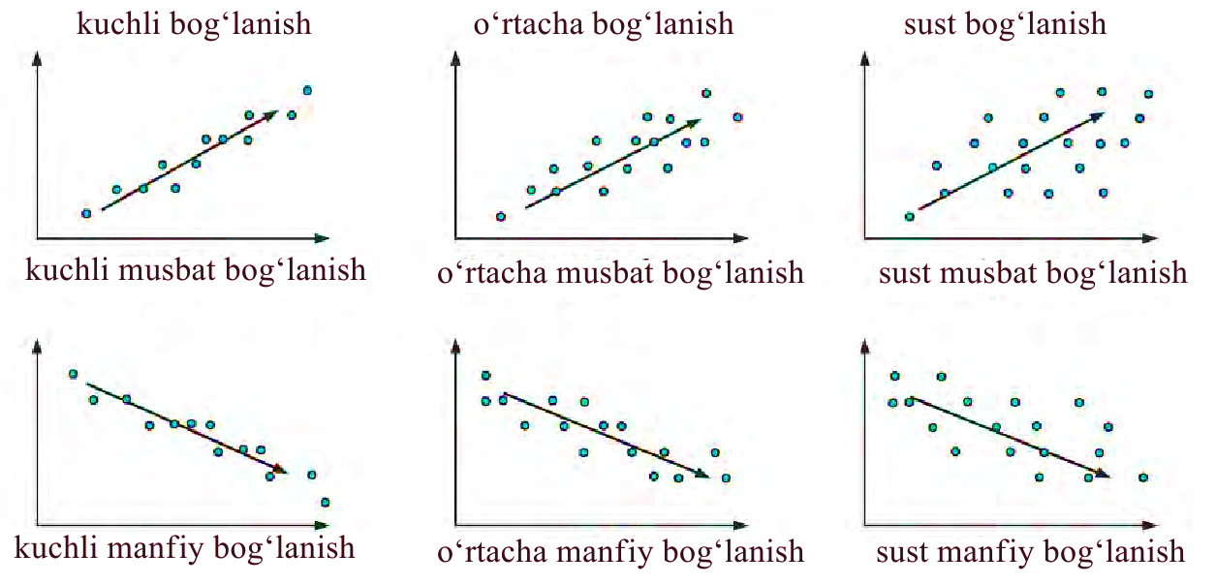
Chiziqli bog‘lanishning turg‘unligi

Slide 14
Chiziqli bog‘lanish darajasini aniqlash
$x_{1}, x_{2}, …, x_{n}$ va $y_{1}, y_{2}, …, y_{n}$ ma’lumotlar qatorlari orasidagi chiziqli bog‘lanishning darajasini aniqlashda korrelyatsiya koeffitsiyenti (ing. correlation – bog‘lanish) tushunchasidan
foydalaniladi.

Slide 15
Korrelyatsiya koeffitsiyenti
$$r=\frac{\sum{\left(x−\overline{x}\right)\left(y−\overline{y}\right)}}{\sum{{\left(x−\overline{x}\right)}^{2}\sum{{\left(y−\overline{y}\right)}^{2}}}}$$
$\overline{x},\overline{y}−$ berilgan ma’lumotlar qatorlarining
o‘rta qiymatlari
$\sum{−}$yig‘indi belgisi

Slide 16
Korrelyatsiya koeffitsiyentining xossalari
$$1) rε\left[−1;1\right]$$
$2) r$ koeffitsiyent ishorasi bog‘lanishning
yo‘nalishini belgilaydi:
Agar $r>0$ bo‘lsa, u holda berilgan ma’lumotlar qatorlari musbat bog‘lanishda bo‘ladi.
Agar $r<0$ bo‘lsa, u holda berilgan ma’lumotlar qatorlari manfiy bog‘lanishda bo‘ladi.

Slide 17
Korrelyatsiya koeffitsiyentining xossalari
$3) r$ koeffitsiyent qiymati bog‘lanishning
turg‘unligini belgilaydi, bunda:
Agar $r=±1$bo‘lsa, u holda berilgan ma’lumotlar qatorlari chiziqli bog‘langan bo‘ladi.
Agar $r=0$ bo‘lsa, u holda berilgan ma’lumotlar qatorlari chiziqli bog‘lanmagan bo‘ladi.

Slide 18
2-masala
Fermer yetishtiriladigan paxta g‘o‘zasi
o‘sish tezligini solingan o‘g‘it miqdori bilan bog‘liqligini o‘rganmoqchi.
U daladan to‘rtta $A, B, C, D$ g‘o‘za ajratib, har biriga har xil miqdorda o‘g‘it soldi va paxta g‘o‘zasining kunlik o‘sishini yozib oldi.

Slide 19
Olingan ikki tur ma‘lumotlar orasidagi bog‘lanishni tadqiq qiling.
G‘o‘za | O‘g‘it miqdori (g) | Kunlik o‘sish (mm)
A | 1 | 3
B | 2 | 3
C | 3 | 6
D | 4 | 8

Slide 20
$$\overline{x}=\frac{\sum{x}}{n}=\frac{1+2+4+5}{4}=\frac{12}{4}=3$$
$$x$$
$$1$$
$$2$$
$$4$$
$$5$$
$$x−\overline{x}=1−3=−2$$
$$x−\overline{x}=2−3=−1$$
$$x−\overline{x}=4−3=1$$
$$x−\overline{x}=5−3=2$$

Slide 21
Jadvalni to‘ldiramiz:
$$\left(x−\overline{x}\right)\left(y−\overline{y}\right)=t$$
$$x$$ | $$y$$ | $$x−\overline{x}$$ | $$y−\overline{y}$$ | $$t$$ | $${\left(x−\overline{x}\right)}^{2}$$ | $${\left(y−\overline{y}\right)}^{2}$$
$$1$$ | $$3$$ | $$−2$$
$$2$$ | $$3$$ | $$−1$$
$$4$$ | $$6$$ | $$1$$
$$5$$ | $$8$$ | $$2$$
$$12$$ | $$20$$

Slide 22
$$\overline{y}=\frac{\sum{y}}{n}=\frac{3+3+6+8}{4}=\frac{20}{4}=5$$
$$y$$
$$3$$
$$3$$
$$6$$
$$8$$
$$y−\overline{y}=3−5=−2$$
$$y−\overline{y}=3−5=−1$$
$$y−\overline{y}=6−5=1$$
$$y−\overline{y}=8−5=3$$

Slide 23
Jadvalni to‘ldiramiz:
$$\left(x−\overline{x}\right)\left(y−\overline{y}\right)=t$$
$$x$$ | $$y$$ | $$x−\overline{x}$$ | $$y−\overline{y}$$ | $$t$$ | $${\left(x−\overline{x}\right)}^{2}$$ | $${\left(y−\overline{y}\right)}^{2}$$
$$1$$ | $$3$$ | $$−2$$ | $$−2$$
$$2$$ | $$3$$ | $$−1$$ | $$−2$$
$$4$$ | $$6$$ | $$1$$ | $$1$$
$$5$$ | $$8$$ | $$2$$ | $$3$$
$$12$$ | $$20$$

Slide 24
$$x−\overline{x}$$ | $$y−\overline{y}$$
$$−2$$ | $$−2$$
$$−1$$ | $$−2$$
$$1$$ | $$1$$
$$2$$ | $$3$$
$$\left(x−\overline{x}\right)\left(y−\overline{y}\right)=\left(−2\right)\left(−2\right)=4$$
$$\left(x−\overline{x}\right)\left(y−\overline{y}\right)=\left(−1\right)\left(−2\right)=2$$
$$\left(x−\overline{x}\right)\left(y−\overline{y}\right)=1∙1=1$$
$$\left(x−\overline{x}\right)\left(y−\overline{y}\right)=2∙3=6$$

Slide 25
Jadvalni to‘ldiramiz:
$$\left(x−\overline{x}\right)\left(y−\overline{y}\right)=t$$
$$x$$ | $$y$$ | $$x−\overline{x}$$ | $$y−\overline{y}$$ | $$t$$ | $${\left(x−\overline{x}\right)}^{2}$$ | $${\left(y−\overline{y}\right)}^{2}$$
$$1$$ | $$3$$ | $$−2$$ | $$−2$$ | $$4$$
$$2$$ | $$3$$ | $$−1$$ | $$−2$$ | $$2$$
$$4$$ | $$6$$ | $$1$$ | $$1$$ | $$1$$
$$5$$ | $$8$$ | $$2$$ | $$3$$ | $$6$$
$$12$$ | $$20$$ |  |  | $$13$$

Slide 26
$$x−\overline{x}$$
$$−2$$
$$−1$$
$$1$$
$$2$$
$${\left(x−\overline{x}\right)}^{2}={\left(−2\right)}^{2}=4$$
$${\left(x−\overline{x}\right)}^{2}={\left(−1\right)}^{2}=1$$
$${\left(x−\overline{x}\right)}^{2}=1^{2}=1$$
$${\left(x−\overline{x}\right)}^{2}=2^{2}=4$$

Slide 27
Jadvalni to‘ldiramiz:
$$\left(x−\overline{x}\right)\left(y−\overline{y}\right)=t$$
$$x$$ | $$y$$ | $$x−\overline{x}$$ | $$y−\overline{y}$$ | $$t$$ | $${\left(x−\overline{x}\right)}^{2}$$ | $${\left(y−\overline{y}\right)}^{2}$$
$$1$$ | $$3$$ | $$−2$$ | $$−2$$ | $$4$$ | $$4$$
$$2$$ | $$3$$ | $$−1$$ | $$−2$$ | $$2$$ | $$1$$
$$4$$ | $$6$$ | $$1$$ | $$1$$ | $$1$$ | $$1$$
$$5$$ | $$8$$ | $$2$$ | $$3$$ | $$6$$ | $$4$$
$$12$$ | $$20$$ |  |  | $$13$$ | $$10$$

Slide 28
$$y−\overline{y}$$
$$−2$$
$$−2$$
$$1$$
$$3$$
$${\left(y−\overline{y}\right)}^{2}={\left(−2\right)}^{2}=4$$
$${\left(y−\overline{y}\right)}^{2}={\left(−2\right)}^{2}=4$$
$${\left(y−\overline{y}\right)}^{2}=1^{2}=1$$
$${\left(y−\overline{y}\right)}^{2}=3^{2}=9$$

Slide 29
Jadvalni to‘ldiramiz:
$$\left(x−\overline{x}\right)\left(y−\overline{y}\right)=t$$
$$x$$ | $$y$$ | $$x−\overline{x}$$ | $$y−\overline{y}$$ | $$t$$ | $${\left(x−\overline{x}\right)}^{2}$$ | $${\left(y−\overline{y}\right)}^{2}$$
$$1$$ | $$3$$ | $$−2$$ | $$−2$$ | $$4$$ | $$4$$ | $$4$$
$$2$$ | $$3$$ | $$−1$$ | $$−2$$ | $$2$$ | $$1$$ | $$4$$
$$4$$ | $$6$$ | $$1$$ | $$1$$ | $$1$$ | $$1$$ | $$1$$
$$5$$ | $$8$$ | $$2$$ | $$3$$ | $$6$$ | $$4$$ | $$9$$
$$12$$ | $$20$$ |  |  | $$13$$ | $$10$$ | $$18$$

Slide 30
Mustaqil bajarish uchun topshiriqlar
66-sahifa
56 va 58-misollar

