Slide 1
ALGEBRA
8- SINF
Mavzu: Takrorlash
(Natural ko‘rsatkichli darajaning arifmetik ildizi, ratsional ko‘rsatkichli daraja va uning xossalari).

Slide 2



Soddalashtiring:
$$=x^{9 }$$
$${=c}^{24 }$$
= 1
$${=c}^{6}$$
= 81

Slide 3
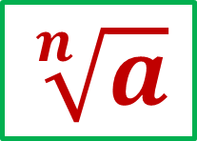
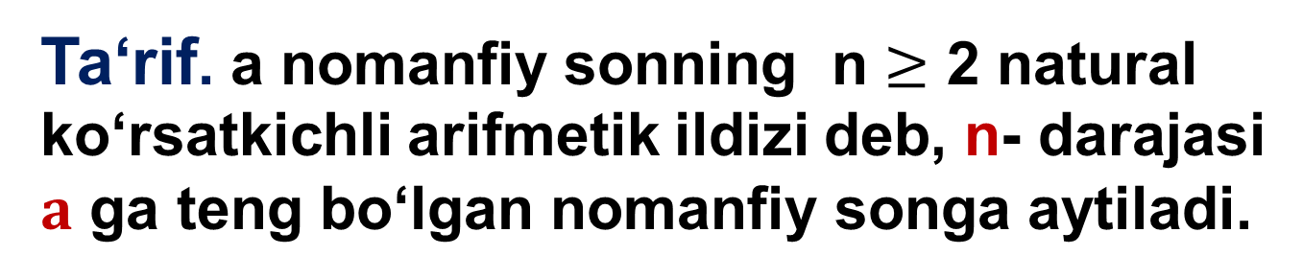
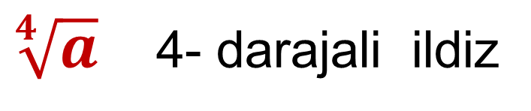
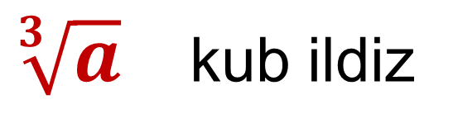
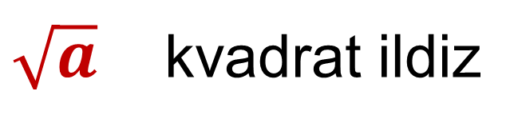
Ta‘rif. a nomanfiy sonning n $≥$ 2 natural ko‘rsatkichli arifmetik ildizi deb, n- darajasi $a$ ga teng bo‘lgan nomanfiy songa aytiladi.
$$\sqrt[n]{a}$$
a sonning n- darajali arifmetik ildizi
$\sqrt{a}$ kvadrat ildiz
$\sqrt[3]{a}$ kub ildiz
$\sqrt[4]{a}$ 4- darajali ildiz

Slide 4
Hisoblang:
13
- 2
1
1-
3
- 4
3
- 2

Slide 5
n- darajali ildiz xossasi

Slide 6
n- darajali ildiz xossasi

Slide 7
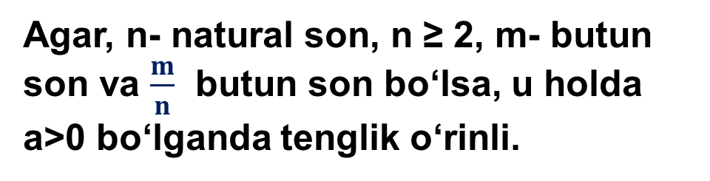
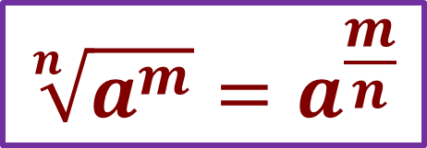
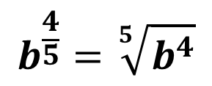
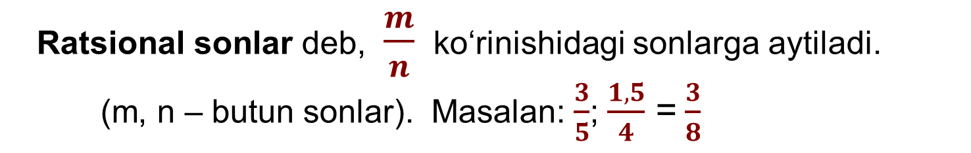
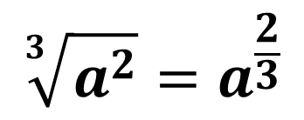
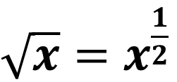
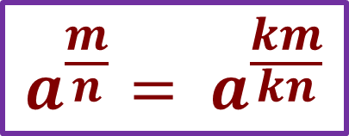
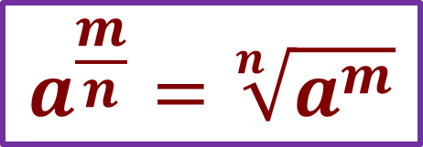
Ratsional sonlar deb, $\frac{m}{n}$ ko‘rinishidagi sonlarga aytiladi.
(m, n – butun sonlar). Masalan: $\frac{3}{5}$; $\frac{1,5}{4}$ =$\frac{3}{8}$
Agar, n- natural son, n ≥ 2, m- butun son va $\frac{m}{n}$ butun son bo‘lsa, u holda a>0 bo‘lganda tenglik o‘rinli.
$${\sqrt[n]{a^{m}}=a}^{\frac{m}{n}}$$
$$a^{\frac{m}{n}}=\sqrt[n]{a^{m}}$$
$$a^{\frac{m}{n}}= a^{\frac{km}{kn}}$$
$\sqrt{x}=x^{\frac{1}{2}}$
$$\sqrt[3]{a^{2}}=a^{\frac{2}{3}}$$
$$b^{\frac{4}{5}}=\sqrt[5]{b^{4}}$$

Slide 8
Arifmetik ildizni ratsional ko‘rsatkichli daraja ko‘rinishiga kelting:
Arifmetik ildizni ratsional ko‘rsatkichli daraja ko‘rinishiga keltirng:
1.
2.
3.
4.
5.

Slide 9
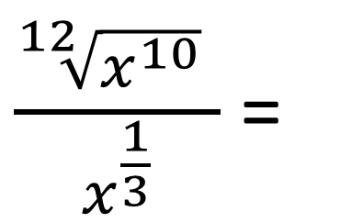
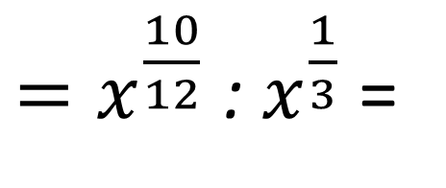
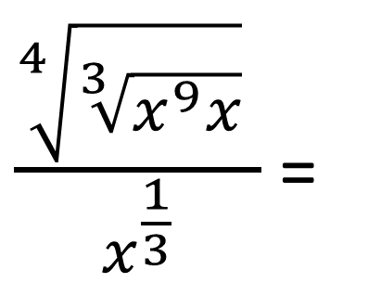
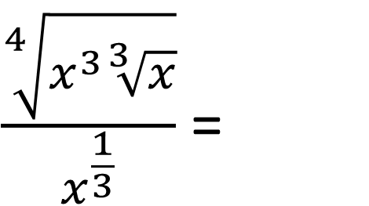
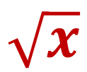
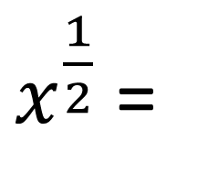
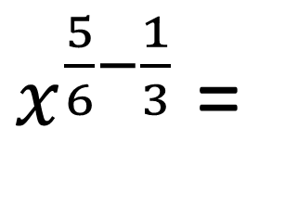
№565. Ifodani soddalashtiring:
$\frac{\sqrt[4]{\sqrt[3]{x^{9}x}} }{x^{\frac{1}{3}}}$ =
$\frac{\sqrt[4]{x^{3}\sqrt[3]{x}}}{x^{\frac{1}{3}}}$ =
$\frac{\sqrt[12]{x^{10}} }{x^{\frac{1}{3}}}$ =
$=x^{\frac{10}{12}}$ : $x^{\frac{1}{3}}$ =
$x^{\frac{5}{6}−\frac{1}{3}}$ =
$x^{\frac{1}{2}}$ =
$$\sqrt{x}$$

Slide 10
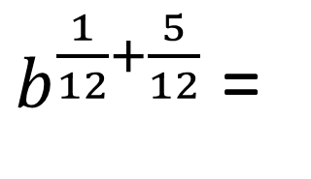
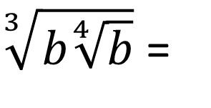
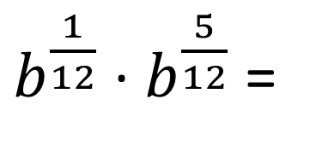
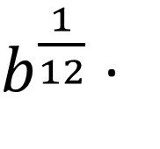
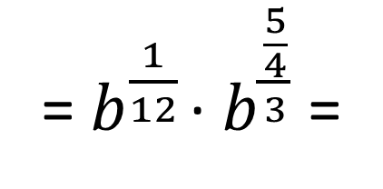
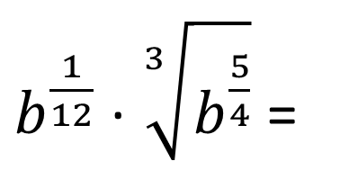
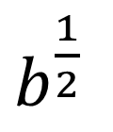
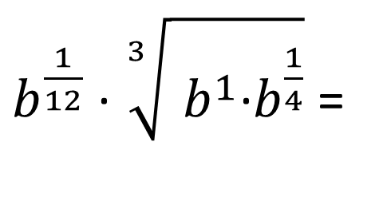
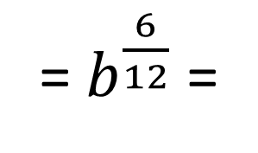
Ifodani soddalashtiring:
$b^{\frac{1}{12}}$ · $\sqrt[3]{ b^{1}\text{·}b^{\frac{1}{4}}}$ =
$b^{\frac{1}{12}}$ · $\sqrt[3]{b^{\frac{5}{4}}}$ =
$b^{\frac{1}{12}}$ ·
$\sqrt[3]{b\sqrt[4]{b}}$ =
=${ b}^{\frac{1}{12}}$ · $b^{\frac{\frac{5}{4}}{3}}$ =
$b^{\frac{1}{12}}$ · $b^{\frac{5}{12}}$ =
$b^{\frac{1}{12}+\frac{5}{12}}$ =
= $b^{\frac{6}{12}}$ =
$b^{\frac{1}{2}}$

Slide 11
Tenglamani yeching:
Javob: 64; 117 649.

Slide 12
Mustahkamlash uchun topshiriq:
№ 565
1
№ 567
222-, 223-sahifa
2
3
№ 569

