Slide 1
GEOMETRIYA
8-sinf
MAVZU: MASALALAR YECHISH

Slide 2
TEST 1
Aylana markazidan B nuqtagacha masofa 5 cm ga, radius 12 cm ga teng. B nuqtadan aylanagacha bo‘lgan eng kichik va eng katta masofani toping.
A) 7 cm, 17 cm;
B) 7 cm, 12 cm;
D) 5 cm, 7 cm;
E) 7 cm, 24 cm.

Slide 3
Aylana markazidan B nuqtagacha masofa 5 cm ga, radius 12 cm ga teng. B nuqtadan aylanagacha bo‘lgan eng kichik va eng katta masofani toping.
Berilgan:
B∈ (O,R) aylana
BO = 5 cm,
R = 12 cm.
N
B
Topish kerak:
BN, BL- ?
O
5 cm
Yechish:
ON = OL = R = 12 cm
BN = 12 – BO = 12- 5 = 7 (cm),
BL = 12 + BO = 12 + 5 = 17 (cm).
L

Slide 4
TEST 1
Aylana markazidan B nuqtagacha masofa 5 cm ga, radius 12 cm ga teng. B nuqtadan aylanagacha bo‘lgan eng kichik va eng katta masofani toping.
A) 7 cm, 17 cm;
B) 7 cm, 12 cm;
D) 5 cm, 7 cm;
E) 7 cm, 24 cm.

Slide 5
TEST 2
Aylana tashqarisida berilgan nuqtadan aylana nuqtalarigacha bo‘lgan eng katta va eng kichik masofalar mos ravishda 30 cm va 10 cm ga teng. Berilgan aylananing radiusini toping.
A) 20 cm;
B) 10 cm;
D) 15 cm;
E) 5 cm.

Slide 6
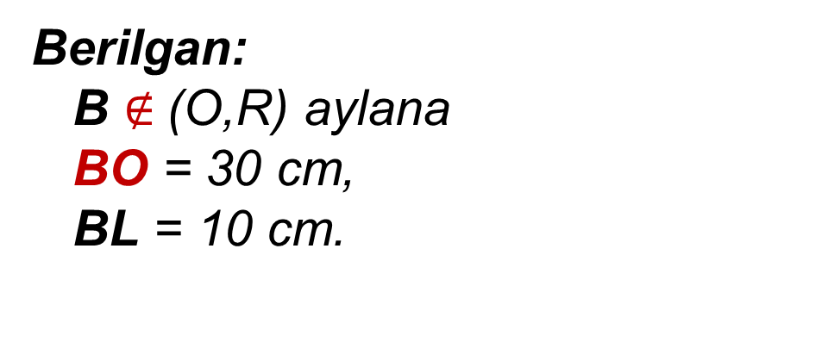
Aylana tashqarisida berilgan nuqtadan aylana nuqtalarigacha bo‘lgan eng katta va eng kichik masofalar mos ravishda 30 cm va 10 cm ga teng. Berilgan aylananing radiusini toping.
Berilgan:
B $∉$(O,R) aylana
BO = 30 cm,
BL = 10 cm.
N
L
B
Topish kerak:
R - ?
O
Yechish:
R = ON = OL
OL = BO - BL = 30 - 10 = 20 (cm).

Slide 7
TEST 2
Aylana tashqarisida berilgan nuqtadan aylana nuqtalarigacha bo‘lgan eng katta va eng kichik masofalar mos ravishda 30 cm va 10 cm ga teng. Berilgan aylananing radiusini toping.
A) 20 cm;
B) 10 cm;
D) 15 cm;
E) 5 cm.

Slide 8
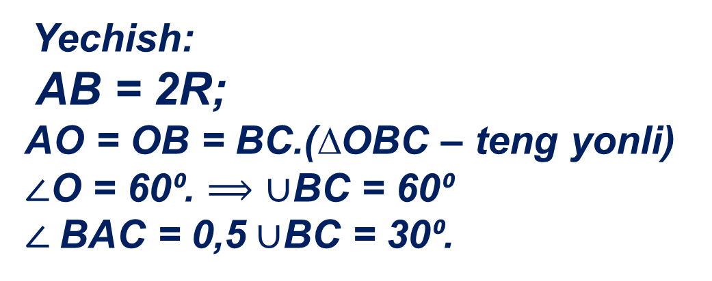
TEST 3
AB – O markazli aylananing diametri. Agar OA = OC = BC bo‘lsa, CAO burchakni toping.
A) 60⁰;
B) 30⁰;
D) 90⁰;
E) 120⁰.
Yechish:
AB = 2R;
AO = OB = BC.(∆OBC – teng yonli)
$∠$O = 60⁰. $⟹$ $∪$BC = 60⁰
$∠$BAC = 0,5 $∪$BC = 30⁰.
B
O
C
?
A

Slide 9
TEST 4
Radiusi R ga teng bo‘lgan aylanadagi nuqtadan uzunliklari R ga teng bo‘lgan ikki vatar o‘tkazildi. Vatarlar orasidagi burchakni toping.
A) 120⁰;
B) 110⁰;
D) 135⁰;
E) 40⁰.

Slide 10
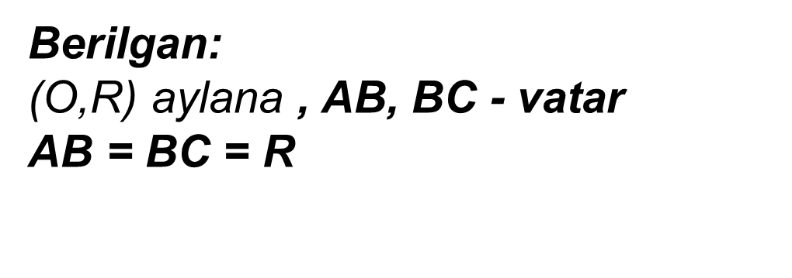
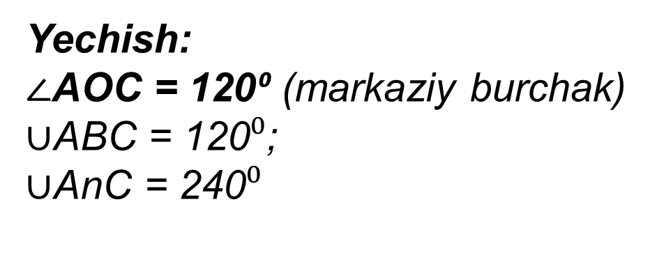
Radiusi R ga teng bo‘lgan aylanadagi nuqtadan uzunliklari R ga teng bo‘lgan ikki vatar o‘tkazildi. Vatarlar orasidagi burchakni toping.
Berilgan:
(O,R) aylana , AB, BC - vatar
AB = BC = R
A
B
?
O
$∠$АBC - ?
60⁰
60⁰
Yechish:
$∠$AOC = 120⁰ (markaziy burchak)
$∪$ABC = 120$⁰$;
$∪$AnC = 240$⁰$
n
C
$∠$ABC = 0,5∙ $∪$AnC = 120⁰

Slide 11
TEST 4
Radiusi R ga teng bo‘lgan aylanadagi nuqtadan uzunliklari R ga teng bo‘lgan ikki vatar o‘tkazildi. Vatarlar orasidagi burchakni toping.
A) 120⁰;
B) 110⁰;
D) 135⁰;
E) 40⁰.

Slide 12
TEST 5
Aylanani kesuvchi ikki vatari orasidagi burchaklaridan biri 80º ga teng. Shu burchakka qo‘shni bo‘lgan burchaklarning yig‘indisini toping.
A) 200⁰;
B) 90⁰;
D) 100⁰;
E) 160⁰.
D
В
Berilgan:
(O,R) aylana , AB, CD – vatarlar. α = 80⁰.
x + y = ?
x
α
y
x
А
О
С
Yechish:
x = y (vertikal burchaklar)
2x = 2·(180º-80⁰) = 200º.

Slide 13
TEST 6
Aylana tashqarisidagi nuqtadan aylanaga ikkita urinma o‘tkazilgan. Agar urinmalar orasidagi burchak 72⁰ bo‘lsa, aylananing urinish nuqtalari orasidagi katta yoyini toping.
A) 248⁰;
B) 240⁰;
D) 252⁰;
E) 236⁰.

Slide 14
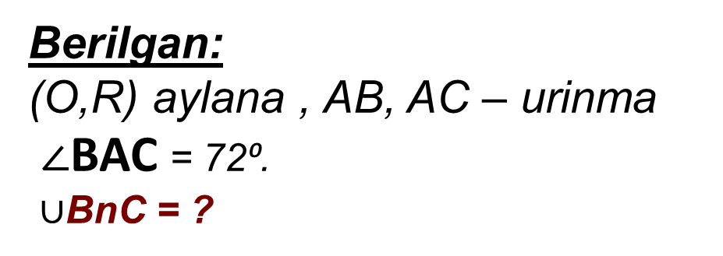
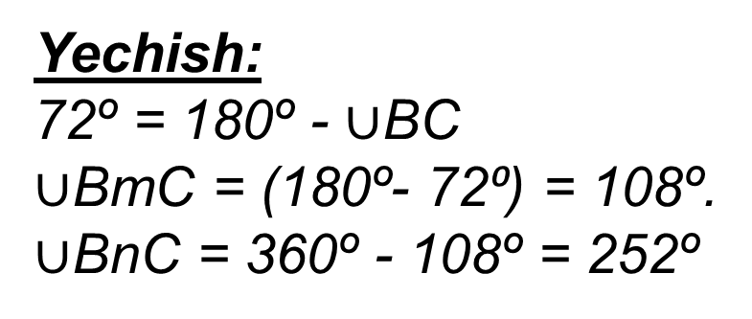
Aylana tashqarisidagi nuqtadan aylanaga ikkita urinma o‘tkazilgan. Agar urinmalar orasidagi burchak 72⁰ bo‘lsa, aylananing urinish nuqtalari orasidagi katta yoyini toping.
Berilgan:
(O,R) aylana , AB, AC – urinma
$∠$BAC = 72⁰.
$∪$BnC = ?
B
n
О
m
72º
Yechish:
72º = 180º - $∪$BC
$∪$BmC = (180º- 72⁰) = 108º.
$∪$BnC = 360º - 108º = 252º
A
C

Slide 15
TEST 6
Aylana tashqarisidagi nuqtadan aylanaga ikkita urinma o‘tkazilgan. Agar urinmalar orasidagi burchak 72⁰ bo‘lsa, aylananing urinish nuqtalari orasidagi katta yoyini toping.
A) 248⁰;
B) 240⁰;
D) 252⁰;
E) 236⁰.

Slide 16
Mustaqil bajarish uchun topshiriqlar:
1
1- 2- masalalar tahlil qilish
145 - sahifa
2
3 - 4- masalalar yechish

