Slide 1

GEOMETRIYA
8-sinf
MAVZU: TAKRORLASH (Uchburchakning yuzi).

Slide 2
Uchburchakning yuzi
В
В
E
R
K
L
А
H
D
А
H
D

Slide 3
Uchburchakning yuzi
В
D
a
1
S_{ABC} = ab
С
b
А
2
To‘g‘ri burchakli uchburchakning yuzi katetlar ko‘paytmasining yarmiga teng.

Slide 4
АBC uchburchak yuzini hisoblang
В
В
S = 0,5AC∙BH
S = 0,5AC∙BC
S = 120
S = 10
4
12
А
С
А
H
С
5
20

Slide 5
АBD – ixtiyoriy uchburchak.
АР balandlikni toping.
В
Р
22
11
S_{ABD} = 88
AP = 8
D
А
H
16

Slide 6
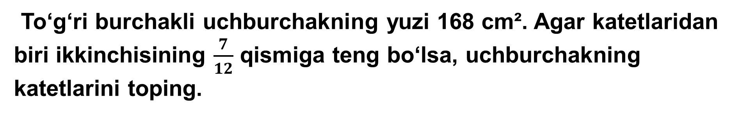
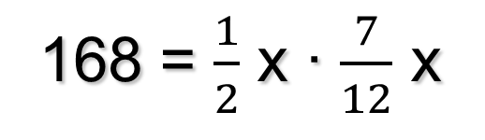
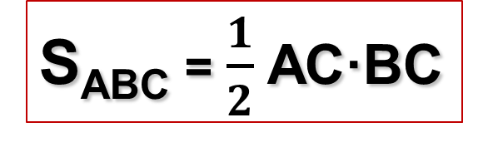

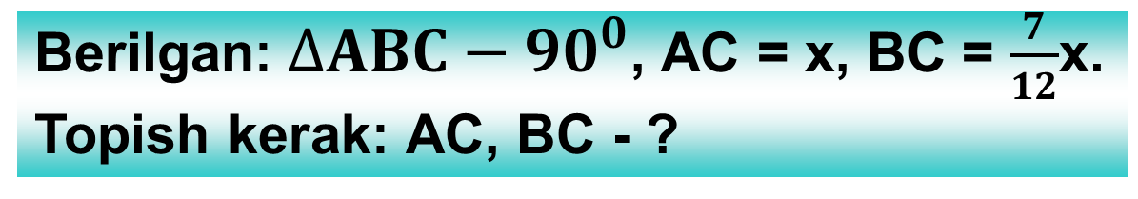
8- masala (151- bet)
To‘g‘ri burchakli uchburchakning yuzi 168 cm². Agar katetlaridan biri ikkinchisining $\frac{7}{12}$ qismiga teng bo‘lsa, uchburchakning katetlarini toping.
C
Berilgan:$∆ABC−90^{0}$, AC = x, BC = $\frac{7}{12}$x.
Topish kerak: AC, BC - ?
168 = $\frac{1}{2}$ x ∙ $\frac{7}{12}$ x
S_{ABC} = $\frac{1}{2}$ AC·BC
A
B
7x² = 4032
x² = 576
x = 24 (AC).
24:12·2 = 14(BC).
Javob: $24 cm$ va 14$cm.$

Slide 7
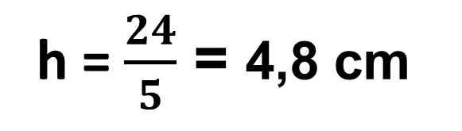
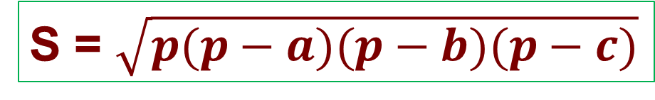
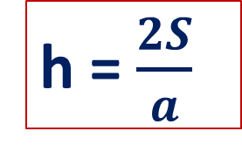
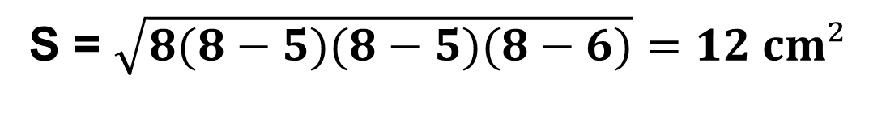
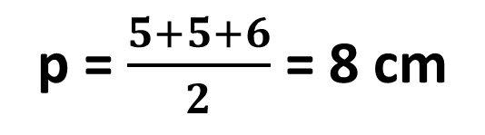
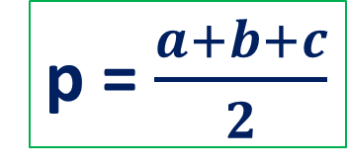
Teng yonli uchburchakning tomonlari 6 cm, 5 cm va 5 cm. Shu uchburchakning yuzi va yon tomoniga o‘tkazilgan balandlikni toping.
В
S = $\sqrt{p(p−a)(p−b)(p−c)}$
D
p = $\frac{a+b+c}{2}$
h = $\frac{2S}{a}$
5 cm
5 cm
p = $\frac{5+5+6}{2}$ = 8 cm
C
А
6 cm
S = $\sqrt{8(8−5)(8−5)(8−6)}=12 cm²$
h = $\frac{24}{5}$ = 4,8 cm
Javob: 12 cm² va 4,8 cm

Slide 8
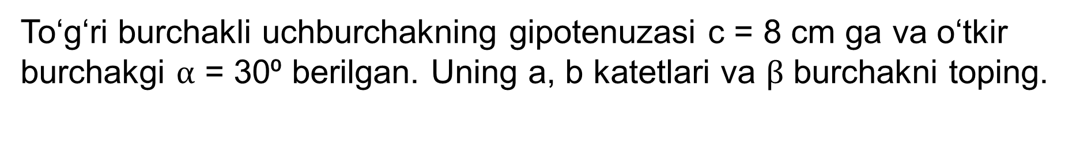
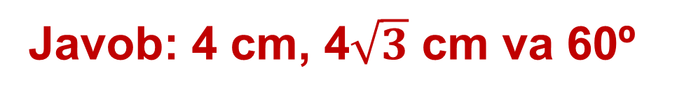
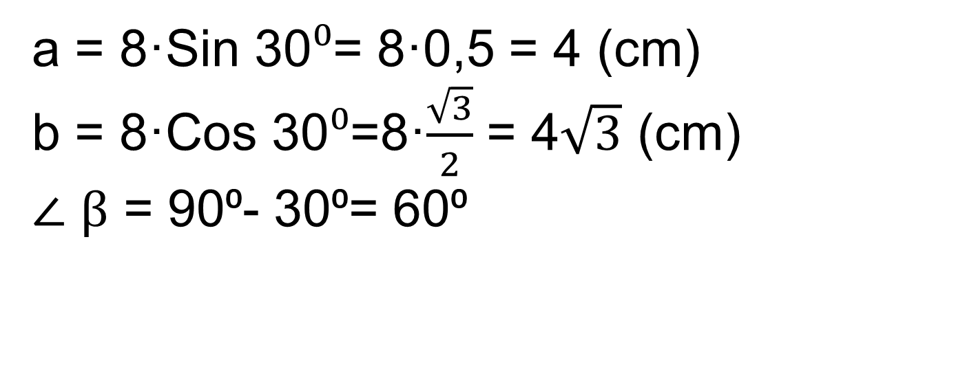
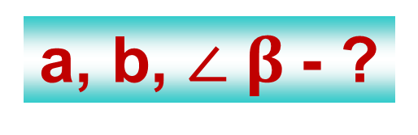
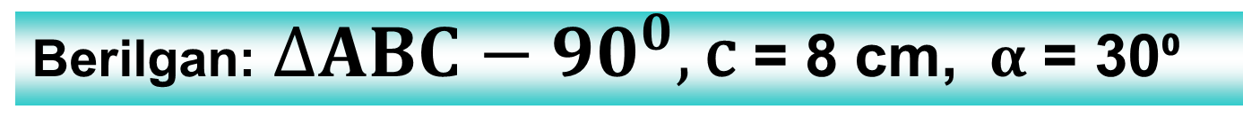
Masala
To‘g‘ri burchakli uchburchakning gipotenuzasi c = 8 cm ga va o‘tkir burchakgi $α$ = 30⁰ berilgan. Uning a, b katetlari va $β$ burchakni toping.
Berilgan:$∆ABC−90^{0},\text{c}\text{ = 8 }\text{cm}\text{,}$ $α$ = 30⁰
a, b, $∠$ $β$- ?
?
8
a = 8·Sin 30$⁰$= 8·0,5 = 4 (cm)
b = 8·Cos 30$⁰$=8·$\frac{\sqrt{3}}{2}$ = 4$\sqrt{3}$ (cm)
$∠$ $β$ = 90⁰- 30⁰= 60⁰
a
30º
b
Javob: 4 cm, 4$\sqrt{3}$ cm va 60º

Slide 9
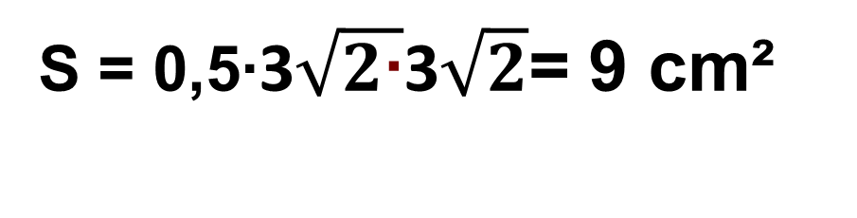
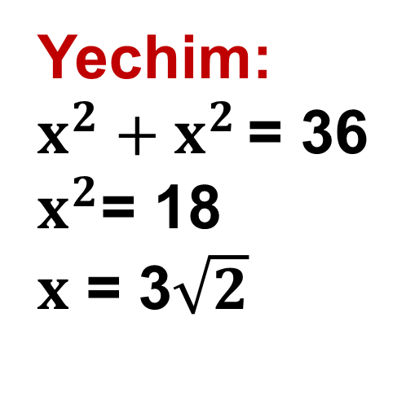
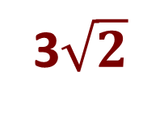
Chizma asosida uchburchak yuzini toping.
S_{ABC} = 0,5AB·AC
135⁰
C
Yechim:
$x^{2}+x^{2 }$= 36
$x^{2}$= 18
$x$ = 3$\sqrt{2}$
6 сm
135⁰
S = 0,5∙3$\sqrt{2\text{∙}}$3$\sqrt{2}$= 9 cm²
B
А
Javob: 9 cm²
x
3$\sqrt{2}$

Slide 10
АВС va КВС uchburchaklarning BC tomoniga tushirilgan balandliklari 7 : 6 kabi. АВС uchburchak yuzi КВС uchburchak yuzidan 15 cm² ga ortiq bo‘lsa, katta uchburchak yuzini toping.
х+15
S_{ABC}
АH
S_{ABC} = ?
=
А
S_{КВC}
КN
х
К
x + 15
7
=
x
6
(х+15)·6 = 7x
x = 90 (cm²)
В
H
С
N
Javob: 105 cm²
Notes:
Л.И. Звавич, Е.В. Потоскуев «Тестовые задания по геометрии» 8 класс.

Slide 11
Mustaqil bajarish uchun topshiriqlar:
1
4 - masala
151- sahifa
2
6 - masala
3
7 – masala

