Slide 1

Geometriya
8-sinf
Masalalar
yechish

Slide 2
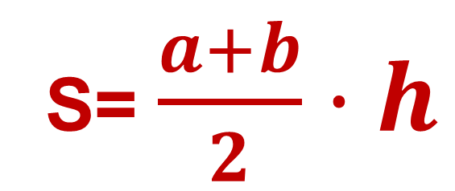
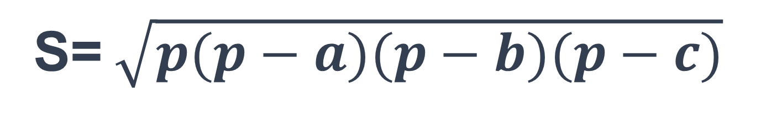
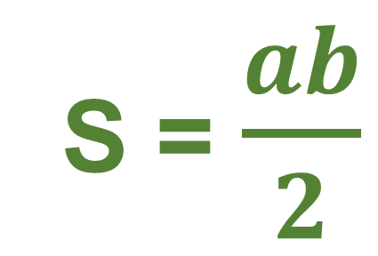
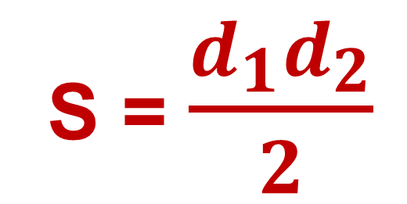
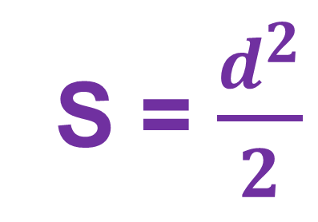
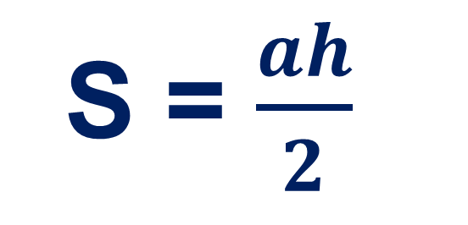
Uchburchak
yuzi
S = $\frac{ah}{2}$
S=ab
S = $\frac{d_{1}d_{2}}{2}$
S = $\frac{d^{2}}{2}$
S = $\frac{ab}{2}$
S=(a+b)·h
S= $\frac{a+b}{2}·h$
S= a²
S=$\sqrt{p(p−a)(p−b)(p−c)}$

Slide 3
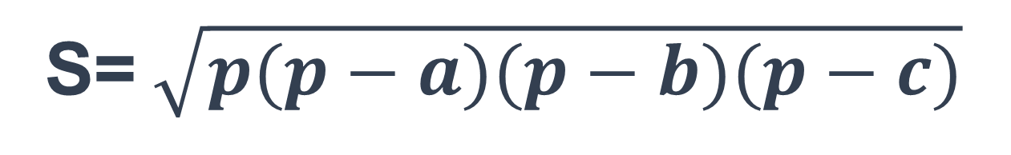
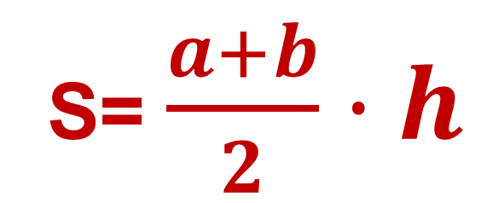


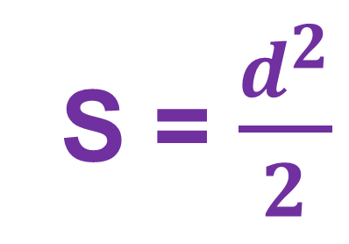

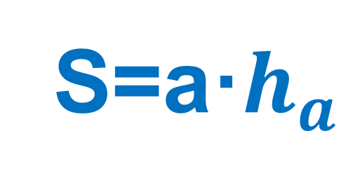
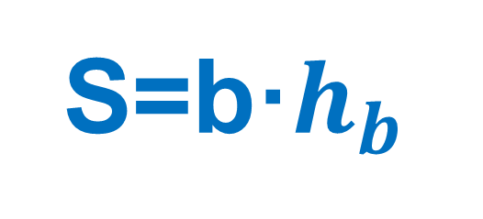
Kvadrat va to‘g‘ri to‘rtburchak yuzi
S=ab
S = $\frac{ah}{2}$
S = $\frac{d_{1}d_{2}}{2}$
S=b·$h_{b}$
S = $\frac{d^{2}}{2}$
S=a·$h_{a}$
S= $\frac{a+b}{2}·h$
S = $\frac{ab}{2}$
S= a²
S=$\sqrt{p(p−a)(p−b)(p−c)}$

Slide 4
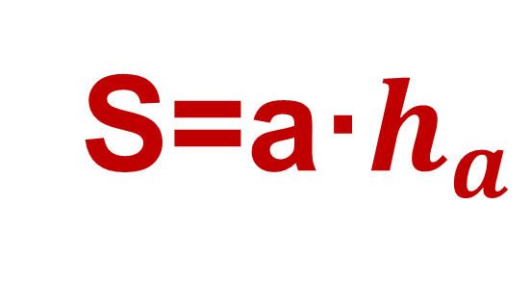
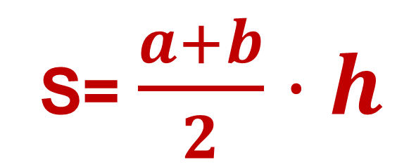
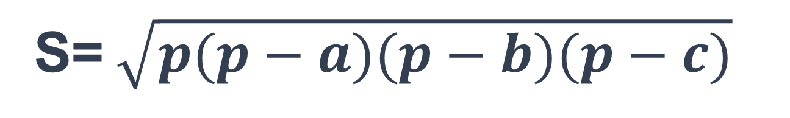

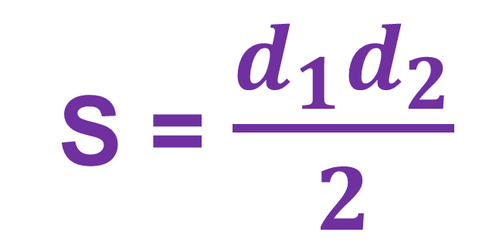
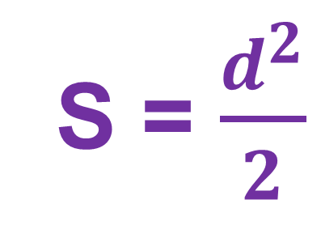

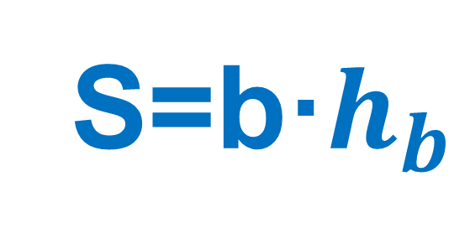
Parallellogramm va romb yuzi
S=ab
S = $\frac{ah}{2}$
S = $\frac{d^{2}}{2}$
S = $\frac{d_{1}d_{2}}{2}$
S = $\frac{ab}{2}$
S=a·$h_{a}$
S= $\frac{a+b}{2}·h$
S=b·$h_{b}$
S= a²
S=$\sqrt{p(p−a)(p−b)(p−c)}$

Slide 5
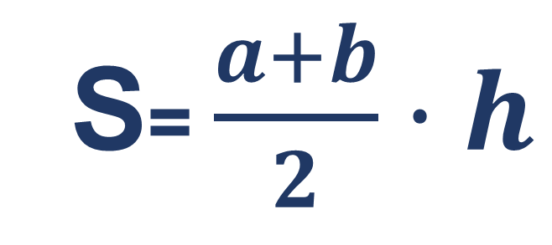

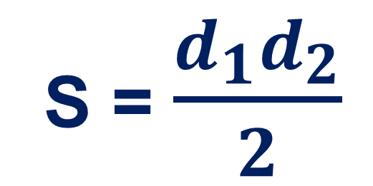
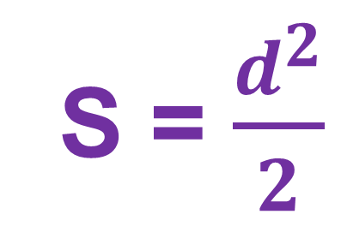
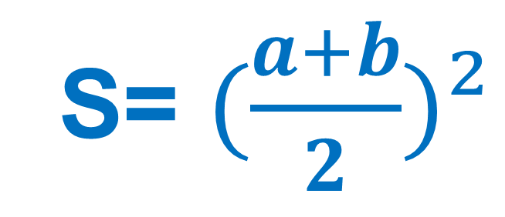
Trapetsiya yuzi
S=ab
S = $\frac{d_{1}d_{2}}{2}$
S =MN·h
S = $\frac{d^{2}}{2}$
S = $\frac{ab}{2}$
S= $(\frac{a+b}{2})²$
S= $\frac{a+b}{2}·h$
S= a²
S=$\sqrt{p(p−a)(p−b)(p−c)}$

Slide 6
151-bet, 10- masala.
ABCD romb berilgan. AC va BD diagonallar mos ravishda 30 sm va 12 sm ga teng. Rombning yuzini toping.

Slide 7
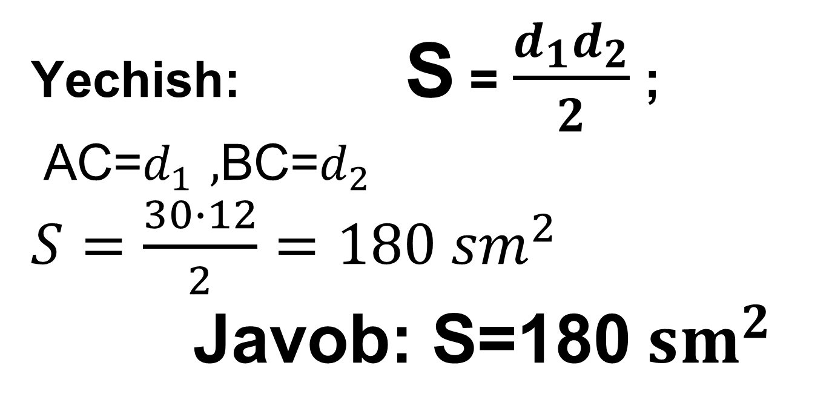

B
A
Berilgan:
ABCD – romb
AC = 30 cm, BD = 12 cm.
d₁
d₂
Topish kerak: $S_{r}$- ?
C
D
Yechish: S = $\frac{d_{1}d_{2}}{2}$ ;
AC=$d_{1 },$BC=$d_{2}$
$S=\frac{30∙12}{2}=180 {sm}^{2}$
Javob: S=180${ sm}^{2}$

Slide 8
161-bet,12-masala.
ABC uchburchakda BC=34cm. BC kesmaning o‘rtasidan AC to‘g‘ri chi-ziqqa o‘tkazilgan EF perpendikular AC tomonni AF = 25 cm va FC = 15 cm li kesmalarga ajratadi. ABC uchburchakning yuzini toping.

Slide 9
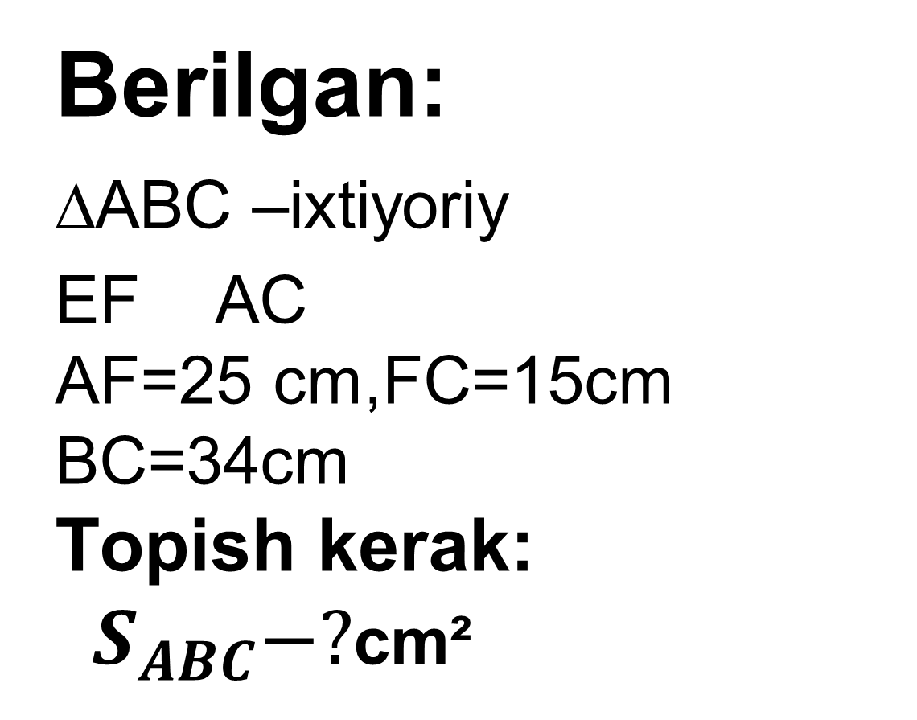
161-bet,12-masala.
Berilgan:
∆ABC –ixtiyoriy
EF AC
AF=25 cm,FC=15cm
BC=34cm
Topish kerak:
$S_{ABC}−?$cm²
A
F
E
B
E
C

Slide 10
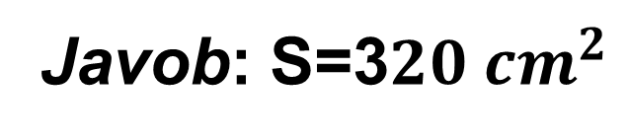
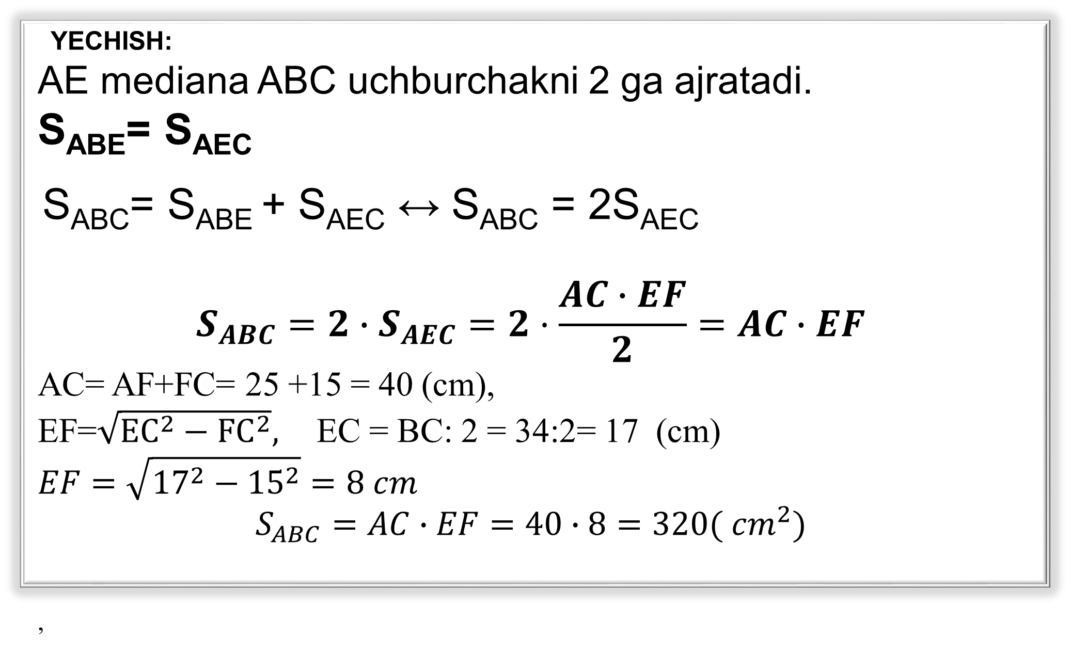
YECHISH:
AE mediana ABC uchburchakni 2 ga ajratadi.
S_{ABE}= S_{AEC}
S_{ABC}= S_{ABE} + S_{AEC} ↔ S_{ABC} = 2S_{AEC}
$$S_{ABC}=2∙S_{AEC}=2·\frac{AC∙EF}{2}=AC∙EF$$
AC= AF+FC= 25 +15 = 40 (cm),
EF=$\sqrt{{EC}^{2}−{FC}^{2}},$EC = BC: 2 = 34:2= 17 (cm)
$$EF=\sqrt{{17}^{2}−{15}^{2}}=8 cm$$
$$S_{ABC}=AC∙EF=40∙8=320( {cm}^{2})$$
,
A
F
B
C
E
Javob: S=3$20{ cm}^{2}$

Slide 11
152-bet, 17-masala
To‘g‘ri to‘rtburchakning bo‘yi 30% ga orttirilsa va eni 30% ga kamaytirilsa, uning yuzi qanday o‘zgaradi?

Slide 12
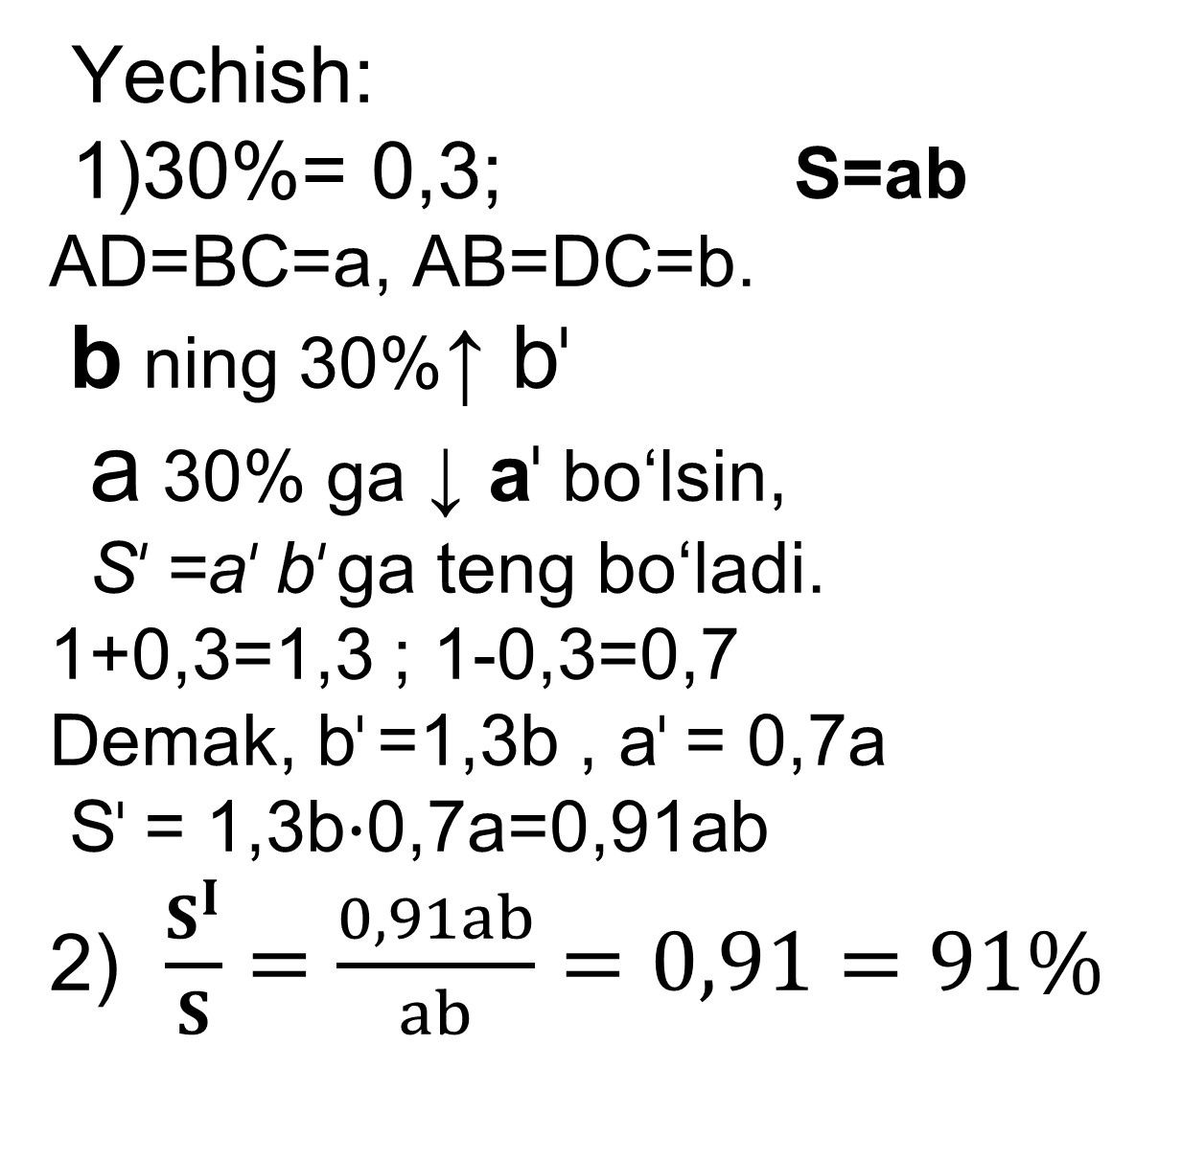
Yechish:
1)30%= 0,3; S=ab
AD=BC=a, AB=DC=b.
b ning 30%↑ b^{ᶥ}
a 30% ga ↓ a^{ᶥ} bo‘lsin,
S^{ᶥ} =a^{ᶥ} b^{ᶥ} ga teng bo‘ladi.
1+0,3=1,3 ; 1-0,3=0,7
Demak, b^{ᶥ} =1,3b , a^{ᶥ} = 0,7a
S^{ᶥ} = 1,3b$∙$0,7a=0,91ab
2) $\frac{S^{I}}{S}=\frac{0,91ab}{ab}=0,91=91\%$
A^{ᶥ}
a^{ᶥ}
D^{ᶥ}
A
D
a
b
b^{ᶥ}
b
a^{ᶥ}
D^{ᶥ}
B
a
C^{ᶥ}
C
3) 100% - 91%= 9%
Javob: 9% ga
o‘zgaradi.

Slide 13
151-bet, 13-masala.
Rombning dioganallari 18 dm
va 24 dm. Shu rombning perimetri
va parallel tomonlari orasidagi
masofani toping.

Slide 14
Mustaqil bajarish uchun topshiriqlar
Darslikning 152- betidagi
14-, 15-, 18-masalalarni yechish.

Slide 16
Masalalar yechish
4-masala
A
D
To‘g‘ri to‘rtburchakning yuzi 540 cm², ikki tomo-nining nisbati 3:5 kabi. Shu to‘g‘ri to'rtburchak-ning perimetrini toping.
a
b
P=?
b
B
a
C

Slide 17
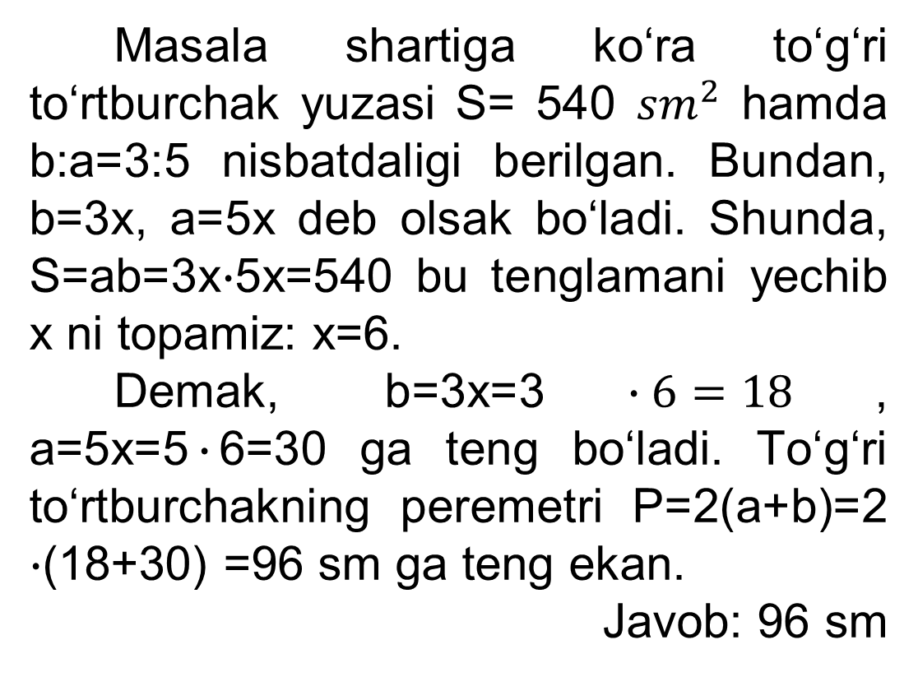
Masalalar yechish
Yechish
Masala shartiga ko‘ra to‘g‘ri to‘rtburchak yuzasi S= 540 ${sm}^{2}$ hamda b:a=3:5 nisbatdaligi berilgan. Bundan, b=3x, a=5x deb olsak bo‘ladi. Shunda, S=ab=3x$∙$5x=540 bu tenglamani yechib x ni topamiz: x=6.
Demak, b=3x=3$∙6=18$, a=5x=5$∙$6=30 ga teng bo‘ladi. To‘g‘ri to‘rtburchakning peremetri P=2(a+b)=2 $∙$(18+30) =96 sm ga teng ekan.
Javob: 96 sm
A
D
a
b
b
B
a
C

