Slide 1
GEOMETRIYA
8-sinf
Mavzu: Pifagor teoremasining tatbiqlari

Slide 2
Pifagor teoremasi
To‘g‘ri burchakli uchburchak gipotenuzasining kvadrati uning katetlari kvadratlarining yig‘indisiga teng.
c² = a² + b²
c =$\sqrt{\text{a}\text{2 }\text{+ }\text{b}\text{2}}$
b
c
a² = c² - b²
a=$\sqrt{{\text{c}}^{2}−b²}$
b² = c² - a²
b=$\sqrt{{\text{c}}^{2}−a²}$
a

Slide 3
Mustahkamlash
Kattaliklardan to‘g‘ri burchakli uchburchak yasash
mumkinmi?
?
√
c² = a² + b²
1) 5, 11, 12;
3) 5, 12, 13;
√
?
2) 6, 8, 10;
4) 11, 12, 15;
c > a
1) 12² = 5² + 11²
^{144 ≠ 25 +121}
3) 13²5² + 12²
¹⁶⁹ ⁼ ²⁵ ⁺ ¹⁴⁴
c > b
2) 10² = 6² + 8²
¹⁰⁰ ⁼ ³⁶ ⁺ ⁶⁴
4) 15² = 11² + 12²
²²⁵ ^{≠ 121 +144}

Slide 4
Noma’lum x ni toping
Berilgan:
Δ ABD va Δ ACD – 90° li
AD - balandlik
AB = 5 cm, AC=6 cm
AB = DC
x(BD) - ?
A
5 cm
6 cm
B
C
x cm
D
5 cm
Yechish:
Δ ACD dan, AD = $\sqrt{6^{2}−5^{2}}=\sqrt{36−25}=\sqrt{11}$
Δ ABD dan, x = $\sqrt{5^{2}−{(\sqrt{11})}^{2}}=\sqrt{25−11}=\sqrt{14}$
Javob: $\sqrt{14}$ cm
4
4

Slide 5
Tomonlari 10 cm, 10 cm va 12 cm bo‘lgan uchburchakning
balandliklarini toping .
Berilgan:
a = 10 cm, b= 10 cm, c = 12 cm.
$h_{a}$, $h_{b}, h_{c }$- ?
a
b
$$h_{b}$$
$$h_{a}$$
Yechish:
$$h_{c}$$
$h_{a}$ = $\frac{2}{a}\sqrt{p(p−a)(p−b)(p−c)}$
$p$ = $\frac{10+10+12}{2}$ = 16
C
$h_{a}=h_{b}$ = $\frac{2}{10}\sqrt{16(16−10)(16−10)(16−12)}=0,2\sqrt{16·6·6·4}$ = 9,6(cm)
$h_{c}$ = $\frac{2}{12}\sqrt{16(16−10)(16−10)(16−12)}=\frac{2}{12}\sqrt{16·6·6·4}$ = 8(cm)
Javob: 9,6cm, 9,6 cm va 8 cm
5

Slide 6
Masala
A
Agar teng tomonli uchburchakning tomoni
12 cm ga teng bo‘lsa,
uning balandligini toping.
a
a
B
a
C

Slide 7
Agar teng tomonli uchburchakning tomoni 12 cm ga teng bo‘lsa, uning balandligini toping.
A
Berilgan:
∆ABC - teng tomonli
AB= AC=BC = 12cm, AE-?
Yechish:
AE- mediana $⟹$ BE = CE
AE² = AC² $−$ EC² bunda,
AC =12 cm, EC = BC/2 = 6
$$AE=\sqrt{{12}^{2}−6^{2}}=\sqrt{144−36}=\sqrt{108}=6\sqrt{3} cm$$
12
12
6
6
B
E
C
Javob$:6\sqrt{3} cm$
:

Slide 8
Masala
O‘tmas burchakli uchburchakning tomonlari a = 16 cm, b = 12 cm va c = 8 cm. Uchburchakning kichik tomoniga tushirilgan balandlikni toping.
A
a
b
c
C
B

Slide 9
A
Berilgan:
∆ABC – ihtiyoriy
a = 16 cm, b = 12 cm, c = 8 cm.
h(AE) -?
a
h
b
$p$ = $\frac{16+12+8}{2}$ = 18
x
E
c
C
B
$h_{c}$ = $\frac{2}{8}\sqrt{18(18−16)(16−12)(16−8)}=$
= $\frac{1}{4}\sqrt{18·2·4·8}$
= $\frac{1}{4}(6\sqrt{15}$) = $\frac{3\sqrt{15}}{2}$
Javob: $\frac{3\sqrt{15}}{2}$

Slide 10
Masala
Δ ABC da AB =13 cm, AC = 20 cm, AD – balandlik 12 cm ga teng. AB, AC tomonlarning BC tomonga tushirilgan proyeksiyalari uzunliklari va BC tomon uzunligini toping.
A
B
C
D
10

Slide 11
Berilgan:
Δ ABC da AB =13 cm,
AC = 20 cm, AD – 12 cm.
BD, CD, BC - ?
Yechish:
$∠$ADB = $∠A$DC = 90°. Δ ABD dan,
BD² = AB² – AD²;
13² – 12² =169 –144 = 25. BD = 5 cm.
A
B
D
C
Δ ACD dan, CD ² = AC² – AD² ;
20² – 12² = 400 – 144 = 256. CD = 16 cm.
BC = BD + DC =5 + 16 = 21 cm.
Javob: BD = 5cm, CD = 16 cm, BC = 21 cm
11
11

Slide 12
Masala
AB to‘g‘ri chiziq O markazli aylananing A nuqtasiga o‘tkazilgan urinma. Agar AB = 24 cm, Aylananing radiusi 7 cm ga teng bo‘lsa, OB kesmaning uzunligini toping.
A
Berilgan:
AB = 24 cm,
AO = 7 cm.
OB = ?
Yechish:
OB = $\sqrt{7^{2}+{24}^{2}}$
OB = $\sqrt{625}$
OB = 25
B
O
OB = $\sqrt{R^{2}+{(AB)}^{2}}$
Javob: 25 cm

Slide 13
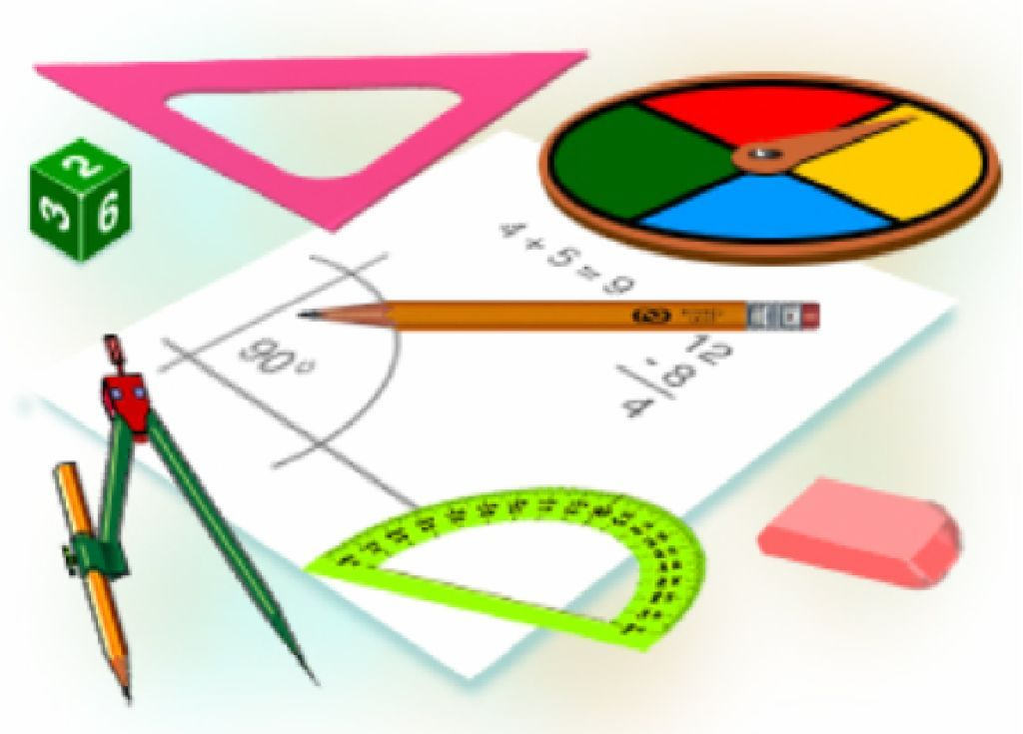
Mustaqil bajarish uchun topshiriqlar:
Darslikda berilgan
9-, 11-, 12 – masalalarni yechish
(151- bet).

