Slide 1
GEOMETRIYA
8-sinf
MAVZU: TEKISLIKDA NUQTANING KOORDINATALARI.
KESMA O‘RTASINING
KOORDINATALARI

Slide 2
Tarixiy ma’lumot
Rene Dekart (1596-1650)
Fransuz faylasufi, matematigi, fizigi, fiziologi. Grek va lotin tillari, matematika va falsafani o‘rgangan. Dekart falsafasi uning matematikasi, fizikasi bilan bog‘liq. Matematikada analitik geometriya asoschilaridan biri.
To‘g‘ri burchakli koordinatalar sistemasini fanga kiritgan.
Rene Dekart

Slide 3
Koordinatalar sistemasi
Koordinatalar sistemasi
у
A
(x; y)
II chorak
( - ; + )
OX - abssisa o‘qi
OY - ordinata o‘qi
O - koordinata boshi
I chorak
( + ;+ )
0
х
III chorak
( - ; - )
IV chorak
( + ; - )

Slide 4
Koordinatalar sistemasi
∙
A(2;4)
y
A (2; 4) $x_{1}$ = 2, $y_{1}$ = 4
B (1; -2) $x_{2}$ = 1, $y_{2}$ = -2
O (0;0)
4
3
2
O
∙
1
x
-3
-2
-1
1
2
3
-1
∙
B(1;-2)
-2

Slide 5
Koordinatalar sistemasi
а) absissa o‘qida yotgan nuqtaning ordinatasi nolga tengdir ;
y
b) Ordinata o‘qida yotgan nuqtaning absissasi nolga teng.
o
x

Slide 6
Koordinatalar sistemasi
Agar A (2; 4) va B (-3; 2), C nuqta AB kesmaning o‘rtasi ekanligi ma‘lum
bo‘lsa, C nuqtaning koordinatasini toping.
∙
y
A(2;4)
$x_{C}$ = - 0,5
∙
4
C
3
∙
$$y_{C}$$
$y_{C}$ = 3
B(-3;2)
B
2
1
O
x
C (-0,5;3)
$$x_{C}$$
-3
-2
-1
1
2
3
-1
-2

Slide 7
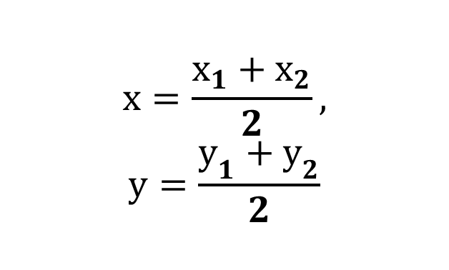
Kesma o‘rtasining koordinatasi
А
С
(х; у)
у
В
х

Slide 8
Kesma o‘rtasining koordinatasi
Agar: А ( - 1; 7 ) va В ( 7; 1) bo‘lsa, AB kesma o‘rtasining koordinatasini toping.
С ( 3; 4)

Slide 9
Agar ABCD parallelogramning А(2; 6), В(4; 7),С(8; 10) bo‘lsa, D nuqtaning koordinatasini toping
В
С
А(2; 6)
В(4; 7)
С(8; 10)
D($x_{D }$; $y_{D }$) -?
О
А
D
АС dioganal orqali topish:
BD dioganal orqali topish:
$$x_{D }=10−4=6$$
$$y_{D }=16−7=9$$
D (6; 9)

Slide 10
Mustahkamlash
Aylananing absissa va orbinata o‘qlari bilan kesishish nuqtalarini aniqlang.
у
5
4
3
2
1
х
-8 -7 -6 -5 -4 -3 -2 -1 0 1 2 3 4 5 6 7 8 9
-1
-2
-3
-4

Slide 11
Mustahkamlash
1. А(4; -1), В(-2; -6) bo‘lsa, АВ kesma o‘rtasining
koordinatasini toping.
(1; -3,5)
2. М(3; -2) nuqtadan
a) absissa o‘qigacha ;
b) ordinata o‘qigacha bo‘lgan masofani aniqlang
a) 2
b) 3

Slide 12
Mustaqil bajarish uchun topshiriqlar:
Darslikning 71- betida berilgan 4- 7 – masalalarni yechish.

