Slide 1
GEOMETRIYA
8-sinf
MAVZU: AMALIY TATBIQIY
MASALALAR YECHISH

Slide 2
Rombning dioganallari 24 cm va 10 cm ga teng bo‘lsa,
uning tomonini toping?
В
Berilgan:
ABCD – romb
$d_{1}$= 24 cm
$d_{2}$ = 10 cm
BD - ?
Yechish: ∆AOB dan,
AB = $\sqrt{{(AO)}^{2}+{(BO)}^{2}}$
AO = 12 cm
BO = 5 cm
?
5
А
O
D
С
AB =$\sqrt{12²+5^{2}}=\sqrt{169}=13(cm)$
Javob: 13 cm.

Slide 3
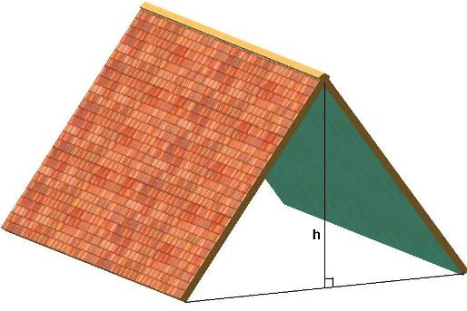
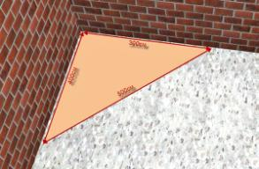
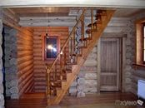
h
b/2

Slide 4
Berilgan: ABCD - parallelegramm
Topish kerak: СD
B
C
a$\sqrt{2}$
a
6
?
a
45⁰
А
Е
D
Javob: $6\sqrt{2}$

Slide 5
ABCD teng yonli trapetsiyaning katta asosiga yopishgan
burchagi 60⁰ ga, yon tomoni 4 cm ga teng bo‘lsa, asoslar
orasidagi masofani toping .
B
C
Berilgan:
BD – teng yonli trapetsiya
$∠A$= 60⁰, AB = 4 cm.
BE - ?
4
30⁰
Yechish:
∆ABE - 90⁰ li
$∠$ABE = 30º ekanligidan:
AE = AB:2 = 4:2 = 2 cm
60⁰
60⁰
А
2
E
D
h = 4 · sin60⁰ = 4 ∙ $\frac{\sqrt{3}}{2}$ = 2$\sqrt{3}$
BE $=\sqrt{16−4}=\sqrt{12}=2\sqrt{3}$
Javob:$2\sqrt{3}$ cm

Slide 6
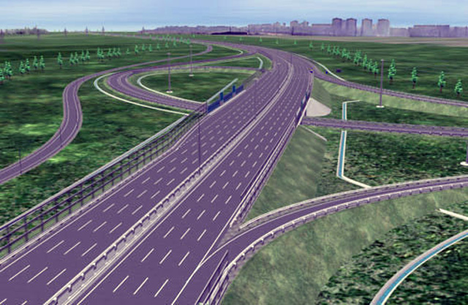
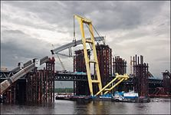
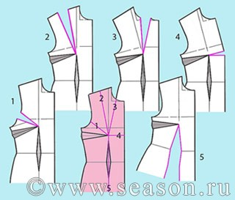

Slide 7
Tomonlari 10 m, 12 m, 10 m bo‘lgan uchburchakning katta tomoniga tushirilgan balandlikni toping.
Yechim:
$p=\frac{1}{2}\text{(}\text{a}\text{+}\text{b}\text{+}\text{c}\text{)}$ $=\frac{1}{2}\text{(10+10+12)}$ $=\frac{32}{2}$ = 16
$h_{a}=\frac{2}{a}\sqrt{p(p−a)(p−b)(p−c)}$ =
= $\frac{2}{12}\sqrt{16(16−10)(16−10)(16−12)}$ =
= $\frac{1}{6}\sqrt{16∙6∙6∙4 }$= $\frac{1}{6}∙4∙6∙2=8$
b =10 m
c =10 m
h -?
a = 12 m
h
Javob: 8 metr

Slide 8
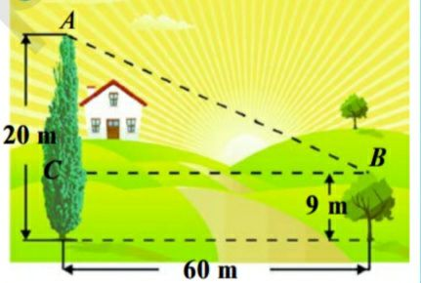
Bir daraxtning balandligi 20 metr, ikkinchisiniki esa 9 metr. Bu daraxtlar orasidagi masofa 60 metrni tashkil qilsa, shu daraxt
uchlari orasidagi masofani toping.
Berilgan:
∆ABC - 90⁰ li,
AC = 20 – 9 = 11 m
BC = 60 m
AB - ?
Yechish:
BE $=\sqrt{3600+121}=\sqrt{3721}=61$

Slide 9
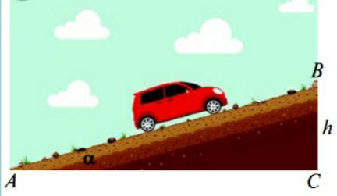
Yengil mashina nishabligi 15⁰ bo‘lgan qiya yo‘l bo‘ylab ko‘tarilmoqda. U qiyalikka ko‘tarilish joyidan 300 metr yo‘l bosib o‘tgach gorizontga nisbatan necha metr balandlikda bo‘ladi?
Berilgan:
∆ABC - 90⁰ li,
AC = 300 m
$∠A$- 15⁰
h -?
15⁰
Yechish:
sinA = $\frac{BC}{AB}$ ;
sin15⁰ = $\frac{h}{300}$
0,2588 = $\frac{h}{300}$
h ≈ 78 m
Javob: 78 metr.

Slide 10
Samolyot ychish yo‘lakchasidan havoga ko‘tariladigan nuqtadan 700 metr masofada o‘rmonzor joylashgan bo‘lib, daraxtlarning maksimal balandligi 24 metrga teng. Samoloyot shu daraxtlarga tegmasligi uchun qanday burchak ostida ko‘tarilishi kerak?
Berilgan:
∆ABC - 90⁰ li,
AC = 700 m
BC = 24 m,
$∠A$- ?
24 m
?
700 m
Yechish:
tgA = $\frac{BC}{AC}$ = $\frac{24}{700}$ = 0,0343 $∠A$ = 2⁰
Javob: 2⁰

Slide 11
Mustaqil bajarish uchun topshiriqlar:
1
1-4 masalalar yechish
2
Hayotiy masala tuzish
67 - sahifa
3
Test topshiriqlar
4
Geometrik terminlar

