Slide 1
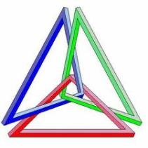
GEOMETRIYA
8-sinf
MAVZU: TO‘G‘RI BURCHAKLI UCHBURCHAKLARNI YASASH

Slide 2
KATETI VA GIPOTENUZASIGA KO‘RA TO‘G‘RI BURCHAKLI UCHBURCHAK YASASH
a
c
c
a

Slide 3
To‘g‘ri burchakli uchburchak o‘tkir burchagi
sinusi $\frac{4}{5}$ ga teng burchak yasash
SinA = $\frac{4}{5}$
B
C
A

Slide 4
IKKATETLARIGA KO‘RA TO‘G‘RI BURCHAKLI UCHBURCHAK YASASH
a
b
a
b

Slide 5
To‘g‘ri burchakli uchburchak o‘tkir burchagi
tangensi $\frac{6}{5}$ ga teng burchak yasash
tgA = $\frac{6}{5}$
B
6
5
C
A

Slide 6
GIPOTENUZA VA O‘TKIR BURCHAGIGA KO‘RA TO‘G‘RI BURCHAKLI UCHBURCHAK YASASH

Slide 7
KATET VA UNGA YOPISHGAN O‘TKIR BURCHAGIGA KO‘RA TO‘G‘RI BURCHAKLI UCHBURCHAK YASASH

Slide 8
5 - Masala (63- bet)
Chizmadagi noma’lum uzunlikni toping.
Berilgan:$∆ABD−90^{0},\text{AD} \text{= 7} \text{cm}\text{, }\text{AB}\text{ =}\sqrt{17}\text{cm}$, AC = x - ? m
A
∆ABD dan, BD = $\sqrt{AD^{2}−AB²}$
BD = $\sqrt{49−17}=\sqrt{32}$ = 4$\sqrt{2}$
∆ABC dan, AC = $\sqrt{AB^{2}+BC²}$
BC = 2$\sqrt{2}$
x = $\sqrt{17+8 }$= $\sqrt{25}$ = 5
$$\sqrt{17} m$$
7 m
X m
B
C
D
Javob: 5 metr

Slide 9
5 - Masala (63- bet)
Chizmadagi noma’lum uzunlikni toping.
Berilgan:$∆ABC−90^{0},\text{c} \text{= 13} \text{cm}\text{, }\text{b}\text{ = 2}\text{x} \text{cm}$, a = 3x cm
${13}^{2}$ = ${(2x)}^{2}+{(3x)}^{2}$
169 = 4x² + 9x²
13x² = 169
x² = 13
x = $\sqrt{13}$
B
13 cm
2x
C
A
3x
Javob: $2\sqrt{13 } cm$ va 3$\sqrt{13} cm.$

Slide 10
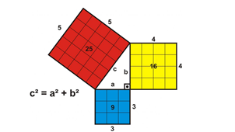
Mustaqil bajarish uchun topshiriqlar:
Darslikning 63- betida berilgan 4-,6-,7 – masalalarni yechish.

