Slide 1
GEOMETRIYA
8-sinf
MAVZU: UCHBURCHAKLARNI YECHISH

Slide 2
Mustahkamlash
Rasmdagi uchburchaklar noaniqroq tasvirlangan. Ularning qaysi biri to‘g‘ri burchakli?
${\left(\sqrt{2}\right)}^{2}+1^{2}$ ${\left(\sqrt{3}\right)}^{2}$
$2+1$ $3$
$3=3$
$5^{2}+{12}^{2} {13}^{2}$
$25+144 169$
$169=169$
${\left(\sqrt{39}\right)}^{2}+5^{2} 8^{2}$
$39+25 64$
$64=64$

Slide 3
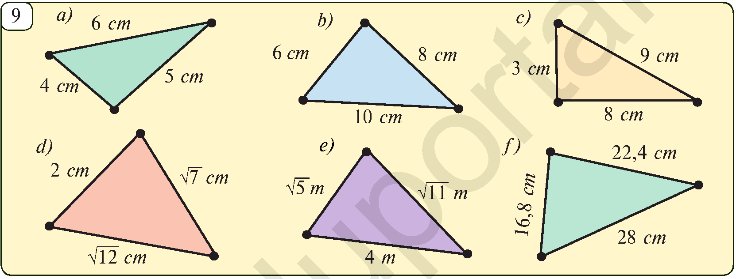
Masala yechish
Rasmdagi uchburchaklar noaniqroq tasvirlangan. Ularning qaysi biri to‘g‘ri burchakli?
$4^{2}+5^{2} 6^{2}$
$16+25 36$
$41≠36$
$6^{2}+8^{2} {10}^{2}$
$36+64 100$
$100=100$
$3^{2}+8^{2} 9^{2}$
$9+64 81$
$73 ≠81$

Slide 4
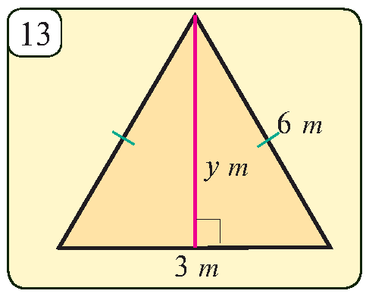
Masalalar yechish
Rasmdagi teng tomonli uchburchakning tomoni 6 m bo‘lsa, uning balandligini toping.
$$6^{2}=x+3^{2}$$
$$x^{2}=6^{2}−3^{2}$$
$$x^{2}=36−9$$
$$x^{2}=27$$
x
x$=\sqrt{27}=3\sqrt{3}$
Javob: $3\sqrt{3} m$

Slide 5
To‘g‘ri burchakli uchburchakning kateti 7 dm ga, uning gipotenuzasiga proyeksiyasi 1,96 dm ga teng. Ikkinchi
katetning uzunligini toping.
$$a=7 dm$$
$$∟$$
$$x=1,96 dm$$
$$b=?$$
$$a$$
$$b$$
$$x=\frac{a^{2}}{c} =>c=\frac{a^{2}}{x}$$
$$h$$
$$x$$
$$∟$$
$$c=\frac{7^{2}}{1,96}=\frac{49}{1,96}=25$$
$$c$$
$$b=\sqrt{c^{2}−a^{2}}=\sqrt{{25}^{2}−7^{2}}=\sqrt{625−49}=\sqrt{576}=24$$

Slide 6
3- Masala(61- bet)
To‘g‘ri burchakli ABC uchburchakda $∠$C = 90⁰, katetlari a = $\sqrt{11}$cm va b= 5 cm. Uchburchakning gipotenuzasi o‘tkir $α$ va $β$ burchaklarini toping.
Berilgan:$∆ABC−90^{0},\text{AC}\text{ = 5 }\text{cm}\text{, }\text{BC}\text{ = }\sqrt{11} \text{cm}$
B
AB$,∠α$, $∠β$- ?
$$\sqrt{11}$$
x
$c^{2}$=$a^{2}+b^{2}$
AB = $\sqrt{25+11}$ = $\text{6} (cm)$
tg$α$ = $\frac{\sqrt{11}}{5}$ ≈ 0,6633
$α$ = 34º
$β$= 90º - 34º = 56º
C
A
5

Slide 7
№5. Hisoblang: 2sin60º + 4cos60º - ctg30º -2tg45º.
α | 30⁰ | 45⁰ | 60⁰
sinα
cosα
tgα |  | 1
2sin60º + 4cos60º- ctg30º-2tg45º=
= 2·$\frac{\sqrt{3}}{2}$ + 4·$\frac{1}{2}$ - $\sqrt{3}$ - 2·1 =
= $\sqrt{3}$ + 2 - $\sqrt{3}$ -2 =
0
ctgα
$$\sqrt{3}$$
1
$$\frac{\sqrt{3}}{3}$$

Slide 8
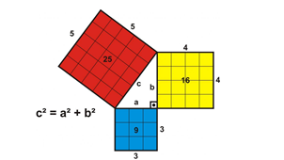
Mustaqil bajarish uchun topshiriqlar:
Darslikning 61- betida berilgan 4-,6-,7 – masalalarni yechish.

