Slide 1
GEOMETRIYA
8-sinf
Mavzu:To‘ldiruvchi burchakning trigonometrik funksiyalari uchun formulalar

Slide 2
Berilgan ma‘lumotlar asosida
sinα, cosα, tgα, sinβ, cosβ, tgβ ning qiymatini toping
 | α | β
sin
cos
tg
sinα = $cos$β
sinβ = $cos\text{α}$
α
13
12
b
β
5

Slide 3
To‘ldiruvchi burchaklar
Har qanday to‘g‘ri burchakli uchburchakning o‘tkir burchagi α uchun tenglik o‘rinlidir.
B
sin(90⁰- $\text{α}$) = cos$\text{α}$
90⁰-α
cos(90⁰- $\text{α}$) = sin$\text{α}$
α
sinx = cos40⁰
cosx = sin76⁰
С
A
Berilgan burchakning sinusi(kosinusi)
to‘ldiruvchi burchakning kosinusiga(sinusiga) teng.

Slide 4
To‘ldiruvchi burchaklar
$$\frac{a}{b}$$
$$\frac{b}{a}$$
$t\text{g}\text{α}$ =
Ctg $\text{α}$=
β
$$\frac{b}{a}$$
$$\frac{a}{b}$$
90⁰-$\text{α}$
c
Ctg$\text{β}$ =
tg$\text{β}$ =
a
tg(90⁰- $\text{α}$) = $\text{Ctg}{\text{α} }$
tgx = ctg56⁰
α
Ctg(90⁰- $\text{α}$) = $\operatorname{tg}{\text{α} }$
ctgx = tg16⁰
b
Berilgan burchakning tangensi(kotangensi) to‘ldiruvchi
burchakning kotangensiga(tangensiga) teng.

Slide 5
№5. A va B burchaklar to‘g‘ri burchakli uchburchakning o‘tkir burchaklari. Agar sin$B$= 0,5 bo‘lsa, cosA va tgA ni toping.
В
Berilgan:
∆ABC - 90⁰li, sinB= 0,5
cosA, tgA - ?
А
Yechish:
sinB = cos(90º-B)
С
cosA = cos(90º-B) = 0,5
sinA = $\sqrt{1−\cos^{2}A}$
= $\sqrt{1−0,25}=\sqrt{0,75}$
= $0,5\sqrt{3}$
tgA =$\frac{sinA}{cosA}$
= $\frac{0,5\sqrt{3}}{0,5}$ = $\sqrt{3}$
Javob: cosA = 0,5, tgA = $\sqrt{3}$

Slide 6
6- masala. No’malum uzunlikni toping , hamda o‘tkir burchak
sinusi, kosinusi, tangensi va kotangensini toping.
B
$x^{2}$= ${12}^{2}$+${(x−6)}^{2}$
$x^{2}$= 144 + $x^{2}$-12x +36
12x = 180
x = 15(cm)
BC = 9 (cm)
x cm
x-6
C
A
12 cm
sinA = $\frac{9}{15}$
cosA = $\frac{12}{15}$
= cosB
= sinB
tgA = $\frac{9}{12}$
ctgA = $\frac{12}{9}$
= tgB
= ctgB

Slide 7
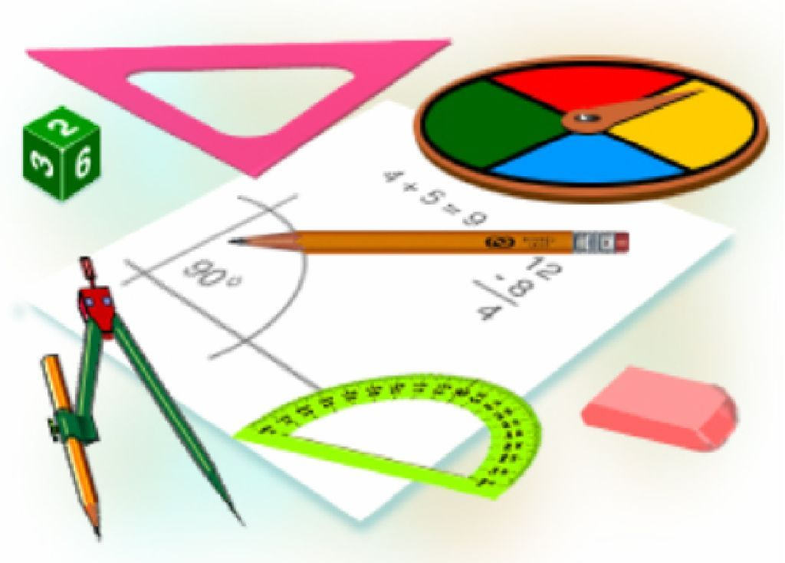
Mustaqil bajarish uchun topshiriqlar:
Darslikda berilgan
4-,7-, 8 – masalalarni yechish
(53- bet).

