Slide 1
GEOMETRIYA
8- sinf
Mavzu: Pifagor teoremasining ba‘zi tatbiqlari

Slide 2
Tomonlari a, b, c bo‘lgan ixtiyoriy uchburchakning balandligini topish.
C
b
c
b
C
b
$$h_{b}$$
$$h_{c}$$
$$h_{a}$$
a
a
a
$h_{a}$ = $\frac{2}{a}\sqrt{p(p−a)(p−b)(p−c)}$
$h_{b}$ = $\frac{2}{b}\sqrt{p(p−a)(p−b)(p−c)}$
$p$ = $\frac{a+b+c}{2}$
$h_{c}$ = $\frac{2}{c}\sqrt{p(p−a)(p−b)(p−c)}$

Slide 3
№1. Tomonlari 10 cm, 10 cm va 12 cm bo‘lgan uchburchakning
balandliklarini toping .
Berilgan:
a = 10 cm, b= 10 cm, c = 12 cm.
$h_{a}$, $h_{b}, h_{c }$- ?
a
b
$$h_{b}$$
$$h_{a}$$
Yechish:
$$h_{c}$$
$h_{a}$ = $\frac{2}{a}\sqrt{p(p−a)(p−b)(p−c)}$
$p$ = $\frac{10+10+12}{2}$ = 16
C
$h_{a}=h_{b}$ = $\frac{2}{10}\sqrt{16(16−10)(16−10)(16−12)}=0,2\sqrt{16·6·6·4}$ = 9,6(cm)
$h_{c}$ = $\frac{2}{12}\sqrt{16(16−10)(16−10)(16−12)}=\frac{2}{12}\sqrt{16·6·6·4}$ = 8(cm)
Javob: 9,6cm, 9,6 cm va 8 cm
3

Slide 4
4-masala
A
Agar teng tomonli uchburchakning tomoni
12 sm ga teng bo‘lsa,
uning balandligini toping.
a
a
B
a
C

Slide 5
№ 4. Agar teng tomonli uchburchakning tomoni 12 sm ga teng bo‘lsa, uning balandligini toping.
A
Berilgan:
∆ABC - teng tomonli
AB= AC=BC = 12cm, AE-?
Yechish:
AE- mediana $⟹$ BE = CE
AE² = AC² $−$ EC² bunda,
AC =12 cm, EC = BC/2 = 6
$$AE=\sqrt{{12}^{2}−6^{2}}=\sqrt{144−36}=\sqrt{108}=6\sqrt{3} cm$$
12
12
6
6
B
E
C
Javob$:6\sqrt{3} cm$
:

Slide 6
7-masala
O‘tmas burchakli uchburchakning tomonlari a = 16 cm, b = 12 cm va c = 8 cm. Uchburchakning kichik tomoniga tushirilgan balandlikni toping.
A
a
b
c
C
B

Slide 7
A
Berilgan:
∆ABC – ihtiyoriy
a = 16 cm, b = 12 cm, c = 8 cm.
h(AE) -?
a
h
b
$p$ = $\frac{16+12+8}{2}$ = 18
x
E
c
C
B
$h_{c}$ = $\frac{2}{8}\sqrt{18(18−16)(16−12)(16−8)}=$
= $\frac{1}{4}\sqrt{18·2·4·8}$
= $\frac{1}{4}(6\sqrt{15}$) = $\frac{3\sqrt{15}}{2}$
Javob: $\frac{3\sqrt{15}}{2}$

Slide 8
3-masala
Δ ABC da AB = 13 cm, AC = 20 cm, AD – uchburchakning balandligi va u 12 cm ga teng. AB, AC tomonlarning BC tomonga tushirilgan proyeksiyalari uzunliklari va BC tomon uzunligini toping.
A
B
D
C
8

Slide 9
3-masala yechimi
Yechish.
Δ ABD va Δ ACD – to‘g‘ri burchakli, chunki
$∠$ADB = $∠A$DC = 90°. AB va AC tomonlarning BC tomondagi proyeksiyalari mos ravishda BD va CD kesmalardan iborat.
A
B
D
C
9
9

Slide 10
3-masala yechimi (davomi)
Δ ABD dan ,
BD²=AB²–AD²=13² – 12² =169 –144 = 25. Bundan, BD = 5cm.
Δ ACD dan,
CD ² = AC² – AD² = 20² – 12² =
= 400 – 144 = 256.
Bundan, CD = 16 cm.
BC =BD + DC =5 + 16= 21 cm.
Javob: BD = 5cm, CD = 16 cm, BC = 21 cm
A
B
D
C
10
10
10

Slide 11
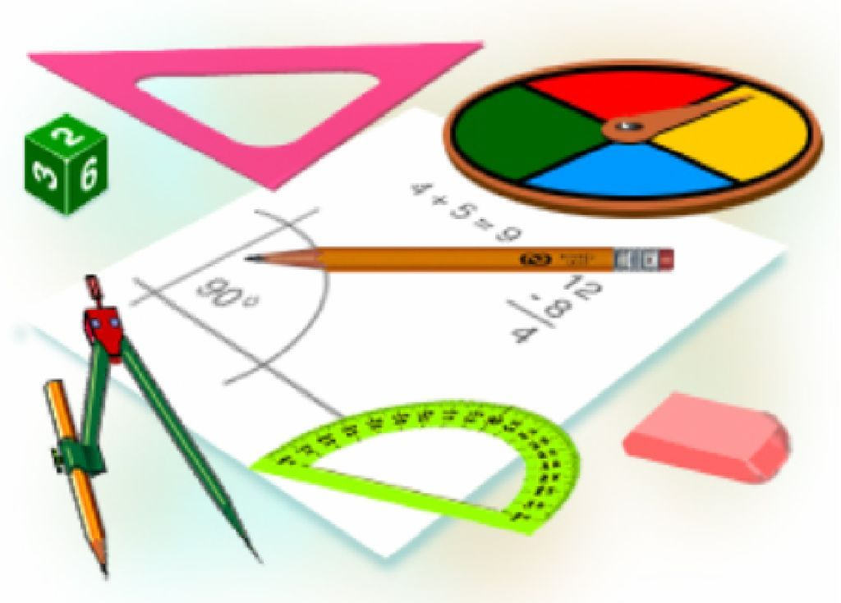
Mustaqil bajarish uchun topshiriqlar:
Darslikda berilgan
1-, 3-, 6 – masalalarni yechish
(48- bet).

