Slide 1
GEOMETRIYA
8- sinf
Mavzu: Pifagor teoremasiga teskari
teorema

Slide 2
Pifagor teoremasi
To‘g‘ri burchakli uchburchak gipotenuzasining kvadrati uning katetlari kvadratlarining yig‘indisiga teng.
c² = a² + b²
c =$\sqrt{\text{a}\text{2 }\text{+ }\text{b}\text{2}}$
b
c
a² = c² - b²
a=$\sqrt{{\text{c}}^{2}−b²}$
b² = c² - a²
b=$\sqrt{{\text{c}}^{2}−a²}$
a

Slide 3
Agar, a =1,5; c =1,7 bo‘lsa, b katetni toping.
Berilgan:
a = 1,5, c = 1,7;
b -?
b
c
c² = a² + b²
a
b = $\sqrt{{\text{c}}^{2}−a²}$
Yechish:
b = $\sqrt{\text{1,7}\text{2 } \text{− }\text{1}\text{,5}\text{2}}$ = $\sqrt{\text{2}\text{,89} \text{−} 2,25}$ = $\sqrt{\text{0,64} }$ = 0,8;
Javob: 0,8

Slide 4
Mustahkamlash
Pifagor uchliklarini aniqlang:
?
√
1) 5, 11, 12;
3) 5, 12, 13;
c² = a² + b²
√
?
2) 6, 8, 10;
4) 11, 12, 15;
c > a
1) 12² = 5² + 11²
^{144 ≠ 25 +121}
3) 13²5² + 12²
¹⁶⁹ ⁼ ²⁵ ⁺ ¹⁴⁴
c > b
2) 10² = 6² + 8²
¹⁰⁰ ⁼ ³⁶ ⁺ ⁶⁴
4) 15² = 11² + 12²
²²⁵ ^{≠ 121 +144}

Slide 5
Pifagor teoremasiga teskari teorema
Agar uchburchak gipotenuzasining kvadrati uning katetlari kvadratlarining yig‘indisiga teng bo‘lsa, u holda uchburchak to‘g‘ri burchakli bo‘ladi .
A
Masalan: AC = 9; BC = 12; AB =15 bo‘lsa,
ucburchak turini aniqlang.
C
B
15² = 9² + 12²
²²⁵ ⁼ ⁸¹ ⁺¹⁴⁴
²²⁵ ⁼ ²²⁵
AB² = AC² + BC²
Demak , ABC uchburchak – to‘g‘ri burchakli.

Slide 6
№4. Noma’lum x ni toping
Berilgan:
Δ ABD va Δ ACD – 90° li
AD - balandlik
AB = 5 cm, AC=6 cm
AB = DC
x(BD) - ?
A
5 cm
6 cm
B
C
x cm
D
5 cm
Yechish:
Δ ACD dan, AD = $\sqrt{6^{2}−5^{2}}=\sqrt{36−25}=\sqrt{11}$
Δ ABD dan, x = $\sqrt{5^{2}−{(\sqrt{11})}^{2}}=\sqrt{25−11}=\sqrt{14}$
Javob: $\sqrt{14}$ cm
6
6

Slide 7
Masala
To‘g‘ri to‘rtburchak tomonlari 2,4 dm va 7 cm ga teng.
Uning dioganalini toping.
Berilgan:
a = 2,4 dm
b = 7 cm
d -?
d -?
d² = a² + b²
b
= 0,7 dm
a
Yechish:
d = $\sqrt{\text{2,4}\text{2 } \text{+} \text{0,7}\text{2}}$ = $\sqrt{\text{5,76} \text{+}0,49}$ = $\sqrt{\text{6,25} }$ =2,5(dm);
Javob: 2,5 dm

Slide 8
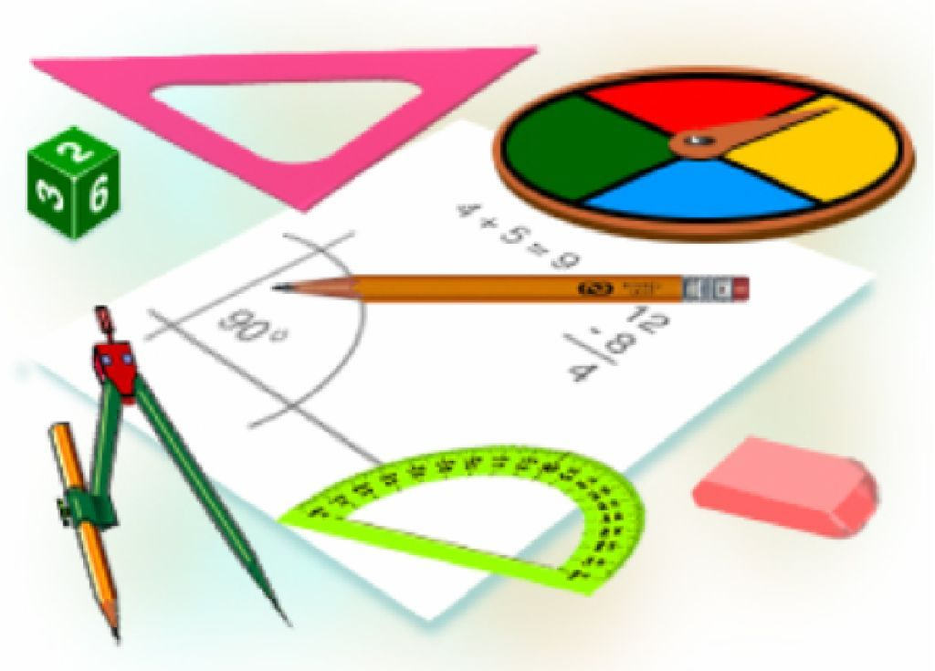
Mustaqil bajarish uchun topshiriqlar:
Darslikda berilgan
2-, 3-, 6 – masalalarni yechish
(46- bet).

