Slide 1
GEOMETRIYA
8- sinf
Mavzu: Pifagor teoremasi va uning turli isbotlari

Slide 2
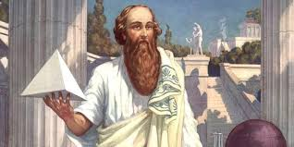
Tarixiy ma’lumot
PIFAGOR - qadimiy grek olimi.
U ko‘p sayohat qilib, o‘zga xalqlar madaniyati va ilmini o‘rgandi.
U o‘z vatanida bilimga chanqoq yoshlardan Pifagor maktabini tashkil qildi. Pifagorchilar matematika, falsafa va aniq fanlar bilan shug‘ullandi.
Pifagor tomonidan arifmetika va geometriyaga oid ko‘p yangiliklar kiritildi.
PIFAGOR
(eramizdan avvalgi VI asr)

Slide 3
PIFAGOR TEOREMASI
To‘g‘ri burchakli uchburchak gipotenuzasining kvadrati uning katetlari kvadratlarining yig‘indisiga teng.
A
AC² + BC² = AB²
c² = a² + b²
c=$\sqrt{\text{a}\text{2 }\text{+ }\text{b}\text{2}}$
c
b
a² = c² - b²
b² = c² - a²
C
a
B
a=$\sqrt{{\text{c}}^{2}−b²}$
b=$\sqrt{{\text{c}}^{2}−a²}$
5² = 3² + 4²

Slide 4
Pifagor teoremasini o‘tkir burchak kosinusi orqali isbotlash.
Berilgan:
ΔABC- to‘g‘ri burchakli
AC, BC – katetlar, AB- gipotenuza.
Isbot qilish kerak:
AC² + BC² = AB²
C
A
D
B
Isbot: ΔABC ning C uchidan AB tomonga CD balandlik o‘tkazamiz.
A, B burchaklarning kosinusini aniqlaymiz:
cosA = $\frac{AD}{AC}=\frac{AC}{AB}$ $⟹{AC}^{2}=AD·AB;$ cosB = $\frac{BD}{BC}=\frac{BC}{AB}⟹{BC}^{2}=BD·AB$
$${AC}^{2}=AD·AB$$
$${BC}^{2}=BD·AB$$
AC² + BC² = AD·AB + BD·AB= (AD + BD)·AB= AB·AB =AB²
Demak, AC² + BC² = AB². Teorema isbotlandi.

Slide 5
Pifagor teoremasini yuzalar orqali isbotlash:
Teoremа. To‘g‘ri burchakli uchburchakda gipotenuza kvadrati katetlar kvadratlari yig‘indisiga teng.
Isbot.
S = (a+b)²= a² + 2ab + b² (1)
S = c² + 4 · (1/2)ab = c²+2ab (2)
(1) va (2) tengliklardan,
a² + 2ab + b² = c² + 2ab
К
а
B
b
L
b
c
a
A
с
с
C
a
с
b
N
b
D
a
M
a² + b² = c²

Slide 6
№2. To‘g‘ri burchakli uchburchakning a va b katetlari berilgan. Agar: 1) a=5, b=12; 2) a = 4$\sqrt{2},$ b = 7 bo‘lsa, c gipotenuzani toping.
Berilgan:
1) a = 5, b = 12
2) a = 4$\sqrt{2},$ b = 7
c -?
c² = a² + b²
b
c
c=$\sqrt{\text{a}\text{2 }\text{+ }\text{b}\text{2}}$
a
Yechish:
1) c = $\sqrt{\text{5}\text{2 }\text{+ }\text{12}\text{2}}$ = $\sqrt{\text{25} \text{+ }144}$ =$\sqrt{\text{169} }$ = 13
2) c = $\sqrt{\text{(}\text{4}\sqrt{2}\text{)}\text{2 }\text{+ }\text{7}\text{2}}$ = $\sqrt{\text{32} \text{+ }49}$ =$\sqrt{\text{81} }$ = 9

Slide 7
№5. To‘g‘ri burchakli uchburchakning a va b katetlar, c gipotenuza. Agar: a=1,5, c =1,7 bo‘lsa, b katetni toping.
Berilgan:
a = 1,5, c = 1,7;
b -?
b
c
c² = a² + b²
a
b = $\sqrt{{\text{c}}^{2}−a²}$
Yechish:
b = $\sqrt{\text{1,7}\text{2 } \text{− }\text{1}\text{,5}\text{2}}$ = $\sqrt{\text{2}\text{,89} \text{−} 2,25}$ = $\sqrt{\text{0,64} }$ = 0,8;
Javob: 0,8

Slide 8
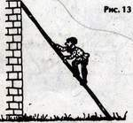
Rasmdagi uyning balandligi 117 dm, narvon uzunligi 125 dm bo‘lsa, narvon proeksiyasini toping.
Berilgan:
a = 117 dm
c = 125 dm
b -?
Yechish:
b = $\sqrt{\text{1}\text{25}\text{2 }\text{ − 1}\text{17}\text{2}}$ = $\sqrt{\text{15625} \text{ −}13689}=$
= $\sqrt{\text{1936} }$ = 44 (dm)
Javob: 44 dm

Slide 9
“Qirg‘oqdagi terak shamoldan sinib, daryoning eni bo‘ylab quladi va uchi narigi qirg‘oqqa yetdi. Agar daryo eni 3 m, terakning qolgan qismi 3 m bo‘lsa, terak uzunligi qanday bo‘lgan?”

Slide 10
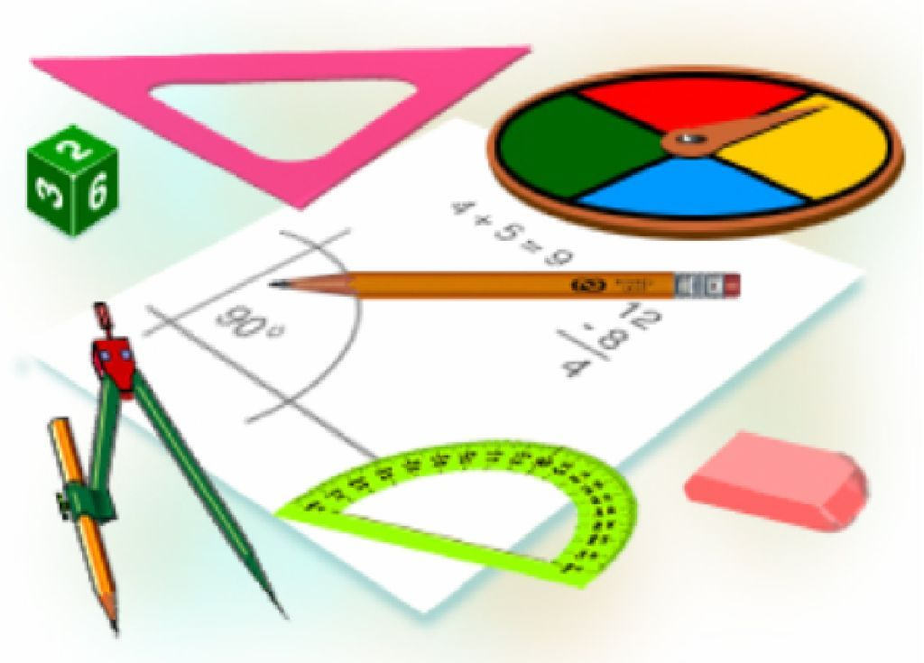
Mustaqil bajarish uchun topshiriqlar:
Darslikda berilgan
2-, 3-, 5 – masalalarni yechish
(43- bet).

