Slide 1

GEOMETRIYA
8- sinf
MAVZU: MASALALAR
YECHISH

Slide 2
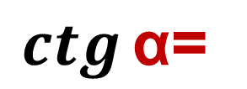
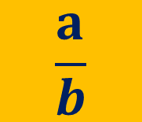

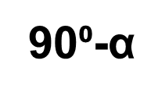
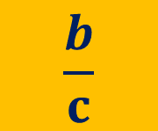


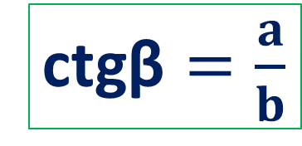

To‘ldiruvchi burchaklar
$$\frac{a}{b}$$
$$\frac{b}{c}$$
β
90⁰-$\text{α}$
c
tg$\text{β}=\frac{b}{a}$
ctg$\text{β}=\frac{a}{b}$
a
$$\operatorname{tg}{\text{α} \text{=}}$$
$$\operatorname{ctg}{\text{α}\text{=} }$$
α
ctg(90⁰- $\text{α}$)=$\operatorname{tg}{\text{α} }$
b
tg(90⁰- $\text{α}$)=$\operatorname{ctg}{\text{α} }$

Slide 3


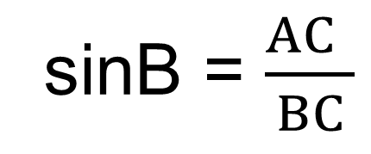
To‘g‘ri burchakli ABC uchburchakda sinB = $\frac{24}{25}$ ga teng.
Bu tenglikdan uchburchakning qaysi tomonlarini topish mumkin?
sinB = $\frac{AC }{BC}$
B
sinB = $\frac{24 }{25}$
AC = 24, BC = 25.
С
A
Javob: Katta katet va gipotenuza.

Slide 4
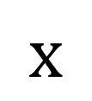
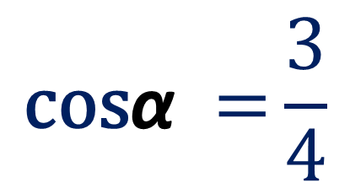
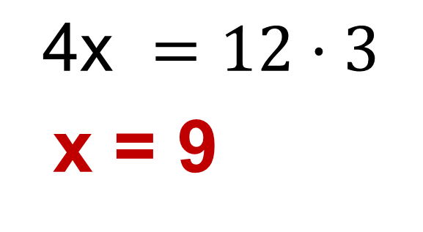
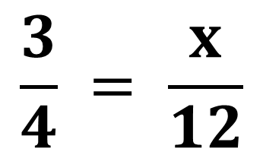
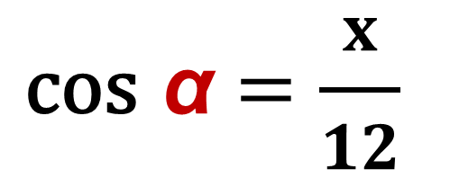
Chizma asosida noma’lum tomonni toping
$$\text{c}\text{os} \text{α}=\frac{x}{12}$$
α
12
$$x$$
$$\frac{3}{4} = \frac{x}{12}$$
$$\text{4}\text{x} =12·3$$
x = 9
$$\text{cos}\text{α} ={\frac{3}{4}}$$

Slide 5
Chizma asosida noma’lum tomonni toping
$$\text{c}\text{os} \text{α}=\frac{x}{12}$$
α
12
$$x$$
$$\frac{3}{4} = \frac{x}{12}$$
$$\text{4}\text{x} =12·3$$
x = 9
$$\text{cos}\text{α} ={\frac{3}{4}}$$

Slide 6


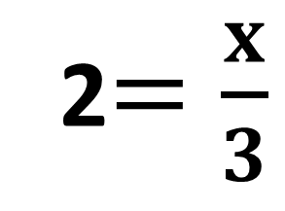
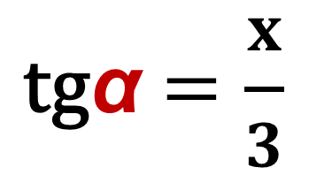
Chizma asosida noma’lum tomonni toping
$$\text{t}\text{g}\text{α}=\frac{x}{3}$$
α
3
2$=\frac{x}{3}$
$$x$$
x = 6
$$\text{tg} \text{α} ={2}$$

Slide 7
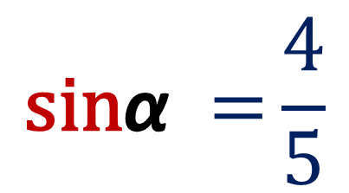
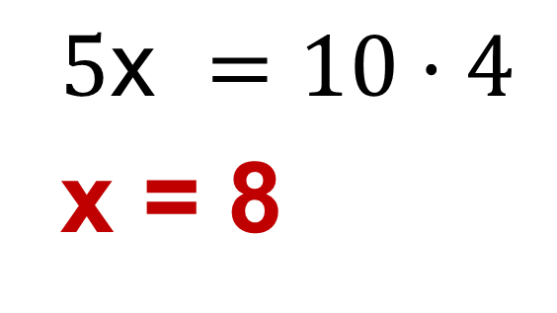
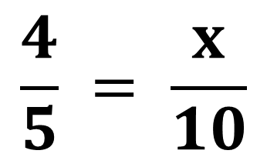
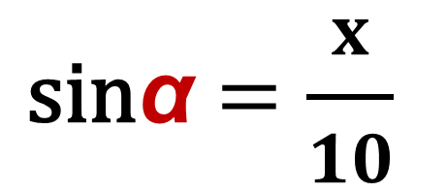
Chizma asosida noma’lum tomonni toping
$$\text{s}\text{in}\text{α}=\frac{x}{10}$$
10
$$x$$
$$\frac{4}{5} = \frac{x}{10}$$
α
$$\text{5}\text{x} =10·4$$
x = 8
$$\text{sin}\text{α} ={\frac{4}{5}}$$

Slide 8





Mustahkamlash
$$\operatorname{tg}{\text{α} }$$
1
$$\frac{sin\text{α}}{cos\text{α}}$$
$$\operatorname{ctg}{\text{α} }$$
$$\frac{cos\text{α}}{sin\text{α}}$$
$$\operatorname{tg}{\text{α}·ctg\text{α}}$$

Slide 9

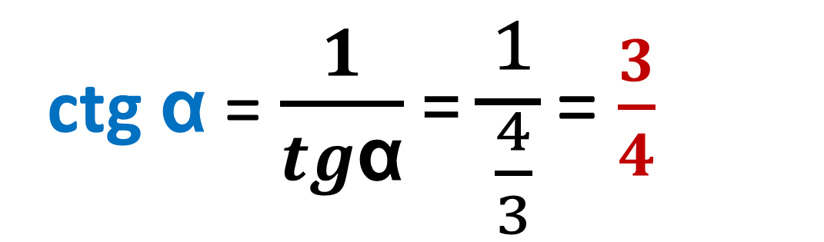

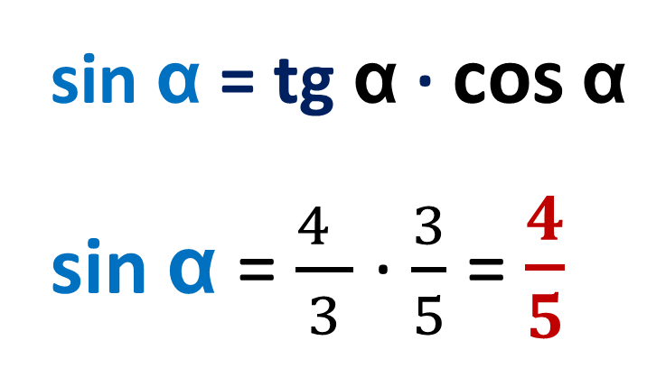
tg $\text{α}$ = $\frac{4}{3}$ va cos $\text{α}$ =$\frac{3}{5}$ ga teng bo‘lsa, sin $\text{α}$, ctg $\text{α}$-?
sin $\text{α}$ = tg $\text{α}$ · cos $\text{α}$
sin $\text{α}$ = $\frac{4 }{3}$ ·$\frac{3}{5}$ = $\frac{4}{5}$
tg $\text{α}$ = $\frac{sin\text{α}}{cos\text{α}}$
$$\operatorname{tg}{\text{α}·ctg\text{α} \text{= 1}}$$
ctg $\text{α}$ = $\frac{1}{tg\text{α}}$ =$\frac{1}{\frac{4}{3}}$ = $\frac{3}{4}$

Slide 10
MUSTAQIL BAJARISH UCHUN TOPSHIRIQLAR:
Darslikda berilgan
7 - 8 masalalarni yechish (40-sahifa).

